Slide 1
FGAI4H-P-054
Helsinki, 20-22 September 2022
Source: | Editor DEL08
Title: | DEL08: AI4H scale-up and adoption - Progress Report
Purpose: | Discussion
Contact: | Sameer Pujari | E-mail: pujaris@who.int
 | Yu (Ursula) Zhao | E-mail: zhaoy@who.int
Abstract: | This PPT contains a progress report on DEL08.

Slide 2

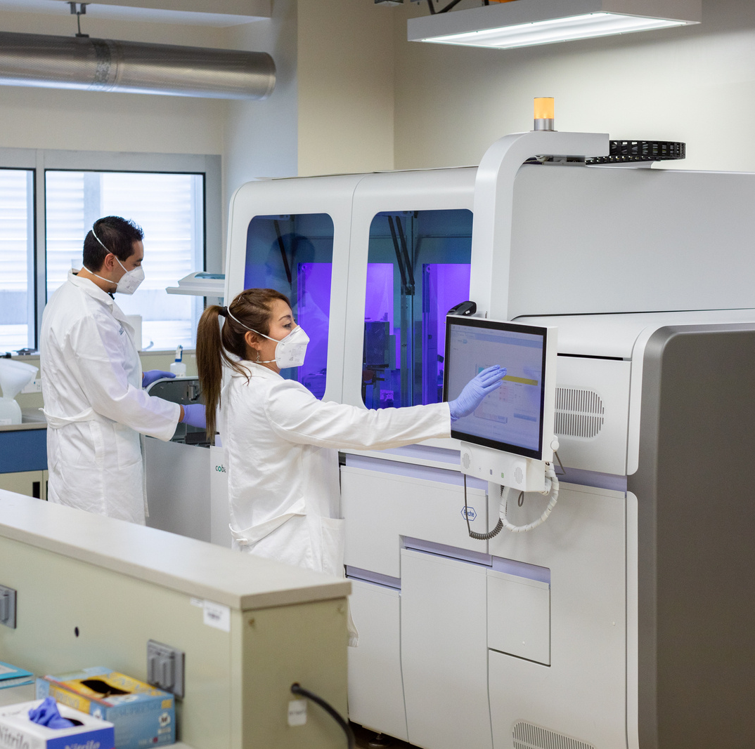
DEL8:
AI4H Scaled up and Adoption
Sameer Pujari
Yu (Ursula) Zhao
Strategy and governance Unit
Department Digital health and Innovation

Slide 3

Global Strategy on Digital Health 2020 – 2025 :
Vision
To improve health for everyone, everywhere by accelerating the development and adoption of appropriate digital health solutions to achieve the health related SDGs.

Slide 4
4 Strategic Objectives
SO1.
Promote global collaboration and advance the transfer of knowledge on digital health
SO2.
Advance the implementation of national digital health strategies
SO3.
Strengthen governance for digital health at global, regional and national levels
SO4.
Advocate people-centred health systems that are enabled by digital health
4

Slide 5
Co-create initiatives out of ongoing and planned activities
Four-step co-creation with countries
Step 02
Prioritize and enable
Assess each initiative across criteria and stakeholders
Step 03
Plan
Create Action plan
(Who, What, When Why and How)
Step 04 Implementation cycle
Implement & Evaluate, Innovate, Iterate
Step 01
Mapping existing initiatives

Slide 6
Ongoing projects
Shared space for knowledge sharing
Actual adoption at global, regional and national level
  Online learning
  Offline/Hybrid Workshops with countries

Slide 7







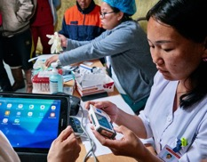




Shared space: Showcase and knowledge sharing
Story of the month
本月国家项目推荐
Explore other initiatives (below are fictional samples)
Share
Digital literacy at fingertips
  Leading actor:
  Key words: Health emergencies, capacity building
  Strategic objective: SO1
Dynamic digital health maturity model
Share your initiatives
Healthy ageing
  Leading actor:
  Key words: Ageing
  Strategic objectives: SO3, SO4
Interoperable digital health ecosystem
  Leading actor:
  Key words: Diagnostics, Telemedicine, Artificial intelligence
  Strategic objectives: SO1, SO4
Notes:
Countries can show their initiatives or check other ones

Slide 8
Shared space: Showcase and knowledge sharing
Explore other initiatives (below are fictional samples)
Share
Digital literacy at fingertips
  Leading actor:
  Key words: Health emergencies, capacity building
  Strategic objective: SO1
Dynamic digital health maturity model
Share your initiatives
Healthy ageing
  Leading actor:
  Key words: Ageing
  Strategic objectives: SO3, SO4
Interoperable digital health ecosystem
  Leading actor:
  Key words: Diagnostics, Telemedicine, Artificial intelligence
  Strategic objectives: SO1, SO4

Slide 9





Shared space: Showcase and knowledge sharing
Explore knowledge products (below are fictional samples)
Share
How to introduce Artificial Intelligence
into health programmes?
Dynamic digital health maturity model
Ethics and governance
Regulatory Considerations
AI training best practice and specification

Slide 10
Actual adoption at regional and national level
  Implementation and institutionalization
    Tailor, develop, pilot and scale up implementation and capacity building activities in all regions
Detailed assessment / framework
Actions prioritised for implementation
Capacity building for implementation at global, regional and country levels

Slide 11
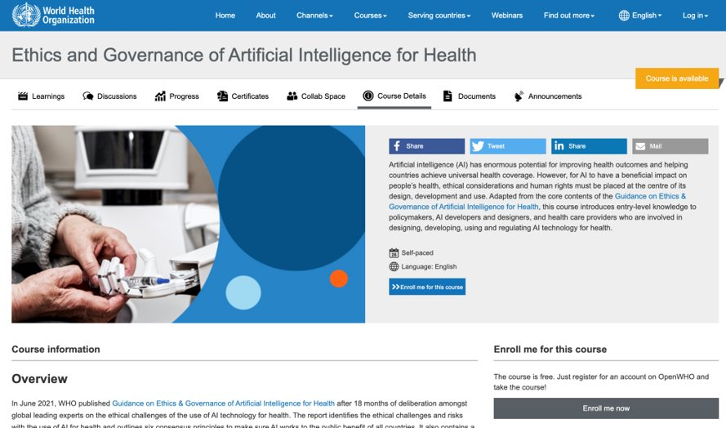

Actual adoption at regional and national level
Online course
…Accelerate translating knowledge from the guidance into actionable information…
Entry-level knowledge on the role of AI in health care, its opportunities, and the challenges on the ethical use of AI technology for health
Designed to support governments, AI technology developers and healthcare providers
Live on
https://openwho.org/courses/ethics-ai
Notes:
Result of the Member States briefing in the beginning of July 2021 and the growing interest among country authorities and other key stakeholders in how to best implement the WHO guidance on Ethics & governance of AI for Health.
Guidance document includes considerations with practical steps to assist with implementation.
Digital Health and Innovation channel

Slide 12
Actual adoption at regional and national level
  Implementation and institutionalization
    Tailor, develop, pilot and scale up implementation and capacity building activities in all regions
Regional workshops before end of December 2021:
Region of the Americas : 14 – 16 November, Panama
European region : 14 -17 November, Greece
Eastern Mediterranean: 28 – 30 November, Cairo, Egypt

Slide 13
Next Steps
Continue advocating and building capacity
  Workshops and trainings
Support the implementation
  Ethics, regulations, governance
Enable human centred approach

