Slide 1
FGAI4H-P-052
Helsinki, 20-22 September 2022
Source: | WHO
Title: | Generating Evidence for Artificial Intelligence Based Medical Devices
Purpose: | Discussion
Contact: | Stephanie Kuku | E-mail: kukus@who.int
Abstract: | This presentation briefs the meeting on WHO Publication "Generating Evidence for Artificial Intelligence Based Medical Devices: A Framework for Training Validation and Evaluation (Including a use-case study for Cervical Cancer Screening)" https://www.who.int/publications/i/item/9789240038462. This first-of-its-kind publication from the WHO is a framework targeted at developers and researchers of AI-based software as a medical device, as well as policy-makers and implementers. It is intended to guide those seeking to understand the evidence generation requirements from development to post-market surveillance of these devices. The publication uses cervical cancer screening as a use-case to support the goals of the WHO strategy on cervical cancer elimination and set the foundations for WHO to be able to usher in new and emerging technologies in cancer screening and beyond. To allow acceleration in the global effort in cancer screening and clinical decision support, WHO will begin to facilitate building the enabling environments so that the benefits of innovative technologies reaches all populations and use-cases of high disease burden globally.

Slide 2
Generating Evidence for Artificial Intelligence- Based Medical Devices
(Publication)
Department of Digital Health and innovation

Slide 3
A Framework for Training, Validation and Evaluation of AI- SaMD

Slide 4
Objectives

Slide 5
Objectives
Provide a Global Health Context with a use-case illustration
Formulate consensus on what evidence is needed
Support future work on Health Technology Assessment of AI-SaMD

Slide 6
Three Sections - Evidence Generation Considerations
SI. AI Software Development
SII.
AI Software Validation and Reporting
SIII. AI Software Deployment
5

Slide 7
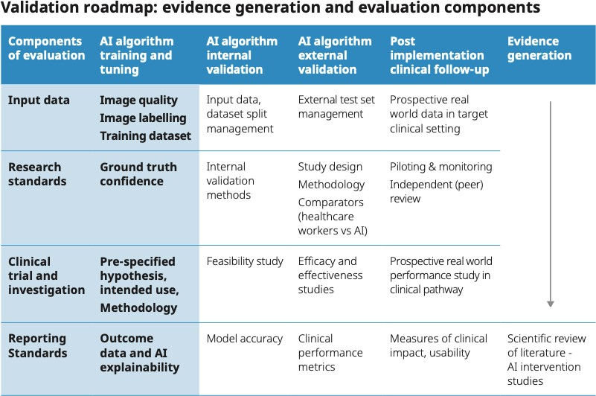
AI Software Development
6

Slide 8
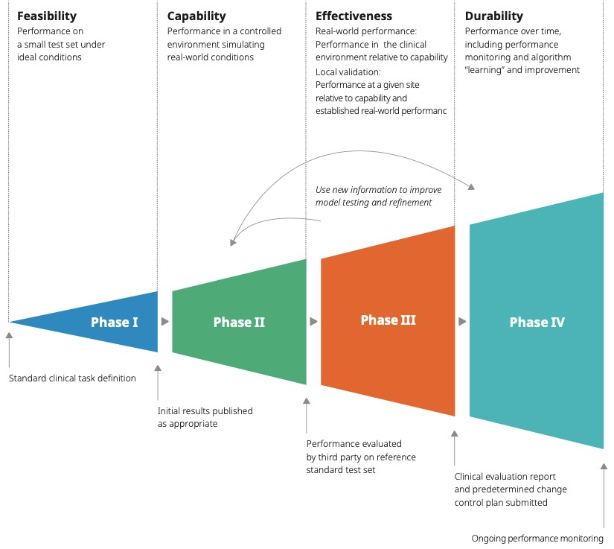
Evidence Generation

Slide 9
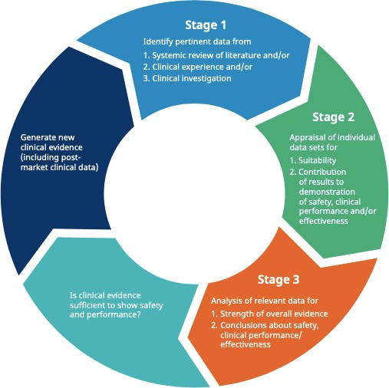
Clinical Evaluation (IMDRF)

Slide 10
Intended Use

Slide 11
AI Model Development

Slide 12
AI Software Validation and Reporting
External Validation
11

Slide 13
Evidence Reporting

Slide 14
Data Management

Slide 15
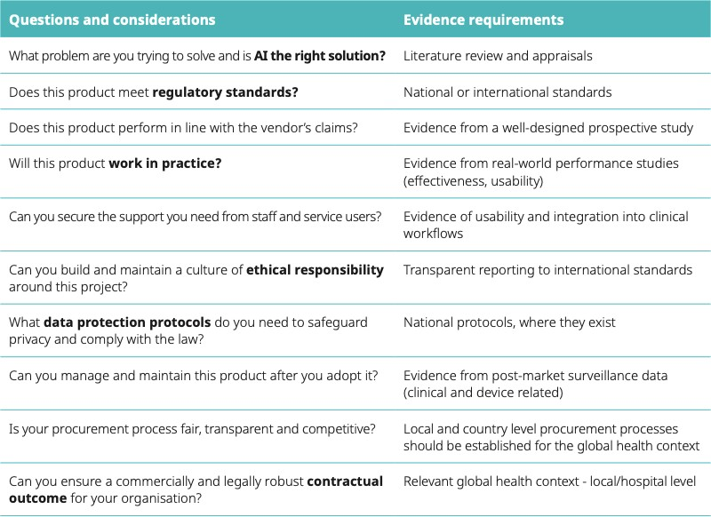
AI Deployment
14

Slide 16
Evidence for Usability

Slide 17
Clinical Impact Assessment

Slide 18
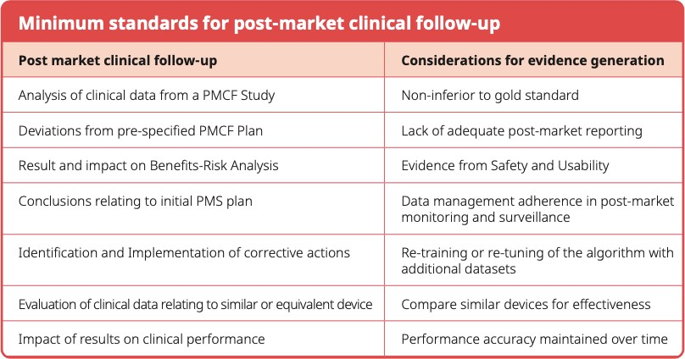
Post-Market Clinical Follow-up

Slide 19
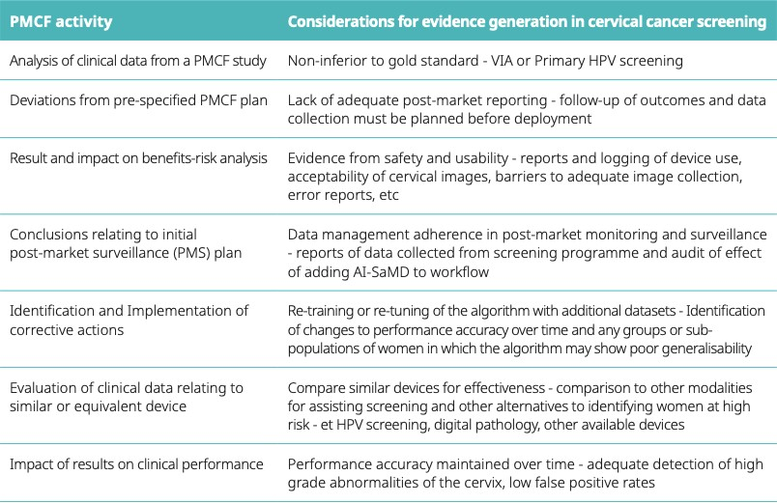
Post-Market Clinical Follow-up: Cervical Cancer Screening Use-Case

Slide 20
Dr Stephanie Kuku kukus@who.int
Senior Advisor & Consultant – Clinical AI Department of Digital Health and innovation

