Slide 1
FGAI4H-P-051
Helsinki, 20-22 September 2022
Source: | Editor
Title: | Cybersecurity and AI/ML Data Lifecycles Follow up
Purpose: | Information & Discussion
Contact: | Pat Baird, Philips | E-mail: Pat.Baird@Philips.com
 | Catherine Lowe, MedSec | E-mail: CatherineLowe@MedSec.com
Abstract: | Information: A presentation at the “O” meeting gave an overview of cybersecurity concepts; this presentation is a more detailed discussion about threat management.

Slide 2
Secure Design
Premarket considerations and requirements informed by the threat modeling and security risk management; includes post market activities and end of support
Notes:
Risk Management spans the entire product lifecycle. Patch management requirements required as design input consideration to meet post market requirements. Vulnerability monitoring and management plan critical to a robust security program.

Slide 3
Threat Modeling for Medical Devices
MedSec experts discuss medical device threat modeling from a variety of perspectives, including methodologies, processes, elements, risk management, regulatory strategy and inputs into design processes.
https://www.youtube.com/watch?v=yOEu157mUHo
Threat Modeling is essential to understanding an attacker’s mindset for the payload and also in protecting the assets of value.

Slide 4
Threat Model Diagramming
Identify System Components
Internal and External components that make up the eco-system
Draw how the data flows
Identify data at rest and in transit through interconnected components and interfaces
Divide Out Trust Boundaries
Denotes secure or unsecure zones
THREAT IDENTIFICATION

Slide 5
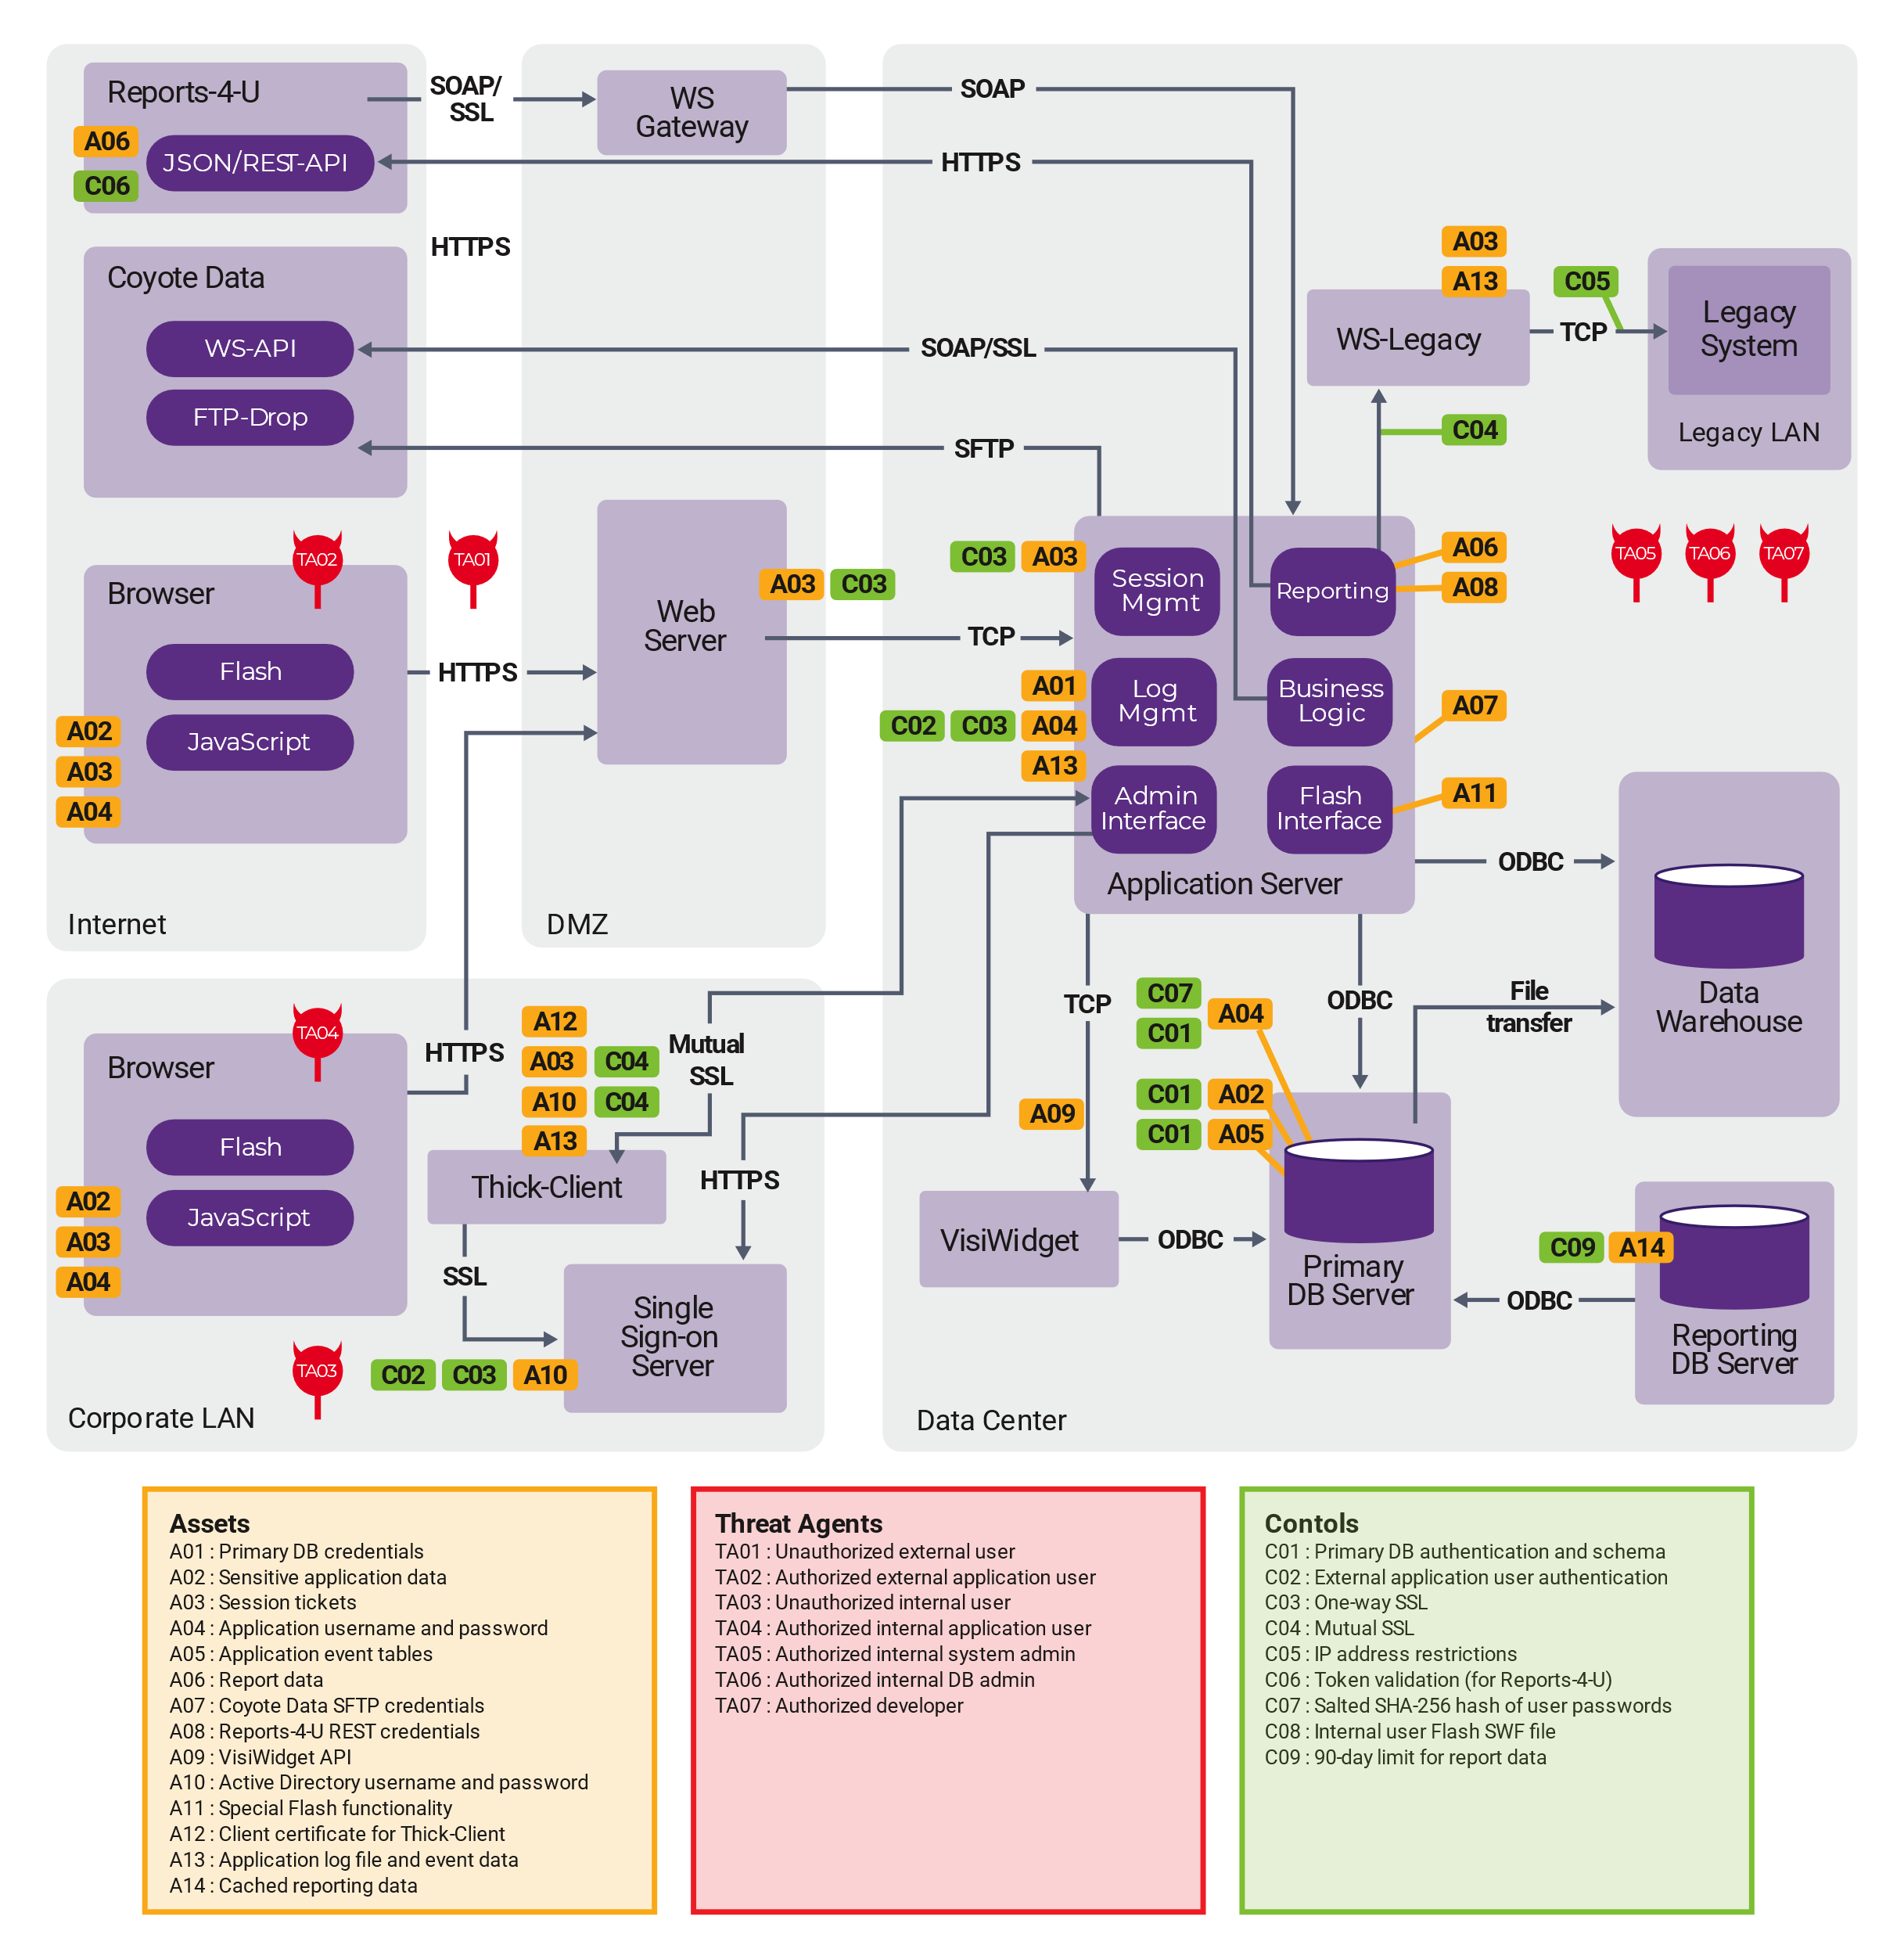
Threat Model Diagram
Architectural Data Flow Diagram
Overall product and system diagram with respect to the interfaces and trust boundaries that it is crossing.
Provides a high level system overview in the ”eco-system’ of interconnected products.
The diagram allows for risk based threat identification and analysis.
Notes:
https://www.synopsys.com/glossary/what-is-threat-modeling.html

Slide 6
ASSET BASED THREAT MODELING At-Risk ML Assets
AI Assets
Models
Actors
Processes
Tools
Artefacts
Data
Raw Data
Labeled Data
Validation Data
Model Architecture
Use Case
Metadata Schema
Data exploration tools
Libraries
Visualization Tools
Data collection
Pre-processing
Model tuning
Data owner
AI developer
Model provider
Model parameters
Hyper-parameters
Trained model
Grouped into 6 different macro-categories – Data Models, Actors, Processes, Tools and Artefacts
Notes:
It should be noted that, given the complex and evolving nature of ML based systems, proper identification of asset that are subject to ML specific threats must be considered an ongoing task that needs to keep pace with developments in AI/ML solutions.

Slide 7
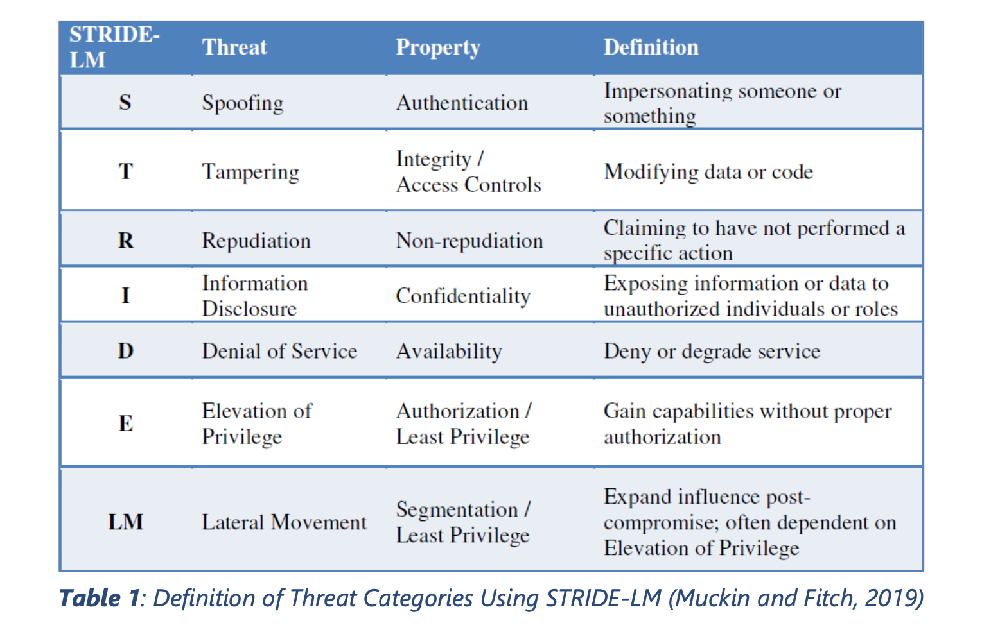
STRIDE – Lateral Movement (LM)
Kohnfelder and Garg (1999) developed STRIDE as a mnemonic to identify various threats types – spoofing, tampering, repudiation, information disclosure, denial of service and escalation of privilege. Muckin and Fitch (2019) further proposed to add LM into the mnemonic to include Lateral Movement.

Slide 8
Threat Modeling
A threat event refers to any event during which a threat actor1, by means of threat vector2, acts against an asset in a manner that has the potential to cause harm. In the context of cybersecurity, threat events can be characterised by the tactics, techniques and procedures (TTP) employed by threat actors.
Notes:
CSA issued the Guide to Conducting Cybersecurity Risk Assessment for Critical Information Infrastructure in December 2019 (subsequently revised in Feb 2021).

Slide 9
Resource Idea! Your Feedback is Requested
There are many resources available to help implement a secure system, including whitepapers, conference presentations, international standards, regulatory requirements, etc. Would the team like us to create a Zip file that provides a discussion of various resources and, where possible, includes those resources?
We could also do something similar when it comes to new security considerations that are specific to Machine Learning.

