Slide 1
FGAI4H-P-050
Helsinki, 20-22 September 2022
Source: | FG-AI4H Management
Title: | Initial considerations on a Global Initiative on AI for health (GI-AI4H)
Purpose: | Discussion
Contact: | Sameer Pujari | E-mail: Pujaris@who.int
Abstract: | This PPT contains a presentation on Initial considerations on a Global Initiative on AI for health (GI-AI4H) .

Slide 2
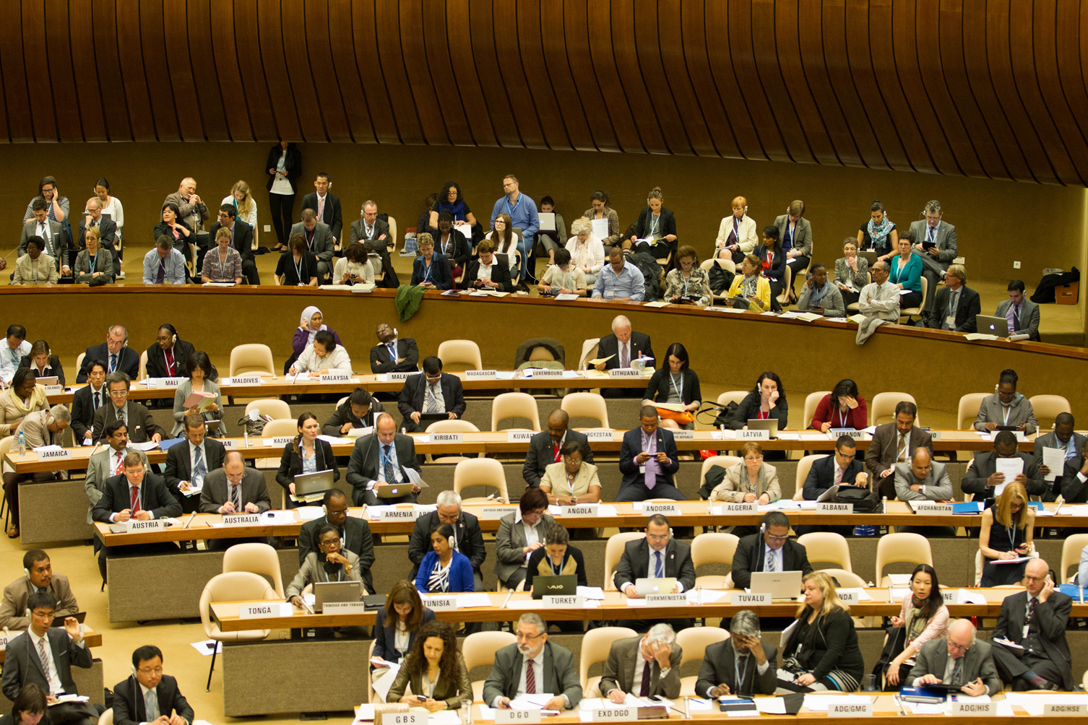
Global Initiative on AI for health WHO ITU + Partners
July 2020
Notes:
Good morning to all of you. At the onset let me hope that you are all well, and thank you all for giving me this opportunity.
My name is Sameer Pujari and over the last 20 years I have spent and earned my career working on my passion to make an impact in the development agenda through data
I started my career with WHO in India working on Polio eradication program where I established information systems and streamlined data flows for 300 field offices during the peak of the polio eradication efforts in India. A system that is still being used
I then took my learnings and experience to deliver data flows and information systems for EPI programs in African region region which was then followed by my work to setup the surveillance and reporting systems for tobacco control at the Global level. Working with WHO HQ.
Across these different portfolio’s and my passion for data systems : I have led designing and implementation of various streamlined data flows at various levels of WHO. And through the different stages of data collection, storage, processing and presentation.
I am setting this stage as I will use a few of these examples in my presentation
As I wont be able to share slides through this recording, I will mention the slide change and the slide number I am referring so you can follow in sync.

Slide 3
Main functions
GAI4H...
has three main functions:
Enable
Facilitate
Implement

Slide 4
Enable
Norms, guidance, standards, (including all benchmarking framework deliverables)
Governance (Ethics, Regulations)
Surveillance, research and evidence
Data sharing

Slide 5
Facilitate
Knowledge Sharing between countries
Pool funding
Cooperation between all stakeholders

Slide 6
Implement
Scale program in countries (Phase 1 to target 12-18 countries)
Build capacity building for AI for health programs
Build sustainability models

Slide 7
Governance structure
Steering committee : WHO(3) + ITU (3) Senior members
Associate committee (Associate members)
Informal expert groups : Topic and area experts
Partners : Donors, developers, other stakeholders
Managed by joint secretariat between WHO, ITU, Associate members

Slide 8
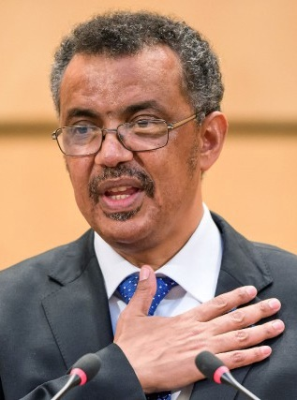
“I firmly believe that technology has a pivotal role to play in helping the world achieve Universal Health Coverage”
@DrTedros to #ITUWTDC, 2018
Lets work together…

