Slide 1
FGAI4H-P-046-A07
Helsinki, 20-22 September 2022
Source: | Charite
Title: | Att.7 - Presentation - Impact of AI on gaze patterns of dentists: A randomized controlled trial
Purpose: | Discussion
Contact: | Lubaina Arsiwala-Scheppach | E-mail: lubaina.arsiwala@charite.de
Abstract: | This PPT contains a presentation on the Impact of AI on gaze patterns of dentists: A randomized controlled trial.

Slide 2
Impact of AI on gaze patterns of dentists:
A randomized controlled trial
ITU-WHO, TG dental Symposium
Meeting P, 19 Sep. 2022
DR. LUBAINA ARSIWALA-SCHEPPACH, BDS, MHS

Slide 3
DISCLOSURE OF CONFLICT OF INTEREST
Falk Schwendicke and Joachim Krois are co-founders of an AI start-up called dentalXr.ai

Slide 4
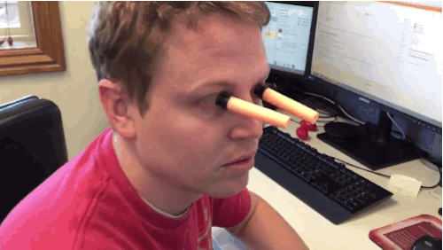
WHAT IS EYE TRACKING ?

Slide 5
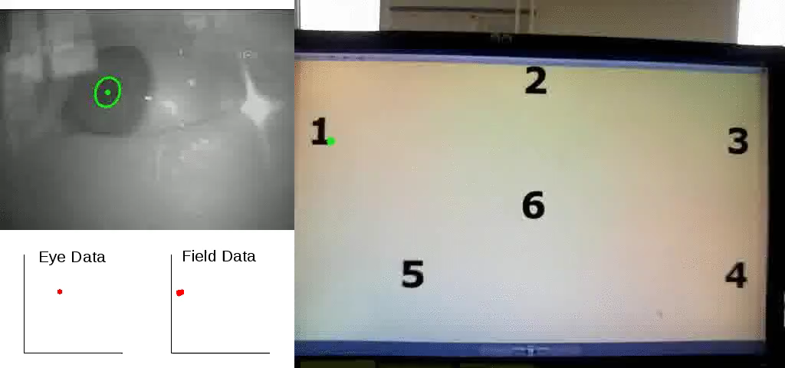
WHAT REALLY IS EYE TRACKING?

Slide 6
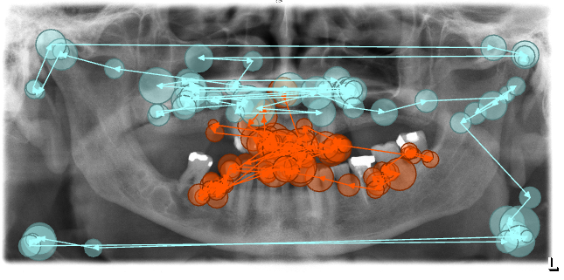
TERMINOLOGY
SCAN PATH
The path followed by your eyes when viewing a field for a given task.
GAZE PATTERN
The characteristic feature of your scan path.
Compare and classify gaze
patterns for behavior recognition.
Experts vs. Novices
Notes:
Explain DIFFERENT TYPES OF GAZE PATTERNS
Imp. For dentistry since the field relies heavily on radiographic images

Slide 7
METHODS
Study design: Randomized controlled trial
Participants: 22 dentists
Task: Diagnose primary caries in bitewing radiographs of the permanent dentition.
Trial arm #1: Dentists only
Trial arm #2: Dentists in conjunction with an AI tool
During this task, the dentists’ eye movements were tracked.
Our aim was to characterize the gaze patterns in the study.

Slide 8
RESULTS
Gender: 16 male and 6 female dentists
Age: 38 years (mean), 27-60 years (range)
FIXATION
Focus your eyes on a certain area
Time to 1st fixation
Fixation count
Fixation duration
Notes:
fixation frequency: indicates how quickly the relevant information is extracted

Slide 9
RESULTS
 | Dentists only | Dentists + AI
Number of data instances used | 172 | 177
Teeth w/o any features | 365 | 341
Teeth with caries | 364 | 378
Teeth with restorations | 481 | 523
Notes:
PRELIM. RESULTS, it is a work-in-progress.
Hence You may feel that some results are not directly in line with our study aim, because we are still exploring the signals in our data.

Slide 10
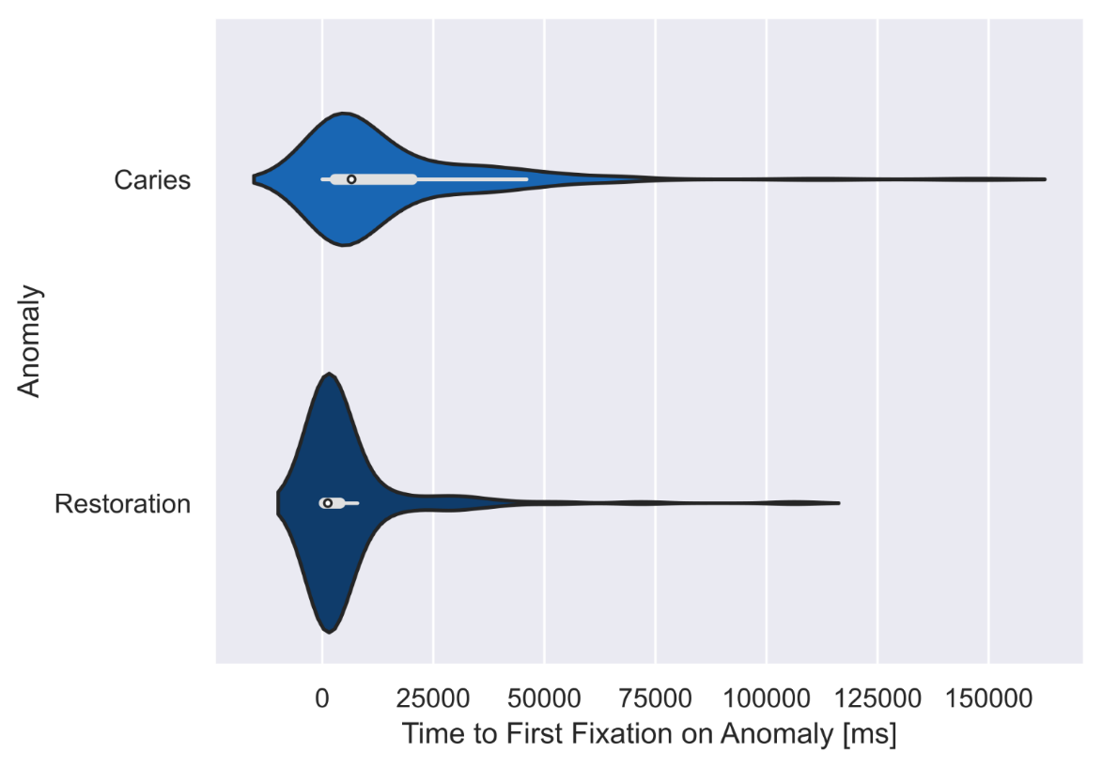
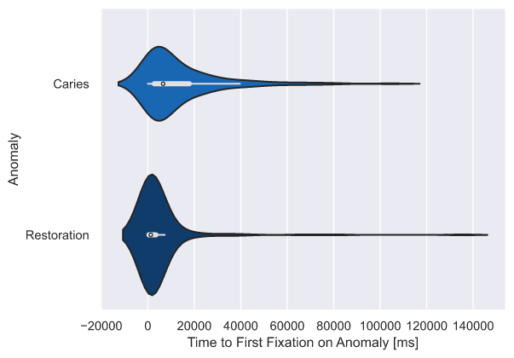
RESULTS
Time to First Fixation, milliseconds
Dentists only Dentists + AI
Dentists only vs Dentists + AI
-
-
<0.001 <0.001
Notes:
Median time to first fixation was shorter for restorations than for caries. This may be because restorations are usually spatially larger than caries hence more likely to attract the dentists’ attention first and also easier to notice, especially if they are radiopaque.
We also stratified by caries depth but found no signif diff.s b/w the groups.

Slide 11
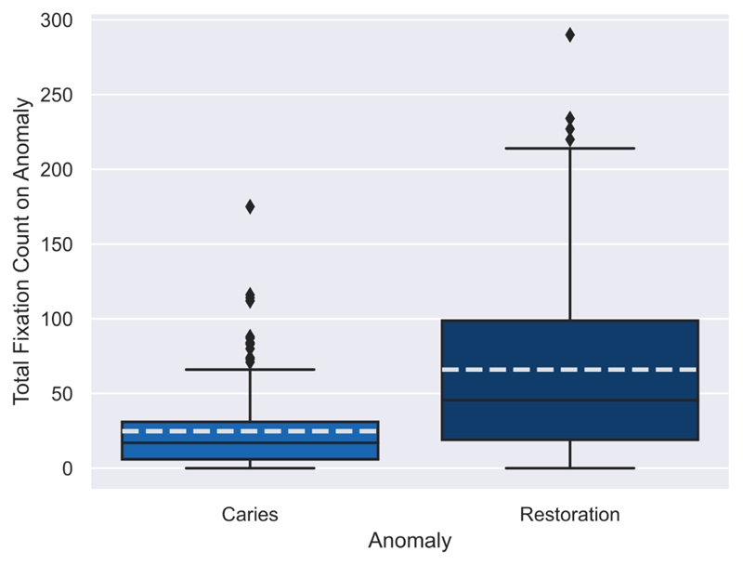
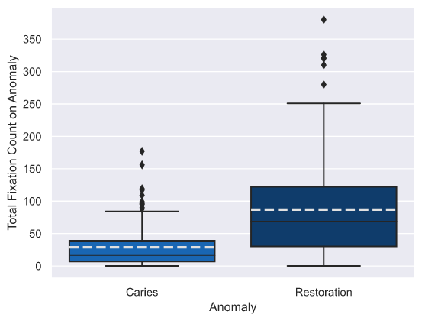
RESULTS
Fixation Count
Dentists only Dentists + AI
Dentists only vs Dentists + AI
-
0.04
<0.001 <0.001
Notes:
Caries< restorations. One possible reason for this may be that since the AI software has assisted the dentists with identifying the caries in the bitewing, i.e., the primary aim of this trial, the dentists may have more chances to closely inspect other areas of the radiograph, determine that there are in fact no caries on the teeth having existing restorations.
This is further supported by the observation that the dentists in AI group had significantly lesser fixations on teeth with D2 caries level, as compared to the noAI group.

Slide 12
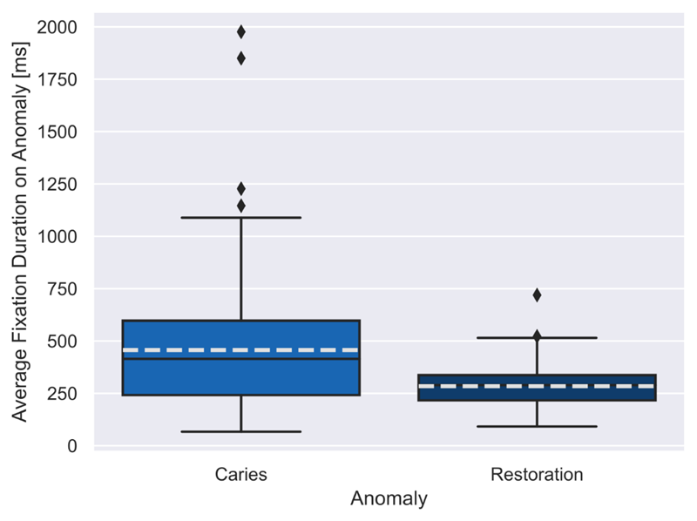
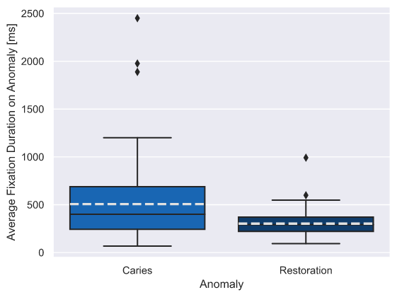
RESULTS
Average Fixation Duration, milliseconds
Dentists only Dentists + AI
Dentists only vs Dentists + AI
-
-
0.002 <0.001
Notes:
The teeth with caries had longer fixation durations than restorations. Again, this would allude to the aim of the study which was to diagnose primary caries and not monitor the status of existing restorations nor diagnose secondary caries. It is also indicative of thorough inspection of the teeth that the dentists determined to have caries.

Slide 13
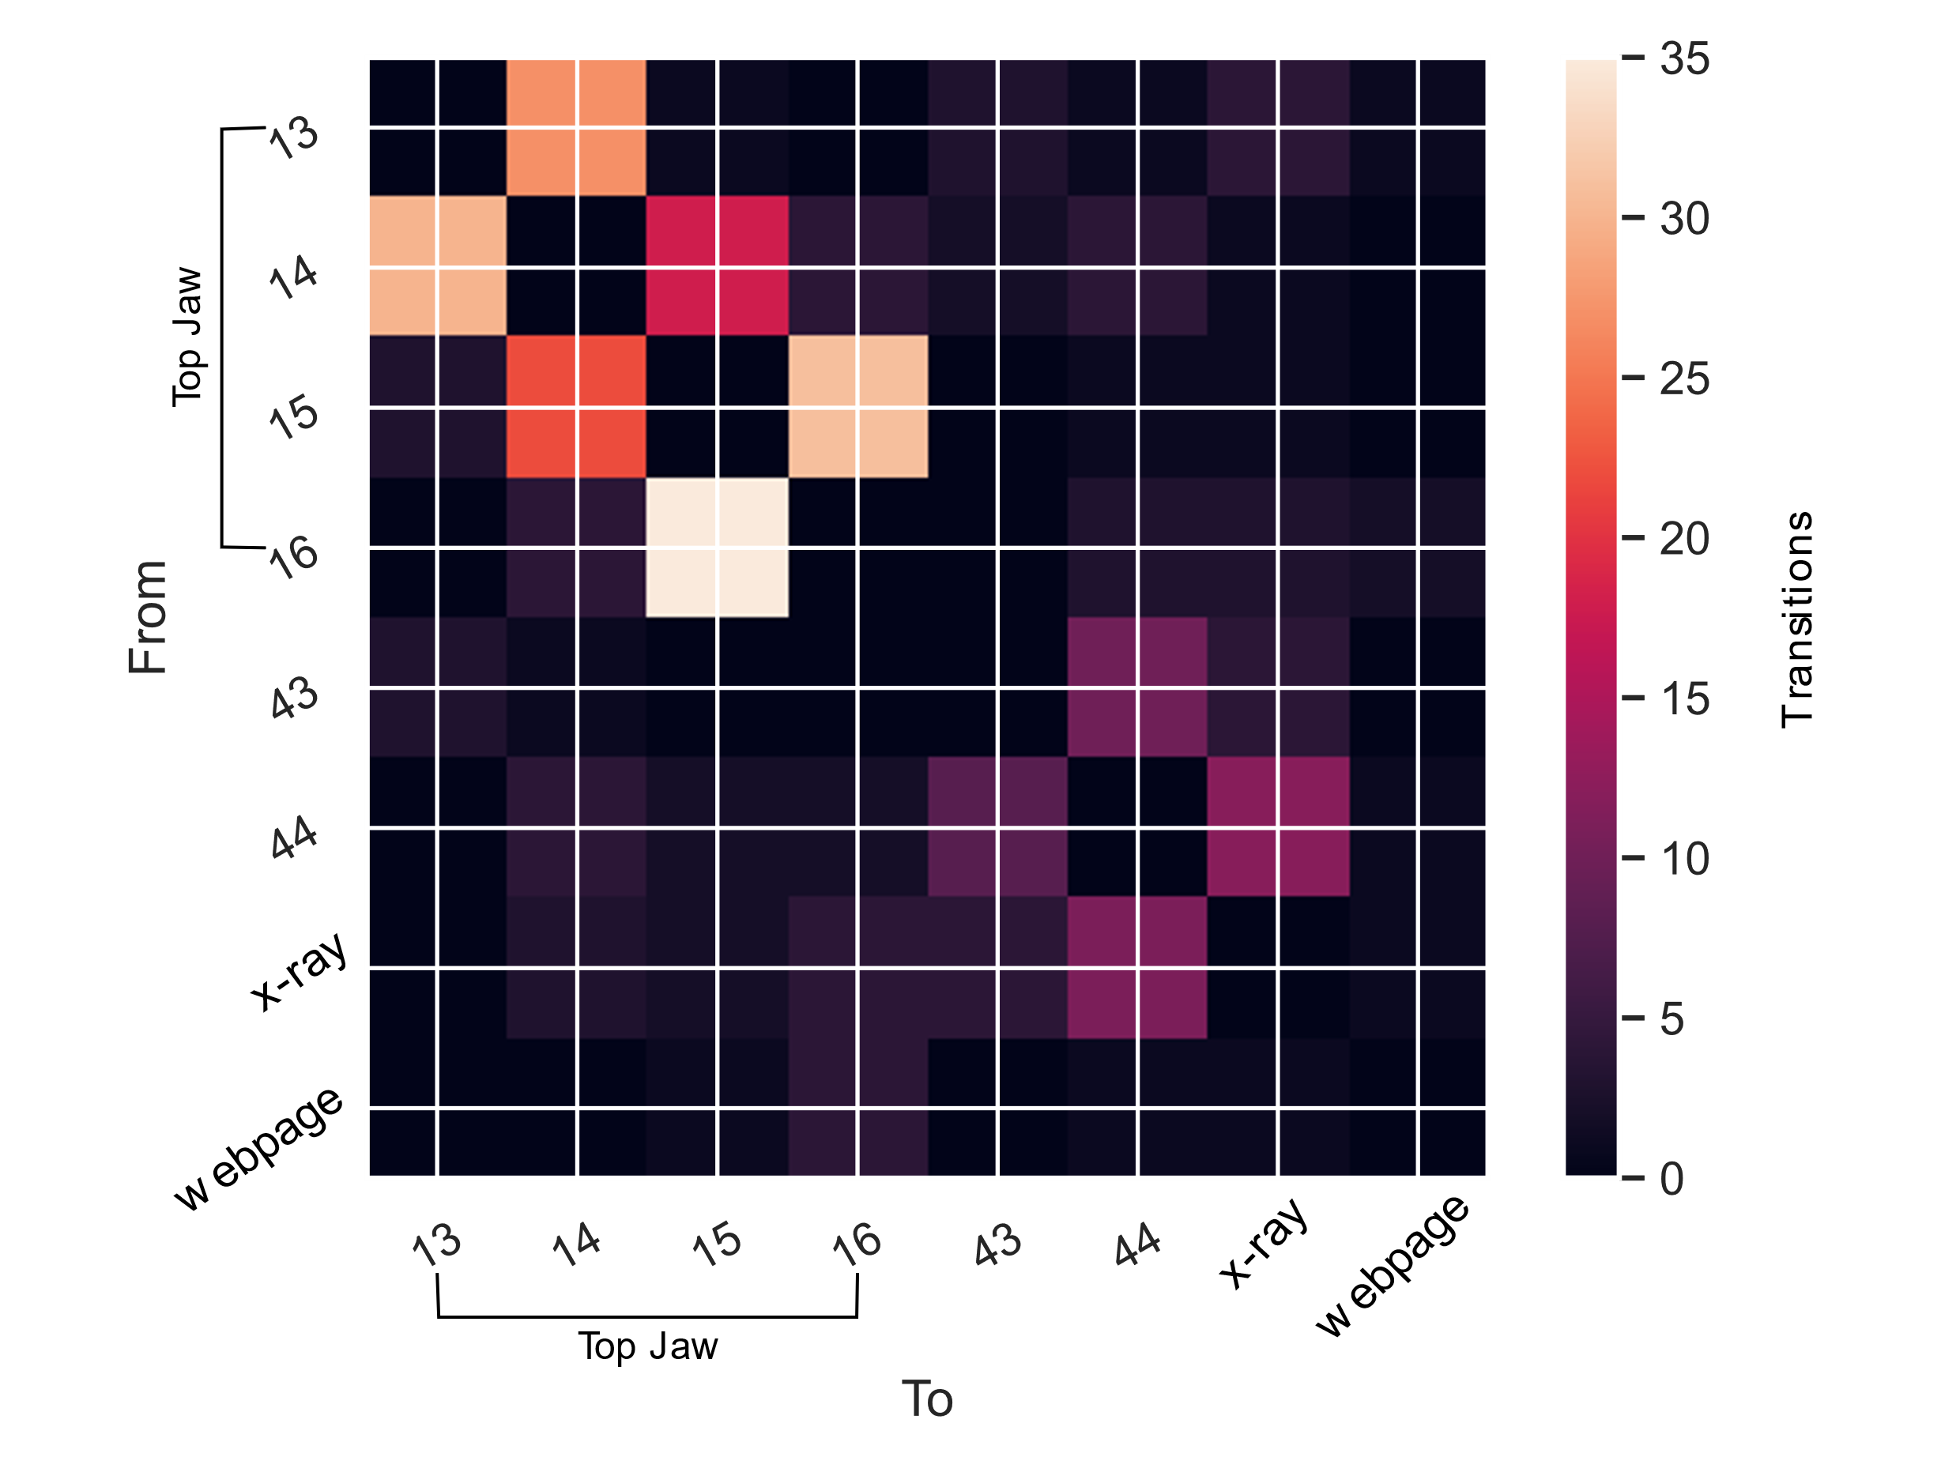
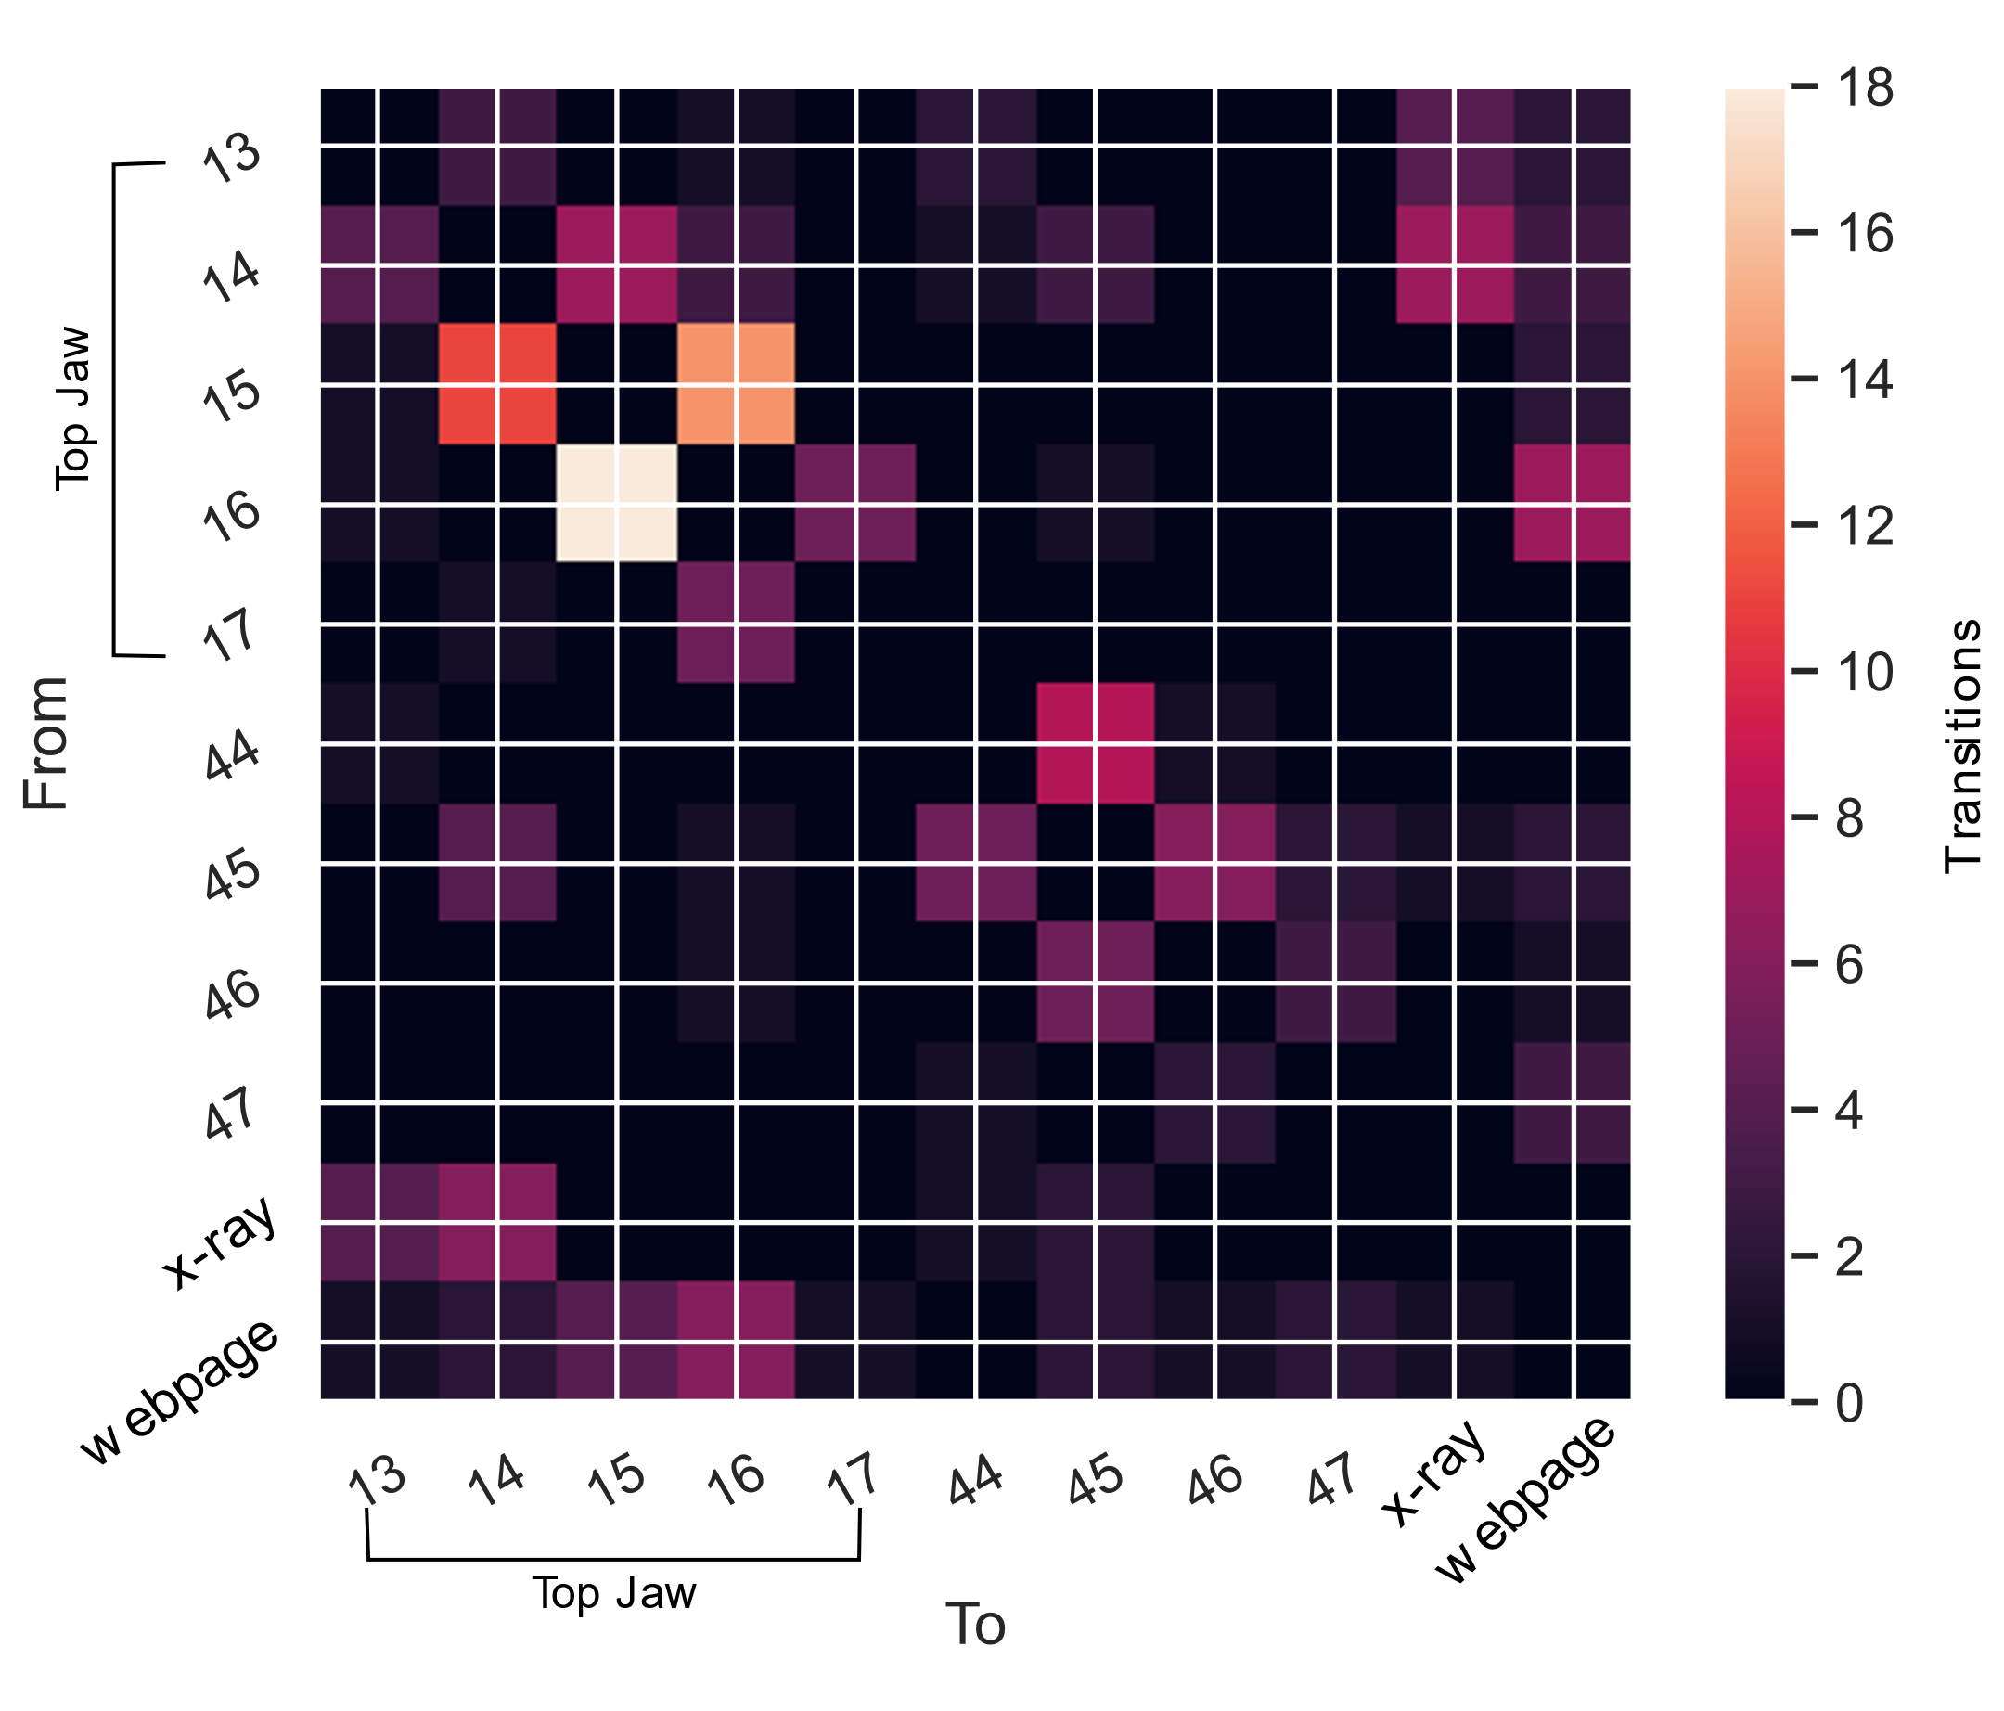
RESULTS
Gaze transitions
Dentists only Dentists + AI
Notes:
To further investigate the procedural aspect of dental experts’ gaze, we looked at the transition behavior of the scan paths. We looked at how often the gaze transitions to a neighboring tooth (e.g., tooth 24 to tooth 25) v/s a not so neighboring tooth (e.g., tooth 27 to tooth 34). When there are a high number of transitions to the next nearest tooth, this gaze strategy can be indicative of systematic search thoroughly moving in a semi-linear fashion between the teeth. Both the groups showed a systematic search pattern. Small differences were observed which pertain to the possibility that in the AI group, dentists may have felt a lesser need to systematically search the radiograph owing to the assistance from the AI tool.

Slide 14
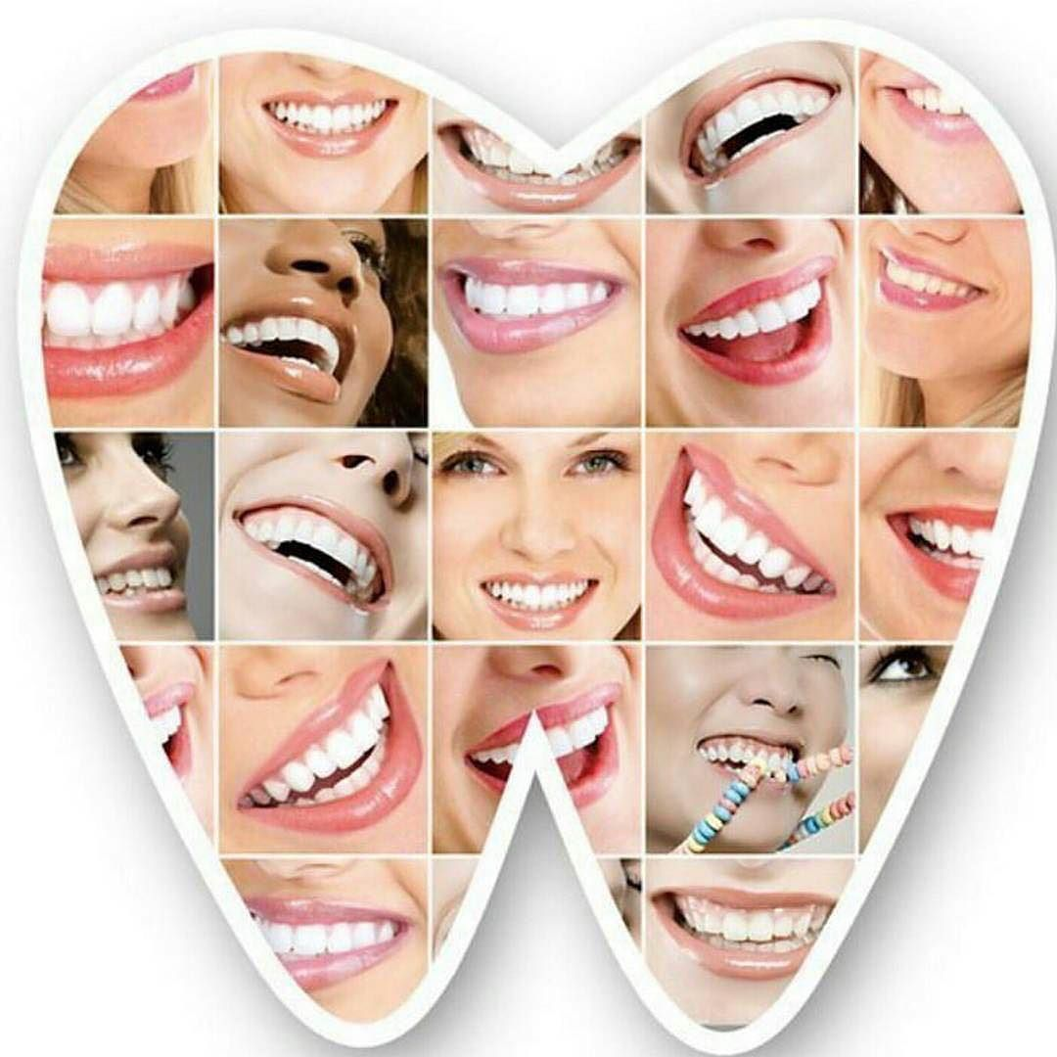
Questions ?
Dr. Lubaina Arsiwala-Scheppach
Email: lubaina.arsiwala@charite.de
larsiwa1@alumni.jh.edu

Slide 15
SUPPLEMENTARY SLIDES

Slide 16
RESULTS
 |  | Dentists only |  | Dentists + AI |  | p-value of Dentists only vs Dentists + AI
Time to First Fixation, median (IQR), milliseconds
 | Tooth with caries | 6598 (2926, 20232) | <0.001 | 6586 (2830, 17826) | <0.001 | -
 | Tooth with restorations | 1259 (485, 3987) |  | 1283 (508, 3410) |  | -
Notes:
Median time to first fixation was shorter for restorations than for caries. This may be because restorations are usually spatially larger than caries hence more likely to attract the dentists’ attention first and also easier to notice, especially if they are radiopaque.
We also stratified by caries depth but found no signif diff.s b/w the groups.

Slide 17
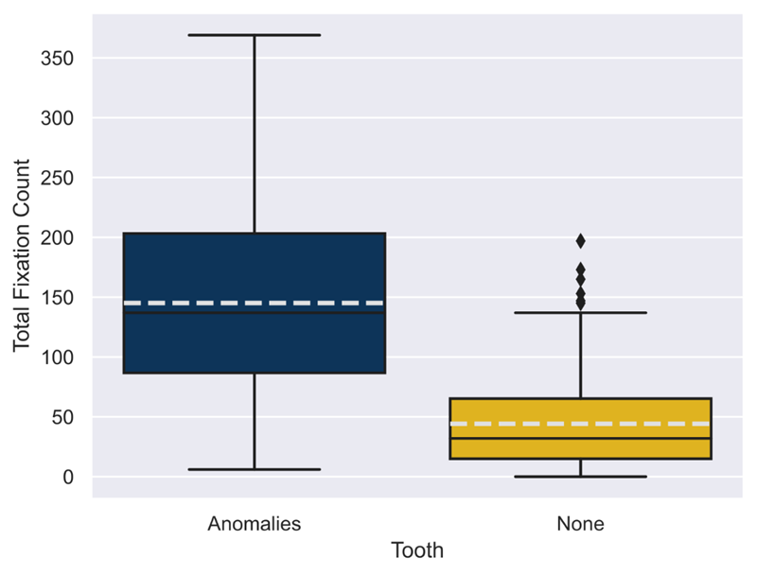
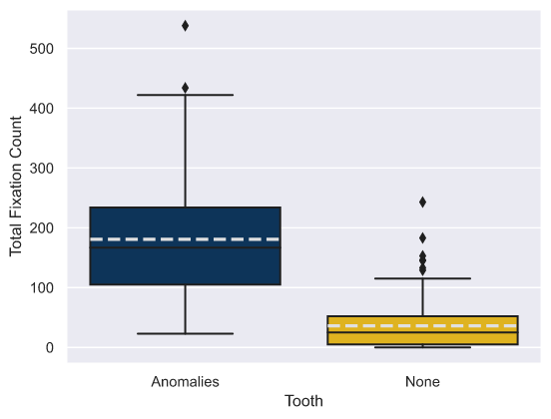
RESULTS
Fixation Count
Dentists only Dentists + AI
Dentists only vs Dentists + AI
0.002
-
<0.001 <0.001
Notes:
Dentists had more fixations on teeth with features than teeth with no features which is likely because the aim of the study was to diagnose primary caries.
AI support made the dentists fixate more on teeth with features, compared to noAI group. On further inspection ….

Slide 18
RESULTS
 |  | Dentists only |  | Dentists + AI |  | p-value of Dentists only vs Dentists + AI
Total Fixation Count, median (IQR) | Teeth with any features | 137 (87, 203) | <0.001 | 167 (105, 234) | <0.001 | 0.002
 | Teeth w/o any features | 32 (15, 65) |  | 25 (5, 52)
 | Tooth with caries | 17 (6, 31) | <0.001 | 17 (7, 39) | <0.001
 | Tooth with restorations | 46 (19, 99) |  | 69 (30, 122) |  | 0.04
Notes:
Dentists had more fixations on teeth with anomalies than teeth with no anomalies which is likely because the aim of the study was to diagnose primary caries.
There was a large difference in the fixation behavior regarding the type of anomaly (caries or restoration), with more fixations on restorations than caries. Though this was unexpected, there were possibly more fixations to thoroughly inspect and determine that there are in fact no caries on the teeth having existing restorations.
AI support made the dentists fixate more on teeth with anomalies, compared to noAI group. On further inspection, we found that this difference stemmed from the teeth with restorations. One possible reason for this may be that since the AI software has assisted the dentists with identifying the caries in the bitewing, i.e., the primary aim of this trial, the dentists may have more chances to closely inspect other areas of the radiograph. This is further supported by the observation that the dentists in AI group had significantly lesser fixations on teeth with D2 caries level, as compared to the noAI group.

Slide 19
RESULTS
 |  | Dentists only |  | Dentists + AI | p-value of Dentists only vs Dentists + AI
Average Fixation Duration, median (IQR), milliseconds | Teeth with any features | 337 (249, 414) | 0.52 | 347 (263, 421) | 0.04
 | Teeth w/o any features | 307 (230, 367) |  | 293 (233, 367)
 | Tooth with caries | 415 (242, 597) | 0.002 | 401 (242, 689) | <0.001
 | Tooth with restorations | 289 (216, 337) |  | 292 (221, 370)
Notes:
The teeth with caries had longer fixation durations than restorations. Again, this would allude to the aim of the study which was to diagnose primary caries and not monitor the status of existing restorations nor diagnose secondary caries. It is also indicative of thorough inspection of the teeth that the dentists determined to have caries.

Slide 20
RESULTS
Results stratified by caries level
The longest time to 1st fixation was for teeth with a caries level E1. This may be because they are incipient lesions and hence most difficult to spot.
The highest fixations were on teeth with D2 level of caries and lowest on E1 level of caries. The dentists were also required to note the caries level for each lesion that they identified. One could hypothesize that the smaller lesions needed more fixations for a diagnosis, and this is reflected in time to 1st fixation and average fixation duration.
Average fixation durations showed less variability, highest for E1 and lowest for D3. Since D3 are the largest lesions and hence lesser time is required to diagnose them.

Slide 21
RESULTS
Results stratified by caries level
Average fixation durations were highest for E1 and lowest for D3. Since D3 are the largest lesions and hence lesser time is required to diagnose them.

Slide 22
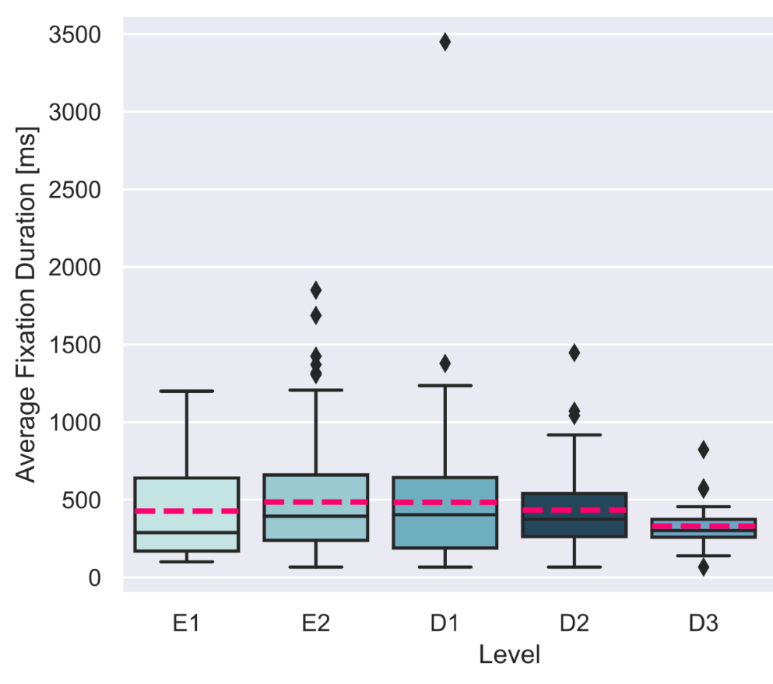
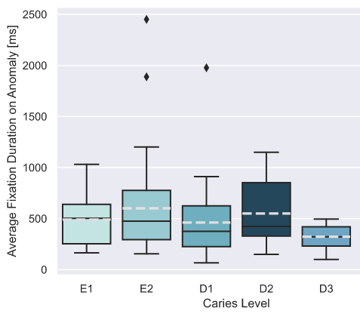
Average Fixation Duration, milliseconds
Dentists only Dentists + AI

Slide 23
Applications of gaze pattern analysis
Automated expertise recognition
How to create more seamless user-AI interactions
Has use in augmented or virtual reality
Next steps in our project
Stratify the dentists by years of experience and see if patterns differ between them.
Use ‘fixation frequency’ since viewing times are variable.
Notes:
A violin plot is two kernel density estimations (KDE) plots aligned on an axis. The "negative" values you are seeing are just an artifact of KDEs. They are estimations of values in your data. It's not saying you have negative data, it's saying that your data contains values very close to negative values, namely 0. And thus you have a non-zero estimated probability of selecting a negative value from your dataset. The kernel density is defined over the full range from -infinity to +infinity

Slide 24
Quality checks on scan path data
Gaze signal > 0.60
Scrolling behavior: Erroneous data points were excluded

Slide 25
EYE TRACKING TOOL
The remote eye tracker used was the SmartEye Aurora running at 60Hz and positioned under a monitor (1920 x 1080px).
Participants were unconstrained and positioned approximately 70cm from the system.
An initial n-point calibration and validation were performed. Gaze data was collected the whole duration of the experiment.
Gaze data was then pre-processed using the iMotions software (version 8.2.22899.4).
Event detection was the iMotions implementation of the I-VT algorithm, with a minimum fixation duration of 60ms and a velocity threshold of 30deg/s.
The current analysis used the fixations reported from the software, which are interpolated between the left and the right eye.
We interpret fixations as the areas of attentional focus related to the stimuli presented on the screen.

