Slide 1
FGAI4H-P-046-A06
Helsinki, 20-22 September 2022
Source: | Rata Rokhshad
Title: | Att.6 - Presentation - Ethics in Dentistry
Purpose: | Discussion
Contact: | Rata Rokhshad | E-mail: ratarokhshad@gmail.com
Abstract: | This PPT contains a presentation on Ethics in Dentistry.

Slide 2
Ethics in Dentistry
Rata Rokhshad

Slide 4
Challenges in dentistry

Slide 6
Data Protection
Reliability and safety

Slide 7
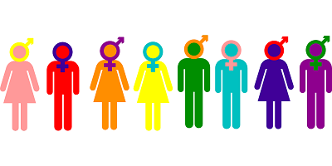
Diversity

Slide 8
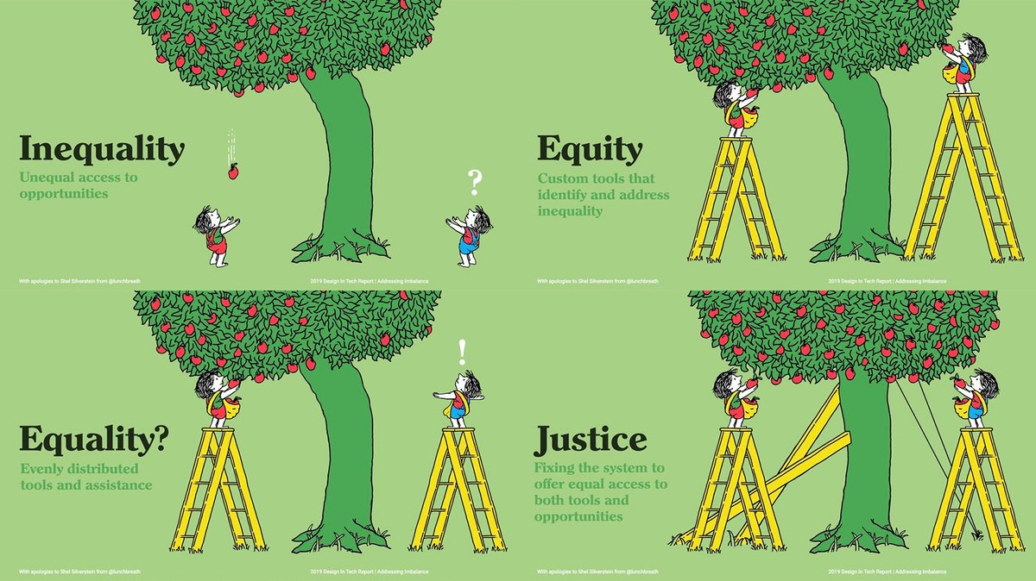
Equity
Availability
Fairness

Slide 9
Decision making and responsibility
Patient and clinician relationship?!
Who is responsible for the treatment, diagnosis and dental procedure?

Slide 10
Transparency
Explainable AI for both patient and clinician
*Data set, methods, model

Slide 11
Sustainable development and Prudence

Slide 12
Solidarity and Wellness
Generation and people solidarity
Grow well-being

Slide 13
Patients
AI should be used in the interest of patients;
The use of AI should not treat any groups of patients unfairly;
Dignity needs to be preserved so the patient should have autonomy of thought, intention, and action when making decisions regarding health care.

Slide 14
Aims and projects
Awareness
Guidelines
Codes for esthetics
Adopting for group projects

Slide 15
Where?
Research
Companies
Clinics
Daily life

Slide 16
Will appreciate your ideas:
Ratarokhshad@gmail.com

