Slide 1
FGAI4H-P-046-A01
Helsinki, 20-22 September 2022
Source: | TG-Dental drivers
Title: | Att.1 – Presentation – Introduction to the 1st TG Dental Symposium
Purpose: | Discussion
Contact: | Falk Schwendicke | E-mail: falk.schwendicke@charite.de
 | Joachim Krois | E-mail: Joachim.krois@charite.de
Abstract: | This PPT contains an introduction to the Dental Symposium that took place on 19 September 2022.

Slide 2
2022/09/19
1st TG DENTAL SYMPOSIUM
BIOMEDICUM HELSINKI THE ACADEMIC MEDICAL CENTER HELSINKI HAARTMANINKATU 8, 00290 HELSINKI , FINLAND
HTTPS://REMOTE.ITU.INT
Urgency contact
hamdanai4h@gmail.com

Slide 3
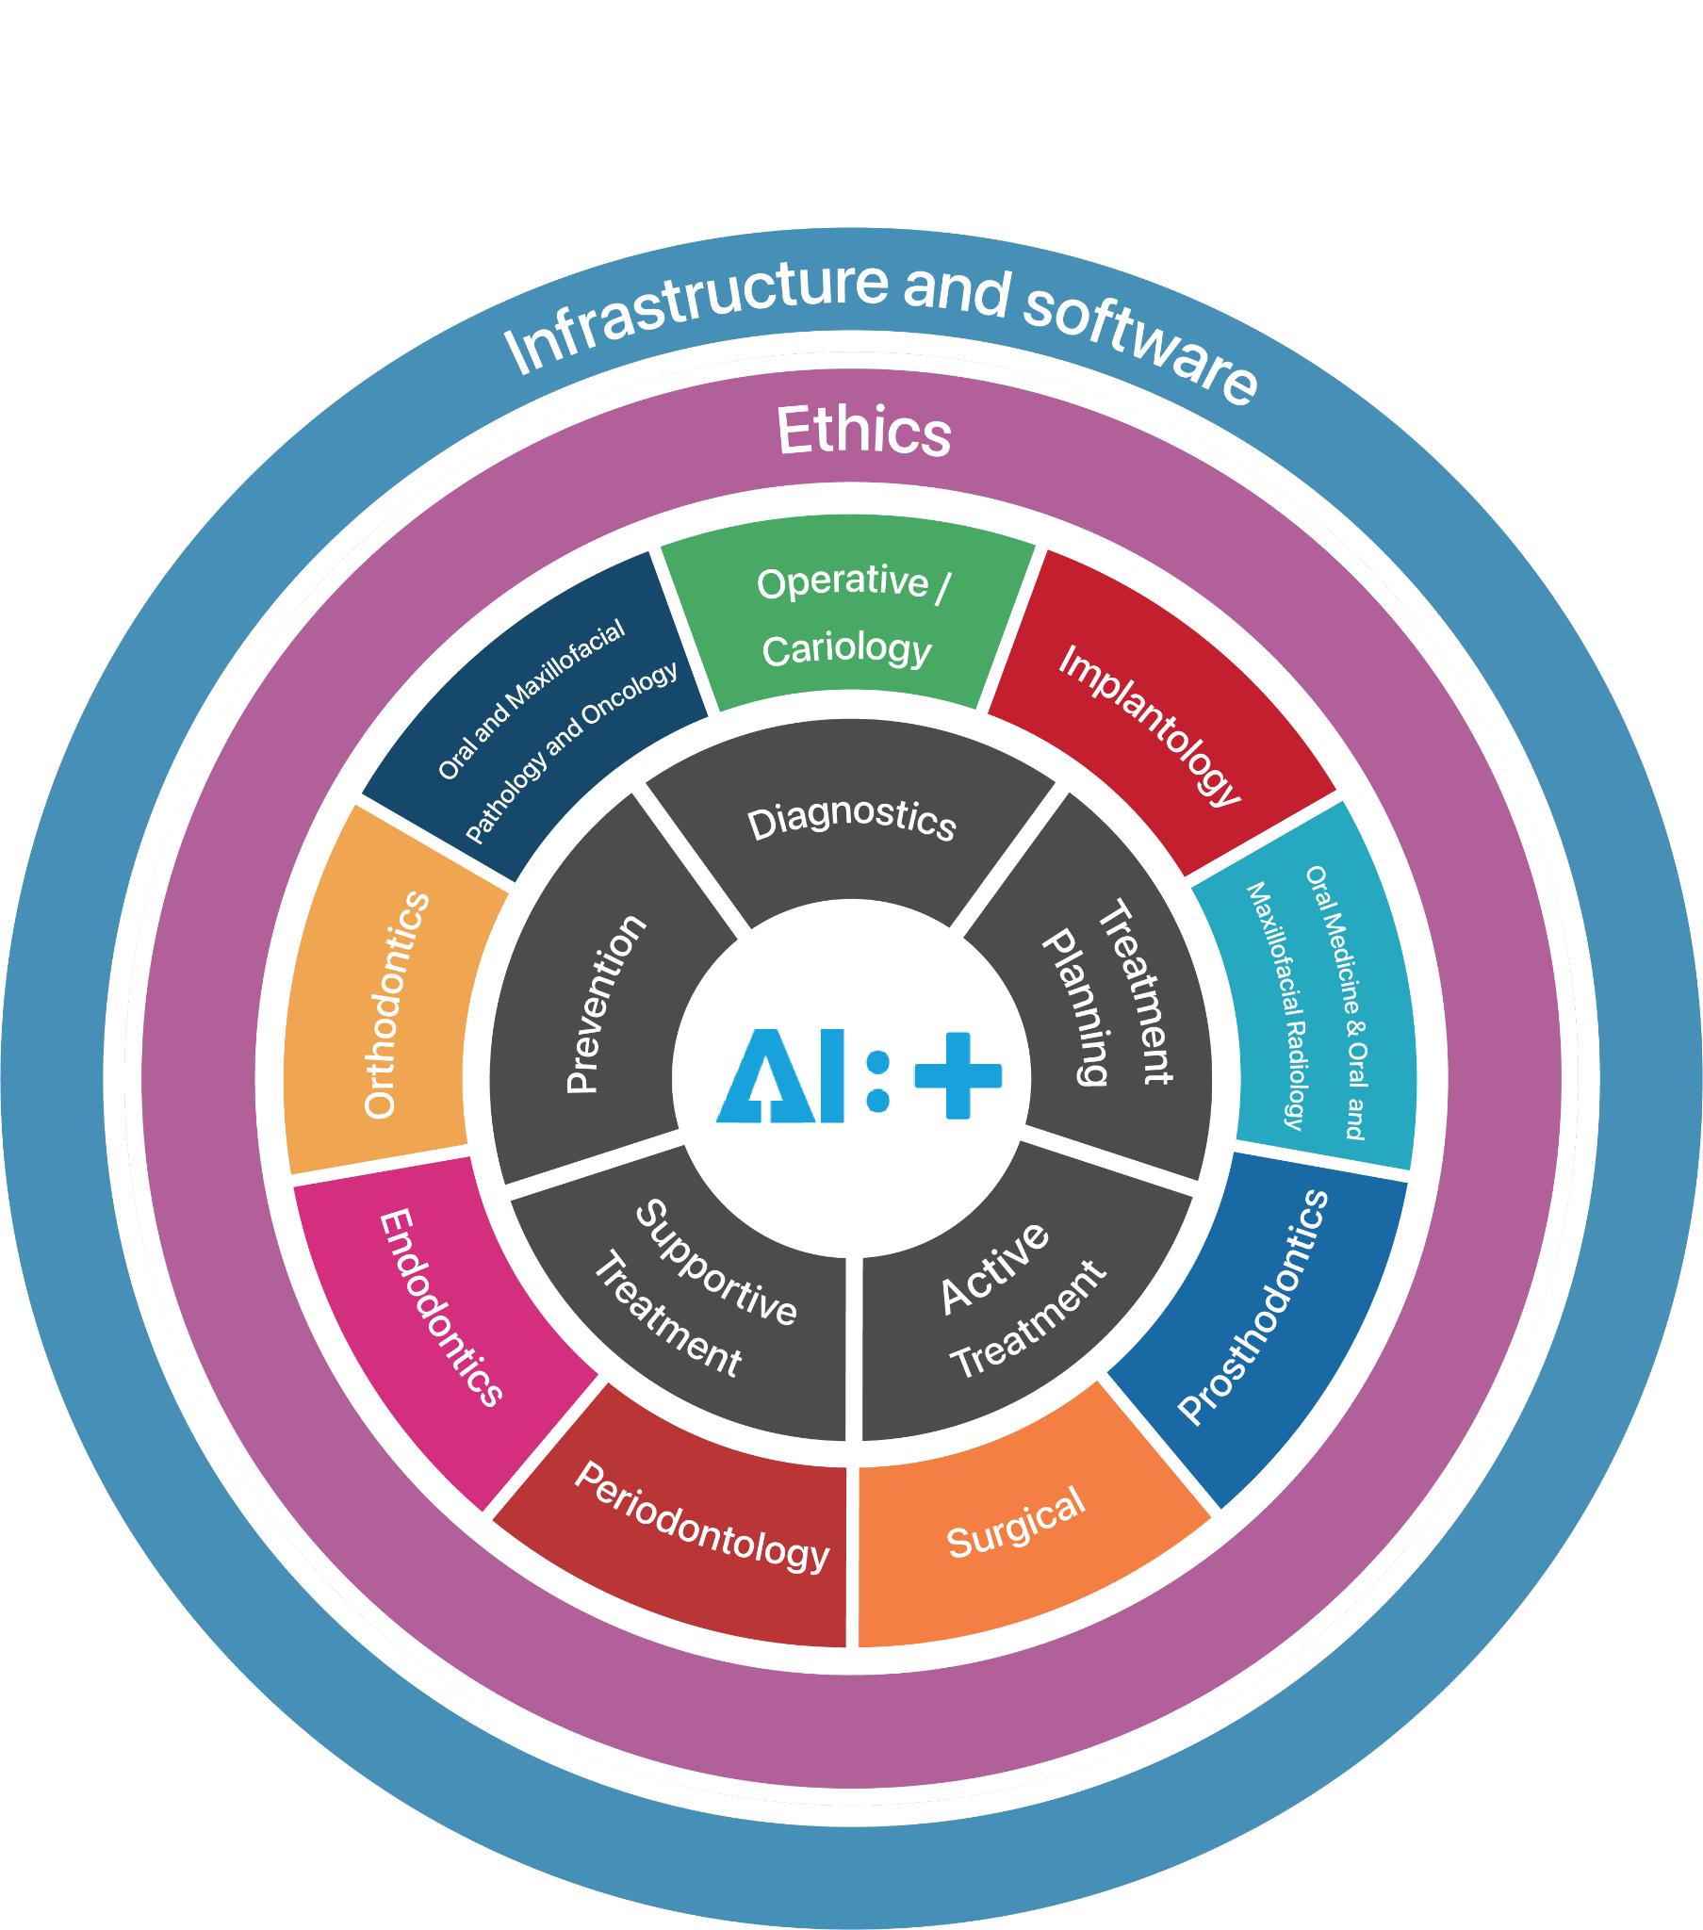
Who are we?
Topic group: Dental Diagnostics and Digital Dentistry
A topic group is a community of stakeholders from the medical and AI communities with a shared interest in a topic. The objectives of the topic group is manifold:
to provide a forum for open communication among various stakeholders,
to agree upon the benchmarking tasks of this topic and scoring metrics,
to facilitate the collection of high-quality labelled test data from different sources,
to clarify the input and output format of the test data,
to define and set-up the technical benchmarking infrastructure, and

Slide 4
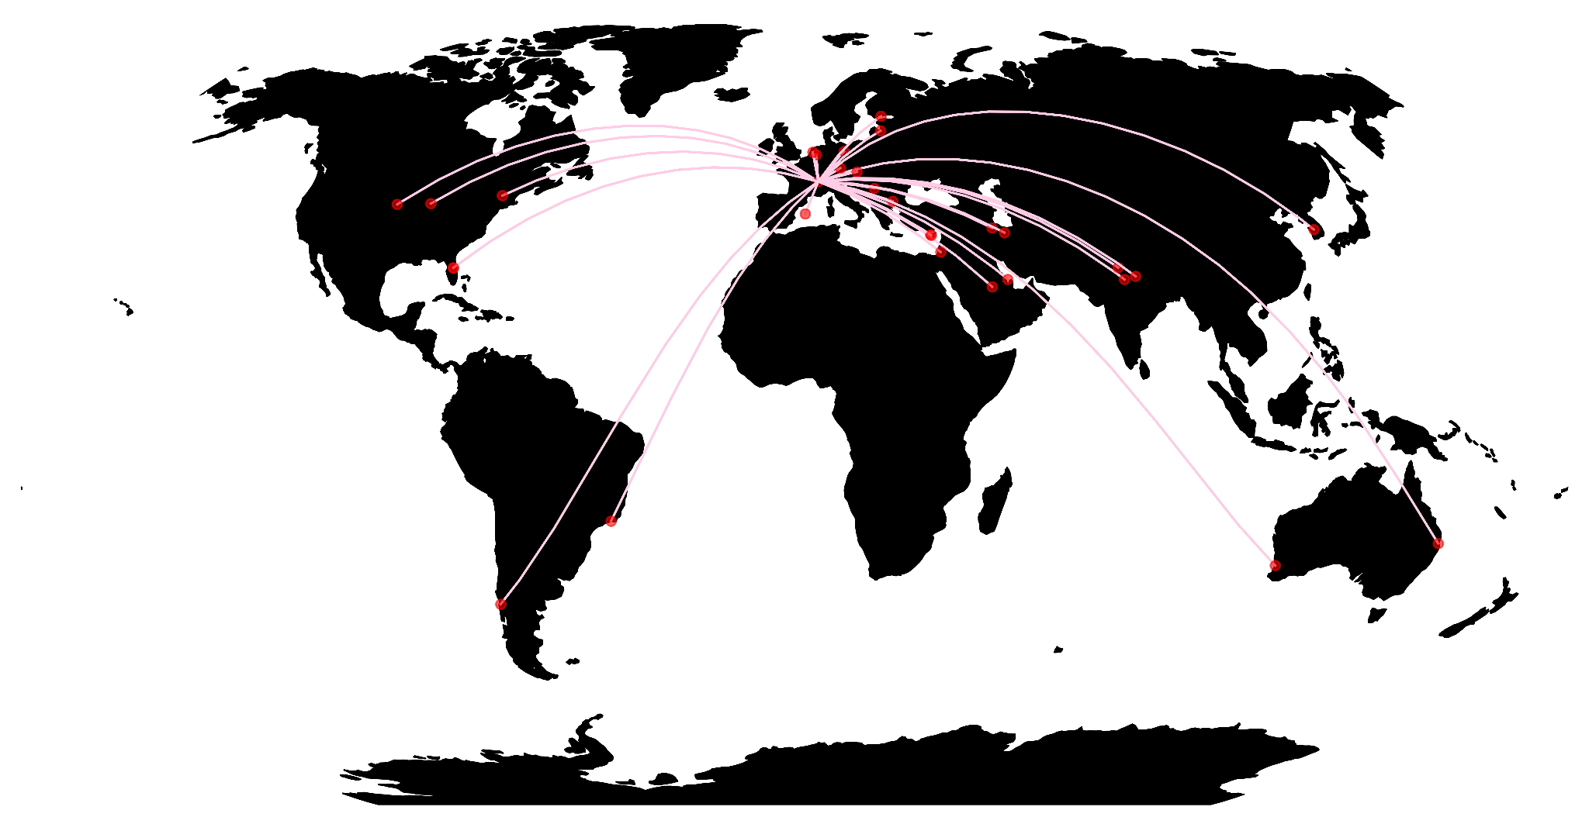
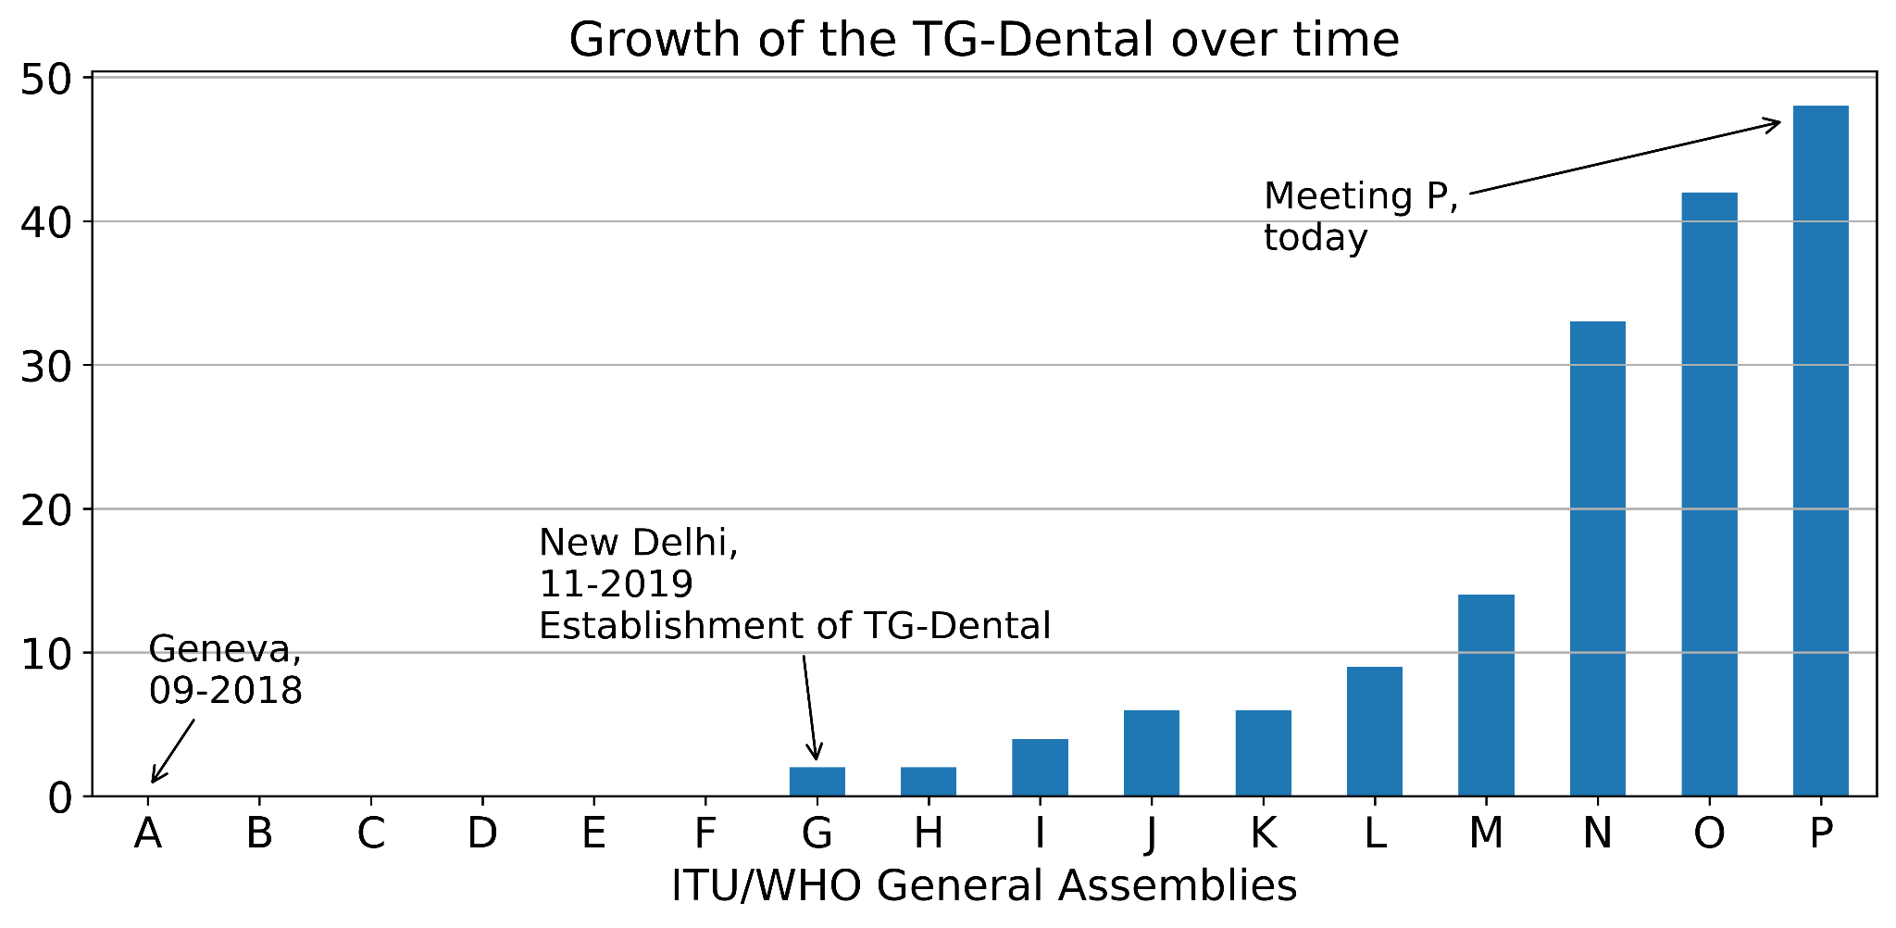
Who are we?
Topic group: Dental Diagnostics and Digital Dentistry
A topic group is a community of stakeholders from the medical and AI communities with a shared interest in a topic. The objectives of the topic group is manifold:
to provide a forum for open communication among various stakeholders,
to agree upon the benchmarking tasks of this topic and scoring metrics,
to facilitate the collection of high-quality labelled test data from different sources,
to clarify the input and output format of the test data,
to define and set-up the technical benchmarking infrastructure, and
48 members / 20 countries / 5 continents

Slide 5
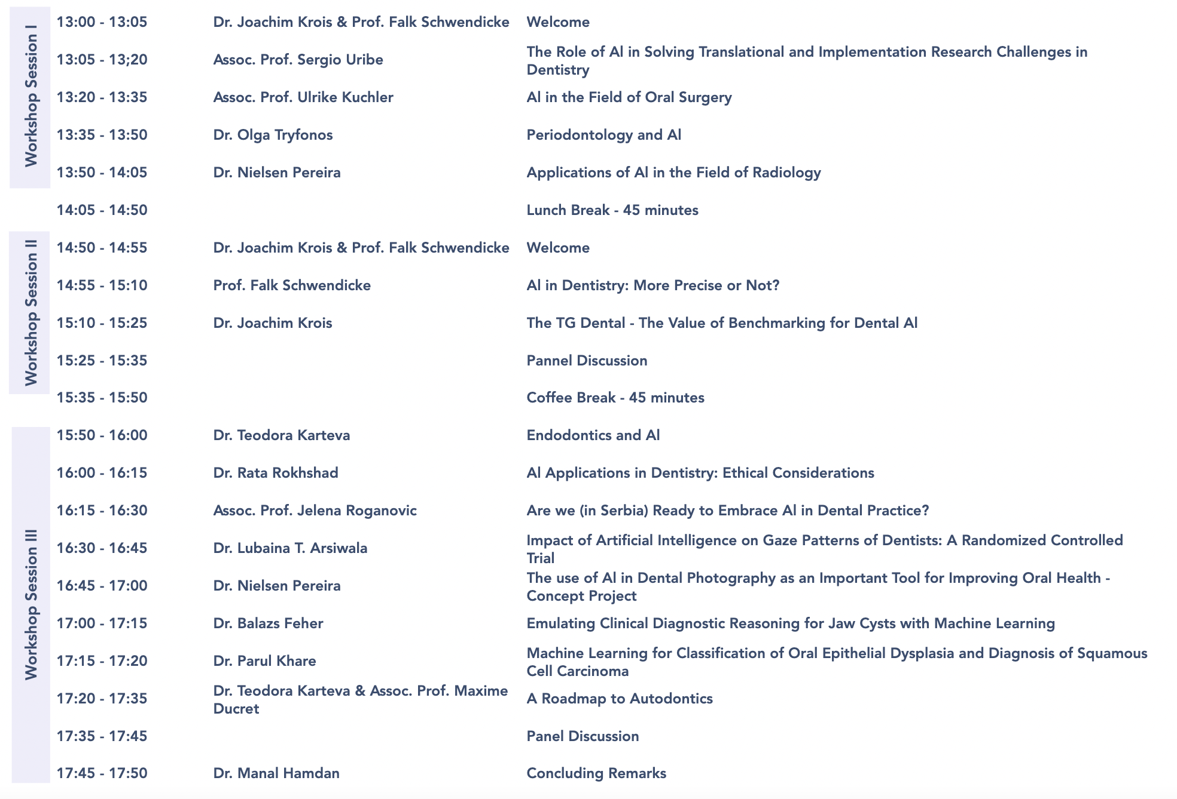
Timetable
Q&A
If time permits after each presentation
Otherwise panel discussion and/or during coffee breaks
How?
[in person] Raise your hand
[remote] Raise your virtual hand
[all] Write down the question in the zoom chat and we try to accommodate
Breakout room B
Breakout room A
Breakout room B
Program
https://www.autodontics.com/tgdentalsymposium

Slide 6
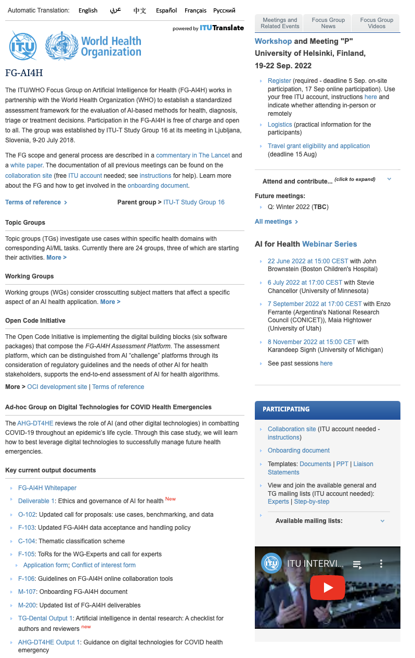
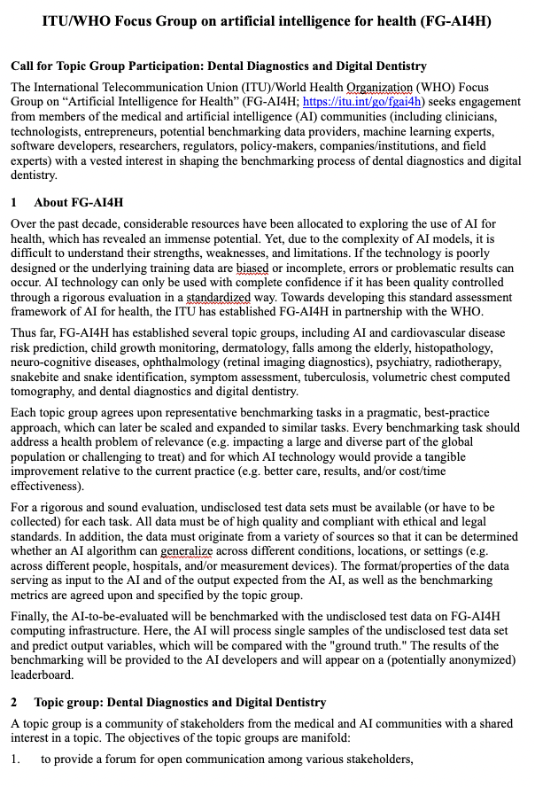
Get involved!
https://www.itu.int/en/ITU-T/focusgroups/ai4h/Pages/default.aspx
Contact
Prof Falk Schwendicke, Charité – Universitätsmedizin Berlin, Germany falk.schwendicke@charite.de
Joachim Krois, dentalXrai, Germany joachim.krois@dentalxr.ai
CfTGP (TG-Dental): P-010-A02
https://www.autodontics.com/

Slide 7
HTTPS://REMOTE.ITU.INT
Urgency contact
hamdanai4h@gmail.com

Slide 8
2022/09/19
1st TG DENTAL SYMPOSIUM
Keynotes
BIOMEDICUM HELSINKI THE ACADEMIC MEDICAL CENTER HELSINKI HAARTMANINKATU 8, 00290 HELSINKI , FINLAND
HTTPS://REMOTE.ITU.INT
Urgency contact
hamdanai4h@gmail.com

Slide 9
Who are we?
Topic group: Dental Diagnostics and Digital Dentistry
A topic group is a community of stakeholders from the medical and AI communities with a shared interest in a topic. The objectives of the topic group is manifold:
to provide a forum for open communication among various stakeholders,
to agree upon the benchmarking tasks of this topic and scoring metrics,
to facilitate the collection of high-quality labelled test data from different sources,
to clarify the input and output format of the test data,
to define and set-up the technical benchmarking infrastructure, and

Slide 10
Who are we?
Topic group: Dental Diagnostics and Digital Dentistry
A topic group is a community of stakeholders from the medical and AI communities with a shared interest in a topic. The objectives of the topic group is manifold:
to provide a forum for open communication among various stakeholders,
to agree upon the benchmarking tasks of this topic and scoring metrics,
to facilitate the collection of high-quality labelled test data from different sources,
to clarify the input and output format of the test data,
to define and set-up the technical benchmarking infrastructure, and
48 members / 20 countries / 5 continents

Slide 11
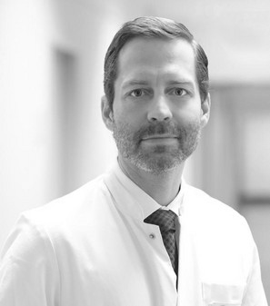
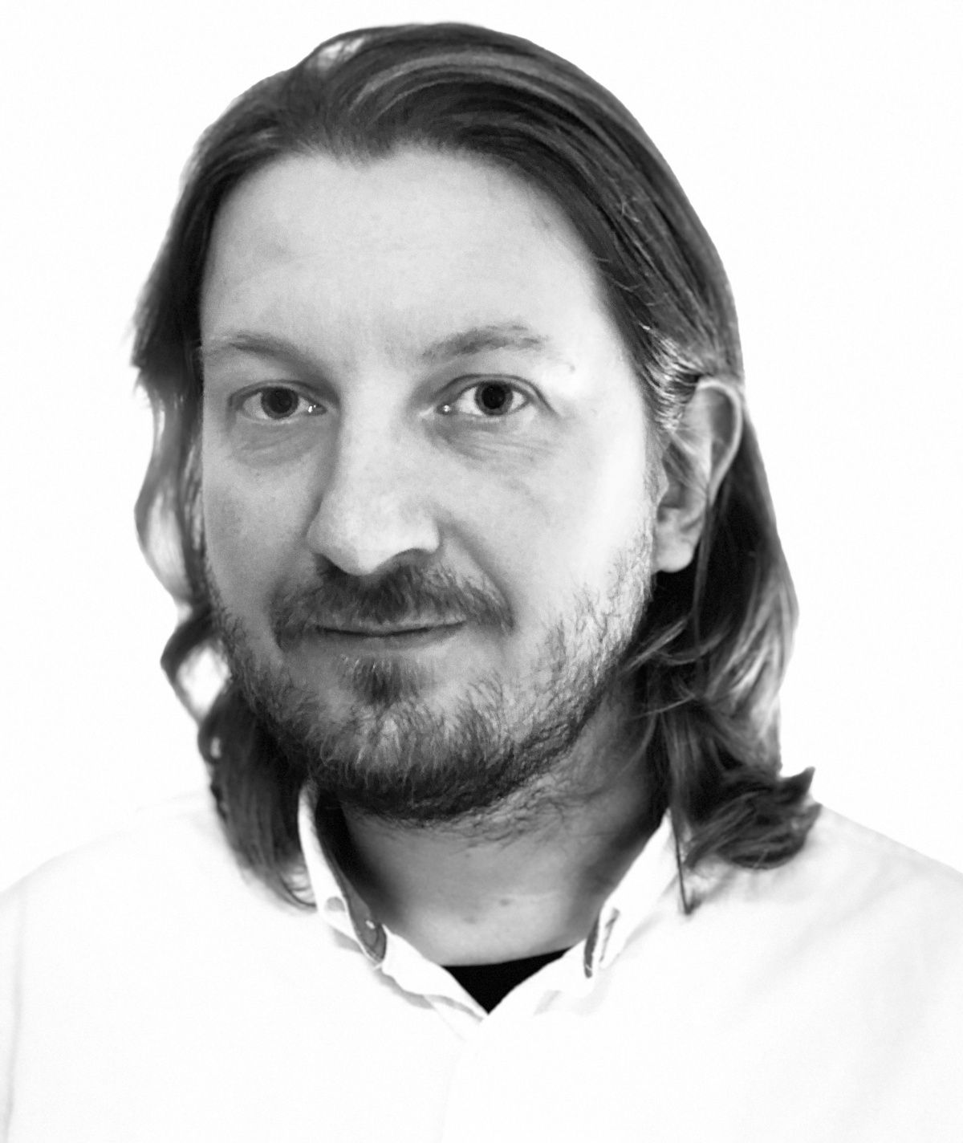
Keynote speakers
Prof Falk Schwendicke
Charité – Universitätsmedizin Berlin, Germany
Dr rer nat Joachim Krois
dentalXrai, Germany
AI in Dentistry: More precise or not?
TG Dental – The value of benchmarking for Dental AI
Notes:
Prof. Dr. Falk Schwendicke is Professor and Head of Department Oral Diagnostics, Digital Health and Health Services Research at Charite – Universitätsmedizin Berlin. He has a demonstrable track record of clinical and scientific excellence in the field of diagnostics, operative, preventive and data-driven dentistry. His research focus is on cariology and restorative dentistry, preventive and public health dentistry, dental diagnostics and AI as well as health economics and health services research. He has authored over 300 articles, edited various books and provided over 20 book chapters on a range of issues, from caries management to health economics. Falk was awarded a range of prestigious awards, among them the Basil Bibby and Lion Award of the IADR, numerous awards of the German Society of Conservative Dentistry as well as the David Sackett Award of the German Network for Evidence-based Medicine. He reviews for over 40 peer-reviewed journals, among them the Lancet, as well as various national funding agencies. He serves as Associate Editor of the Journal of Dental Research and has been on the editorial board of various dental journals before.
Dr. Joachim Krois recently transitioned from an academic dental AI researcher at the Department of Oral Diagnostics, Digital Health and Health Services Research at Charite – Universitätsmedizin Berlin, towards entrepreneurship as the Managing Director at dentalrXai GmbH, Berlin, Germany, a company developing AI solutions for dentistry. One of his core interests is the development of tangible solutions to improve dental diagnostics by applying machine learning and deep learning techniques. He is an advocate of the paradigm of data driven dentistry. Thereby, he is embracing the complexity of decision-making in the medical domain and is critically reviewing costs, benefits and trustworthiness.

Slide 12
Lunch break
Reconvening at 14:50 EEST
Breakout room A
HTTPS://REMOTE.ITU.INT
Program
https://www.autodontics.com/tgdentalsymposium
Urgency contact
hamdanai4h@gmail.com

Slide 13
Coffee break
Reconvening at 15:50 EEST
Breakout room B
HTTPS://REMOTE.ITU.INT
Program
https://www.autodontics.com/tgdentalsymposium
Urgency contact
hamdanai4h@gmail.com

Slide 14
HTTPS://REMOTE.ITU.INT
Urgency contact
hamdanai4h@gmail.com

