Slide 1
FGAI4H-P-042-A01
Helsinki, 20-22 September 2022
Source: | Editors DEL10
Title: | Att.1 – Presentation – DEL10 Update: AI4H use cases: Topic Description Documents
Purpose: | Discussion
Contact: | Eva Weicken | E-mail: eva.weicken@hhi.fraunhofer.de
Abstract: | This PPT contains a presentation of: an introduction to the topic groups an update on DEL 10_0 “Del. 10_0: AI4H use cases: Topic Description Documents”

Slide 2
24+ topic groups
Huge variety of specific health use cases in the context of AI​

Slide 3
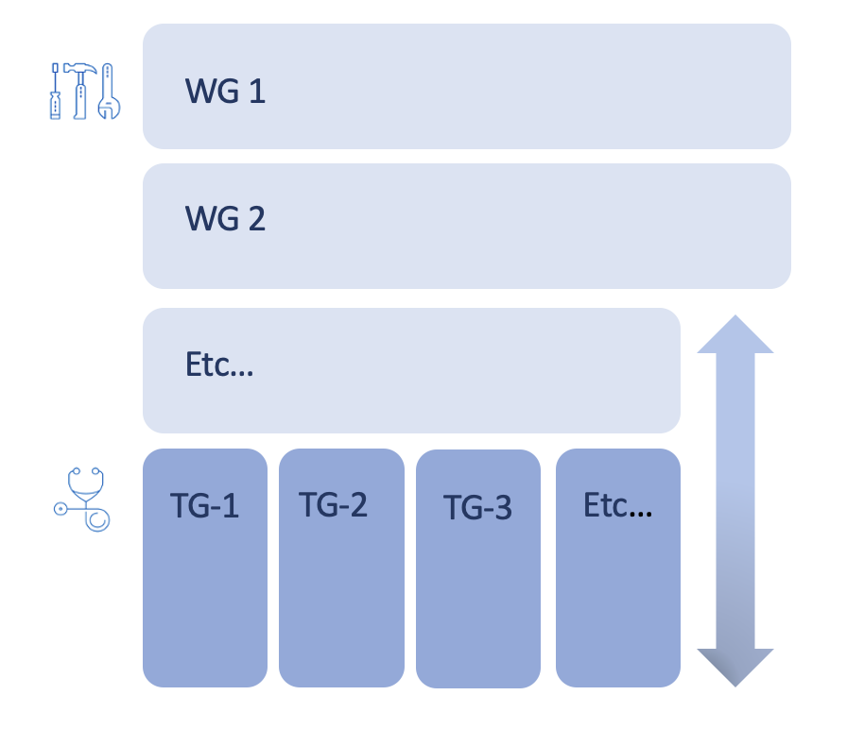
Topic groups x Working groups
WG = Working Groups
TG = Topic Groups

Slide 4
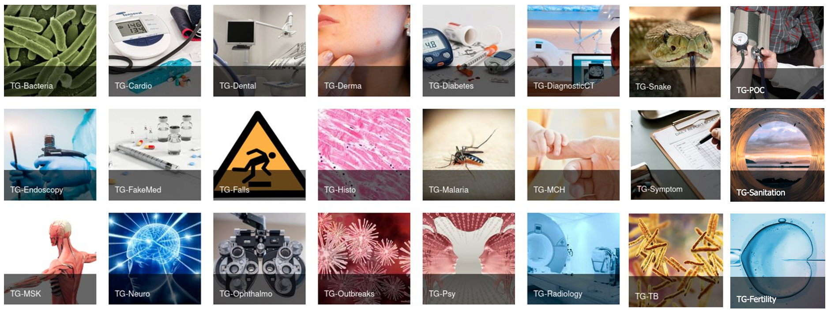
What is a topic group?
specific health/AI use case, e.g., Malaria detection from blood smear images, tuberculosis screening from x-rays
producing evidence and case studies, propose procedures to benchmark AI models, combine experts & data
Topic driver(s) organize work
Developing a topic description document

Slide 5
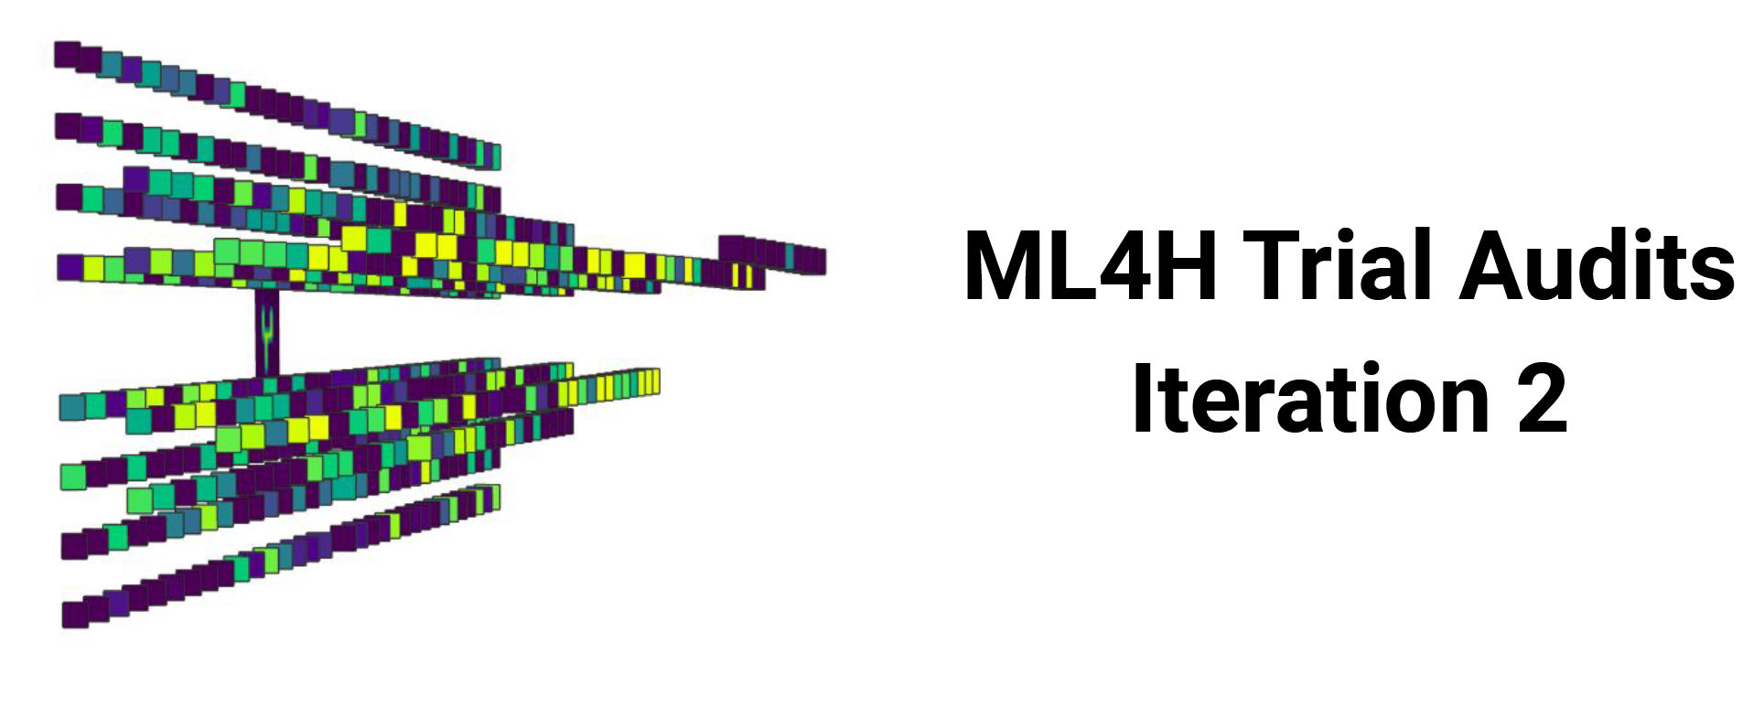
More topic group activities
& Open Code Initiative
Topic groups
Ophthalmology – Malaria – Symptoms – Psychiatry – Snakes – Radiology – Neurology – Outbreaks – Dental – Falls – … tbc
Source: aiaudit.org

Slide 6
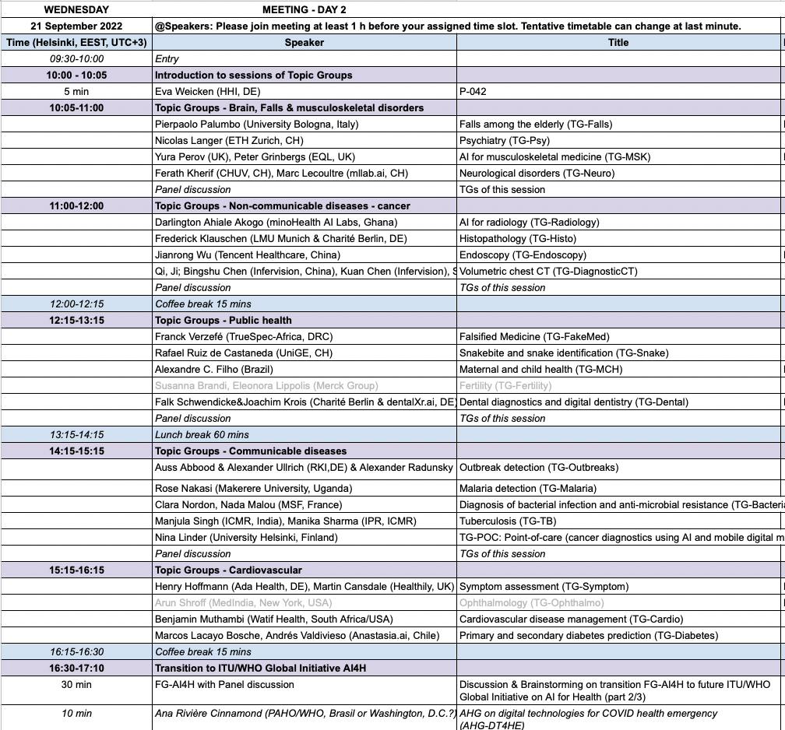
Interactive discussions today
Brief update, overlaps, challenges, publication plans

Slide 7
Thank you!
For any questions & feedback, please contact eva.weicken@hhi.fraunhofer.de

