Slide 1
FGAI4H-P-039-A01
Helsinki, 20-22 September 2022
Source: | University of Turku
Title: | Att.1 – Presentation – Privacy-preserving AI for synthetic and anonymous health data
Purpose: | Discussion
Contact: | Juho Vaiste | E-mail: juho.vaiste@utu.fi
Abstract: | Data-driven technology solutions offer new opportunities in healthcare, for example in sectors such as disease diagnosis, monitoring and follow-up, and self-care. However, data availability is challenging due in part to privacy restrictions. One proposed solution has been to generate synthetic data via differential privacy techniques that provide a guaranteed level of privacy and advanced privacy protection. New machine learning assisted ways of generating synthetic data have shown promising results to the previous problems with the synthetic data in terms of data accuracy and usability.

Slide 2
PRIVASA Privacy-preserving AI for synthetic and anonymous health data
Juho Vaiste, University of Turku
ITU/WHO Focus group 20.9.2022
Notes:
15 min esitys suomeksi

Slide 3
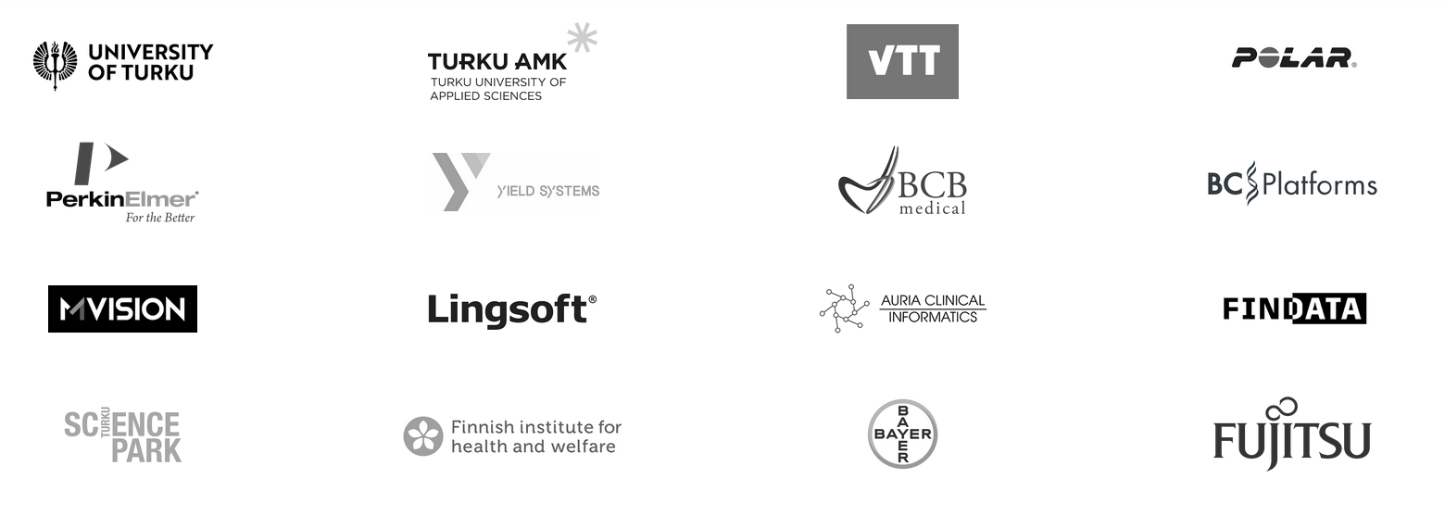
PRIVASA 2021-2023 www.privasa.eu
A Co-Innovation project focused on privacy-preserving AI and synthetic data.
Notes:
2 min

Slide 4
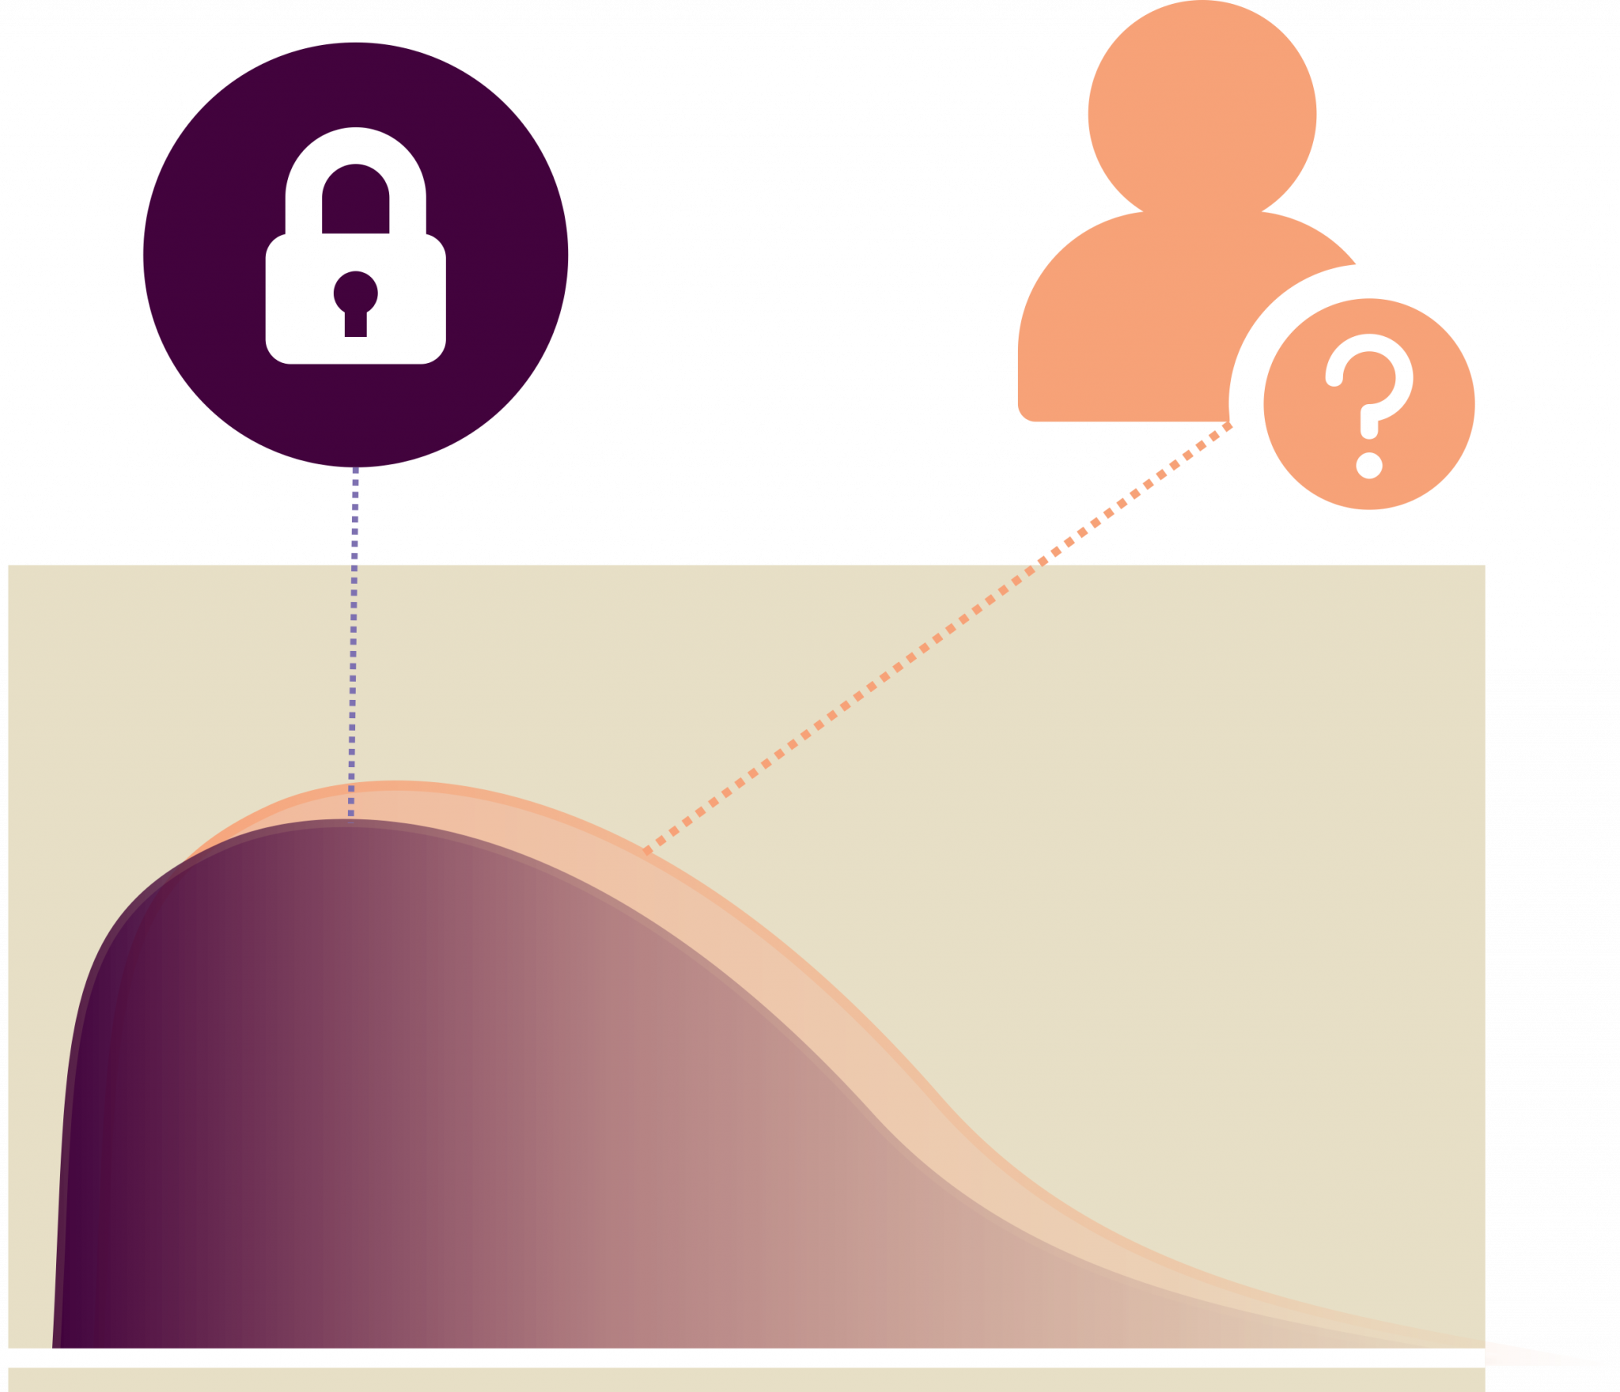
Privacy-preserving AI for synthetic and anonymous health data
The core aim of the project is to add flexibility in the way that health data can be utilized in various stages of product development. This aim extends beyond technical solutions, as it also requires trust-building between owners, holders and users of the data. Transparency, legal aspects and ethics are the cross-cutting themes to be explored throughout the project.
Privacy-preserving:
- Anonymous datasets for faster development cycles
- Safe and efficient hypothesis testing
-
Notes:
3 min

Slide 5
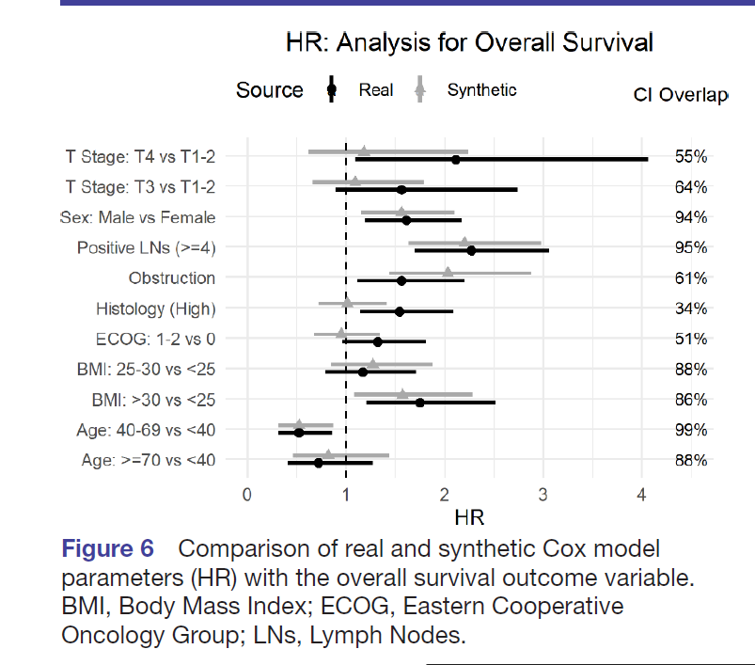
Azizi et al. 2021 Can synthetic data be a proxy for real clinical trial data? A validation study. BMJ Open www.doi.org/10.1136/bmjopen-2020-043497 Open access

Slide 6
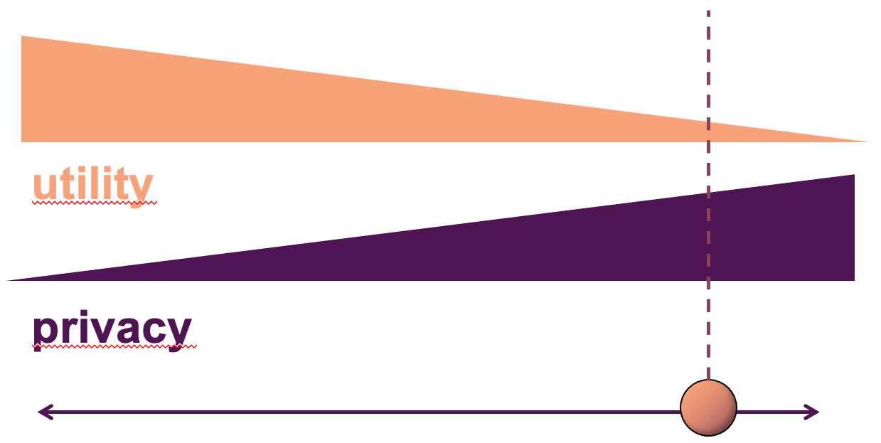
Current insights and results: Synthetic data with differential privacy
- Traditional methods of anonymization , f.ex. Statistical Disclosure Control SDC, have some identified problems, see Sweeney, L. (2002)
1) Subjectivity of choosing sensitive data points
2) Connecting auxiliary information
3) Future risks: available data, processing capabilities (impossible to predict), see e.g. Narayanan, A., & Shmatikov, V. (2008)
- Generating synthetic data with differential privacy offers advantages compared to traditional methods
1) A possibility to estimate privacy risks
2) Privacy guarantees for a maximum breach
3) Guarantees hold on also for future risks
→ Strong privacy protection, but always a tradeoff between privacy vs utility/accuracy → Downsides: technically challenging, requires a lot of expertise (Nieminen, 2022)
Notes:
3 min

Slide 7
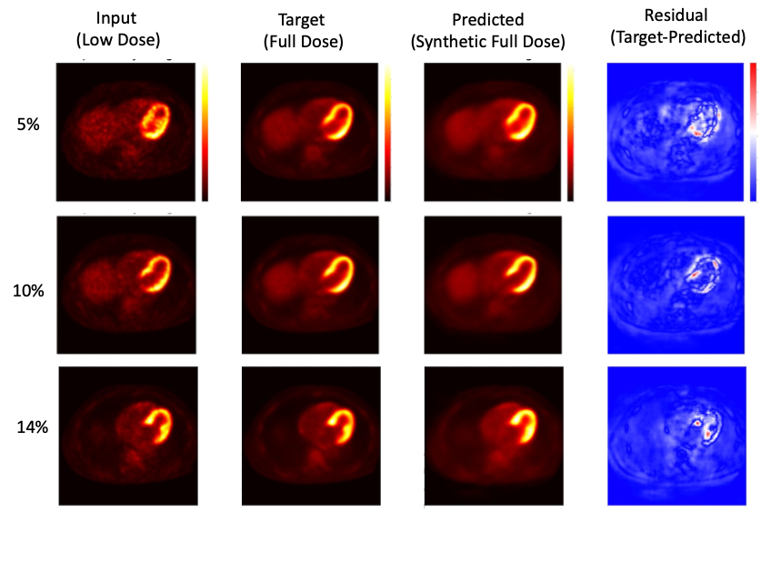
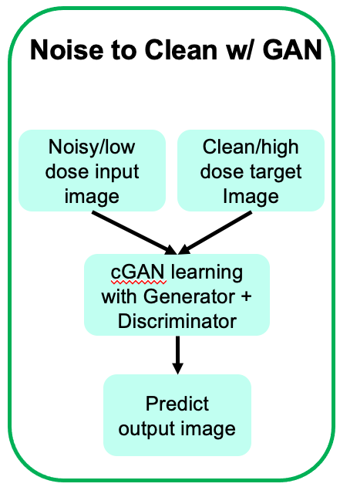
Current insights and results: Generating synthetic full-dose PET images from low-dose images
Generating synthetic full-dose PET images from low-dose images. This reduces the burden of radiation exposure on patients resulting from the injection of radioactive tracers.
Using Pix2Pix, a conditional generative adversarial network (cGAN) that learns a mapping from input images to output images.
Jafari Tadi, M. et al. (2022) Generating synthetic full-dose PET images from low-dose images. To be published.
Synthetic full dose images predicted from low dose input images in three patients (with different resampled LM data) using 2.5D Pix2Pix model.
Jafari Tadi, M. et al. (2022) Generating synthetic full-dose PET images from low-dose images
To be published.
Notes:
3 min

Slide 8
Ethical and regulative problems
- Regulative: in Finland, the use of health data is regulated inter alia by the National Data Protection Act, the EU Data Protection Regulation (GDPR) and the Act on the Secondary Use of Social and Health
- Compliance with GDPR? secondary use permitted if "...rendered anonymous in such a manner that the data subject is not or no longer identifiable" (Regulation 2016/679/EU)
- Following closely the development of EU AI act
Ethics:
- Privacy: Defining and assessing a sufficient level of anonymization is an essential question from the privacy perspective
- Bias/fairness: The synthesized data can also reproduce or amplify the bias of the original data, producing unbalanced results.
- Who determines the level of privacy, and under what conditions?
Notes:
3 min

Slide 9
Notes:
3 min

Slide 10
Notes:
3 min

Slide 11
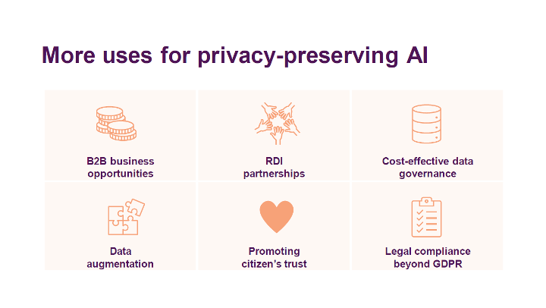
Summary
- A promising approach for enabling some secondary use of health data, but not a quick-fix solution for mass-production of anonymous data
- The approach requires a lot of technical expertise: a possible organizational challenge
- Case-based evaluation of synthetic data and ethical aspects required: privacy assurance and quality assurance
- More than a privacy-preserving mechanism
Notes:
3 min

Slide 12
Thank you!
CONTACT:
Juho Vaiste juho.vaiste@utu.fi
www.privasa.eu

Slide 13
References
Azizi, Z., Zheng, C., Mosquera, L., Pilote, L., & El Emam, K. (2021). Can synthetic data be a proxy for real clinical trial data? A validation study. BMJ open, 11(4), e043497.
Data Protection Act (1050/2018) https://www.finlex.fi/en/laki/kaannokset/2018/en20181050.pdf
Jafari Tadi, M. et al. (2022) Generating synthetic full-dose PET images from low-dose images. To be published.
Narayanan, A., & Shmatikov, V. (2008, May). Robust de-anonymization of large sparse datasets. In 2008 IEEE Symposium on Security and Privacy (sp 2008) (pp. 111-125). IEEE.
Nieminen, V. (2022) Synteettinen data ja yksityisyys. HYTKI-webinaari - Synteettinen data terveysalalla, 28.4.2022.
Regulation (EU) 2016/679 (General Data Protection Regulation)
Sweeney, L. (2002). k-anonymity: A model for protecting privacy. International journal of uncertainty, fuzziness and knowledge-based systems, 10(05), 557-570.
The Finnish Act on the Secondary Use of Social and Health Data (552/2019)
Data
Notes:
3 min

