Slide 1
FGAI4H-P-032-A01
Helsinki, 20-22 September 2022
Source: | WG-DAISAM
Title: | Att.1 – Presentation - ML4H Trial Audits–Iteration 2.0
Purpose: | Discussion
Contact: | Pradeep Balachandran | E-mail: pbn.tvm@gmail.com
Abstract: | This presentation contains the latest updates on the ML4H trial audits–Iteration 2.0 project.

Slide 2
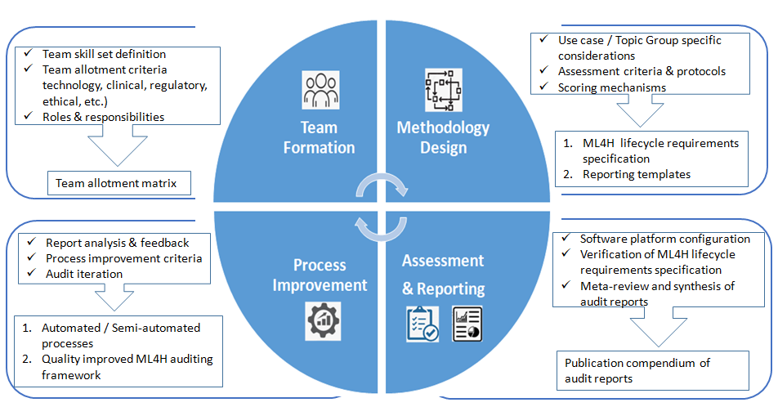
ML4H Audit :Scope
Aims at conducting the verification and validation of the technical, clinical, regulatory and ethical requirements of ML4H solutions developed by the Topic Groups following a structured audit process
Long term goal : Conformity assessment for ML4H product certification

Slide 3
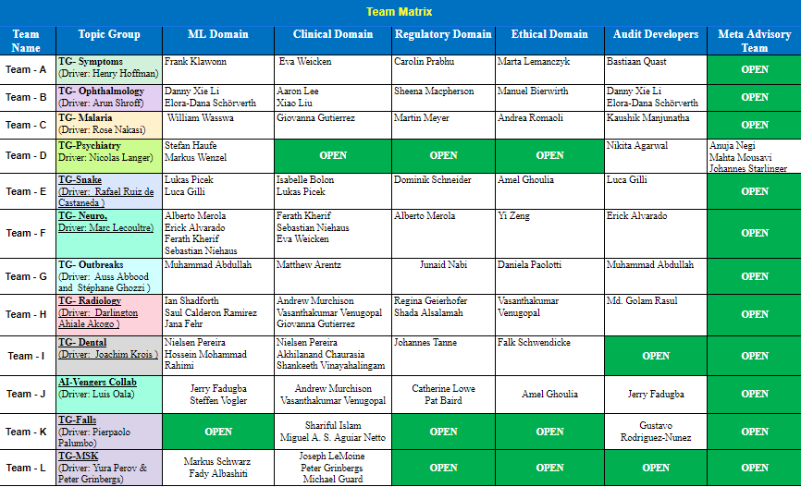

Slide 4
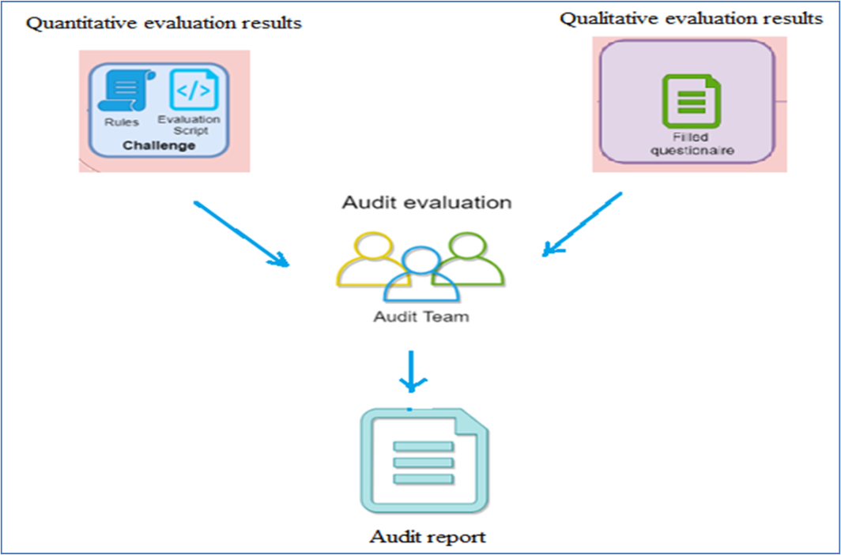
Audit Framework- Utility Additions-1
Qualitative assessment ( audit questionnaire )
Challenge: How to customize the audit questionnaire as per TG specific considerations
Assessment criteria scope
Intended Use
Clinical Workflow Integration
Clinical Effectiveness
Patient Safety
User Data Security & Privacy
Performance Evaluation Results
Risks and Severity
Other TG/ Use-case specific metrics
procedure
Solution: Audit Questionnaire customization procedure implemented

Slide 5
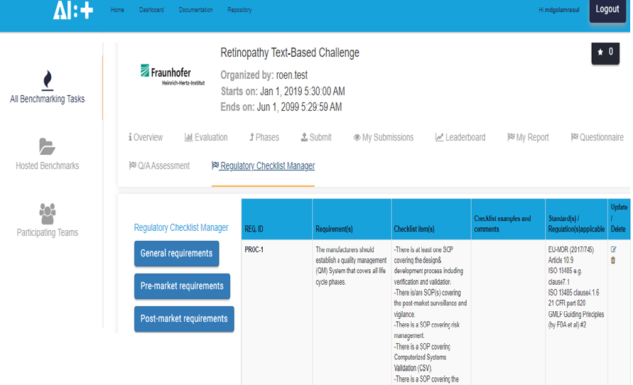
Audit Framework- Utility Additions-2
Started implementing “Regulatory Checklist Manager” as an ML4H audit workflow utility over the FG-AI4H Assessment platform

Slide 6
Progress Chart
 | Progress Chart
 | Assessment Platform on boarding | Audit –Qualitative & Quantitative assessment | Audit Report Generation | JoMS / Peer Journal manuscript preparation
Teams | Stage I | Stage II | Stage III | Stage IV
TG-MSK | ✓
TG-Neuro | ✓
AI-Vengers-Collab | ✓
TG-Symptoms | ✓
TG-Radiology | ✓ | ✓ | ✓
TG-Ophthalmology | ✓ | ✓ | ✓
TG-Falls | ✓ | ✓ | ✓
TG-Psychiatry | ✓ | ✓ | ✓ | ✓
TG-Outbreaks | ✓ | ✓ | ✓ | ✓
TG-Dental | ✓ | ✓ | ✓ | ✓

Slide 7
Audit Outreach

Slide 8
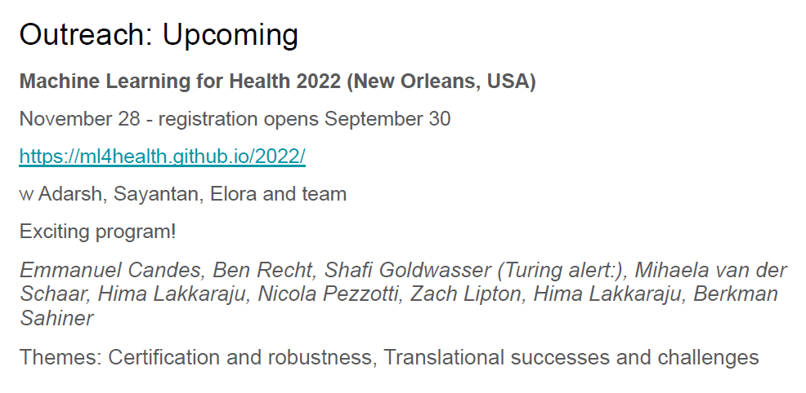
Audit Outreach

Slide 9
Thank you

