Slide 1
FGAI4H-P-026-A03
Helsinki, 20-22 September 2022
Source: | TG-MSK Topic Drivers
Title: | Att.3 - Presentation (TG-MSK)
Purpose: | Discussion
Contact: | Peter Grinbergs (EQL, UK) & Yura Perov (Independent Contributor, UK) | E-mail: tgmskorg@googlegroups.com (the email is read by Peter, Yura and their associate(s))
Abstract: | This is for presentation and discussion during the focus group meeting.

Slide 2
Background & Relevance
“Musculoskeletal conditions comprise more than 150 diagnoses that affect the locomotor system; that is, muscles, bones, joints and associated tissues…” [1]
Painful MSK conditions affect 20-33% of the world's population [1].
According to the WHO, “[Musculoskeletal] conditions are the leading contributor to disability worldwide, with low back pain being the single leading cause of disability globally. ... MSK conditions significantly limit mobility and dexterity, leading to early retirement from work, reduced accumulated wealth and reduced ability to participate in social roles. The greatest proportion of non-cancer persistent pain conditions is accounted for by MSK conditions. ... MSK conditions are commonly linked with depression and increase the risk of developing other chronic health conditions” [1].
Up to 30% of consultations carried out by primary care doctors in the UK (as an example) are for MSK conditions [2].

Slide 3
Topic Group’s Goal
The topic group is dedicated to AI/ML applications for MSK medicine. It is dedicated to establishing standardised benchmarking guidelines.
That includes specifying input data and outputs of AI systems for different AI tasks for MSK medicine.
Relevant areas for the topic group: prevention strategies, triage (in particular identifying urgency), diagnosis, prognosis and treatment of musculoskeletal (MSK) conditions with the applications of artificial intelligence (AI) and machine learning (ML) approaches including computer vision (CV), augmented and virtual reality (AR/VR), natural language processing (NLP), natural language understanding and other approaches.

Slide 4
The current focus
Prediction for and prevention of MSK conditions, including:
recovery, improvement, risk identification (e.g. prediction/probability estimation),
risk reduction (including new conditions, worsening of MSK condition states, etc.).

Slide 5
Updates
Two new members (now 11 members in total)
Six topic group meetings
Updates to the document with synthetic cases
Comments/documents received and some of those have been discussed
Work in regard to the audit

Slide 6
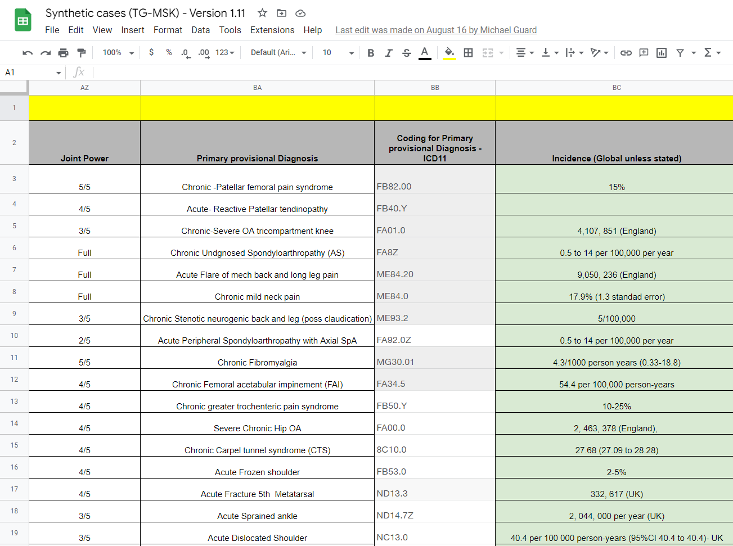
Update to the document with synthetic cases

Slide 7
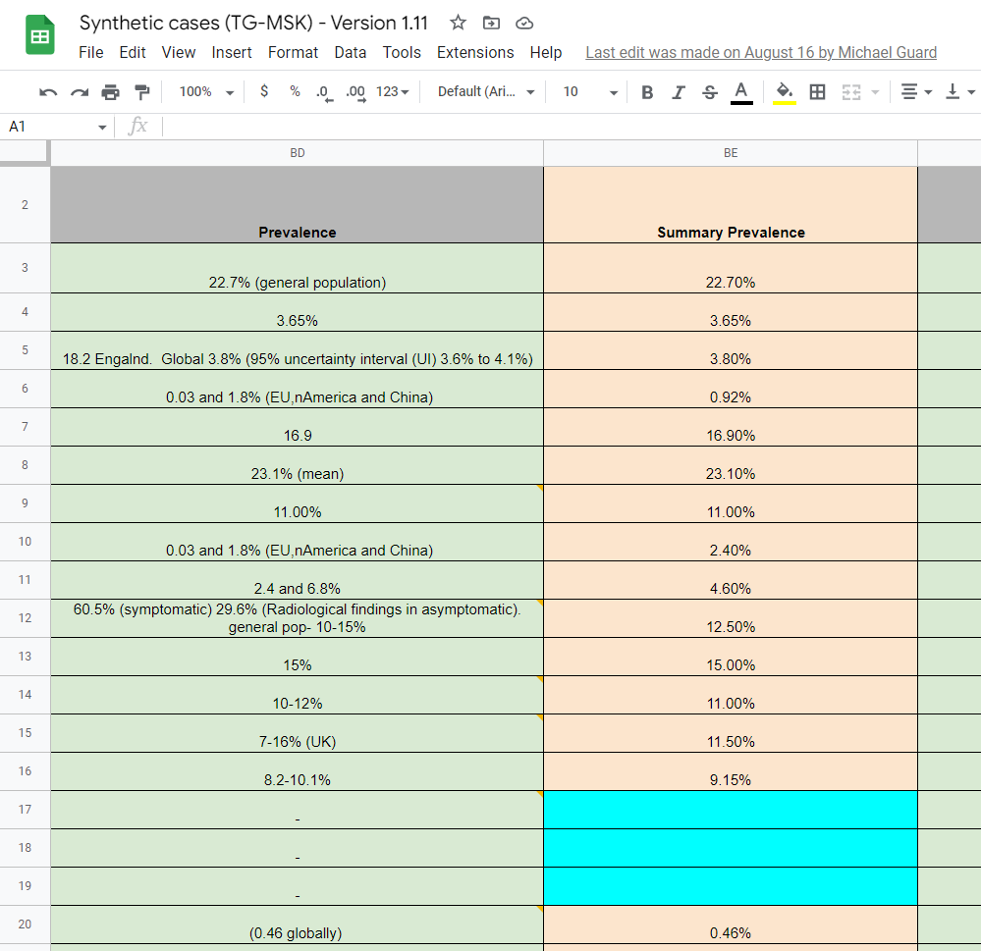
Update to the document with synthetic cases

Slide 8
References
[1] "Musculoskeletal conditions" on WHO website. https://www.who.int/news-room/fact-sheets/detail/musculoskeletal-conditions
[2] "Musculoskeletal" page on NHS England website. https://www.england.nhs.uk/elective-care-transformation/best-practice-solutions/musculoskeletal/

