Slide 1
FGAI4H-P-023-A03
Helsinki, 20-22 September 2022
Source: | TG-Radiology Topic Driver
Title: | Att.3 – Presentation (TG-Radiology)
Purpose: | Discussion
Contact: | Darlington Ahiale Akogo minoHealth AI Labs Ghana | Email: darlington@gudra-studio.com
Abstract: | This PPT contains a presentation of P-023-A01.

Slide 2
Topic Group on AI for Radiology: Audit Trial, Sep 22
Darlington Akogo Topic Driver
Founder, CEO
minoHealth AI Labs
darlington@gudra-studio.com

Slide 3
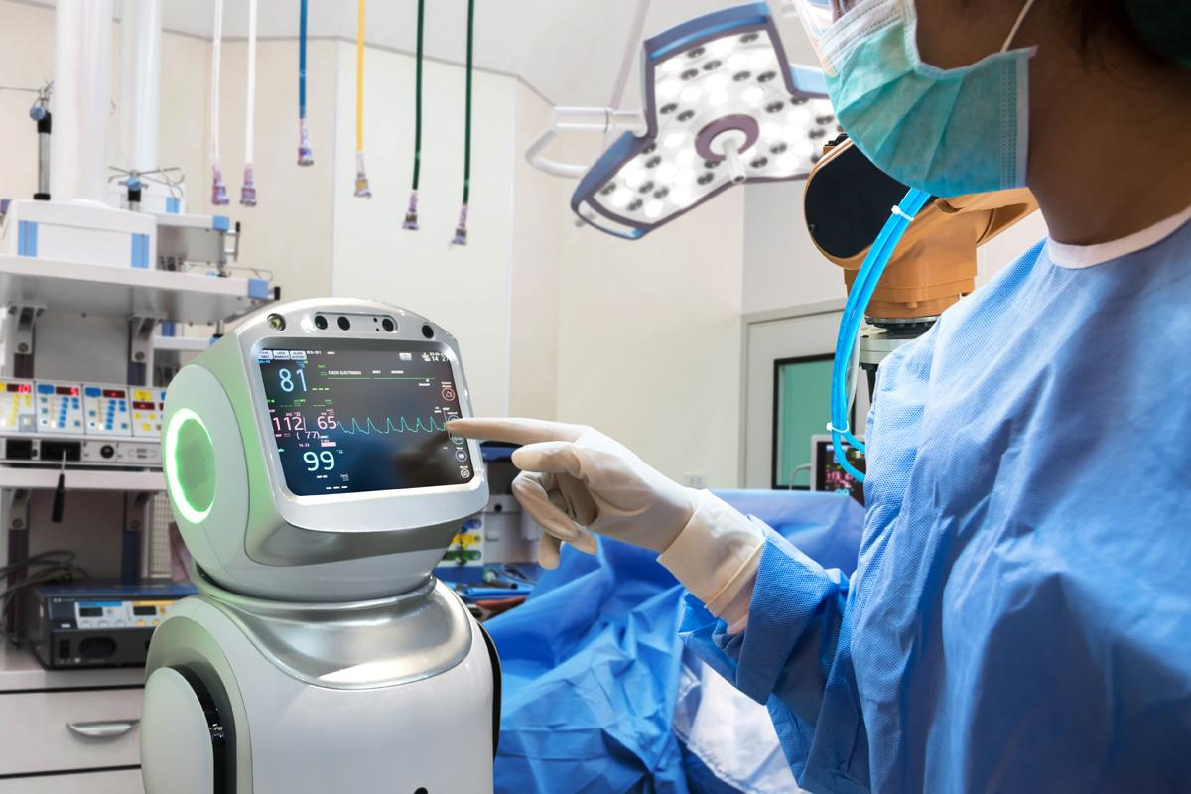
Audit Team
1. Andrew Murchison (Clinical Expert) 3. Giovanna Gutierrez (Clinical Expert) 4. Ian Shadforth (ML Expert) 5. Jana Fehr (ML Expert + Clinical Expert) 6. Md. Golam Rasul (Software Platform Expert / Audit Developer) 7. Regina Geierhofer (Regulatory Expert) 8. Saul Calderon Ramirez (ML Expert + Regulatory Expert) 9. Shada Alsalamah (ML Expert + Clinical Expert + Regulatory Expert) 10. Vasanthakumar Venugopal (ML Expert + Clinical Expert + Ethical Expert) 11. Vincent Appiah 12. Issah Abubakari Samori 13. Judy Wawira Gichoya 14. Dominik Stosik 15. Edson Mintsu Hung

Slide 4
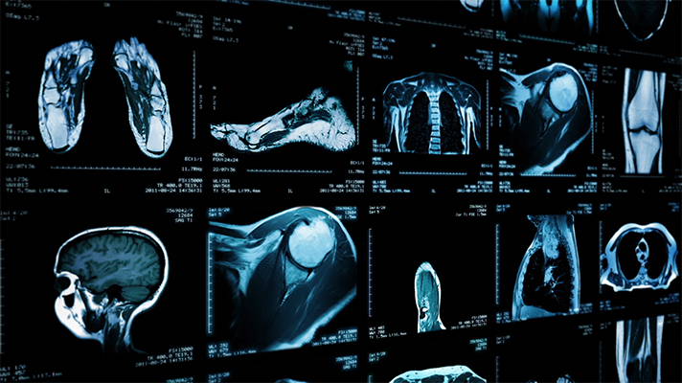
AI in Radiology - Use Case
Diagnosis of COVID-19 via Chest X-Ray Undisclosed Test Data (Vasantha): 917 cases 436 RTPCR+ cases 481 COVID negative cases Open source models for audit trial: https://github.com/velebit-ai/COVID-Next-Pytorch https://github.com/lindawangg/COVID-Net

Slide 5
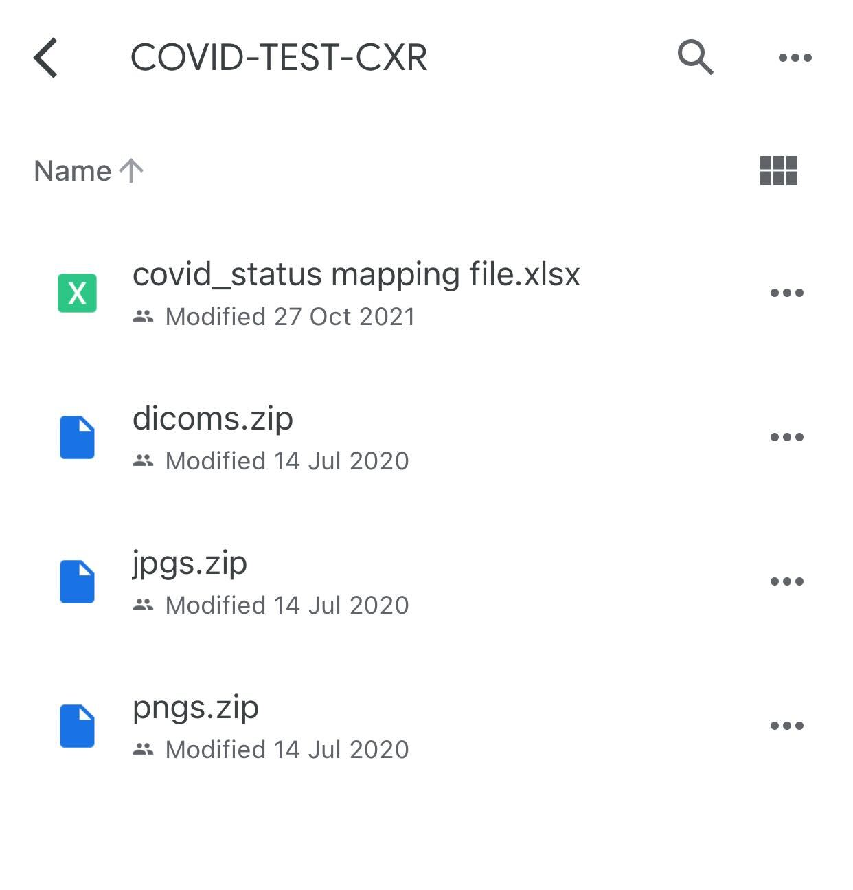

Slide 6
Audit Verification Checklist
Completed
Link: https://docs.google.com/document/d/1y9diy9cdM9dIakCttlsDR3xxrKSwbrlYQ9C-EWWJXAA/edit#heading=h.gjdgxs
Findings:
Very detailed
Too long, can be reduced
Some items can be combined

Slide 7
Audit Challenge
Link: https://health.aiaudit.org/web/challenges/challenge-page/174/overview
Creating the TG-Radiology Audit challenge on health.aiaudit.org
Added in metrics (precision, recall, AUROC, accuracy, F1 score)

Slide 8
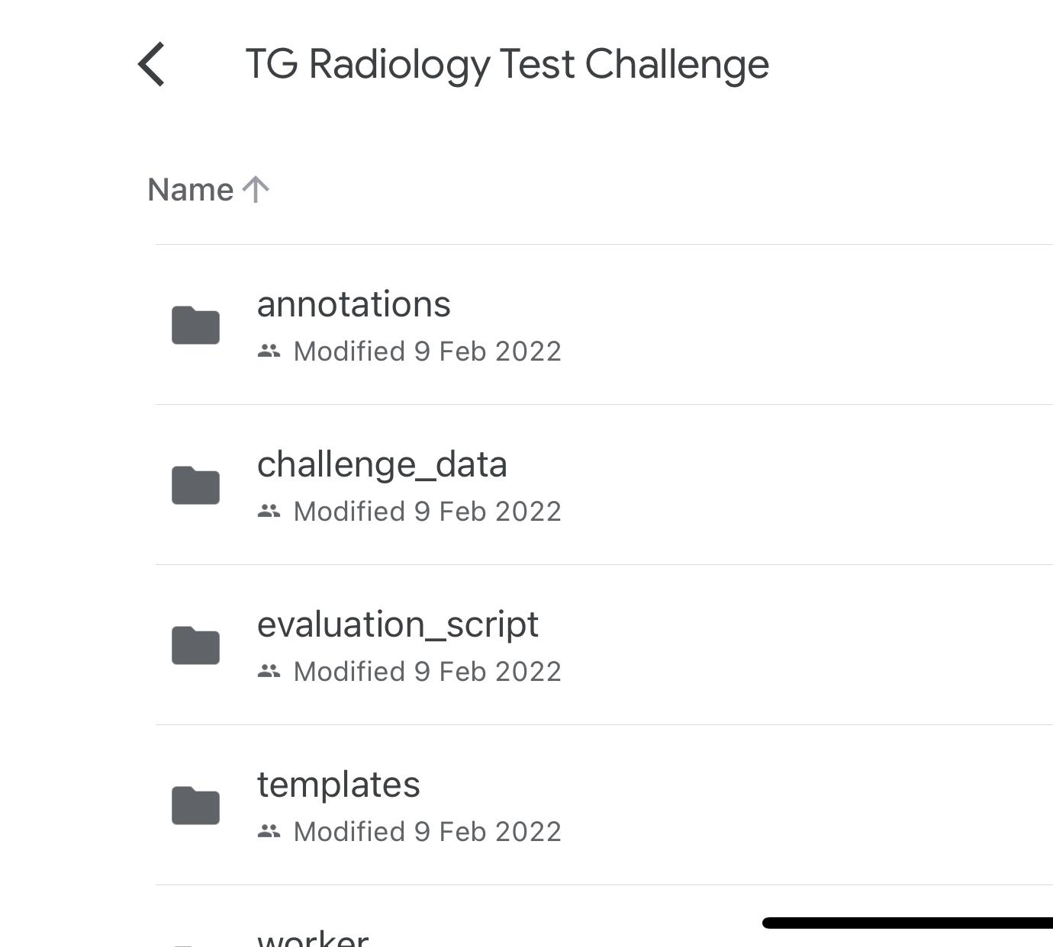

Slide 9
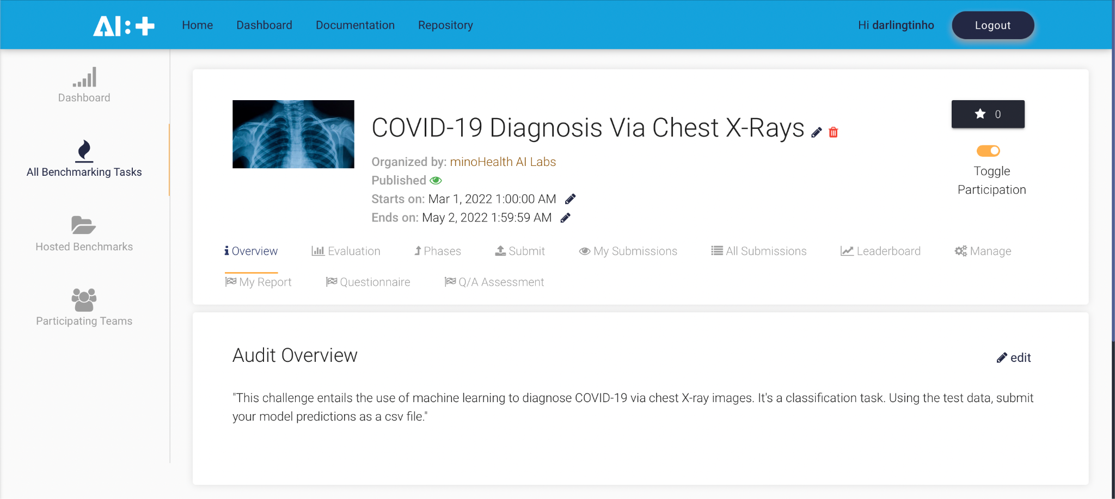

Slide 10
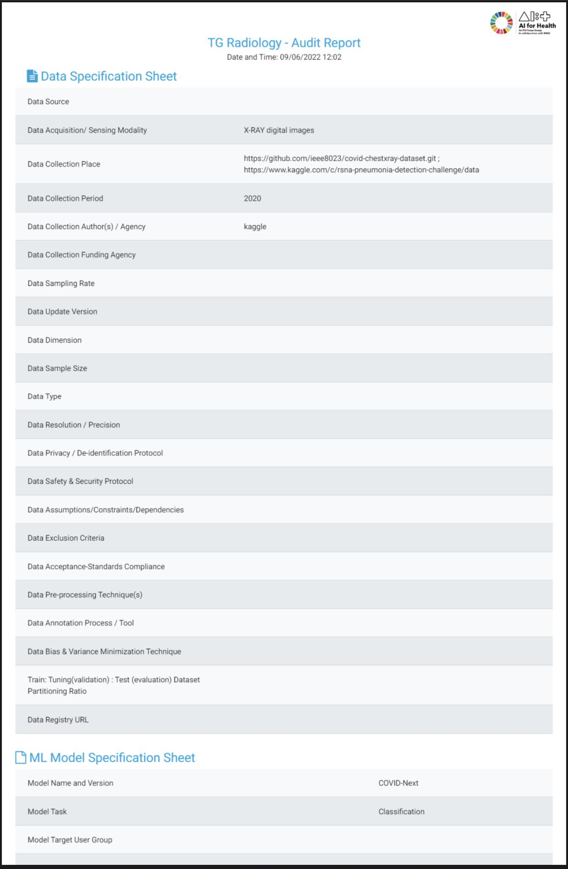
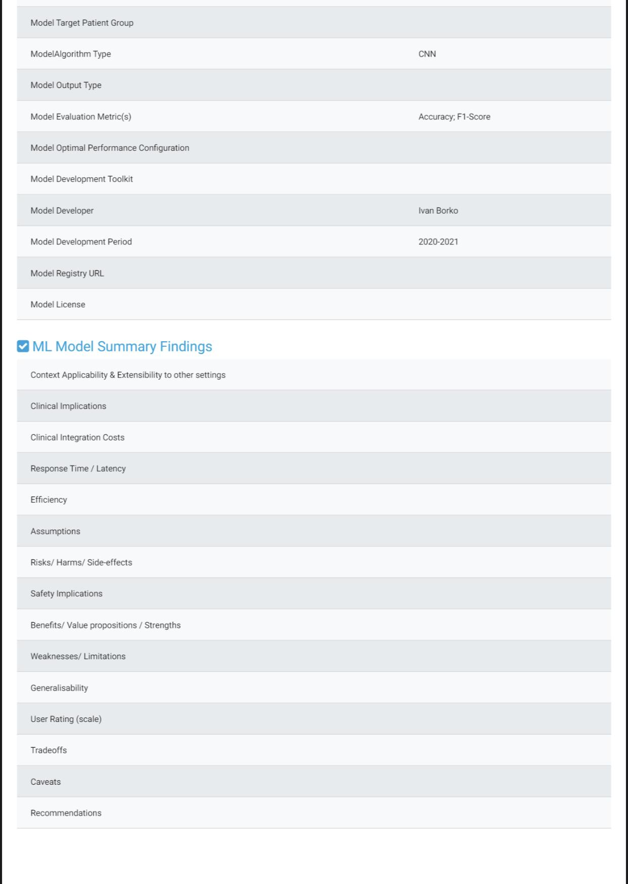

Slide 11
Clinical Evaluation Of AI For Chest Condition Diagnosis In Ghana
MinoHealth AI Labs is conducting clinical evaluations of AI systems for the diagnosis of chest conditions, including cardiomegaly and pleural effusion. 2 AI systems developed were benchmarked against radiologists in Ghana.
Results will be shared at the ITU Kaleidoscope in Ghana, December 22.
We are working on the risk assessments and software varification reports for FDA approval.

Slide 12
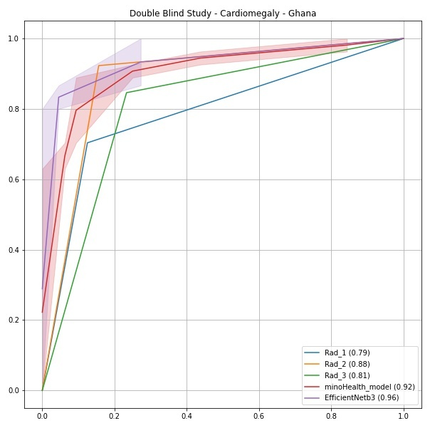
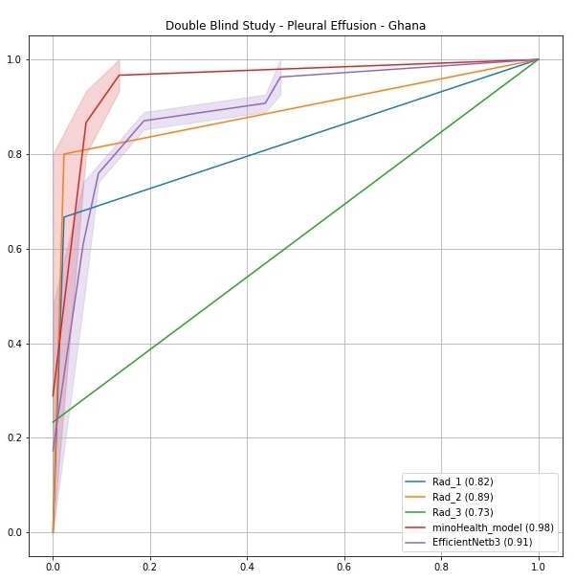

Slide 13
Clinical Evaluation Of AI For Chest Condition Diagnosis In Ghana: Evaluation Metrics
Negative Predictive Value is important, though not popularly used in ML.
The negative predictive value is a metric that computes the fraction of true negative predictions among the outcomes that the model classified as negative. This is useful for use cases where the false negative predictions are costly.
It is different from Specificity.

Slide 14
Topic Group on AI for Radiology: Audit Trial
Darlington Akogo Topic Driver
Founder, CEO
minoHealth AI Labs
darlington@gudra-studio.com

