Slide 1
FGAI4H-P-021-A03
Helsinki, 20-22 September 2022
Source: | TG-Symptom Topic Co-Driver
Title: | Att.3 – Presentation (TG-Symptom)
Purpose: | Discussion
Contact: | Henry Hoffmann | E-mail: henry.hoffmann@ada.com
 | Martin Cansdale | E-mail: martin@livehealthily.com
Abstract: | This PPT summarizes the status of work within TG-Symptom, for presentation and discussion during the meeting.

Slide 2
Meeting O Update for the
Topic Group “Symptom Assessment”
Topic Group:
Symptom Assessment
Update for Meeting P
Berlin, 31 May – 2 June 2022

Slide 3
AI-based Symptom Assessment
Mobile/Web Applications – sometimes called ”Symptom Checkers” that
Allow users to enter (INPUT)
Patient information (age, sex…)
Current presenting complaints (symptoms, free text)
To then engage in a dialog similar to a doctor collecting (INPUT)
Additional symptoms, findings, factors, attributes, investigations (lab, imaging, genetics…)
To finally provide the user with (OUTPUT)
Pre-clinical triage (emergency, see doctor today, self-care…)
Possible causes (disease A 93%, B 73% - e.g. in ICD10, SNOMED CT)
Additional recommended investigations, treatment advice, explanations

Slide 4
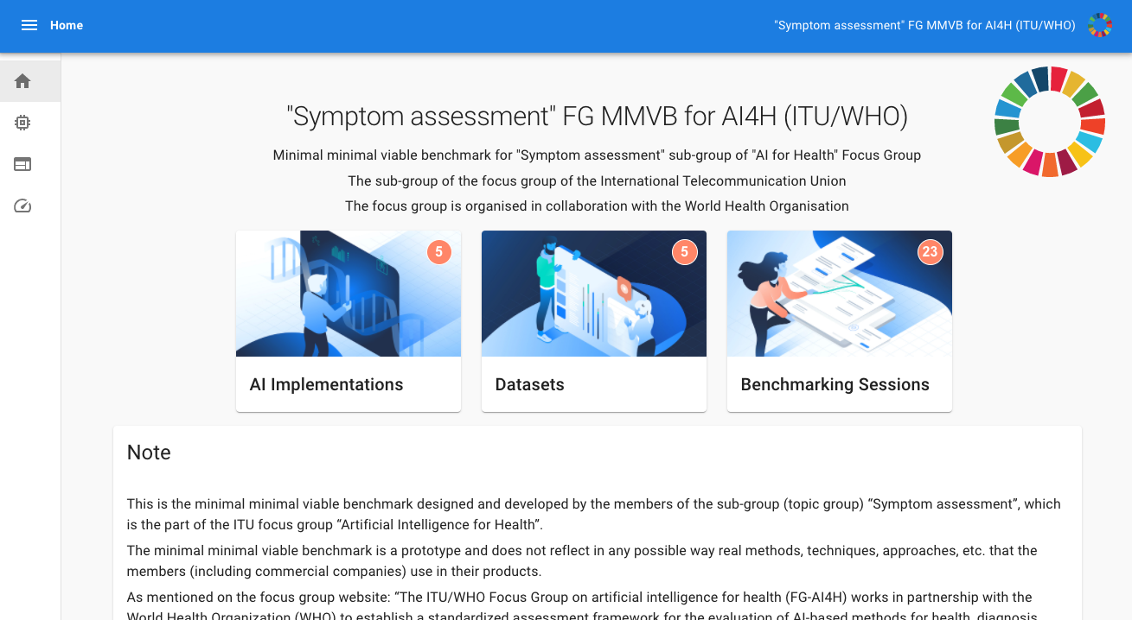
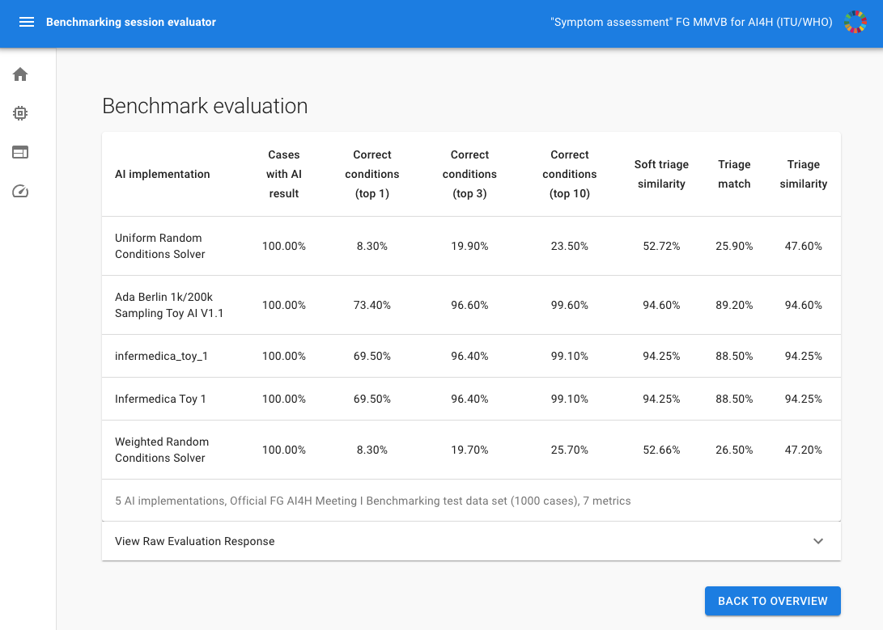
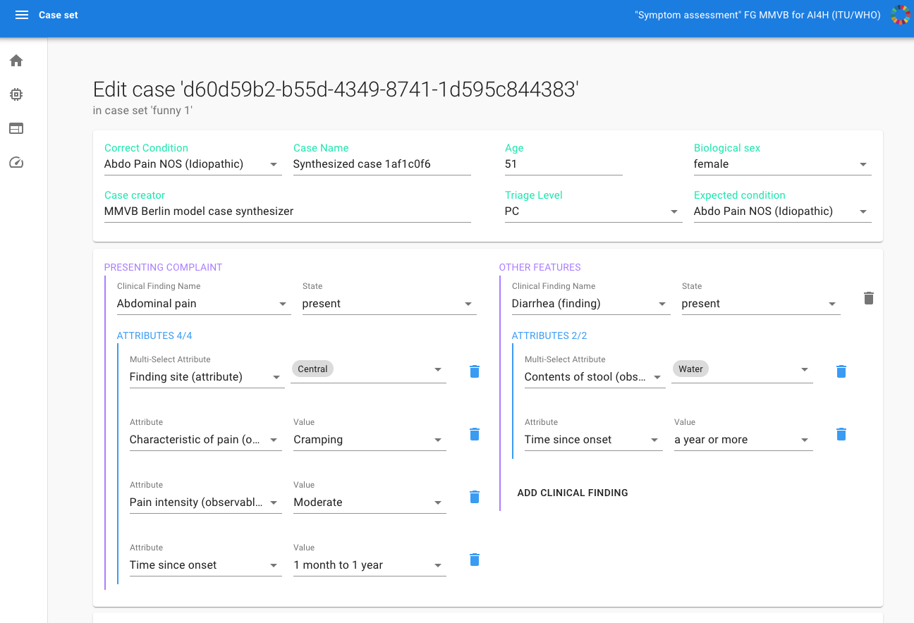
Benchmarking Approach
General approach
Started with toy AI and toy data to build a benchmarking system
Stepwise increasing complexity
Learn all the relevant details for the real benchmarking
Benchmarking approach
MMVB 2.2 with annotation tool and benchmarking process
Toy Ais: Ada, Babylon, Infermedica, Healthily (all cloud hosted)
Integrate annotation tool with open-code initiative annotation, evaluation, and reporting packages
Annotation tool implementation work
Testing of AI ontology mapping by TG doctors
Continuous updates of the annotation tool according to feedback
Migrating cases to FHIR/SNOMED CT format

Slide 5
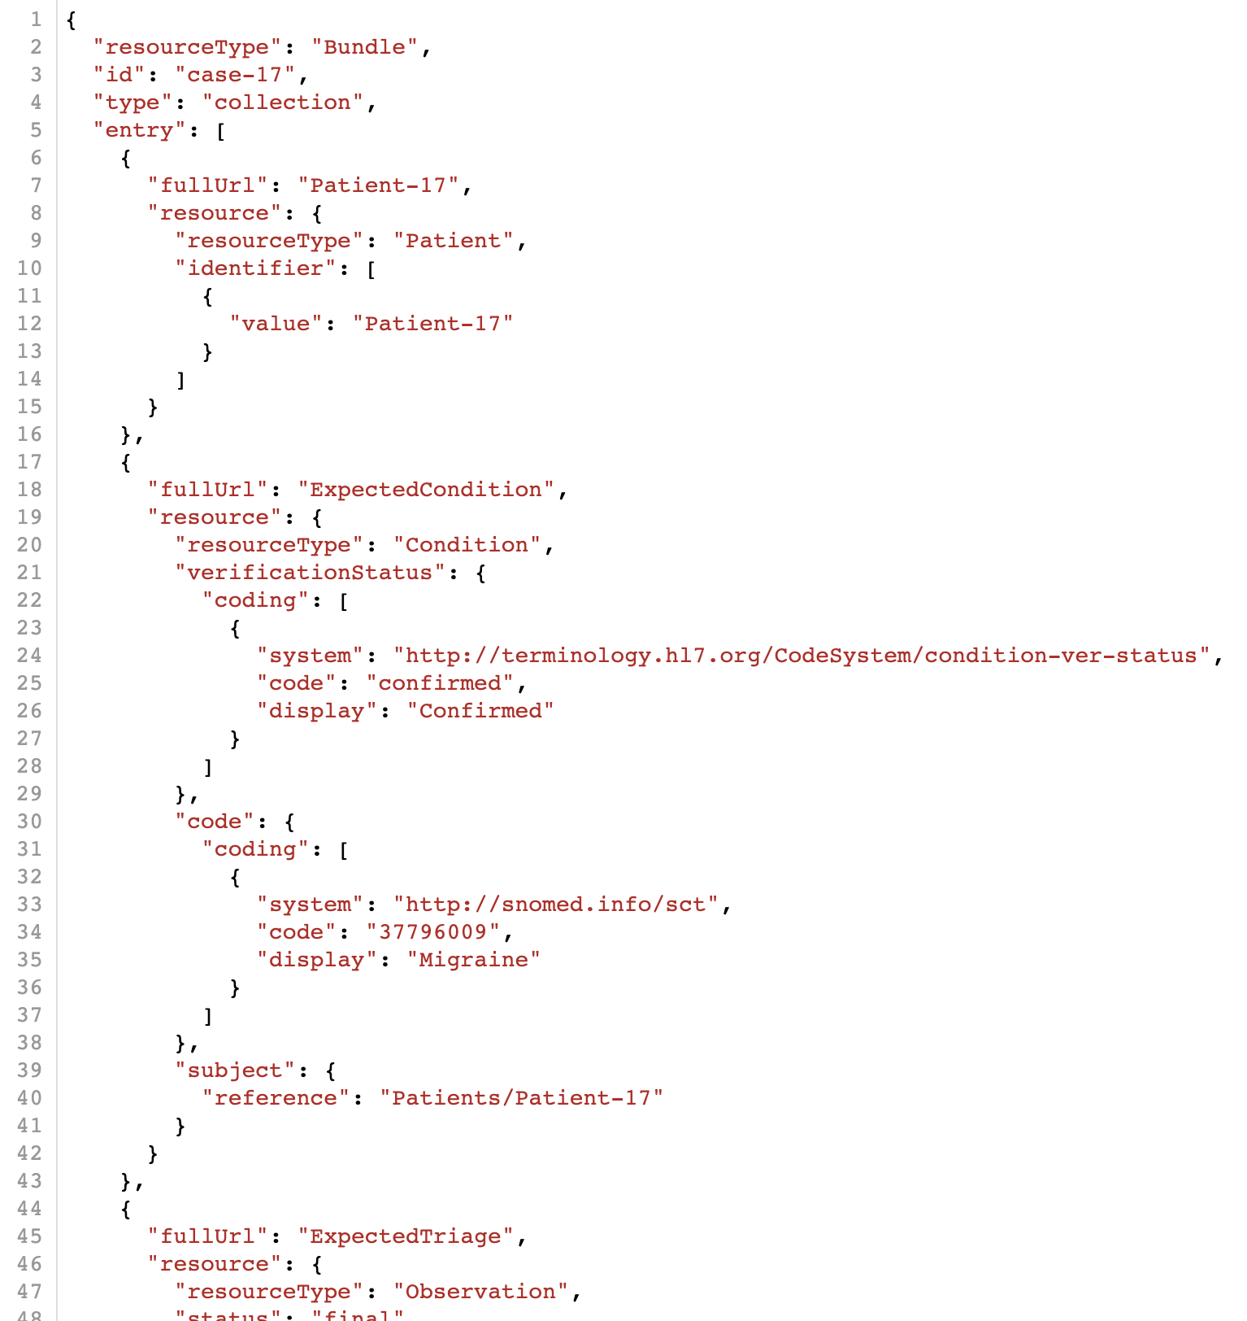
Technical Work
Test case storage and communication formats
FHIR compliant format for storing test cases developed
Testing storage of existing cases in new FHIR format
Next: finalising the FHIR interface for communication with the symptom checker AIs
Annotation tool/AIs/OCI integration next steps
Converting the annotation tool to provide cases in FHIR JSON format
Implementing the connection to the OCI platform
Adjusting AI interface to new FHIR format, and updating toy/real AIs
Updating audit benchmarking to use FHIR format inputs/outputs

Slide 6
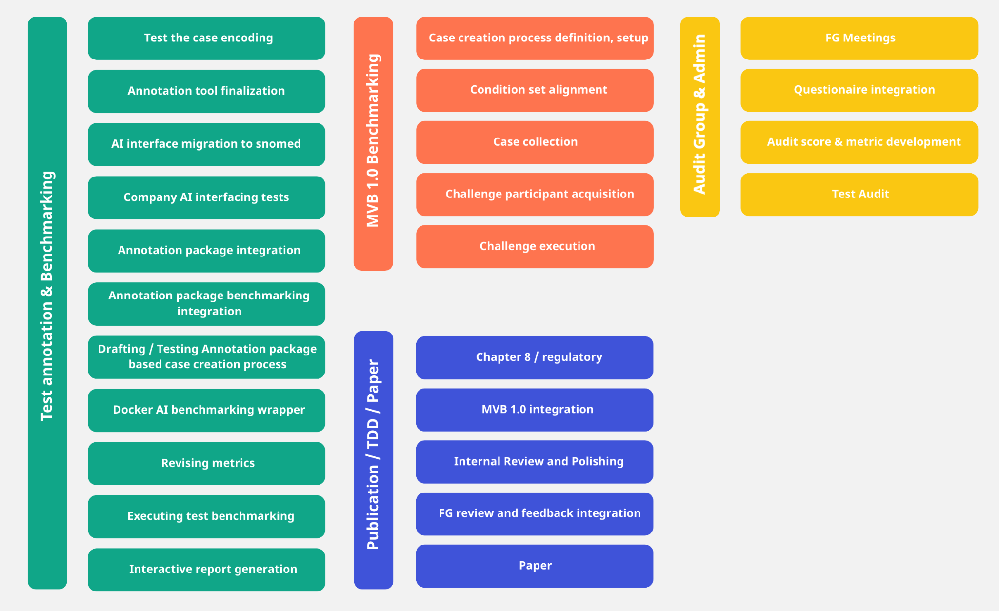
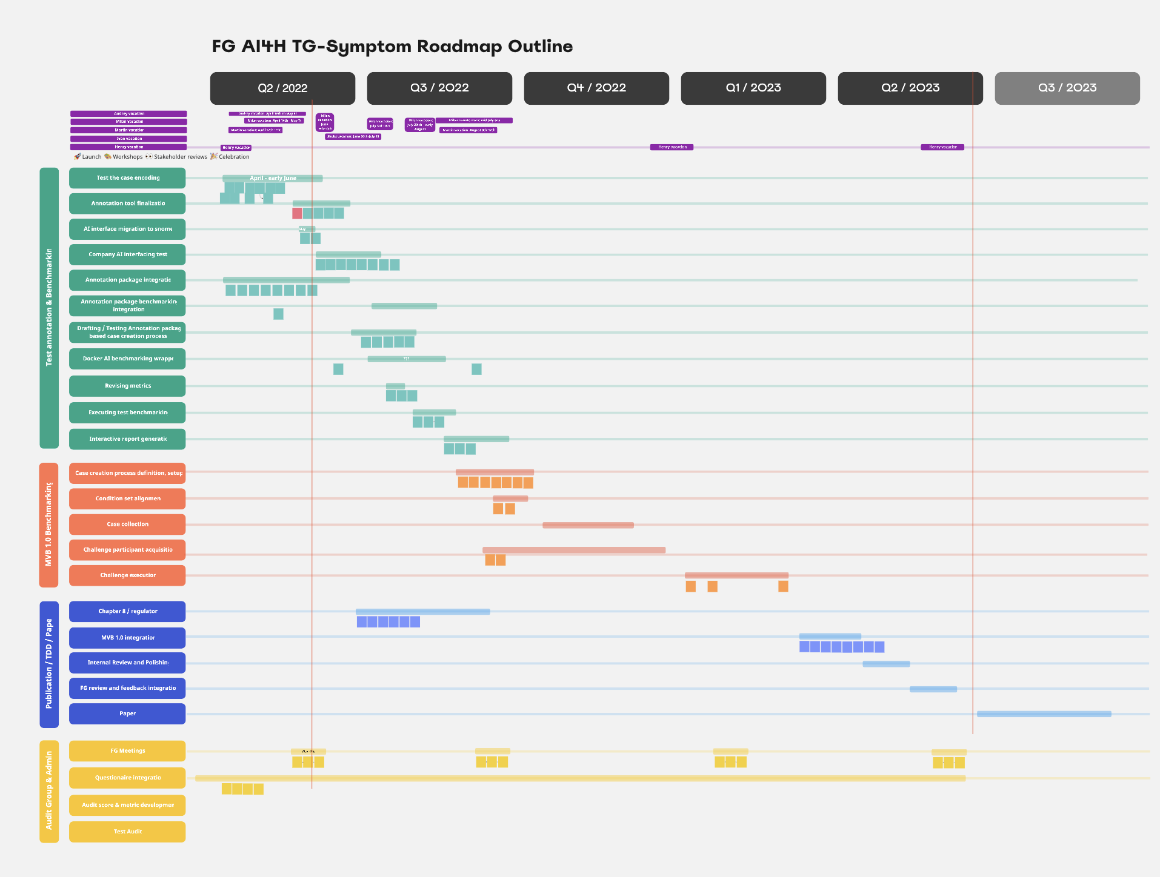
Non-Technical Work
General
Testing annotation tool with a wider group of doctors and gathering feedback
Extending and revising annotation guidelines
Topic Description Document (TDD)
Almost complete, but on hold until we implement benchmarking with real data and a real AI - until mid-2023 batch
Audit Group Cooperation
Audit questionnaire testing within topic group
Publication after TDD publication mid-2023
Next: evaluating and revising questionnaire based on testing

Slide 7
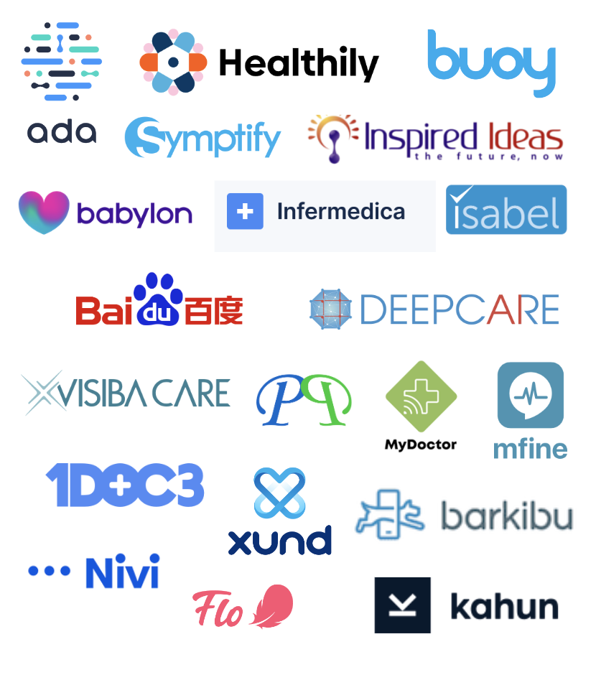
Thank you!
WHO/ITU FG AI4H TG Symptom Assessment
Meeting P Update
Helsinki, 20 – 22 September 2022

