Slide 1
FGAI4H-P-016-A03
Helsinki, 20-22 September 2022
Source: | TG-Neuro Topic Driver
Title: | Att.3 - Presentation (TG-Neuro)
Purpose: | Discussion
Contact: | Ferath Kherif CHUV - LREN Switzerland Marc Lecoultre Switzerland | E-mail: Ferath.kherif@chuv.ch
Abstract: | This PPT summarizes the status of work within TG-Neuro, for presentation and discussion during the meeting.

Slide 2
TG-Neuro
Aim: investigate machine learning-based diagnostics for neurodegenerative diseases (Alzheimer's disease, Parkinson's Disease, and related dementia syndromes, which are located within the neurological domain of the DSM V) based on real-world imaging and genetic information.
Relevance: As the population ages, the chance of becoming demented is on the rise. Current estimates suggest that there are approximately 48 million people worldwide suffering from dementia.
The social cost of care to 1% of world’s gross domestic product – GDP.
These statistics led the World Health Organization to classify neurocognitive disorders as a global public health priority.

Slide 3
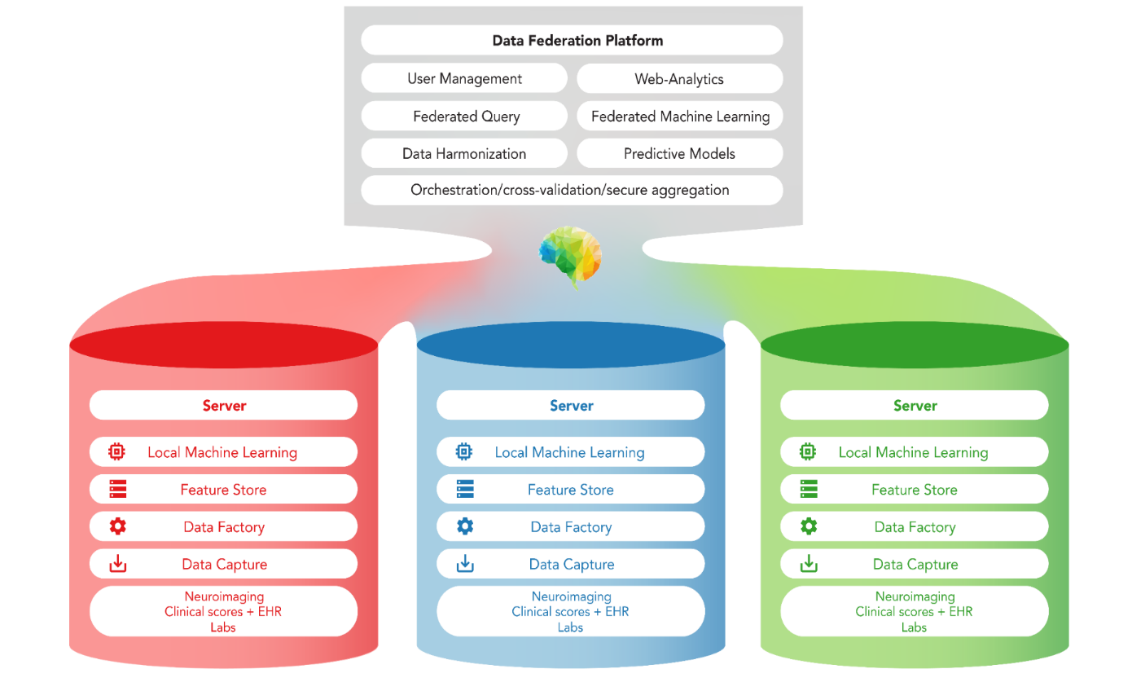
TG-Neuro Centralised and federated approach
Whole Brain images from MRI, PET or CT scans.
Image File Format: DICOM or NIFTI format
Image File Names: Images names will be anonymised to exclude any patient identifying information.
Image Resolution: the images will be supplied in their original resolution as captured from the MRI scanner
HUB
Count Vascular lesion
History
Genetic
Memory Score
Executive functioning scores
Co-morbidity symptoms
Verbal fluency
Delayed memory scores
Motor scores
Psychiatric questionnaires
Alcohol Use
Temperature
The diagnosis of cognitive disorders an disease severity:
Alzheimer's Diseas
Mild cognitive impairment (MCI)
Cognitively normal (CN)
Other Mixed Dementia (MD)

Slide 4
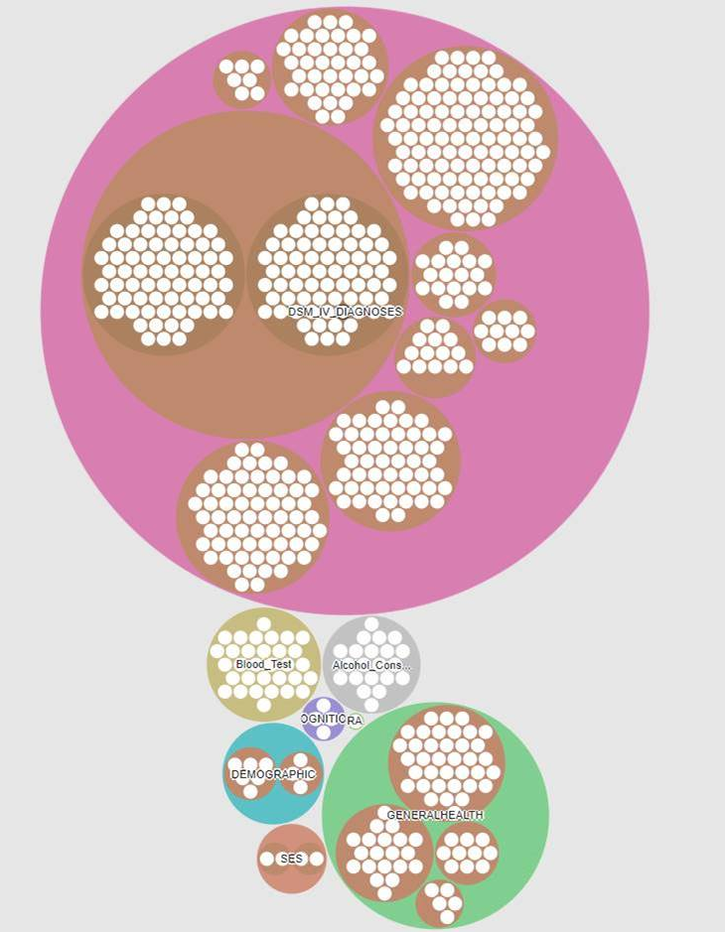
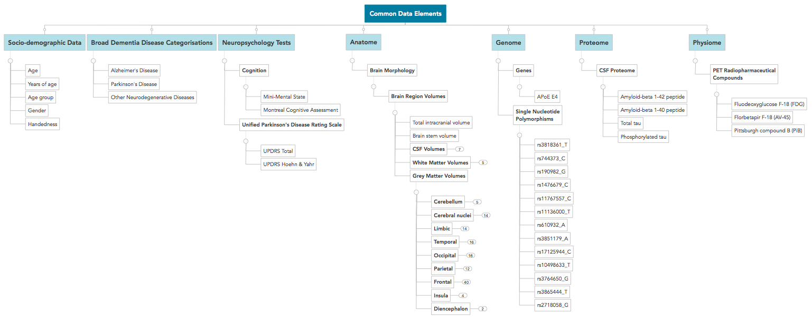
Data Catalogue
Dementia and general Population Data

Slide 5
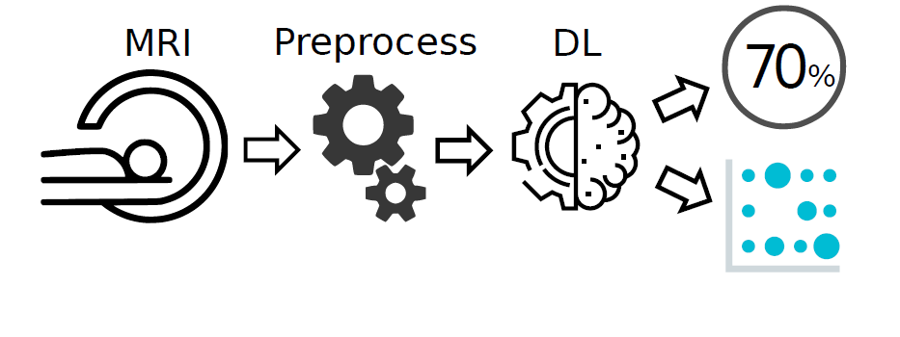
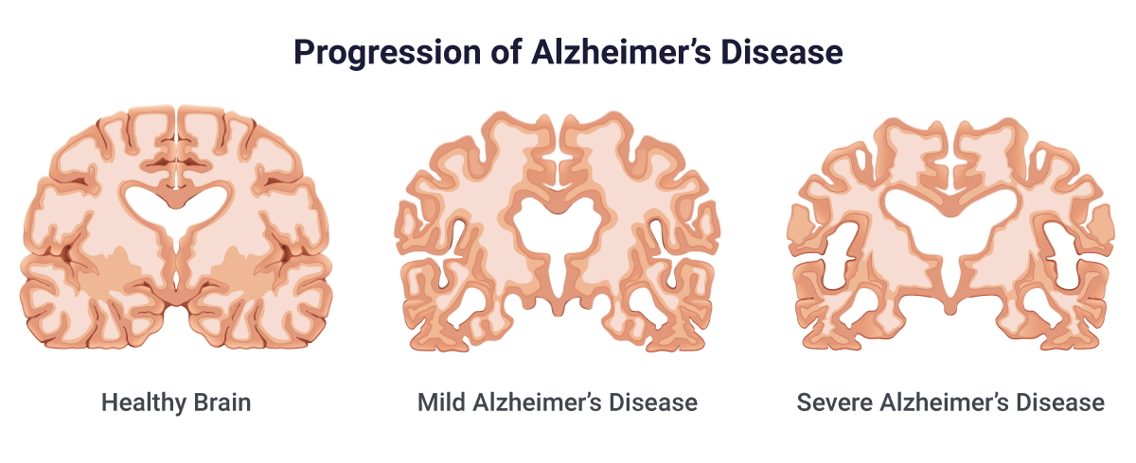
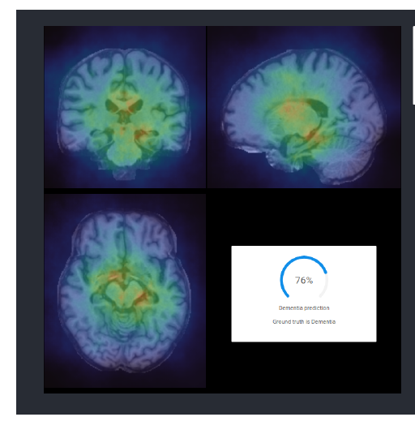
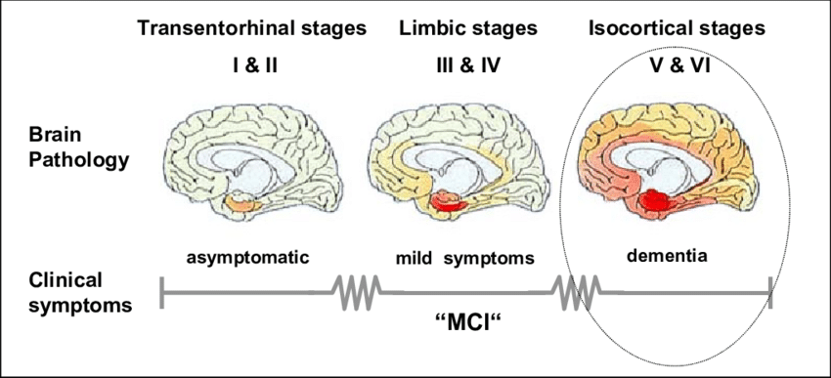
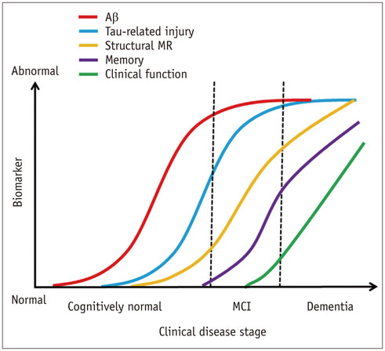
Moving beyond classification diagnostic
Dynamic systems

Slide 6
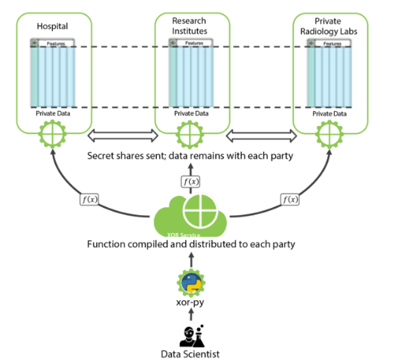
TG-Neuro Federated Learning (FL) and secret sharing
Cloud computing and
Hardware acceleration
FPGA hardware acceleration
In collaboration
Secure Multi-Party Computation

Slide 7
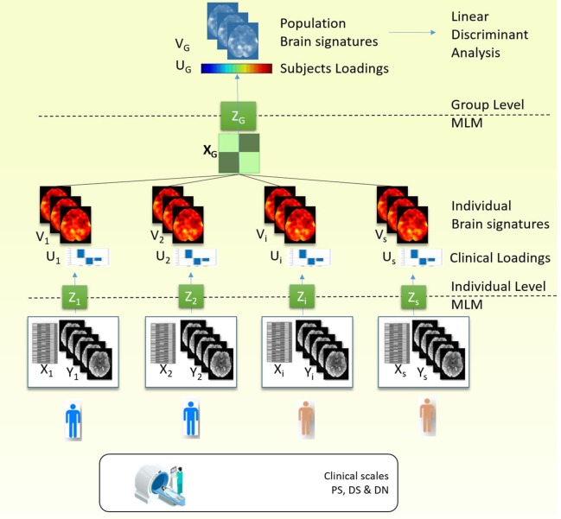
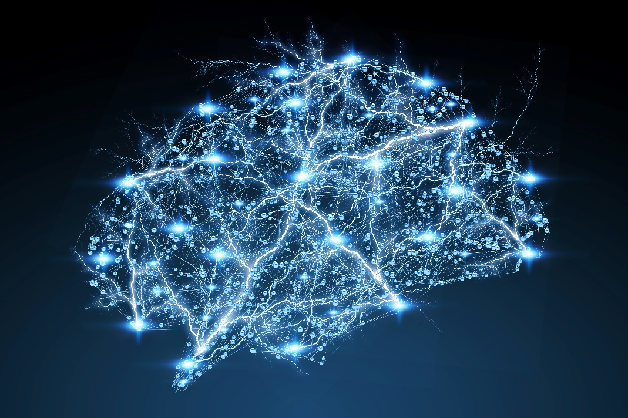
TG-Neuro ongoing plan
Trial Audit
Integration of new subtopic explore psychiatric aspect and co-morbidities.
Collaboration with Department of Psychiatry and Medical Psychology, Plovdiv, Bulgaria
Find a quantitative replacement of subjective scores
Lung-Brain axis: People with asthma and COPD are at high risk for cognitive impairment and psychiatric symptoms.
These behavioral changes have been linked to changes in brain structure and physiology

