Slide 1
FGAI4H-P-009-A03
Helsinki, 20-22 September 2022
Source: | TG-DiagnosticCT Topic Driver
Title: | Att.3 – Presentation (TG-DiagnosticCT)
Purpose: | Discussion
Contact: | Bingshu Chen | E-mail: cbingshu@infervision.com
 | Rongguo Zhang | E-mail: zrongguo@infervision.com
Abstract: | This PPT contains a research about lung tumor detection, updates on three indicators for secondary benchmarking metrics, result, discussion and future plan.

Slide 2
Purpose of the TG
Establish a standardized assessment framework for the evaluation of AI-based methods for medical applications
Propose a benchmark for AI in volumetric Chest CT which include data format, desired data for AI training and testing as well as AI performance evaluation methodologies.
Structure and Content
Include a general review of a specific area of Chest CT lung cancer detection
Relevant existing AI solutions
AI Input Data Structure and Output Data Structure
Test Data Labels
Score and Metrics : updated
Available Public Data and Undisclosed Test Data Set Collection
Reporting Methodology
Result and Discussion

Slide 3
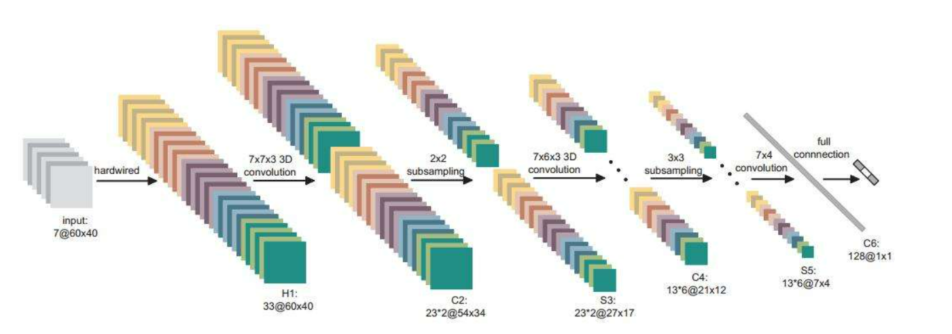
AI on lung tumor detection
Artificial intelligence (AI) products have been widely used for the clinical detection of primary lung tumors. However, their performance and accuracy in risk prediction for metastases or benign lesions remain underexplored.

Slide 4
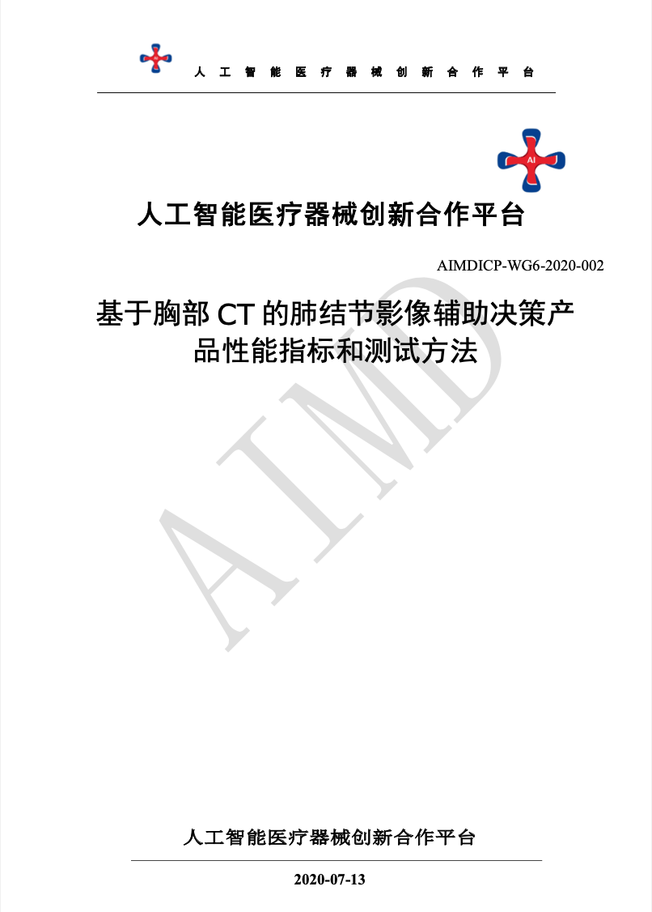
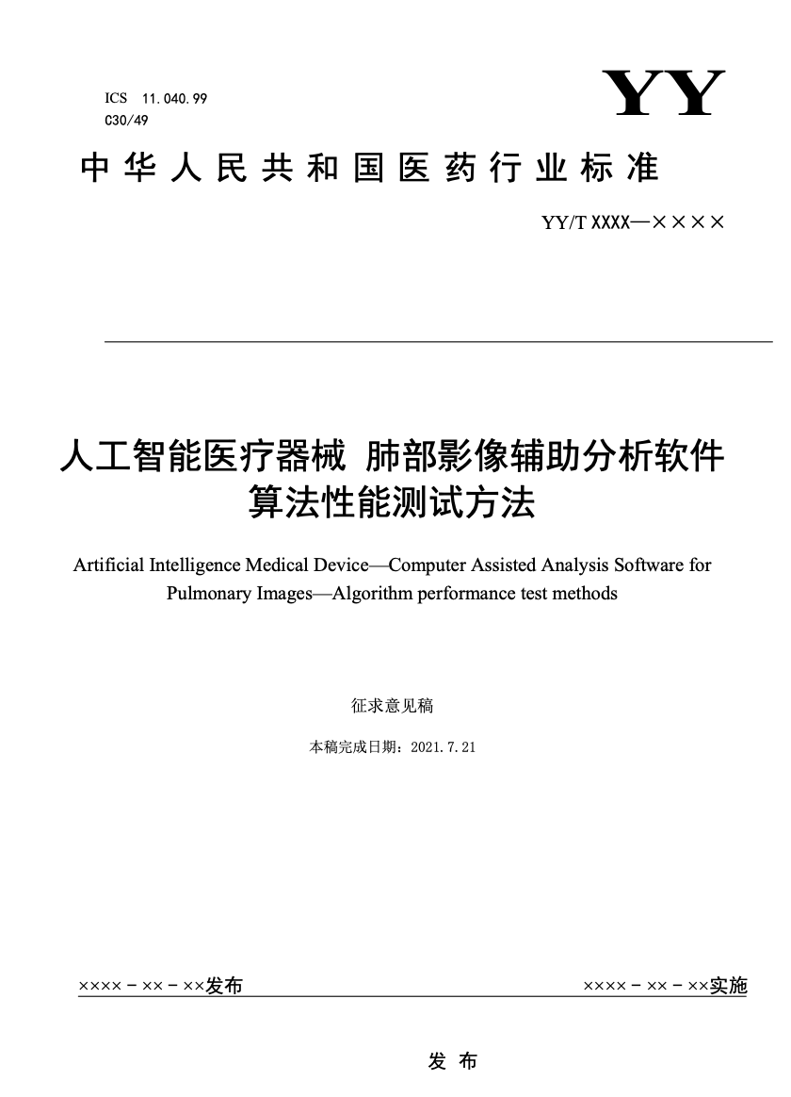
This TDD has referred and cited from these two industrial standard which has broadly discussed with associations, companies and experts.

Slide 5
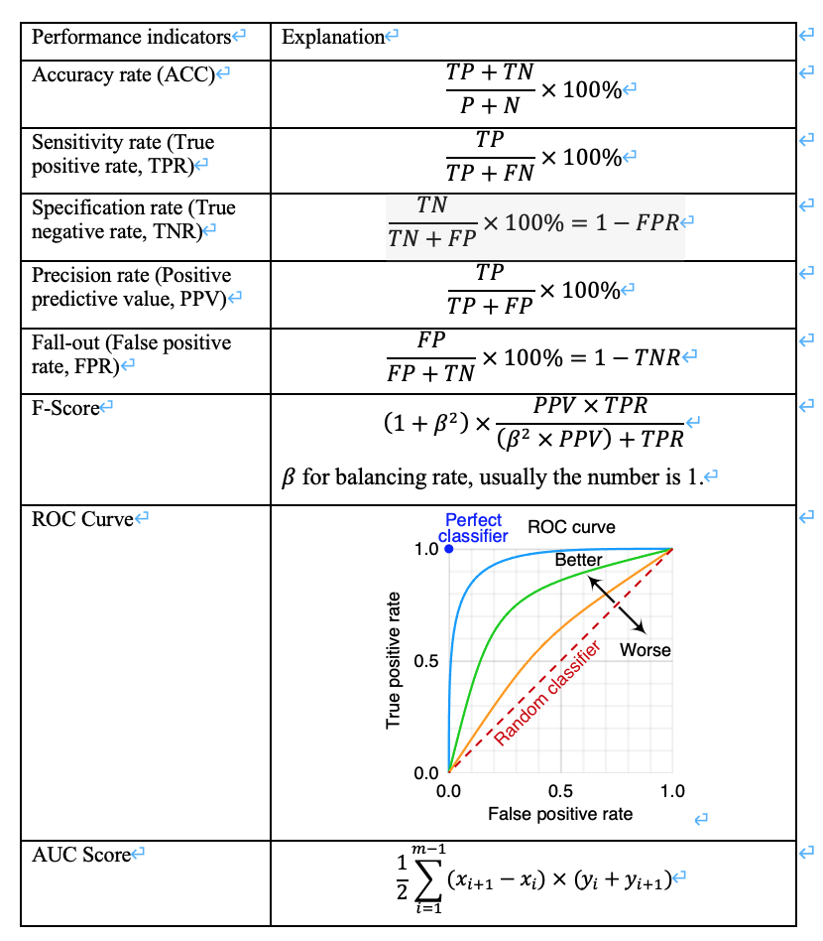
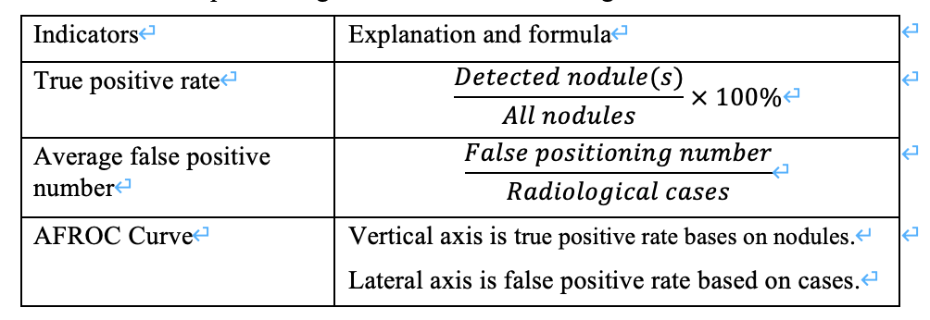
Primary Benchmarking Metrics
Clinical Performance indicators by binary classification
Nodule detection refers to positioning nodules based on radiological results. The indicators include:

Slide 6
Secondary Benchmarking Metrics
In addition to the primary benchmarking metrics, other performance metrics relevant to the task at hand should be included as secondary benchmark metrics.
Robustness
Reproducibility
Generalization

Slide 7
Robustness
Evaluate various factors
Obtain or simulate relevant data
Adversarial testing for hardware changes
Adversarial testing for software pre-processing
Adversarial testing for spoofing attacks
Stress test

Slide 8
Stress Test
Stress testing is to test the performance, reliability, stability, etc. of an algorithm model in the simulation of long-term extreme inputs or environments that may be encountered in practical applications.
The selection of stress test samples can follow the following principles:
a) images with older subjects;
b) imaging of specific diseases;
c) images with artifacts but meeting data quality requirements;
d) the layer thickness of the image is extremely large or small;
e) the image series contains a very large number of images;
f) with implants (interfering items);
g) with complications;
h) multiple, diffuse lesions.

Slide 9
Reproducibility
Testers should repeat the test on the same test set, and the number of tests should not be less than three times.
Generalization
Generalization ability refers to the ability of the algorithm to adapt to unfamiliar samples.
Analyze the differences between the training set and real-world samples
Verify the generalization ability of the algorithm

Slide 10
Result: Dataset we built
we collect the largest and most diverse dataset named PN9 for pulmonary nodule detection by far. Specifically, it contains 8,798 CT scans and 40,439 annotated nodules from 9 common classes. We further propose a slice-aware network (SANet) for pulmonary nodule detection.
In Table 1, we compare the PN9 with several existing pulmonary nodule datasets. Compared to the widely used public dataset LUNA16, PN9 contains over 10 times more CT scans and over 30 times more annotated nodules. As for the class diversity, other datasets only have three categories: nodule >= 3 mm, nodule < 3 mm, and non-nodule. Due to these limitations, it is difficult for most of the existing nodule datasets to apply to the practice. However, our PN9 contains many CT scans and 9 classes, which will contribute to the detection and classification tasks of the pulmonary nodules, allowing researchers to design more effective algorithms based on different types of nodules. Besides, there are more pulmonary nodules of small size, like 0-3mm solid nodules and 0-5mm ground-glass nodules. It helps identify small nodules more accurately, then the doctors can diagnose and treat patients earlier. In summary, our dataset not only is larger than the previous datasets, but also has superior diversity and performance.

Slide 11
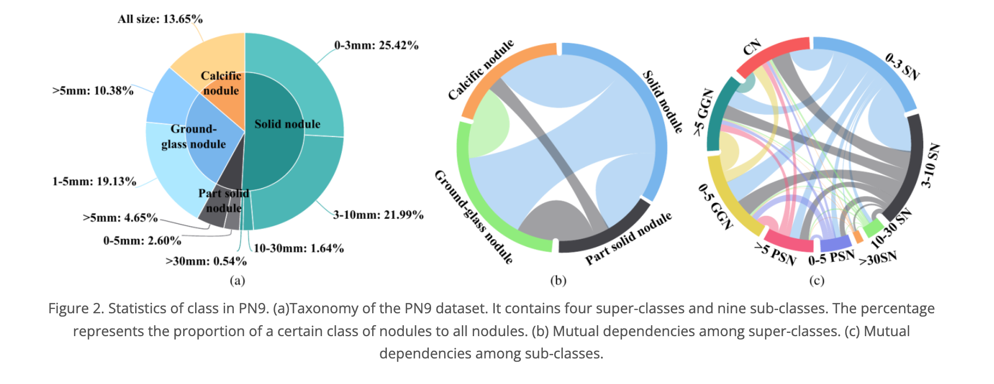
Result: Dataset we built
Our PN9 has a hierarchical class structure, and its detailed taxonomy is shown in Fig. 2. According to the property of the pulmonary nodules, all nodules in our dataset are first divided into four upper-level classes (denoted as super-class), including solid nodule (SN), part-solid nodule (PSN), ground-glass nodule (GGN), and calcific nodule (CN). Meanwhile, To satisfy the practical demands of doctors and hospitals, we further subdivide the super-class referring to the medical guidelines. Each nodule is assigned with a subordinate class (denoted as sub-class) belonging to a certain super-class based on the nodule size. For example, sub-class 0-3mm solid nodules (denoted as 0-3SN) are defined as any nodules identified to be super-class solid nodules with the most significant in-plane dimension in the range of 0-3 mm. And 9 different sub-classes are finally obtained. The statistics of nodules in each class are shown in Fig. 2 (a). In Fig. 2 (b-c), we show the mutual dependencies among super-classes and sub-classes, respectively. The larger width of a link between two classes indicates a higher probability for the two classes’ nodules appearing in one patient simultaneously. For example, a patient diagnosed with ground-glass nodules is also likely to have solid nodules.

Slide 12
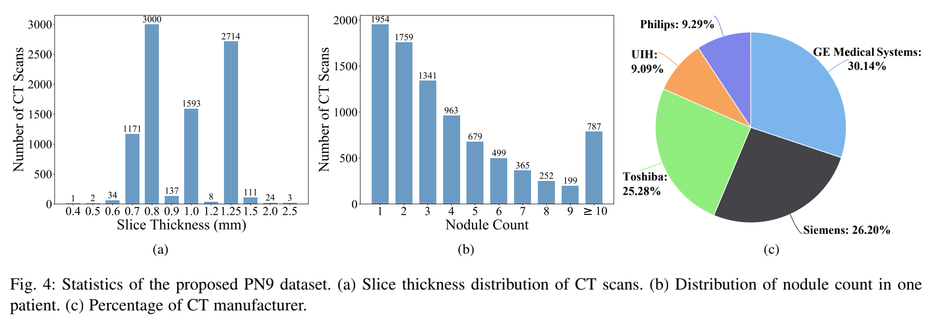
Result: Dataset we built
The CT scans in PN9 are obtained by a series of CT manufacturers and corresponding models, as shown in Fig. 4 (c). PN9 includes 2,652 scans from ten different GE Medical Systems scanner models, 2,305 scans from eleven different Siemens scanner models, 2,224 scans from three different Toshiba scanner models, 800 scans from two different United Imaging Healthcare (UIH) scanner models, and 817 scans from six different Philips scanner models. Since the images of thick slice are not optimal for CAD analysis , we mainly collect the CT scans with thin-slice. As illustrated in Fig. 4 (a), slice thickness ranges from 0.4 mm to 2.5 mm, and most are located at 0.7, 0.8, 1.0, and 1.25 mm. Besides, the pixel spacing ranges from 0.310 mm to 1.091 mm, with a mean of 0.706 mm. In Fig. 4 (b), we illustrate the distribution of nodule count in one patient. We observe that approximately 68 % of patients have nodules less than 5 in our PN9. However, there are about 9 % of patients with more than 10 nodules, which may be difficult to detect.

Slide 13
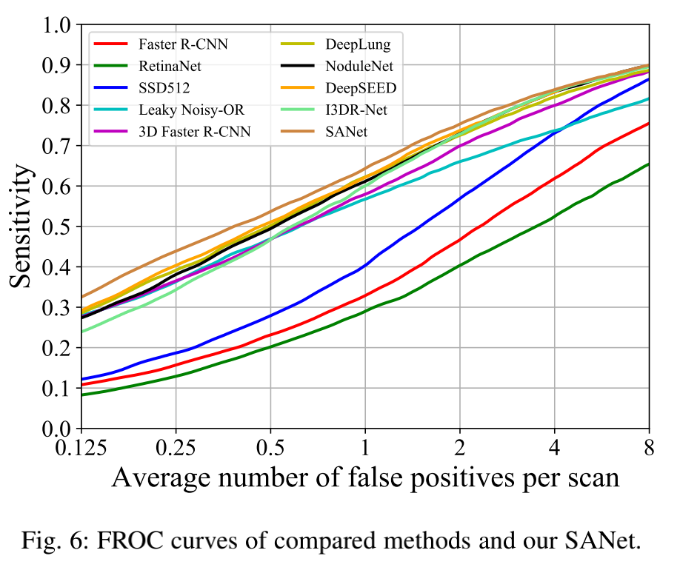
Results: Research Evidence
For the dataset PN9, we split the 8,798 CT scans into 6,707 scans for training and 2,091 scans for testing. During training, we separate 670 CT scans from the training set as the validation set to monitor the convergence of the model. There are three preprocessing steps for the raw CT images. First, all raw data are converted into the Hounsfield Unit (HU) since HU is a standard quantitative value describing radiodensity. Then, the data is clipped into [[ 1200, 600]. Finally, we transform the data range linearly into [0, 255].
Comparison based on FROC. We first evaluate the FROC score defined in the LUNA16 dataset. The experiment results are listed in Table 2, and the FROC curves are illustrated in Fig. 6.
It is noted that our SANet achieves the best results over other methods, which obtains an improvement of 3.04 % on average FROC score over the second-best DeepSEED. And our method especially outperforms the other detection methods by a large margin for the average number of false positives per CT scan smaller than 2.

Slide 14
Comparison on the LUNA16 dataset.
To further validate the performance of the proposed SANet, we conduct experiments on the widely used dataset LUNA16 with 10-fold crossvalidation. As shown in Table 4, our SANet achieves the best results for pulmonary nodule detection. For example, it obtains an average FROC score of 87.39 %, which improves the secondbest method DeepSEED [39] by 1.19 %. Besides, our SANet outperforms the state-of-the-art nodule detection methods by a large margin for the settings of average number of false positives per CT scan larger than 1.

Slide 15
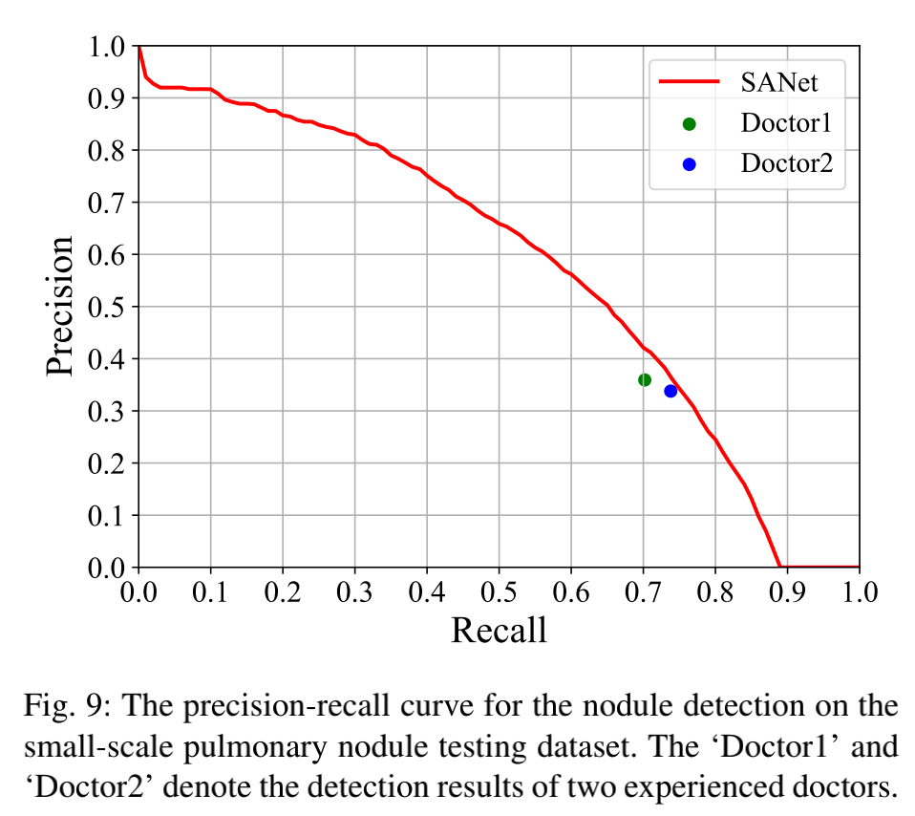
Comparison with Experienced Doctors.
Furthermore, We compare the detection performance of our SANet and two experienced doctors with at least 10 years’ clinical experience. We collect an additional small-scale pulmonary nodule testing dataset that contains 120 CT scans. After annotated accurately by several attending physicians from major hospitals, this testing dataset contains 2,137 annotated nodules with the golden standard. The other two experienced doctors, who never diagnose the small-scale testing dataset, are invited to individually identify lung nodules. As for our SANet, it is trained on dataset PN9 and tested on this small-scale testing dataset, which is evaluated using AP@0.25. The PR curve of our SANet and the detection results of two experienced doctors are shown in Fig. 9. It is noted that the performance of our model is better than two doctors on their individually diagnosed nodules, which validates that SANet surpasses the human-level performance and is suited for pulmonary nodule detection.

Slide 16
Nodule characterization: size measurement, density, classification, and malignancy
InferRead® CT Lung is an FDA-cleared, CE-marked AI solution to assist radiologists with their chest CT image analysis, serving as a second pair of eyes. It is capable of identifying various types of lung nodules, providing quantification for each lesion, and generating radiological reports. The application has been trained with hundreds of thousands of exams to ensure its accuracy, robustness, and generalizability.
Validated through our retrospective, multi-reader multi-case (MRMC) studies, InferRead® CT Lung has shown its ability to reduce nearly 15% image reading time and increase over 40% in the sensitivity of detection. InferRead® CT Lung is currently in use at hundreds of hospitals and imaging centers globally. Millions of patients have already benefited. It is highly compatible with legacy systems and accepts chest CT images from PACS, RIS, or directly from a CT scanner.

Slide 17
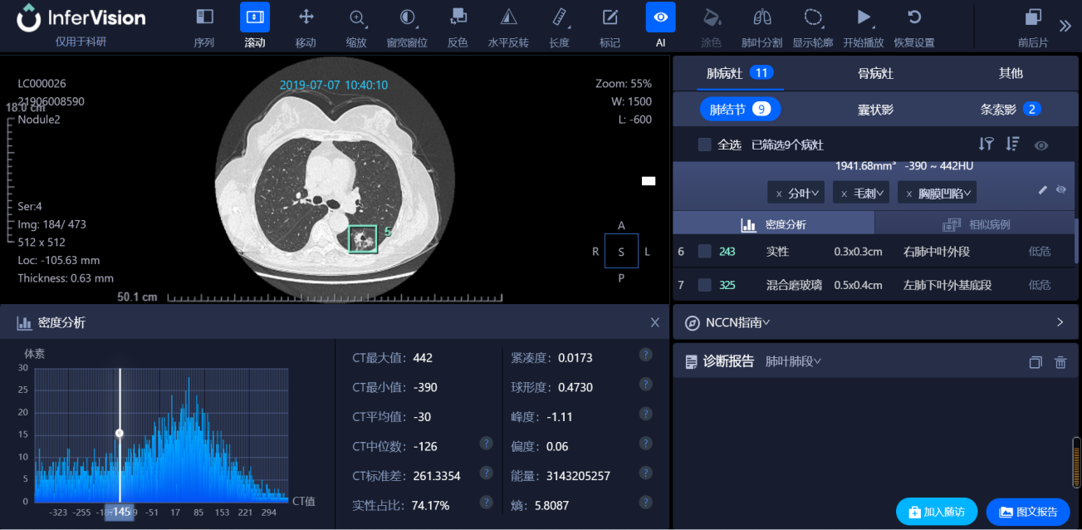
Nodule characterization: size measurement, density, classification, and malignancy
"The tremendous potential for lung cancer screening to reduce mortality in the US is very much unrealized due to a combination of reasons. Based on our experience reviewing the algorithm for the past several months and my observations of its extensive use and testing in China, I believe that Infervision's InferRead® CT Lung application can serve as a robust lung nodule “spell-checker” with the potential to improve diagnostic accuracy, reduce reading times, and integrate with the image review workflow.”
--- Eliot Siegel, MD, Professor and Vice-Chair of Research Information Systems in Radiology, University of Maryland School of Medicine

Slide 18
Discussion
As shown above, our proposed SANet obtains the best performance on our PN9 and public dataset LUNA16 compared with other state-of-the-art detection methods. Besides, the performance of SANet is better than two experienced doctors. However, there are still some failure cases when identifying nodules with class 0-3 SN. Since the nodules of PSN usually have a fuzzy border, SANet may not identify the entire nodules of PSN and produce smaller bounding boxes than the ground truth. In the future, we will consider the attributes of different categories to detect pulmonary nodules better. In the future, we will compare the results of doctor's independent image reading with those of AI-assisted reading.

Slide 19
Future Plans
Finish the document
Apply for auditing
Close the topic

Slide 20
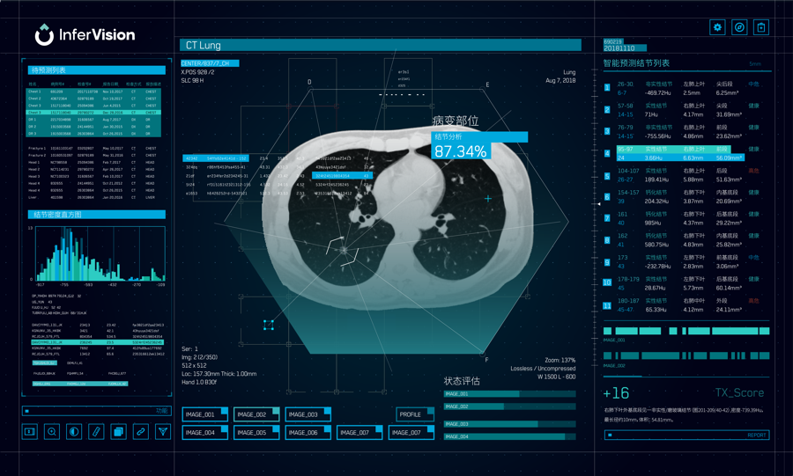
Thank You
Bingshu Chen: cbingshu@infervision.com
Rongguo Zhang: zrongguo@infervision.com

