Slide 1
FGAI4H-O-056
Berlin, 31 May – 2 June 2022
Source: | Editor DEL7.1
Title: | DEL7.1: AI4H evaluation process description - Dynamic Digital Health Maturity Model
Purpose: | Discussion
Contact: | Sameer Pujari | E-mail: pujaris@who.int
Abstract: | This PPT contains a presentation on Dynamic Digital Health Maturity Model.

Slide 2

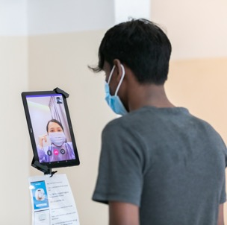

Dynamic Digital Health Maturity Model
Shada Alsalamah
Yu Zhao
Melissa Harper
Sameer Pujari
Strategy and Governance
Department Digital Health and Innovations
World Health Organization
Notes:
* Present DDHMM Indicators concepts
* Discuss feedback process and next steps

Slide 3
Strategic Objectives (SOs)
Notes:
The four strategic objectives in the Global Strategy on Digital Health are intended:
To provide guidance and coordination on global digital health transformation and
To strengthen synergies between initiatives and stakeholders to improve health outcomes and mitigate associated risks at all levels.

Slide 4
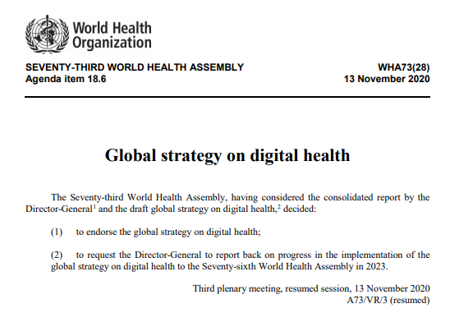
4 Strategic Objectives
SO1.
Promote global collaboration and advance the transfer of knowledge on digital health
SO2.
Advance the implementation of national digital health strategies
SO3.
Strengthen governance for digital health at global, regional and national levels
SO4.
Advocate people-centred health systems that are enabled by digital health
4
Notes:
The 1st strategic objective aims to align countries and stakeholders to collectively act upon global opportunities to improve health and work towards universal health coverage, while meeting challenges, identifying and communicating risks, and focusing on threats associated with the use of digital technologies
Strategic objective 2 aims to stimulate and support every country to own, adapt and strengthen its strategy on digital health in a way that best suits its vision, national context, health situation and trends, available resources and core values.
The 3rd strategic objective focuses on strengthening the governance of digital health at national and international levels through the creation of sustainable and robust governance structures and building the capacity for digital health at global and national levels.
Last but not least, the 4th strategic objective advocates people-centered health systems, and advances digital health literacy, gender equality and women’s empowerment and inclusive approaches to adoption and management of digital health technologies.

Slide 5
172 Actions agreed by Member States under the Global Strategy on Digital Health
SO1-ST01-Analyse digital health network landscape
SO1-ST02-Provide policy dialogue for digital prioritization at national level
SO2-ST04-Capacity building for strategy implementation and investment
SO2-ST05-Digital health maturity model
SO3-ST01-Criteria for impact assessment
SO4-ST06-Develop an ethics framework for technologies for health
Notes:
There were 172 actions agreed by MS under the Global Strategy on Digital Health
As we can see on the histogram diagram above that for each SO,
these actions target 3 stakeholders: WHO secretariat, Partners, and MS
For short-, medium-, and long term plans
Which supports the implementation of the global strategy on digital health

Slide 6
Dynamic Digital Health Maturity Model

Slide 7
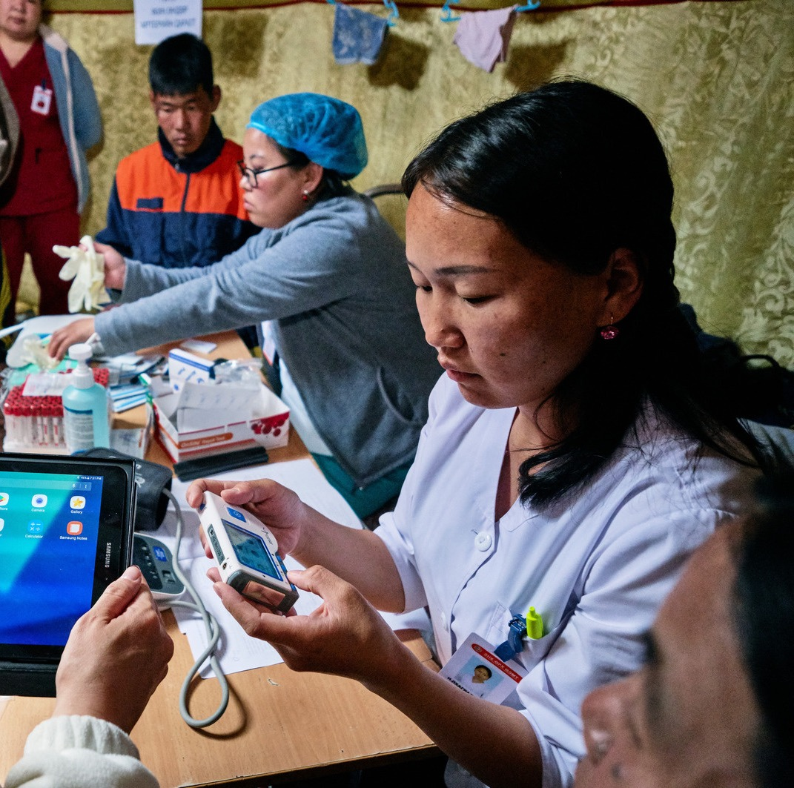
What is Dynamic Digital Health Maturity Model (DDHMM)?
  Digital health implementation initiative that dynamically monitors the status of development and implementation progress of digital health at the country level
Notes:
The DDHMM (MM for short) is a digital health implementation initiative that dynamically describes the status of development and implementation progress of digital health strategies
That is intended to accelerate the implementation of the global strategy

Slide 8
How can countries apply DDHMM to compliment the implementation of the Global Strategy on Digital Health?
Frameworks
Global strategy on digital health
172 actions targeting three stakeholders: WHO secretariat, Member States and Partners
Co-create initiatves supporting national health priorities
Implementation roadmap
Dynamic digital maturity model
Evaluate if a country is digitally ready to roll out these selected initiatives
Prioritised actions defined and knowledge shared
Shared space for countries to show case initiatives and retrieve knowledge
Shared space for countries to search for existing practice and refine actions
Value generation
Notes:
This shows how we assume countries can apply the MM to compliment the implementation of the Global Strategy on Digital Health
Which demonstrates the relationship between the implementation roadmap and the MM
As we mentioned there are 172 under the Global strategy targeting 3 stakeholders
Where the frameworks for the implementation roadmap and MM are derived
This MM is used to evaluate if a country is digitally ready to roll out the initiatives during the prioritization process
And the anticipated value generated is a shared space or interconnected space where countries can showcase their initiatives, or, search for existing practices and actions…

Slide 9
Four Work Streams
WS1
Major deliverable: A list of comprehensive indicators ready for validation
WS2
Major deliverable: Online Dashboard and CMS populated with existing and future datasets
WS3
OPERATIONALISING
SCOPING
POPULATING
WS4
Incorporate indicators from the existing frameworks and the digital health strategy actions
Major deliverable: online dashboard
Visualise the concept and framework
Define a robust mechanism for information sharing and knowledge generation
INSTITUTIONALISING
Training and institutionalisation to meet local needs
Major deliverable: tailored training programs and courses
Notes:
The plan is to implement the MM is divided into 4 WS
Workstream 1
focuses on harmonising indicators from the past and present digital health framework
The 40 indicators the key deliverable of this WS
Workstream 2
focuses on creating a dynamic online space to facilitate information sharing, using the scope and indicators defined by WS1
Workstream 3
focuses on populating dataset and establishing a robust mechanism of information generation and exchange
Workstream 4
focuses on training and institutionalization to meet local needs with tailored training programs and courses

Slide 10
40 indicators overview
SO No. | SO Class | Total No of Indicators = 40
SO1 | Collaboration and Knowledge Transfer | 7
SO2 | Strategy Implementation | 15
SO3 | Governance and Policy | 8
SO4 | Human-centered digital health systems | 10

Slide 11
40 indicators overview
50% Unchanged indicators
Extracted from 5 frameworks
30% adapted indicators
Adapted from 5 frameworks and 1 strategy
20% New indicators
Addressing the missing components
Notes:
We needed a short list of indicators that are object-oriented, and easier to measure and answer when communicated to MS.

Slide 12
A quick glance at the data harmonisation
DHPMAT
eHealth survey
IS4H
SCIROCCO
GDHI
DH Strategy
Notes:
This illustrates the SO mapping for each model

Slide 13
Key topics covered in the existing indicators
Existing/Emphasising | Less frequently addressed | Missing components with regards to the Global strategy
Infrastructure (ICT, EHR) | Leadership | Gender equality
Interoperability | Compentency | Health equity
Data | Change management | Inclusion
Policy/Policies | Community engagement | Emerging technology management (AI, big data, etc.)
Legislation/legal | Integrated strategy | Policy/Policies interfacing with international and global rules
Governance | Sustainable financing | Interlinks with emergencies
Capacity building | Communication | Interlinks with other mandates and frameworks
Training | Interlinks between digital health, economics and development
National strategy and planning | Knowledge accessibility
Toos and solutions

Slide 14
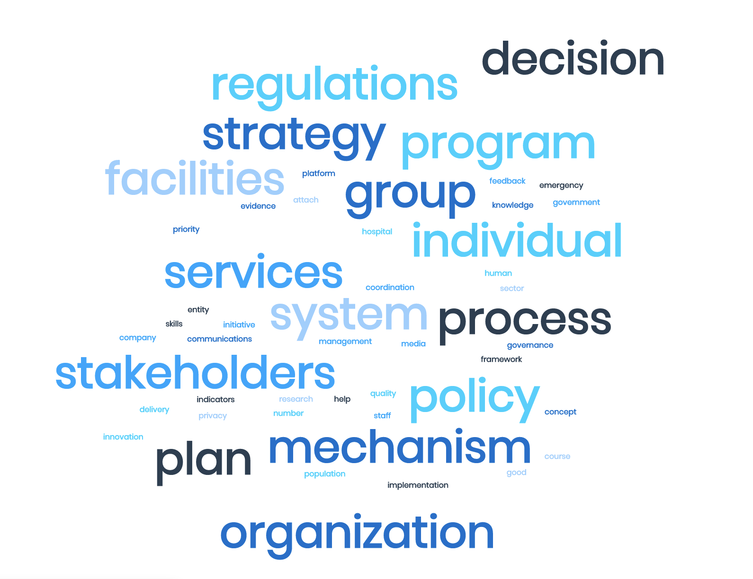
Top key words of top frequency from the 415 indicators out of 5 framework and 1 strategy

Slide 15

Indicators
Under which SO | Unique_IDs | Proposed indicators | Keywords | Frameworks of origin | Relevant DHS actions
SO1 | DDHMM_145 | Are there training programs (in either public or private institutions) to produce trained digital health work force on a regional or national level | Capacity building | DHPMAT-The Digital Health Profile & Maturity Assessment Toolkit; eHealth Survey | MEM_SO1_MEDIUM_1
SO1 | DDHMM_370 | Are digital health trainings conducted at least once to various stakeholders (policy makers, public officials and program planners and public health care work force)? | Capacity building | DHS-Global strategy on digital health; eHealth Survey | MEM_SO1_SHORT_4, MEM_SO1_SHORT_5
SO1 | DDHMM_189 | Are there adequete human resources with the required knowledge and skills to effectively implement and sustain digital health services are available: | Capacity building | IS4H-Information Systems for Health Standard; SCIROCCO-Maturity Model for Integrated Care | MEM_SO1_SHORT_5
SO1 | DDHMM_22 | In general, is training in digital health / health informatics / health information systems / biomedical informatics degree programs (in either public or private institutions) producing trained digital health workers? | Capacity building | GDHI-Global digital health index; eHealth Survey | MEM_SO3_SHORT_3, MEM_SO3_LONG_2
SO1 | DDHMM_371 | Are there multi-stakeholder partnerships and protocols of cooperation between the health and other sectors involved in digital health implementation ? | Stakeholders | DHS-Global strategy on digital health | MEM_SO1_SHORT_1, MEM_SO1_SHORT_3, MEM_SO1_MEDIUM_1
SO1 | DDHMM_400 | Does the country engage in international knowledge sharing on digital health? | Knowledge | DHS-Global strategy on digital health | MEM_SO2_SHORT_10
SO1 | DDHMM_201 | Does the country have capacity to meet national and international data and reporting obligations? | Knowledge | IS4H-Information Systems for Health Standard | MEM_SO2_SHORT_9, MEM_SO2_MEDIUM_2, MEM_SO3_MEDIUM_3
SO1 | DDHMM_218 | Are there institutions that use digital health tools and platforms that facilitate knowledge sharing and effective collaboration? | Knowledge | IS4H-Information Systems for Health Standard | MEM_SO1_MEDIUM_4
Notes:
This table from the workbook shows the new proposed indicators mostly relevant to knowledge transfer / CBC unit
Where there is the proposed indicators column, framework of origin and relevant digital health actions (from the 172 indicators)

Slide 16

Mock up
SO1 68%
Next leveling ups of indicators for Country A
SO2 25%
Indicator No. 12
78%
SO3 53%
SO4 78%
Indicator No. 23
65%
Indicator No. 35
26%
SO1
SO2
SO3
SO4
Explore the dynamic digital health maturity model
Dynamic digital health maturity model
Notes:
Although we are not at the operalization yet, but this slides shows one way of how we are thinking about it as a next step
Where we can have a country-based visual profile
That a country can use for leveling ups of indicators

Slide 17
Next milestones
Indicator No. 12
Are there training programs (in either public or private institutions) to produce trained digital health work force on a regional or national level?
SO1 68%
SO2 25%
SO3 53%
78%
SO4 78%
Countries are upgrading indicator 12 with these initiatives
Digital literacy at fingertips
Digital 101 for medical students
Key words: Academics, future leadership
Implementor: Country A
Implementor: Country B
Key words: Digital literacy, emergencies, capacity building
Notes:
or digging deeper into a particular indicator, to have an indicator-oriented suggestions wherof relevent initiatives or activities other countries are using to level up this particular indicator

Slide 18





Shared space
Story of the month
本月国家项目推荐
Explore other initiatives (below are fictional samples)
Share
Digital literacy at fingertips
Leading actor:
Key words: Health emergencies, capacity building
Healthy ageing
Leading actor:
Key words: Ageing
Interoperable digital health ecosystem
Leading actor:
Key words: Diagnostics, Telemedicine, Artificial intelligence
Strategic objective: SO1
Strategic objectives: SO3, SO4
Strategic objectives: SO1, SO4
Dynamic digital health maturity model
Share your initiatives
Notes:
Countries can show their initiatives or check other ones

Slide 19
Shared space
Explore other initiatives (below are fictional samples)
Share
Digital literacy at fingertips
Leading actor:
Key words: Health emergencies, capacity building
Healthy ageing
Leading actor:
Key words: Ageing
Interoperable digital health ecosystem
Leading actor:
Key words: Diagnostics, Telemedicine, Artificial intelligence
Strategic objective: SO1
Strategic objectives: SO3, SO4
Strategic objectives: SO1, SO4
Dynamic digital health maturity model
Share your initiatives

Slide 20


Shared space
Explore knowledge products (below are fictional samples)
Share
Use cases
Telemedicine portal
Regulatory Considerations
Dynamic digital health maturity model
How to launch a Telemedicine programme for my country ?
Notes:
Instead of an indicator-focused view, the DDHMM countries can

Slide 21
Shared space
Explore knowledge products (below are fictional samples)
Share
AI training best practice and specification
Regulatory Considerations
Ethics and governance
Dynamic digital health maturity model
How to introduce Artificial intelligence
into health programmes?

Slide 22


Thank you.
@sameer_pujari
Anup, visually impaired pupil listening at Resource centre for children with visual impairments, Jharkhand, India.
Credit: WHO/NOOR/Arko Datto
Notes:
The roadmap is structured so together we can ensure that the Digital Health is safe, sustainable and leaves no one behind. We look forward to supporting you all.

