Slide 1
FGAI4H-O-054
Berlin, 31 May – 2 June 2022
Source: | WG-CO
Title: | WG-CO update
Purpose: | Discussion
Contact: | Andrew Farlow University of Oxford UK | E-mail: andrew.farlow@oriel.ox.ac.uk
Contact: | Matthias Gröschel ITU | E-mail: matthias.groeschel@itu.int
Abstract: | This PPT contains an update on the Working Group on Collaborations & Outreach for discussing during the meeting.

Slide 2
Working Group Collaborations & Outreach
Andrew Farlow & Matthias Gröschel

Slide 3
Workshops

Slide 4
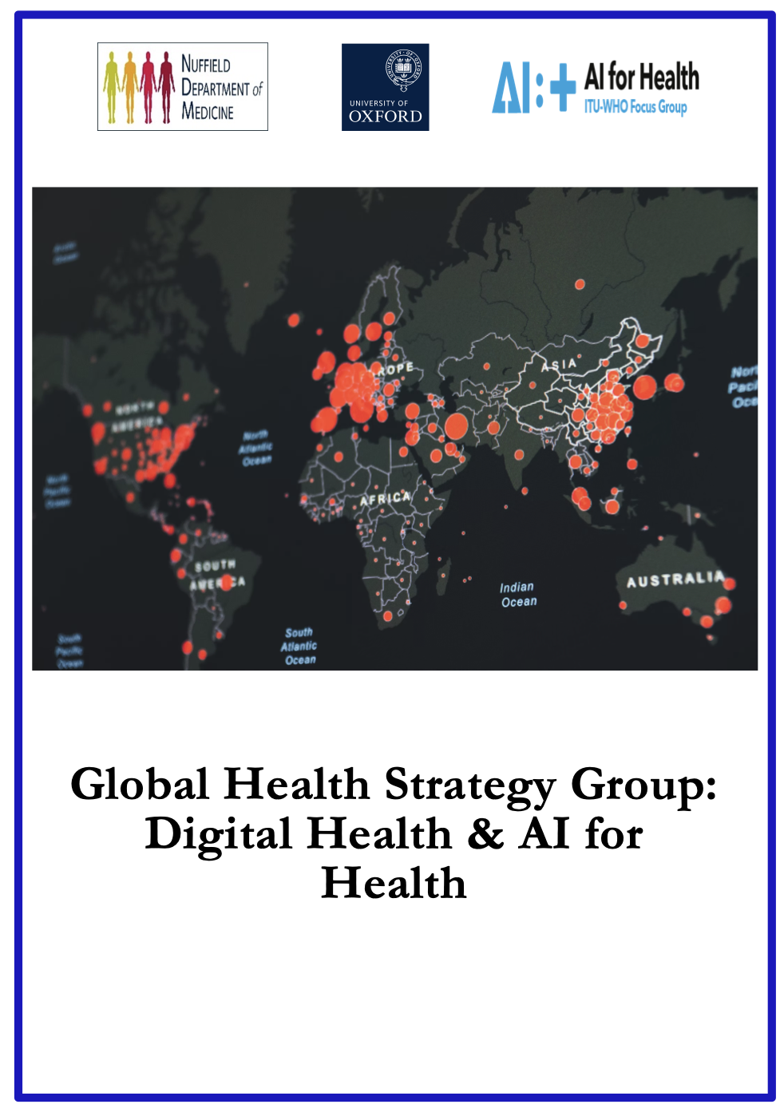
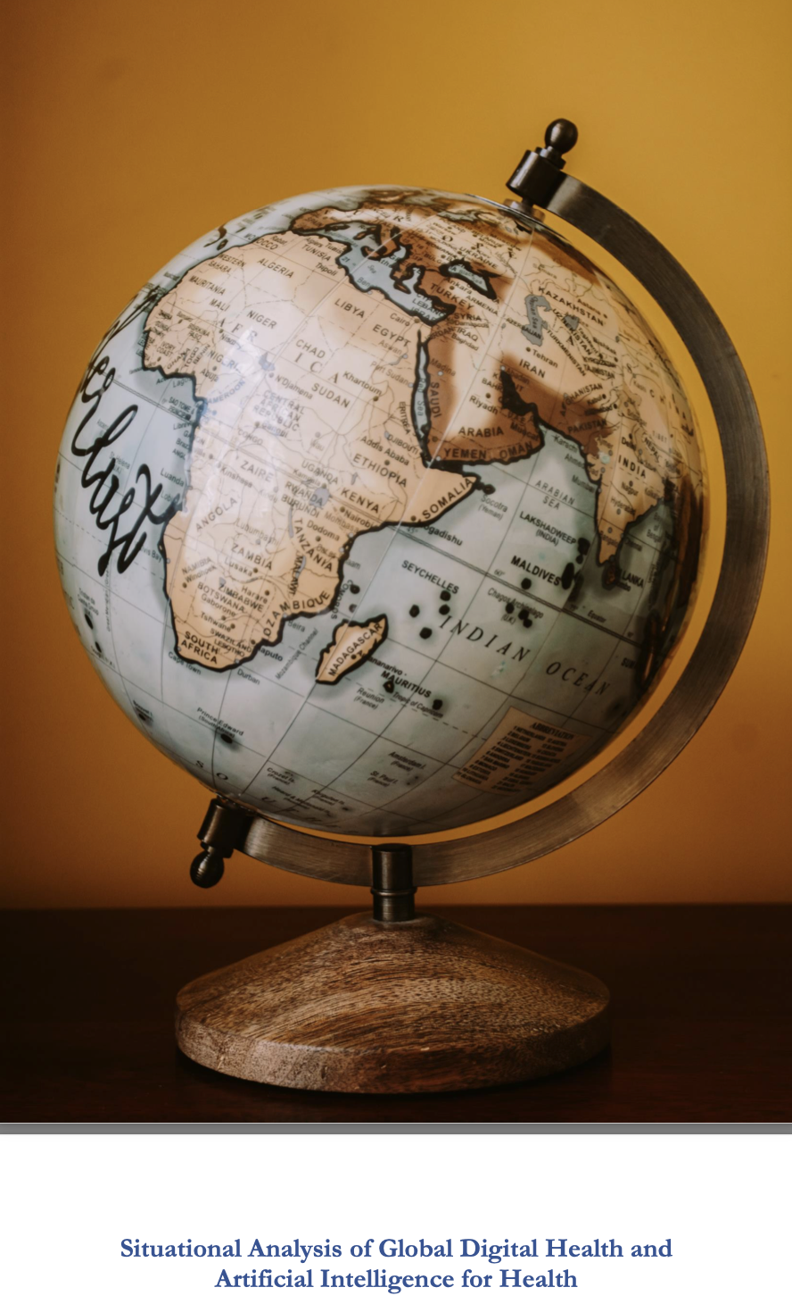
Addressing debated and challenging topics

Slide 5
Webinars

Slide 6
Webinars
Bringing ML to the bedside
The gift from yesterday – Medical data as public good
Beyond bias – Algorithmic unfairness, infrastructure, genealogies of data
Refusing AI contact: Autism, Algorithms and the Dangers of ‘Technopsyence’
AI-enabled public health from a marginalized perspective
Ethics in AI for Health: The quest for global governance
Making Neural Nets uncool again
…

Slide 7
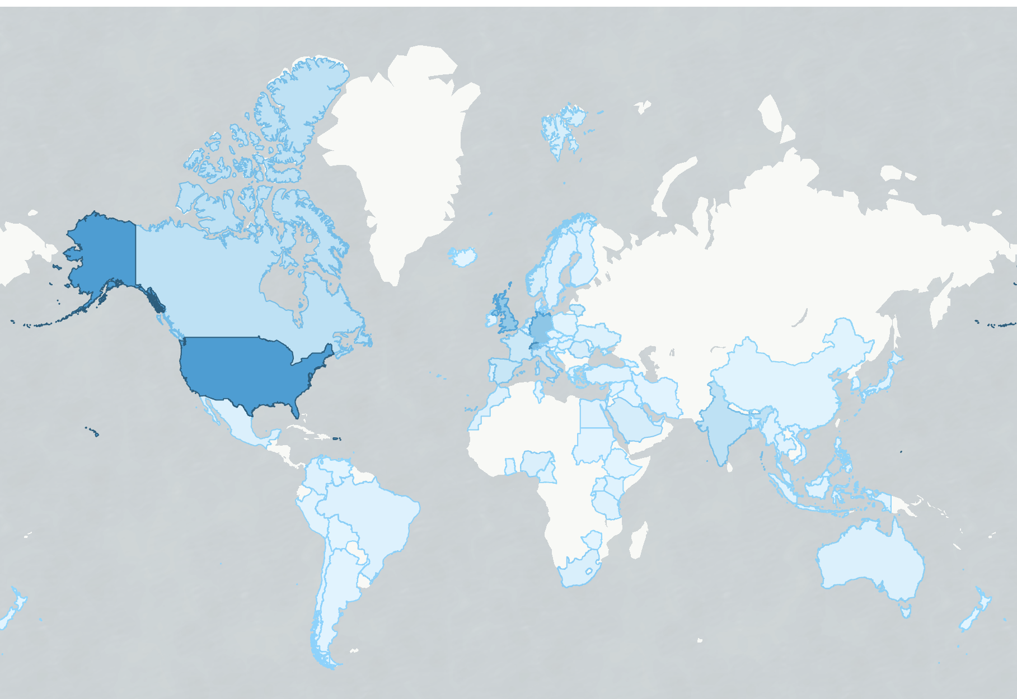
18,929 people reached
103 countries
36 minutes on average

Slide 8
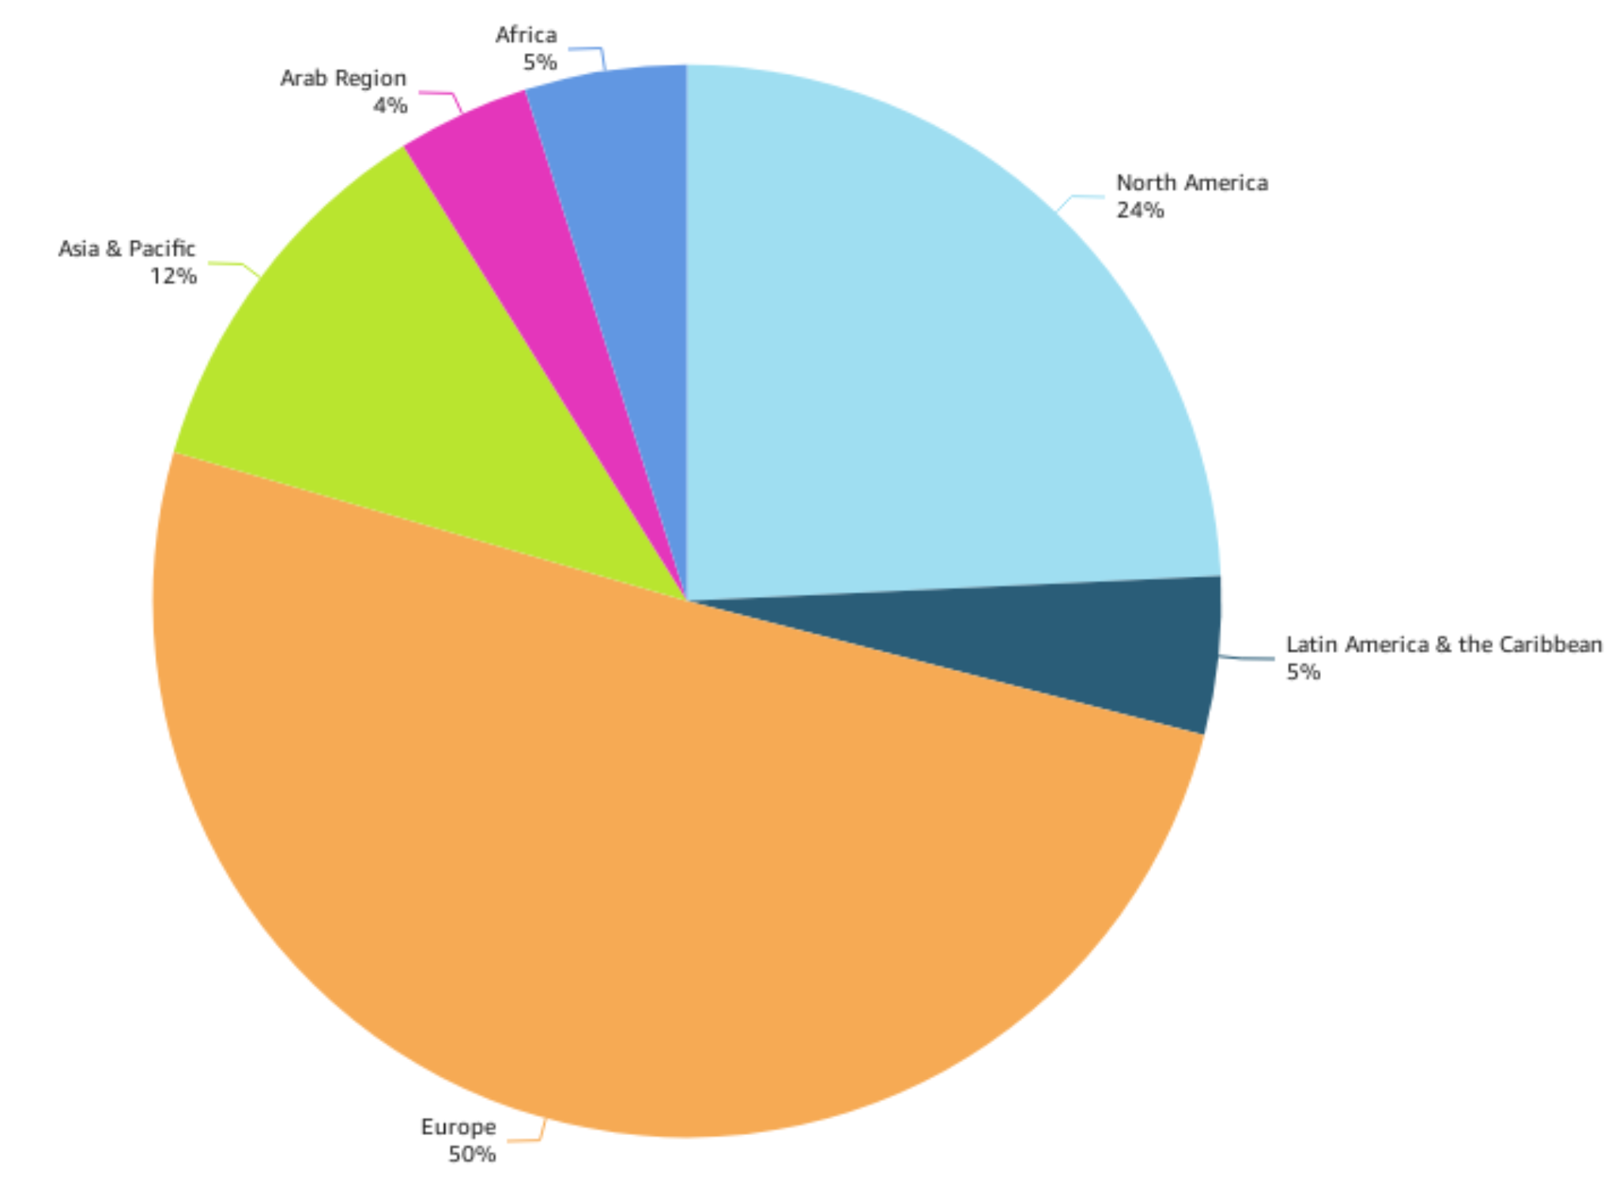
~75% US or Europe
Africa (5%)
Arab Region (4%)
North America (24%)
Asia & Pacific (12%)
Latin America & Carribean (5%)
Europe (50%)

Slide 9
Hackathons to tackle globally relevant health problems with FG-AI4H standards and software
But only 5% of solutions continue to be developed after such events. Why?
Nolte et al., 2020 and McIntosh et al., 2021

Slide 10
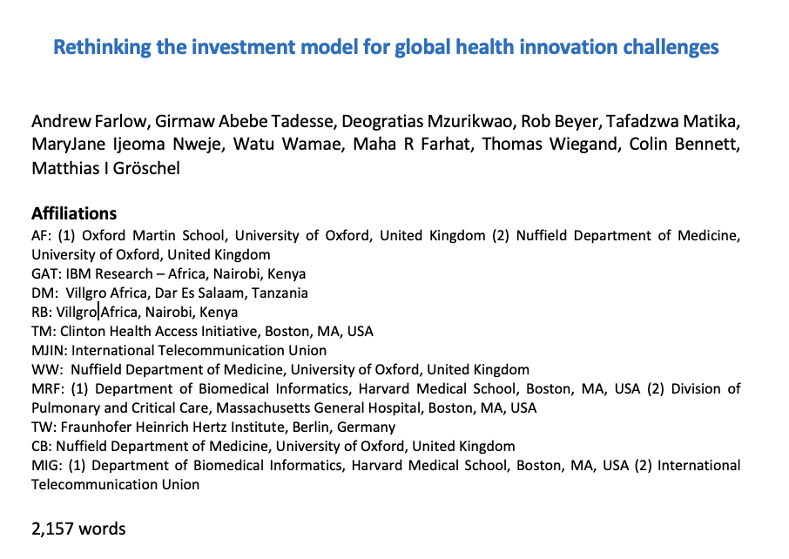
A venture building structure that can run sustainable hackathons

