Slide 1
FGAI4H-O-053
Berlin, 31 May – 2 June 2022
Source: | WG-Ethics
Title: | WG-Ethics update
Purpose: | Discussion
Contact: | Andreas Reis (WHO) Ursula (Yu) Zhao (WHO) | reisa@who.int zhaoy@who.int
Abstract: | This PPT contains an update on activities on WG-Ethics plus a slide set on “Knowledge transfer - Introductory course: Ethics and governance of AI4Health”, which was also presented at the Workshop session on WG-Ethics (Monday, 30 May 2022).

Slide 2
Updates on WG-Ethics activities (1)
Collaboration / Coordination with other International Organizations working on ethical issues in AI
  ITU, UNESCO, OECD, Council of Europe (focus on patient-provider relationship)
New WHO publication on “Ageism in artificial intelligence for health”, Link: https://www.who.int/publications/i/item/9789240040793
Starting to draft a policy brief on Ethics & AI-based development of medicines/vaccines
  Interested FG-AI4H experts are invited to join, contact Andreas Reins

Slide 3
Updates on WG-Ethics activities (2)
Analysis of the existing legal landscape in digital health/AI and developing model legislation for the use of AI for health to assist WHO member States.
Online training course on Ethics & Governance of AI
  Link to join: https://openwho.org/courses/ethics-ai
WHO is planning a series of regional workshops in the next 6 months to disseminate the guidance documents. Collaboration with FGA4H will be important during these implementation activities.
  See next slides

Slide 4
Collaboration within the FG-AI4H
WG-Ethics worked with various TGs to provide feedback in TDDs in ethics activity, following the development of the WHO guidance on Ethics for AI in health
WHO Ethics and governance of artificial intelligence for health guidance document
  Launched in June 2021 and it is currently in implementation and dissemination phase.
  A product of collaboration within the FG-AI4H, can be issued as DEL01

Slide 5
Presentation on WS, 30 May 2022

Slide 6


Knowledge transfer:
Introductory course on Ethics and Governance of AI4H
Strategy and governance unit
Department of Digital health and innovation

Slide 7

Accelerate the implementation of the guidance
Free for all, at any time, at anywhere
Growing interest among country authorities and other key stakeholders in how to best implement the WHO guidance on Ethics & governance of AI for Health.
Accelerate translating knowledge from the guidance into actionable information to support governments, AI developers and healthcare providers’ activities.
Audience: Member states, developers and health workforce

Slide 8
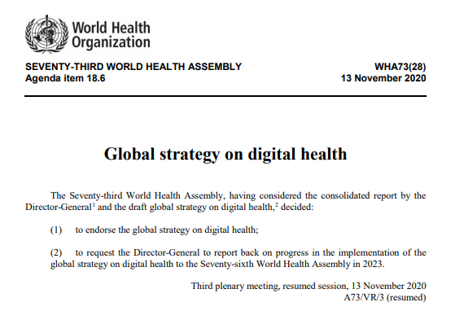
4 Strategic Objectives
SO1.
Promote global collaboration and advance the transfer of knowledge on digital health
SO2.
Advance the implementation of national digital health strategies
SO3.
Strengthen governance for digital health at global, regional and national levels
SO4.
Advocate people-centred health systems that are enabled by digital health
8

Slide 9

Learning objectives
Describe the opportunities and benefits of using AI in healthcare;
Outline the ethical considerations and explain the ethical challenges of its use;
Describe liability considerations associated with the design, development, and use of AI for health;
Summarise frameworks and regulatory considerations for the design, development, and use of such technology in the sector.
WHO / Blink Media –
Nana Kofi Acquah
Notes:
Ethical principles for AI are important for all stakeholders who seek guidance in the responsible development, deployment, use, and evaluation of, AI technologies for health.
This includes:
Clinicians and primary care medical professionals;
Systems developers;
Health system administrators;
Policy-makers in health authorities;
Researchers;
Local and national governments.

Slide 10

Course structure
Module 1: Applications of Artificial Intelligence for Health
Module 2: Laws, Policies and Principles that Apply to the Use of Artificial Intelligence for Health
Module 3: Key Ethical Principles for Use of Artificial Intelligence for Health
Module 4: Ethical Challenges to Use of Artificial Intelligence for Health Care
Module 5: Building an Ethical Approach to Use of Artificial Intelligence for Health
Module 6: Liability Regimes for Artificial Intelligence for Health
Module 7: Elements of a Framework for Governance of Artificial Intelligence for Health
Practical Guidance for AI Developers
Practical Guidance for Ministries of Health
Practical Guidance for Healthcare Providers
Course Assessment
Notes:
The course includes pre- and post-course surveys and integrates video introductions by Professors Effy Vayena and Partha Majumder, Co-chairs of WHO Expert Group on Ethics and Governance of AI for Health.

Slide 11


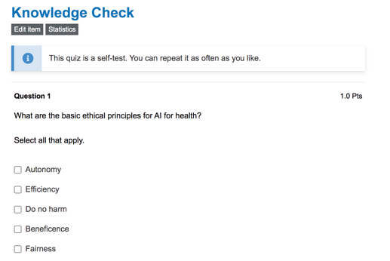
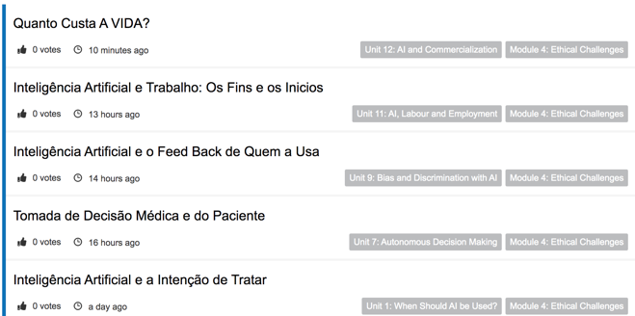
Advocate community of learning
Online modules
Peer discussion
Thematic seminars
Notes:
Feedback form link https://forms.office.com/pages/responsepage.aspx?id=t8AQ9iS9OUuBCz3CgK-1kMrIoNo_-rBHkcVoqL4Kjg5UNjk1SUxNRUVVNTdKMFpUMDJYMTUzM1FCSSQlQCN0PWcu

Slide 12
Learning certificates from WHO
A Confirmation of participation is offered at the end of the course
A Record of Achievement available for participants who score at least 80% in the final assessment
Notes:
Feedback form link https://forms.office.com/pages/responsepage.aspx?id=t8AQ9iS9OUuBCz3CgK-1kMrIoNo_-rBHkcVoqL4Kjg5UNjk1SUxNRUVVNTdKMFpUMDJYMTUzM1FCSSQlQCN0PWcu

Slide 13
How to enroll
https://openwho.org/courses/ethics-ai
Notes:
How to enrol: https://openwho.org/courses/ethics-ai

Slide 14



Knowledge transfer in the pipeline
Introductory course on ethics and governance of AI4H
Global strategy on
digital health implementation workshops
Regulatory framework for AI
Course LIVE on OpenWHO.org
Integrated into configurable sessions under the scope of the digital health strategy implementation course
Introductory course free access for public
2022
05
09
10-11
12
2023
05
Introductory course on ethics and governance of AI4H
Regulatory framework for AI
Course production initiated
Multilingual versions available

