Slide 1
FGAI4H-O-043
Berlin, 31 May – 2 June 2022
Source: | Drugs for Neglected Diseases Initiative
Title: | Workshop: WG-CO - The clinical research perspective
Purpose: | Discussion
Contact: | Nathalie Strub-Wourgaft Director COVID-19 Response & Pandemic Preparedness Drugs for Neglected Diseases Initiative | E-mail: nstrub@dndi.org
Abstract: | This PPT contains a presentation from the WG-CO workshop on “Equitable data infrastructures to support equitable and effective pandemic intelligence”.

Slide 2
The clinical research perspective
May 30th, 2022
Dr Nathalie Strub-Wourgaft
Director COVID-19 Response & Pandemic Preparedness

Slide 3
Equitable data infrastructure to support effective & equitable pandemic intelligence
Proposed agenda
Background
What data?
Experience
Conclusion

Slide 4
background
Context: rapid knowledge generation is critical in epidemic/pandemic
“No one is safe until everyone is safe”
Dr Tedros, DG WHO
“Speed can also be enabled by a more systematic approach to how data and samples are captured, shared and analysed. Real-time data collection, distribution and use is critical in a pandemic (as well as between pandemics as part of embedding best practice), but requires robust infrastructure and operational systems, supported by appropriate governance models”
Demonstration of a clinical benefit usually requires large sample size
Scientific understanding evolves quickly: we can/should learn from our data and be able to adjust
Transparency goes along with public trust – within the scientific and general communities
Ethical considerations around data protection, equity and reward drive the feasibility of datasharing

Slide 5
experience
COVID: an unprecedented number of data … that could learn from each other
Source: Welcome | IDDO (cognitive.city)

Slide 6
background
From preclinical to clinical: non alignment on definitions
Need for agreed standards, access to detailed material
and access to IPD, for robust interpretation of results

Slide 7
background
What type of “data sharing” and for what purpose
Type of data
Usage, benefit
Current status ...
Sharing Study Standard Documents:
clinical protocol, methodologies, SOPs, CRFs
HR & time saver – facilitates later pooling
Clinical trials registries, but limited
https://covid19crc.org/
Sharing study results
Critical to drive and adjust new research – guide policy / signal strength
For COVID:
Access to IPD (Individual Patient Data) from clinical trials
Ability to conduct robust meta-analyses informing Guidelines
https://www.iddo.org/
for malaria and NTDs

Slide 8
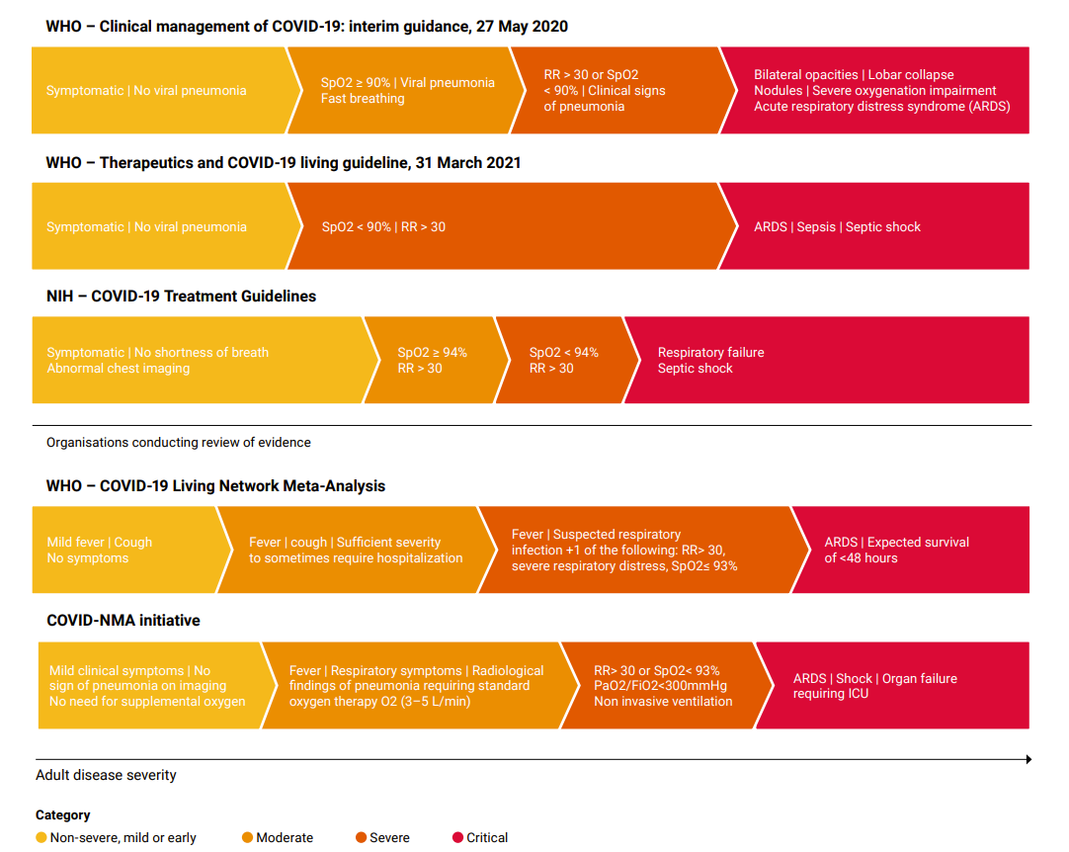
Experience in covid
Why do we need IPD?
For solid interpretation of results ... e.g when definition vary

Slide 9
Experience in covid
Why do we need IPD?
To conduct secondary analyses
Power to detect sub-groups effect
Age group
Pregnant patients
Patients at risk
.vaccinated versus non vaccinated individuals
Identifying new and less frequent (but potentially important) safety signals ... requires bigger datasets

Slide 10
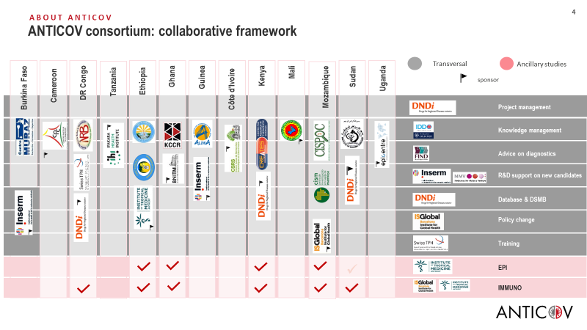
experience
The example of ANTICOV
1 adaptive platfrom trial testing several treatment options for early COVID
26 institutions including 10 different sponsors contribute to the study
Data-sharing set-up as a principle of our governance between members but also for secondary research by other groups via IDDO
Practicalities remain complex in the context of GDPR and its interpretation across sponsors

Slide 11
Conclusion
What is needed
Data protection -> understand what can be shared
Ensure legal agreements are in place early on ...
Data format needs to allow this -> prepare / CDISC
Investigator and sponsors’ ownership : critical -> can be addressed through governance mechanism as with IDDO
Patients consent ... more?
Ethical re-use of data: define purpose, framework – committing to publications
Need for independent Infrastructure
Funding, funding, funding ...

Slide 12
Transparency and coordination
CONCLUSION AND RECOMMENDATIONS
The fight against COVID is a race against time …
Science evolves at an unprecedented speed
We need treatments to prevent and treat all stages of COVID
Many groups are producing scientific results
Several platform trials allow the dynamic inclusion of new treatment arms, based on emerging data
Mechanisms to promote open collaboration from upstream (preclinical) to downstream (clinical) platforms are needed.
Mechanisms to facilitate individual data sharing will support the interpretation of completed clinical trials and benefit Guidelines development
Such mechanisms will further contribute to an efficient allocation of research resources for the success of the response, that needs to be collective.

Slide 13
Thank you

