Slide 1
FGAI4H-O-028-A03
Berlin, 31 May – 2 June 2022
Source: | TG-Sanitation Topic Driver
Title: | Att.3 – Presentation (TG-Sanitation)
Purpose: | Discussion
Contact: | Alex Radunsky ITGH UT Southwestern | E-mail: Alex.Radunsky@mail.harvard.edu
Contact: | Khahlil Louisy ITGH Harvard Kennedy School | E-mail: klouisy@hks.harvard.edu
Abstract: | This PPT summarizes the status of work within TG-Sanitation, for presentation and discussion during the meeting.

Slide 2
Update Topic Group - Sanitation
Focus Group AI for Health, Meeting O Fraunhofer Heinrich Hertz Institute, Berlin June 1, 2022
Alex Radunsky Director of Global Health - ITGH
Internal Medicine - UT Southwestern
Alex.Radunsky@mail.harvard.edu
Khahlil Louisy President - ITGH
Technology and Human Rights Fellow - Harvard Kennedy School
klouisy@hks.harvard.edu

Slide 3
Contributors
Co-drivers
Khahlil Louisy, USA Alex Radunsky, USA ITGH Contributors
Augusto Gesualdi, Germany
Rebecca Perez, UK Maria Carnovale, USA Simona Tiribelli, Italy Gokul Parameswaran, UK Woodco LLC
Mark McCarville, Ireland Patricia Moore, Ireland

Slide 4
Executive Summary
Update on data collection system in Durban
Multi-layer data streams present view into population level predictors
Project timeline
TG merger and next steps

Slide 5
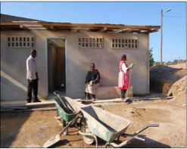
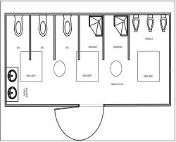
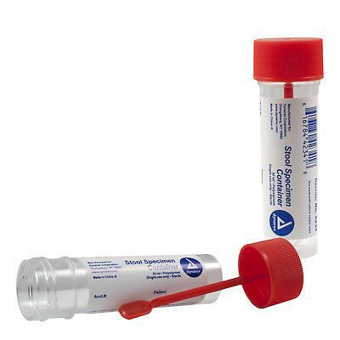
Problem Statement
Diarrheal disease is among the leading cases of death globally
Disproportionate impact on children in low-income countries (WHO Global Health Estimates, 2021)
Waste management system
Watershed management system
Health System Access and utilization
Community Ablution Block
Manual testing to automated testing

Slide 6
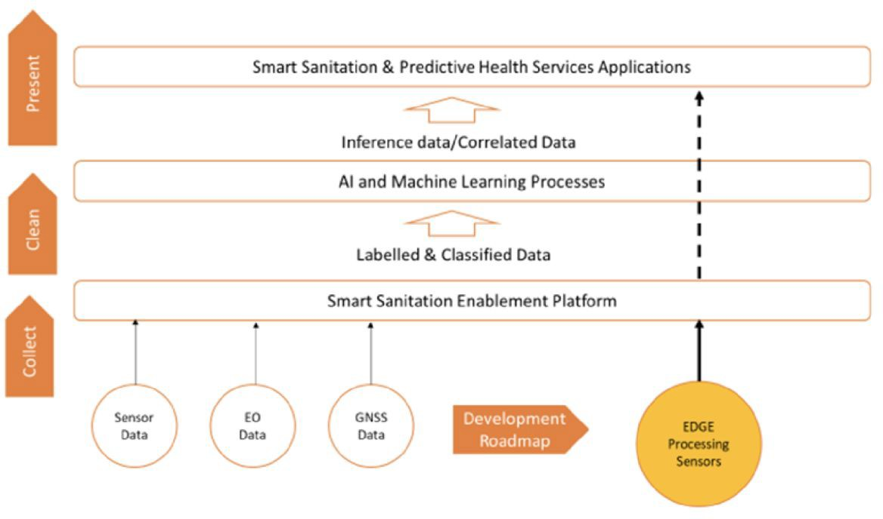
Mixed Model - high frequency data
We use an array of community based data streams that will provide a consolidated view of the spread of diarrhoeal disease
Granular measurement of CAB usage and disease detection therein
Area-level measurements of weather patterns and water level and quality
Supply chain KPIs of the sludge disposal and pyrolysis process
Satellite observations of land use, water levels and atmospheric composition
Model development, training, and benchmarking
Integration of data streams
Development of data architecture and analysis plans
Target: Prediction of disease outbreaks in informal settlements around Durban, ZA

Slide 7
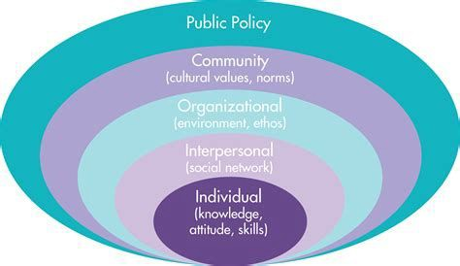
Ethical Guidelines & Technical Recommendations
A) Develop and B) apply ethical framework
A. Development
Risk-assessment of benchmarking AI using Socio-ecological Model
Mapping core AI ethics principles to mitigate ethical risk of predictive ML in national surveillance data and community based surveillance data
Assessment of these ethics principles as applied to these initial use cases
Develop sub-criteria (guidelines; checklist) for ethical framework developed
Application
National surveillance data
Community based surveillance data
Analysis and recommendations for AI applications

Slide 8
Project timeline
- Ireland based sensor testing and real use collection is ongoing
Design of Data Collection Infrastructure
In-situ Deployment & Validation
Requirements Capture
Sensor and Data storage testing
2020
2021
2022
2023
AI system specification and development
Meeting O

Slide 9
Next steps
TG_Outbreaks
Timeline and planning
CfGP - Call for Group Participation TDD - Topic Description Document
Potential sub-topics (e.g. wastewater surveillance)

