Slide 1
FGAI4H-O-023-A03
Berlin, 31 May – 2 June 2022
Source: | TG-Radiology Topic Driver
Title: | Att.3 – Presentation (TG-Radiology)
Purpose: | Discussion
Contact: | Darlington Akogo Topic Driver Founder, CEO minoHealth AI Labs | E-mail: darlington@gudra-studio.com
Abstract: | This PPT summarizes the status of work within TG-Radiology, for presentation and discussion during the meeting

Slide 2
Topic Group on AI for Radiology: Audit Trial, May 22
Darlington Akogo Topic Driver
Founder, CEO
minoHealth AI Labs
darlington@gudra-studio.com

Slide 3
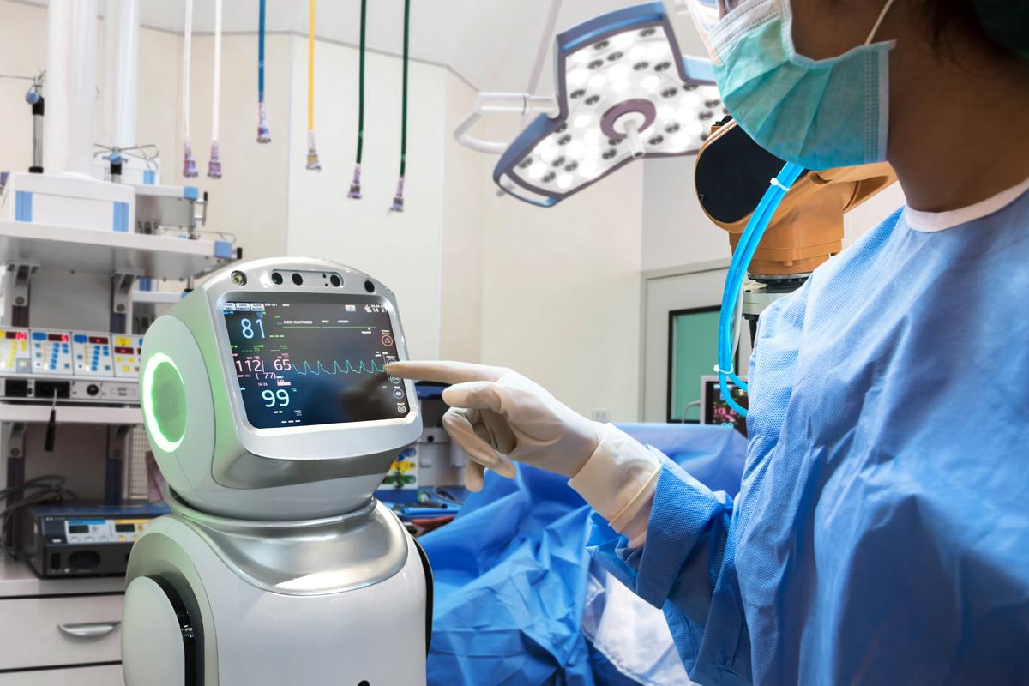
Audit Team
1. Andrew Murchison (Clinical Expert) 3. Giovanna Gutierrez (Clinical Expert) 4. Ian Shadforth (ML Expert) 5. Jana Fehr (ML Expert + Clinical Expert) 6. Md. Golam Rasul (Software Platform Expert / Audit Developer) 7. Regina Geierhofer (Regulatory Expert) 8. Saul Calderon Ramirez (ML Expert + Regulatory Expert) 9. Shada Alsalamah (ML Expert + Clinical Expert + Regulatory Expert) 10. Vasanthakumar Venugopal (ML Expert + Clinical Expert + Ethical Expert) 11. Vincent Appiah 12. Issah Abubakari Samori 13. Judy Wawira Gichoya 14. Dominik Stosik 15. Edson Mintsu Hung

Slide 4
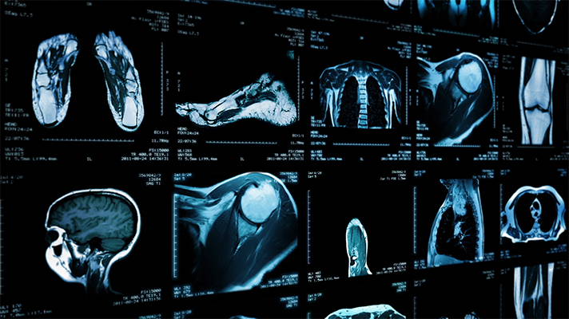
AI in Radiology - Use Case
Diagnosis of COVID-19 via Chest X-Ray Undisclosed Test Data (Vasantha): 917 cases 436 RTPCR+ cases 481 COVID negative cases Open source models for audit trial: https://github.com/velebit-ai/COVID-Next-Pytorch https://github.com/lindawangg/COVID-Net

Slide 5
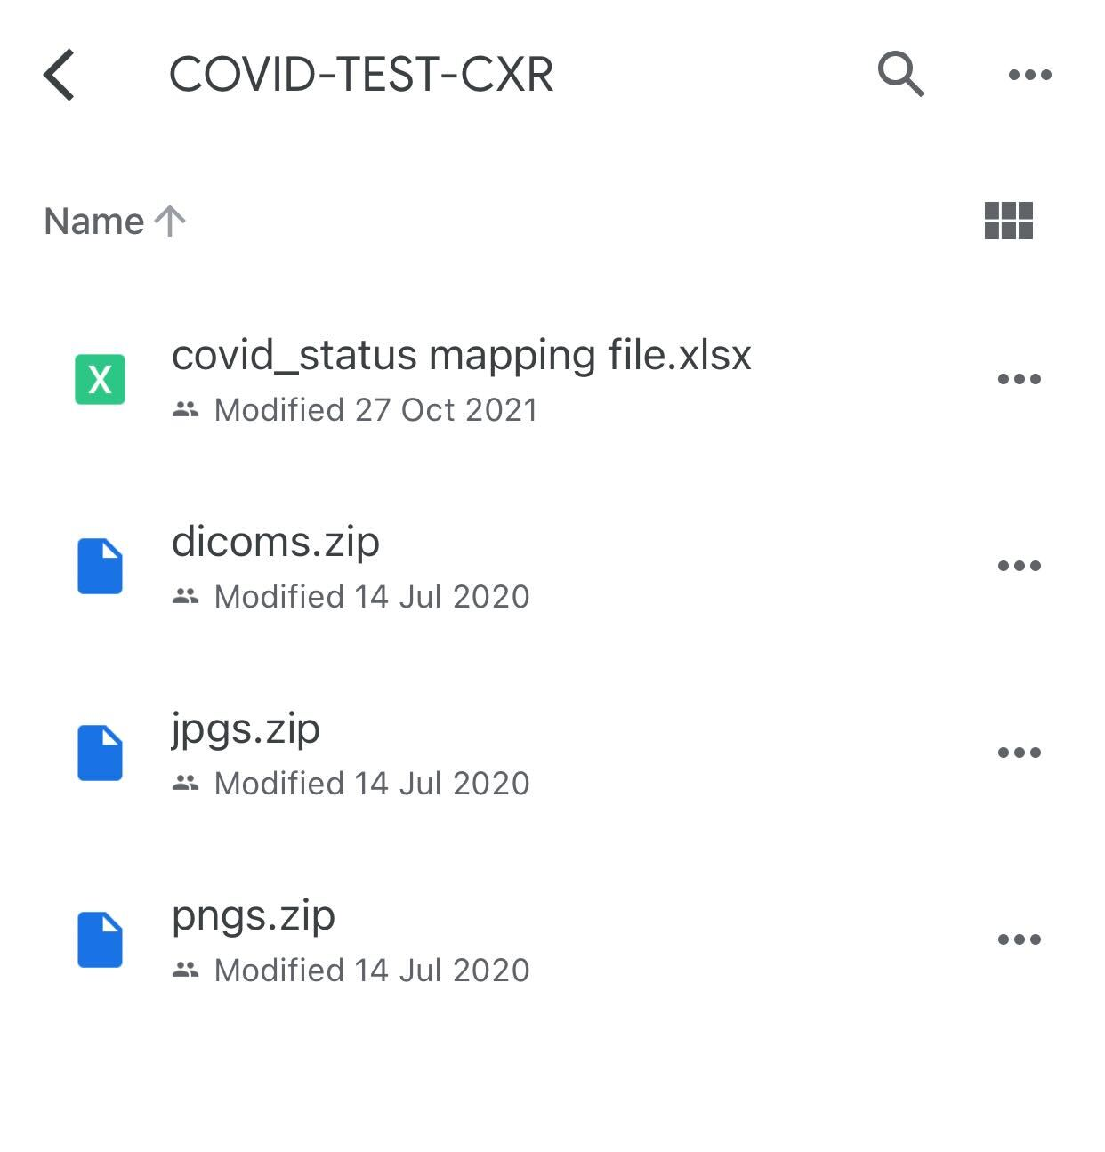

Slide 6
Audit Verification Checklist
Completed
Link: https://docs.google.com/document/d/1y9diy9cdM9dIakCttlsDR3xxrKSwbrlYQ9C-EWWJXAA/edit#heading=h.gjdgxs
Findings:
Very detailed
Too long, can be reduced
Some items can be combined

Slide 7
Audit Challenge
Link: https://health.aiaudit.org/web/challenges/challenge-page/174/overview
Creating the TG-Radiology Audit challenge on health.aiaudit.org
Added in metrics (precision, recall, AUROC, accuracy, F1 score)

Slide 8
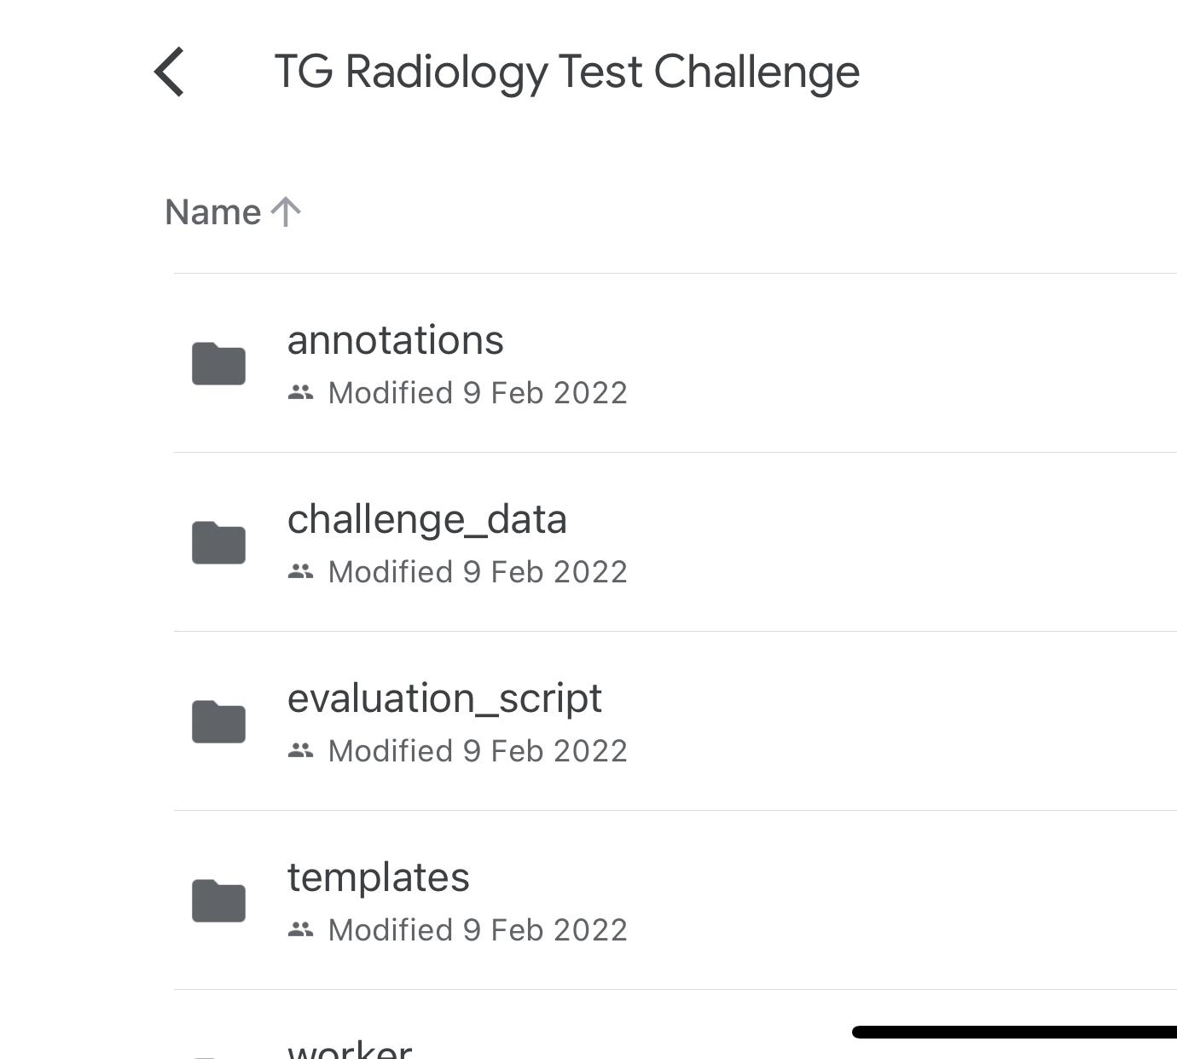

Slide 9
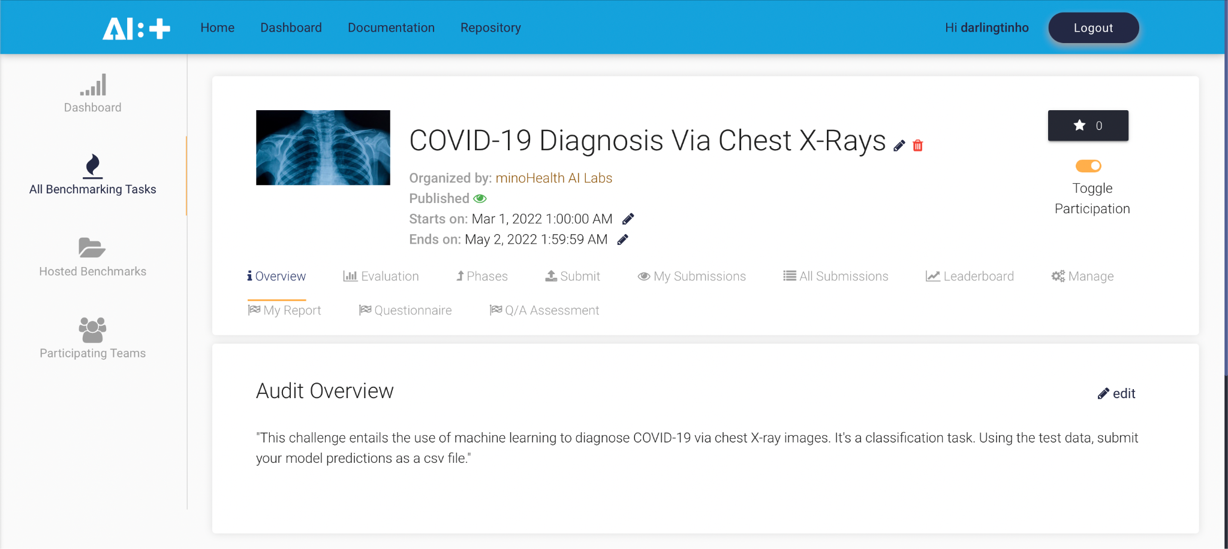

Slide 10
Topic Group on AI for Radiology: Audit Trial
Darlington Akogo Topic Driver
Founder, CEO
minoHealth AI Labs
darlington@gudra-studio.com

