Slide 1
FGAI4H-N-053
E-meeting, 15-17 February 2022
Source: | Editors DEL5.3
Title: | DEL5.3: Data annotation specification - Presentation
Purpose: | Discussion
Contact: | Shan Xu, CAICT, China | E-mail: xushan@caict.ac.cn
Contact: | Sebastian Bosse, Fraunhofer HHI, Germany | Email: sebastian.bosse@hhi.fraunhofer.de
Contact: | Jianrong Wu Tencent Healthcare, China | Email: edwinjrwu@tencent.com
Abstract: | This PPT contains a presentation of DEL5.3 presented at Meeting N of the FG-AI4H (e-meeting), 15-17 February 2022.

Slide 2
Contributors
Harpreet Singh ICMR, India | Email: hsingh@bmi.icmr.org.in
Yanwu Xu Intelligent Healthcare Unit, Baidu, China | Email: xuyanwu@baidu.com
Huihui Fang Artificial Intelligence Innovation Business, Baidu, China | Email: fanghuihui@baidu.com
Nathan Guo ShuKun Techonology, China | Email: guoning@shukun.net
Yajun Zhang Tencent Technology (Shenzhen), China | Email: yajunzhang@tencent.com
Chunyang Niu Zhejiang Lab, China | Email: niucy@zhejianglab.com
Guoqiang Li Zhejiang Lab, China | Email: gli@zhejianglab.com

Slide 3
Abstract
This initial draft describes the topics to be addressed in the forthcoming deliverable "DEL05-A03: Data Annotation Specification" and help seed future content. This document is committed to give a framework of data annotation specification for different stakeholders to develop and implement AI-based tools in advancing healthcare.
A questionnaire is attached to seek input and collaboration with topic groups in FG-AI4H regarding data annotation.

Slide 4
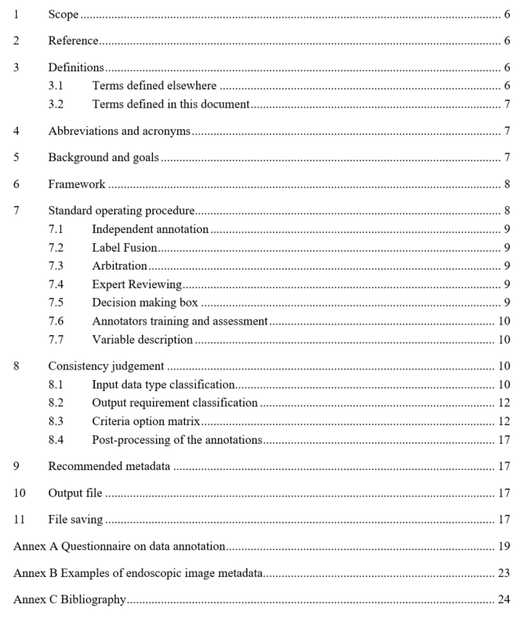
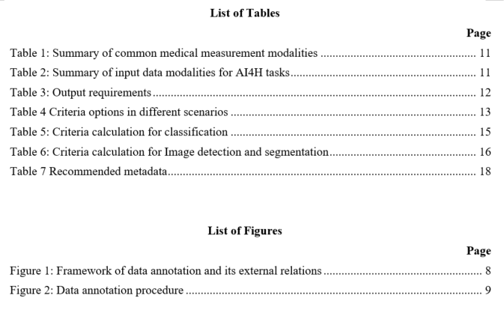
Content

Slide 5
Background
AI technology can only be used with complete confidence if it has been quality controlled through a rigorous evaluation in a standardized way.
Data annotation would be one of the most dependable factors on model performance. In the case of mislabelled or inaccurate training instances, it is difficult for the supervised model to learn correctly.
Quality control on data annotation is especially critical to models based on large-scale dataset.

Slide 6
Objectives
To assist the quality control of data annotation from standard operating procedure.
To reduce model performance problems caused by inconsistent data annotations.
To enable large-scale dataset projects on high diversity of data formats and multi-annotators.
To facilitate the training and education for non-professional annotators and improve common understandings.

Slide 7
Framework
Dataset
Input
Training dataset
Validation dataset
Test dataset
Annotators
Data Annotation
Standard Operating Procedure (SOP)
Supervised Machine Learning
Tools
Training Process
Testing & Evaluation
Output
Annotation Metadata
Figure 1: Framework of data annotation and its external relations

Slide 8
Standard operating procedure
Data Distribution
Independent Annotation
Arbitration
Annotator
-
1
Annotator
-
2
Annotator
-
i
Annotator
-
n
Annotation
??
Annotation
Annotation 1
Annotation 2
??
Annotation i
??
Annotation n
n+1
n+m
Label Fusion
Label Fusion
Consistency in
No
No
Consistency in
Labeling
Labeling
Expert
Yes
Reviewing
Yes
yes
No
Put in the Annotation Metadata Set
Put in the Annotation Metadata Set
Put in the Annotation Metadata Set
Put in the
Put in the
Put in the
training set
training set
training set
Discard
Figure 2: Data annotation procedure

Slide 9
Consistency judgement
Two factors to consider
  Input data type (P11 in slides, clause 8.1 in doc)
  Output requirement (P12 in slides, clause 8.2 in doc)
Options on consistency criteria
  Criteria option matrix (P13 in slides, clause 8.3 in doc)

Slide 10
Input modalities
Table 2: Summary of input data modalities for AI4H tasks
Data | Dimensionality | Description | Examples
Image | 2D | Two-dimensional medical imaging | Fundus photos
3D images | 3D | Three-dimensional spatial imaging | Sets of CT slices
4D | 4D（3D+t） | 3D space imaging changes over time | Heart film imaging
Video | 2D +t | Camera or monitor recording | Falls among the elderly
Audio/ signal | 1D +t | Sound or transmitted in signal form. | Heart sound /ECG
Text | 1D, 2D | Structured/ unstructured description in words | Case history, diagnosis extraction
Single number | 1D | Single measurement data | Blood pressure or respiratory rate

Slide 11
Output requirements
Table 3: Output requirements
Task | Description | Examples
Classification | The problem of classifying instances into two or more classes. | Identify abnormal tissue Diabetic retinopathy grade
Detection | Identify an object, usually marked with rectangle for further processing. | Detect the position of a coronary plaque for further processing
Segmentation | separate certain lesions, and draw the specific outline of the lesion | Tumour segmentation
Localization | Calculate the central coordinate of the anatomical structure | Localize the optic disc or macular fovea for further analysis of ocular fundus diseases

Slide 12
Criteria option matrix
Table 4 Criteria options in different scenarios
Task Data type | Classification | Detection | Segmentation | Localization
Image | Type 1: Classification | Type 2: Detection and segmentation for images |  | Type 3: Localization
3D images |  | (a) slicing 3D data into different 2D views before fusing to obtain a final detection or segmentation regions (b) exploit the 3D data by using architectures that perform 3D convolutions and then train the network from scratch on 3D medical images[1][2][3][4] |  | (a) slicing 3D data into 2D views to obtain the regions of the target object before calculate the final position coordinate (b) exploit the 3D data by using architectures that perform 3D convolutions and then train the network from scratch on 3D medical images
4D |  | condensing the 4D data into three dimensions |  | _
Video |  | condensing the 2D +t data into three dimensions |  | _
Audio/ signal
Text
Single number

Slide 13
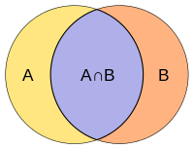
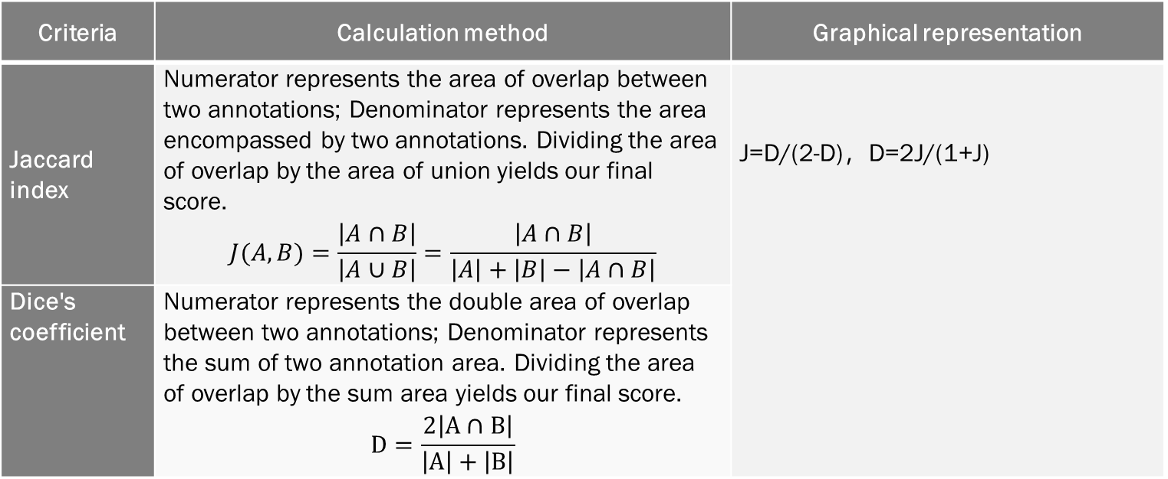
Criteria calculation
Table 6: Criteria calculation for Image detection and segmentation
Criteria | Calculation method | Graphical representation
Jaccard index | Numerator represents the area of overlap between two annotations; Denominator represents the area encompassed by two annotations. Dividing the area of overlap by the area of union yields our final score. $$J(A,B)=\frac{\left|A∩B\right|}{\left|A∪B\right|}=\frac{\left|A∩B\right|}{\left|A\right|+\left|B\right|−\left|A∩B\right|}$$ | J=D/(2-D)，D=2J/(1+J)
Dice's coefficient | Numerator represents the double area of overlap between two annotations; Denominator represents the sum of two annotation area. Dividing the area of overlap by the sum area yields our final score. $$D=\frac{2\left|A∩B\right|}{\left|A\right|+\left|B\right|}$$

Slide 14
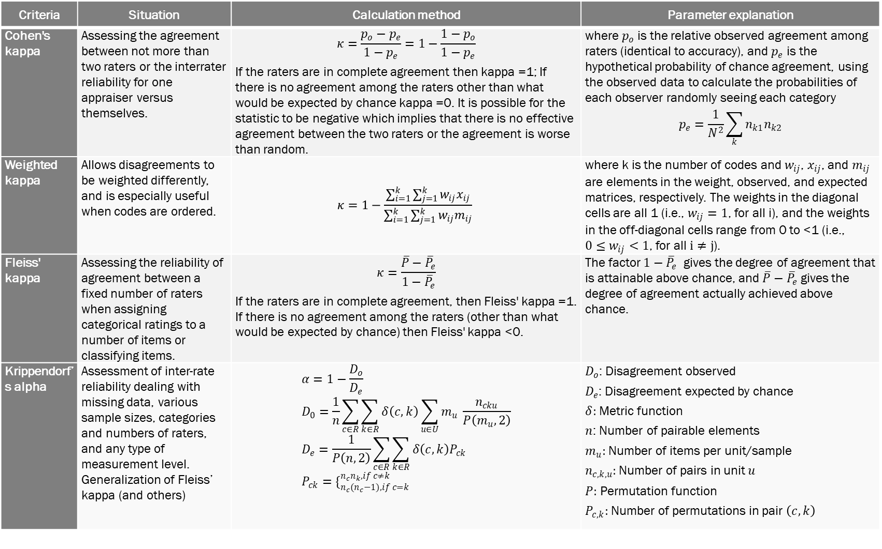
Table 5: Criteria calculation for classification
Criteria | Situation | Calculation method | Parameter explanation
Cohen's kappa | Assessing the agreement between not more than two raters or the interrater reliability for one appraiser versus themselves. | $$κ=\frac{p_{o}−p_{e}}{1−p_{e}}=1−\frac{1−p_{o}}{1−p_{e}}$$ If the raters are in complete agreement then kappa =1; If there is no agreement among the raters other than what would be expected by chance kappa =0. It is possible for the statistic to be negative which implies that there is no effective agreement between the two raters or the agreement is worse than random. | where $p_{o}$ is the relative observed agreement among raters (identical to accuracy), and $p_{e}$ is the hypothetical probability of chance agreement, using the observed data to calculate the probabilities of each observer randomly seeing each category $$p_{e}=\frac{1}{N^{2}}\sum_{k}{n_{k1}n_{k2}}$$
Weighted kappa | Allows disagreements to be weighted differently, and is especially useful when codes are ordered. | $$κ=1−\frac{\sum_{i=1}^{k}{\sum_{j=1}^{k}{w_{ij}x_{ij}}}}{\sum_{i=1}^{k}{\sum_{j=1}^{k}{w_{ij}m_{ij}}}}$$ | where k is the number of codes and $w_{ij}$, $x_{ij}$, and $m_{ij}$ are elements in the weight, observed, and expected matrices, respectively. The weights in the diagonal cells are all 1 (i.e., $w_{ij}=1$, for all i), and the weights in the off-diagonal cells range from 0 to <1 (i.e., ${0≤w}_{ij}<1$, for all $i≠j$).
Fleiss' kappa | Assessing the reliability of agreement between a fixed number of raters when assigning categorical ratings to a number of items or classifying items. | $$κ=\frac{\overline{P}−{\overline{P}}_{e}}{1−{\overline{P}}_{e}}$$ If the raters are in complete agreement, then Fleiss' kappa =1. If there is no agreement among the raters (other than what would be expected by chance) then Fleiss' kappa <0. | The factor $1−{\overline{P}}_{e}$ gives the degree of agreement that is attainable above chance, and $\overline{P}−{\overline{P}}_{e}$ gives the degree of agreement actually achieved above chance.
Krippendorf’s alpha | Assessment of inter-rate reliability dealing with missing data, various sample sizes, categories and numbers of raters, and any type of measurement level. Generalization of Fleiss’ kappa (and others) | $$α=1−\frac{D_{o}}{D_{e}} \\ D_{0}=\frac{1}{n}\sum_{c∈R}{\sum_{k∈R}{δ\left(c,k\right)}\sum_{u∈U}{m_{u} }\frac{n_{cku}}{P\left(m_{u},2\right)}} \\ D_{e}=\frac{1}{P\left(n,2\right)}\sum_{c∈R}{\sum_{k∈R}{δ\left(c,k\right)P_{ck} }} \\ P_{ck}=\{_{n_{c}(n_{c}−1), if c=k}^{n_{c}n_{k}, if c≠k}$$ | $D_{o}$: Disagreement observed $D_{e}$: Disagreement expected by chance $δ:$ Metric function $n$: Number of pairable elements $m_{u}:$ Number of items per unit/sample $n_{c,k,u}:$Number of pairs in unit $u$ $P:$ Permutation function $P_{c,k}:$ Number of permutations in pair $\left(c,k\right)$

Slide 15
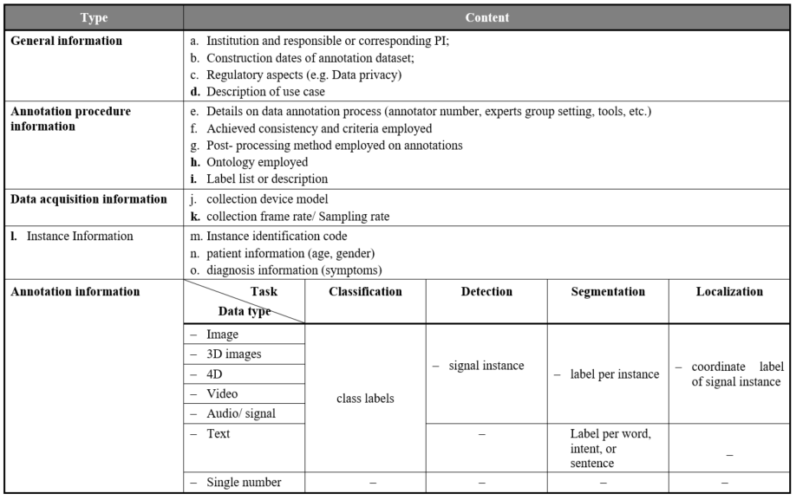
Table 7 Recommended metadata

Slide 16
Output file & File saving
The output files include the annotation documents and the origin images. The formats of the annotation documents include but are not limited to xml, json, txt, etc. The annotation documents should include at least three items: image path, object name and object coordinates. Supporting document may be given if it’s necessary to interpret the annotation information.
Both the images and the documents should be named according to the same rules for easy querying. For example, they can be named with the number of the classification of the object, and the document’s name is the same with the corresponding origin images.

Slide 17
FGAI4H
M-meeting, 28-30 September 2021
Thank you

Slide 18
Annex 1: Common medical measurement
Table 1: Summary of common medical measurement modalities
 | Dimensionality | Description | Anatomies
X-ray | 2D, 2D+t | Produces images by measuring the attenuation of X-ray through the body, via a detector array | Most organs
CT | 2D, 3D, 3D+t | Creates 2D cross-sectional images of the body by using a rotating X-ray source and detector | Most organs
Ultrasound | 2D, 2D+t, 3D, 3D+t | A transducer array emits acoustic pulses and measure he echoes from tissue scatters ¹ | Most organs
MRI | 3D, 3D+t | Use a magnetic field to align protons; RF and gradient pulses are used to selectively excite protons in tissues and blood in order to measure their spatially encoded unclear magnetic resonance signals | Most organs
Nuclear | 2D, 3D, 3D+t | Measures the emission of gamma rays through decay of radioisotopes introduced into the body via external detectors/Gamma cameras. ¹ | All organs with radioactive tracer uptake
Microscopy | 2D, 3D, 3D+t | Typically uses an illumination source and lenses to magnify specimens before capturing an image¹ | Primarily biopsies and surgical specimens

