Slide 1
FGAI4H-N-048-A01
E-meeting, 15-17 February 2022
Source: | Editors DEL7.4
Title: | DEL7.4 Update - Att.1 Presentation
Purpose: | Discussion
Contact: | Naomi Lee Shubs Upadhyay Eva Weicken | E-mail: naomi.lee@lancet.com E-mail: shubs.upadhyay@ada.com E-mail: eva.weicken@hhi.fraunhofer.de
Abstract: | This PPT contains a presentation of: Status update Working Group on Clinical Evaluation Updates on DEL 7.4

Slide 2
Working Group on Clinical Evaluation Deliverable 7.4
FG-AI4H meeting “N”, 15 – 17 February 2022

Slide 3
Overview
Introduction WG-CE
Status Update
Summary of Del. 7.4 (final version 1.1)

Slide 4
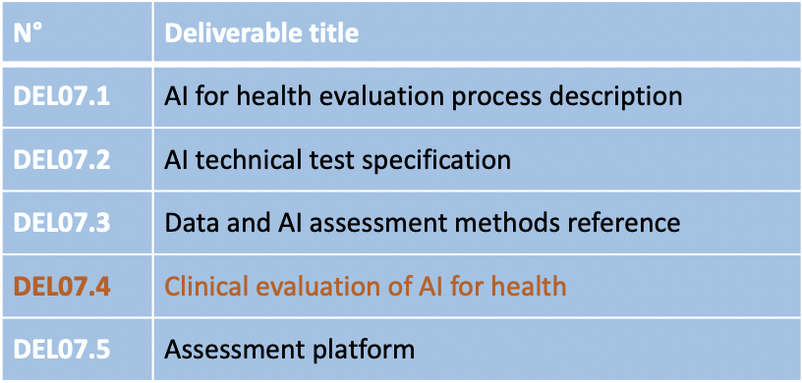
Introduction WG Clinical Evaluation (WG-CE)
Scope & Objective
Collaboration
Guidance for best practice evaluation & principles
Special consideration LMIC settings
Framework for: clinicians, researchers, developers, regulators, policy makers & patients, public
Intended to be used together with other FG-AI4H guidance

Slide 5
Collaboration
65+ members
AbouElkhir Osama, Akogo Darlington, Allen Megan, Alsalamah Shada, Balachandran Pradeep, Bastawrous Andrew, Bathke Arne, Chiavegatto Filho Alexandre, Darkoh Ernest, Ehrenfeld Jesse, Fehr Jana, Fürstenau Daniel, Gaudin Robert, Gilbert Stephen, Greaves Felix, Gupta Saurabh, Gütter Zdenek, Hatton Grace, Ho Dean, Ibrahim Hussein, Islam Shariful, Jarral Reza, Jeon Jonghong, John Oommen, Kadam Rigveda, Kherif Ferath, Kuku Stephanie, Kurtys Michal, Lapão Luís, Linder Nina, Loh Irv, Loveys Kate, Magrabi Farah, Mahajan Arnav, Malpani Rohit, Mamun Khondaker, Masud Jakir Hossain Bhuiyan, Matin Rubeta, Matthew Fenech, McCradden Melissa, Menezes Audrey, Murchison Andrew, Murphy Lisa, Nakasi Rose, Oala Luis, Pankova Natalie, Piekut Agata, Porras Lina, Reddy Sandeep, Salim Ally, Schwendicke Falk, Sethi Tavpritesh, Sood Harpreet, Sousa Inês, Srivastava Manish, Starlinger Johannes, Wasswa William, Werneck Leite Alixandro
Writing group: Carolan Jane, Denniston Alastair, Lee Naomi, Liu Xiao, Karpathakis Kassandra, Upadhyay Shubs, Weicken Eva, Wilkinson Tommy

Slide 6
Overview
Introduction WG-CE
Status Update
Summary of Del. 7.4 (final version 1.1)

Slide 7
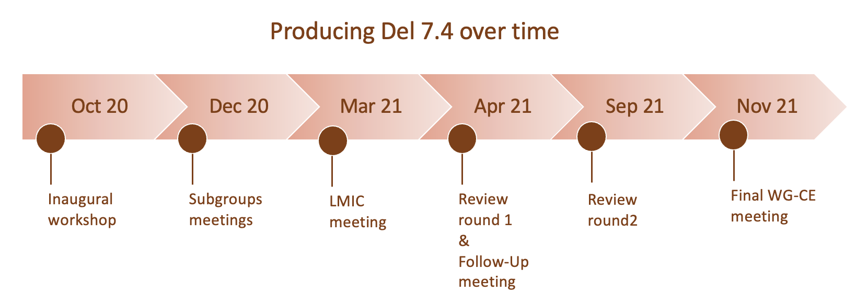
Timeline
Feb 22
FG-AI4H „N“ final document
version 1.1

Slide 8
Activities since meeting M
FG-AI4H Collaboration
AI Auditing
Asked for a condensed overview of CE for auditing purposes
Extracted a summarised guidance to be used by auditing teams
Meeting about „Cybersecurity“ with Catherine Lowe & Pat Baird
Implementation of WG-Ethics input

Slide 9
Activities since meeting M
Summary of changes (final version 1.1)
Implementation of written & verbal WG-CE feedback
Recommendations
Addition of executive summary & summary table
Restructuring/Condensing of sections
Revision of diagram

Slide 10
Overview
Introduction WG-CE
Status Update
Summary of Del. 7.4 (final version 1.1)

Slide 11
Deliverable 7.4 (final version 1.1)
Table of content
Executive Summary
Introduction
Model design and suitability
Algorithmic validation
Clinical validation
Deployment and ongoing monitoring
Economic evaluation
Conclusions and recommendations for future action
References
posted on collaboration site: Del 7.4/N-048

Slide 12
Framework for evaluation of AI technologies in health

Slide 13
Evaluation phase & report content
1 Design & Purpose
Description of the clinical problem and intended clinical pathway, intended benefits & risks of AI use
Evaluation of interoperability and security
Description of stakeholder engagement and user testing
2 Analytical validation
Description of data used for development and testing
Type of model, performance metrics, comparison against the current standard of care
Results of any benchmarking against either current standard of care or other models

Slide 14
Evaluation phase & report content
3 Clinical validation
Description of the clinical evaluation (study design, population, setting, intervention, comparator, pre specified outcomes)
Transparent reporting (EQUATOR & standard performance metrics)
Details of any regulatory approval, if required
4 Ongoing monitoring
Description of ongoing monitoring in place
How will adverse events be collected? When will the model be audited and by whom?
Clear reporting of the audits to describe the post-deployment performance

Slide 15
Evaluation phase & report content
Across all 4 Phases:
Economic evaluation
comparative measurement of the expected costs relative to its expected impacts when implemented in a particular context
reasonable level of reimbursement is required
Ethics considerations
meet standards of scientific validity, accuracy, explainability, reproducibility applied
Consideration of appropriate adaptation to LMICs, potential benefits and risks

Slide 16
Conclusions & Recommendations for future action (I)
Guidance provides a framework for current best-practice evaluation of AI health technologies that if applied will work towards ensuring AI systems are effective, safe, cost effective, ethical, inclusive, fair (urgent global priority).
This requires input from a wide range of stakeholders.
Evaluation must be transparent, results open and accessible to build trust and enable stakeholders having evidence to assess the safety, effectiveness and value of AI and its performance

Slide 17
Conclusions & Recommendations for future action (II)
Areas of future actions
High quality datasets to train & evaluate the performance of health AI systems
Clinical studies are essential (assess whether in silico performance translates into measurable benefit in the real world)
Acquisition of relevant health economic data (to support decisions & underpin public trust)
Much more active role for health technology assessment (HTA) in addition to regulators

Slide 18
Next steps & publication plans
To-Do: define and add relevant terms to common unified terms deliverable 0.1
Share the draft with WHO for review and publication possibly together with WG-RC guidance

Slide 19
Thank you!
AbouElkhir Osama, Akogo Darlington, Allen Megan, Alsalamah Shada, Balachandran Pradeep, Bastawrous Andrew, Bathke Arne, Chiavegatto Filho Alexandre, Darkoh Ernest, Ehrenfeld Jesse, Fehr Jana, Fürstenau Daniel, Gaudin Robert, Gilbert Stephen, Greaves Felix, Gupta Saurabh, Gütter Zdenek, Hatton Grace, Ho Dean, Ibrahim Hussein, Islam Shariful, Jarral Reza, Jeon Jonghong, John Oommen, Kadam Rigveda, Kherif Ferath, Kuku Stephanie, Kurtys Michal, Lapão Luís, Linder Nina, Loh Irv, Loveys Kate, Magrabi Farah, Mahajan Arnav, Malpani Rohit, Mamun Khondaker, Masud Jakir Hossain Bhuiyan, Matin Rubeta, Matthew Fenech, McCradden Melissa, Menezes Audrey, Murchison Andrew, Murphy Lisa, Nakasi Rose, Oala Luis, Pankova Natalie, Piekut Agata, Porras Lina, Reddy Sandeep, Salim Ally, Schwendicke Falk, Sethi Tavpritesh, Sood Harpreet, Sousa Inês, Srivastava Manish, Starlinger Johannes, Wasswa William, Werneck Leite Alixandro, Carolan Jane, Denniston Alastair, Lee Naomi, Liu Xiao, Karpathakis Kassandra, Upadhyay Shubs, Weicken Eva, Wilkinson Tommy

