Slide 1
FGAI4H-N-047
E-meeting, 15-17 February 2022
Source: | Co-chairs AHG-DT4HE
Title: | Updated FG AI4H DT4HE Output "Guidance on AI and digital technologies for COVID health emergency“ – Presentation
Purpose: | Discussion
Contact: | Shan Xu, CAICT, China | E-mail: xushan@caict.ac.cn
 | Ana Rivière Cinnamond, PAHO/WHO | Email: rivierea@paho.org
Abstract: | This PPT contains a presentation of the updated AHG-DT4HE output document presented at Meeting N of the FG-AI4H (e-meeting), 15-17 February 2022.

Slide 2
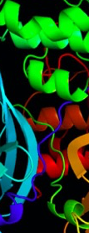
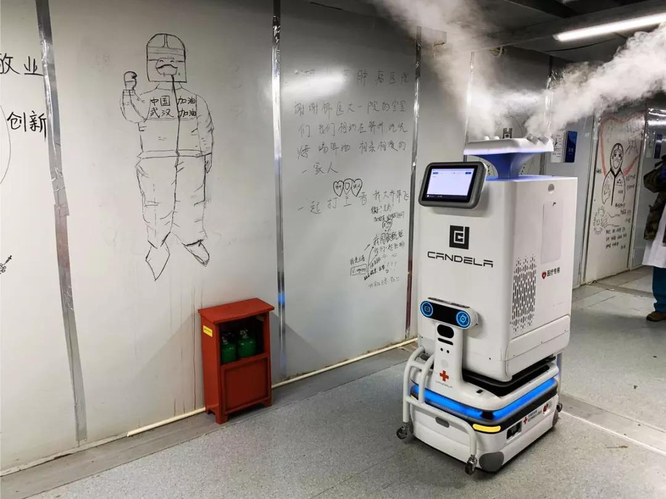

Guidance on digital technologies for COVID health emergency
AHG-DT4HE: Ad-hoc group on digital technologies for COVID health emergency

Slide 3
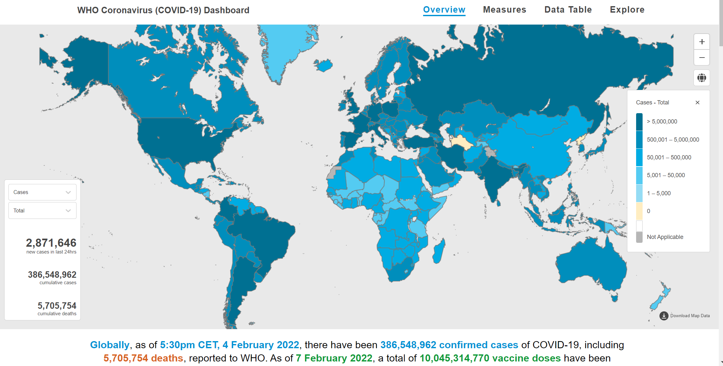
Introduction
WHO Coronavirus Disease (COVID-19) Dashboard, https://covid19.who.int/

Slide 4

AHG-DT4HE Roadmap
Long-term
This document evolves towards a more generalizable framework on the health emergency continuum, applicable to other health emergencies, and contributes to global digital public health.
Mid-term
To summarize experience extracted from COVID-19.
To deliver a guidance on digital technologies-based approach that cover the entire cycle of public health emergency management.
Short term
A mechanism to collect effective experience on AI and other digital health technologies in combating COVID-19, including:
-use cases
-best practice
-experts network
Ad-hoc Group on “Digital Technologies for COVID Health Emergencies”, https://www.itu.int/en/ITU-T/focusgroups/ai4h/Pages/dt4he.aspx

Slide 5
Mechanism
Experts | Affiliation
Ananya Gangavarapu | Ethicallyai
Andrea Romaoli Garcia | UNITED NATIONS. ISOC/ICANN. FIBREE FOUNDATION
Dean Ho | The N.1 Institute for Health (N.1)/The Institute for Digital Medicine (WisDM)
Jonghong Jeon | Electronics and Telecommunications Research Institute (ETRI)
Kirmene Marzouki | SPIKE-X
Mo Murhaba | Independent
Nejma Cheikh | World Bank
Patricia Mechael | Health Enabled
Pradeep Balachandran | Independent Consultancy
Riviere-Cinnamond, Dra. Ana | Pan American Health Organization
Shan Xu | China Academy of Information Technology
Shariful Islam | Deakin University
Wasswa William | Mbarara University of Science and Technology
Zara Shubber | World Bank
Weekly con-call:
22 meetings have been held every Mondays at 3:00pm Washington DC time (EST) since Jun 12
Collaboration site:
https://extranet.itu.int/sites/itu-t/focusgroups/ai4h/SitePages/AHG-DT4HE.aspx
Documents:
Continuous iteration on the Guidance on digital technologies for COVID health emergency

Slide 6
Enablement Factors
Prevention
Early detection
Surveillance
Information
Network
Early screening systems（e.g. point-of-entry syndrome screening）
Contact tracing
AI-powered epidemiological models
Information publication platform or dashboard
Fight misinformation
Wireless Communication, Internet, and Routers.
Preparedness
Training
Supply
Living Support
Data resource
Personnel capacity building (professional development for health workers)
Emergency supply chain management system
Medical waste system
Emergency support for life necessities and mental health
Data Resource, storage, curation, and integration to data repositories
Computing capability
Response
Healthcare service
Delivery
R&D
Smartphones, Edge devices, Elastic Cloud Resources
Virtual assistants, chatbots, online service
Medical imaging auxiliary diagnosis
Contactless delivery
Disinfection robot
Developments of drugs and vaccines
Algorithm
Recovery
Monitor
Supervised, unsupervised, and reinforcement learning.
Treatment monitoring
Service monitoring
Economic monitoring
Digital governance
Evaluation Criteria
governance factors on AI and other digital interventions in health emergencies.
measures and indicators to evaluate the performance and applicability.
AI applications at different stages of the COVID-19 response (adapted from OECD)

Slide 7
Current activities
Case collection:
  Already collected information on DT used in the context of the COVID-19 emergency cycle;
  Continue the collection of typical cases in different countries and regions by designing a questionnaire to collect further information.

Slide 8
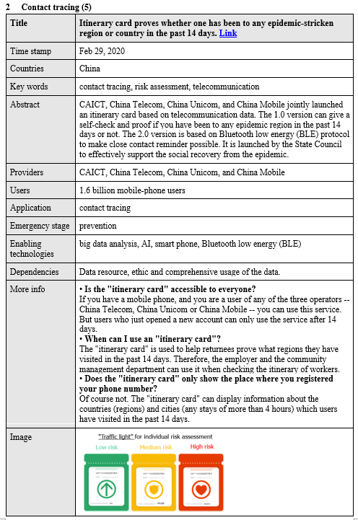
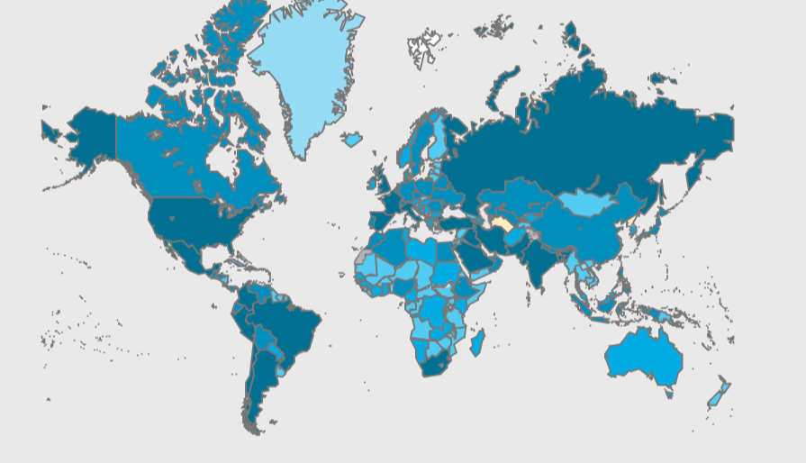

A - Case Collection
Canada, 1 case
Danish, 1 case
UK, 3 cases
USA, 6 cases
UAE, 1 case
Japan, 1 case
Saudi, 1 case
China, 11 cases
India, 1 case
Australia, 1 case
27 cases in the current stage, the collection will continue…

Slide 9
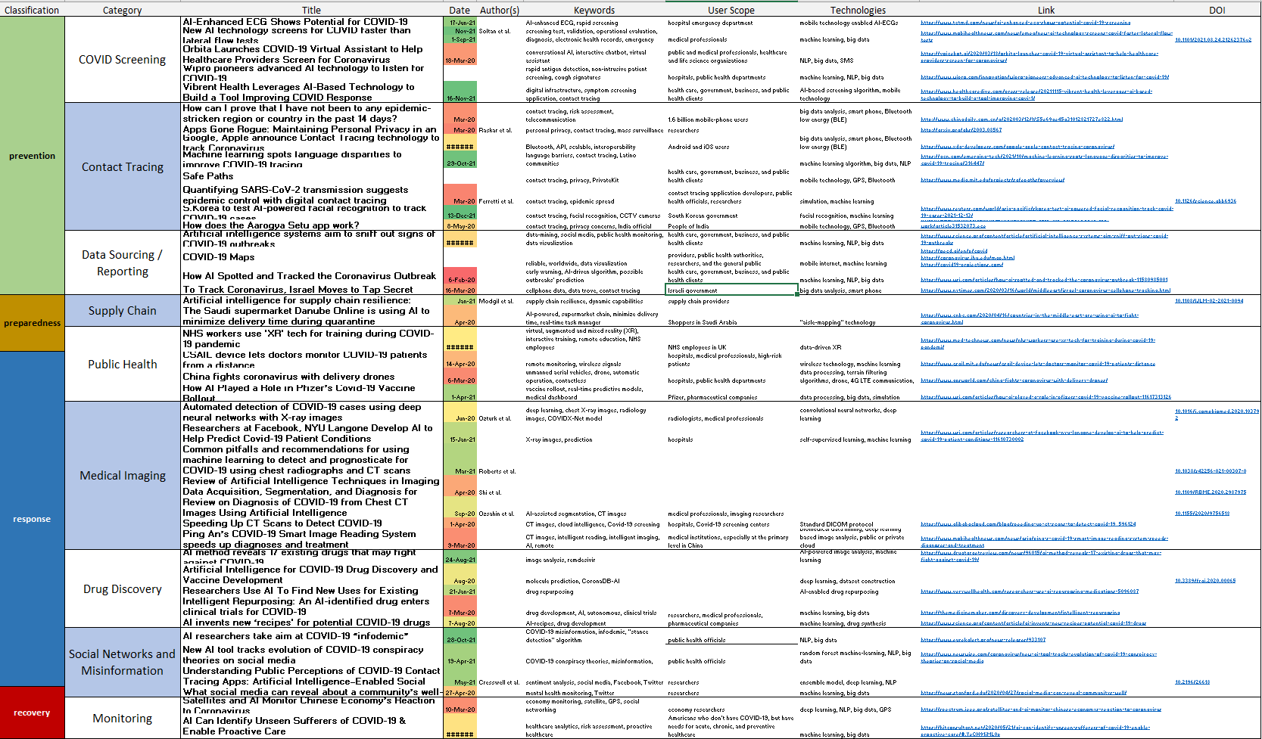
A- Case collection (cont)
44 referenced articles where DT4ER with AI focus have been identified and classified within the PPRR framework

Slide 10
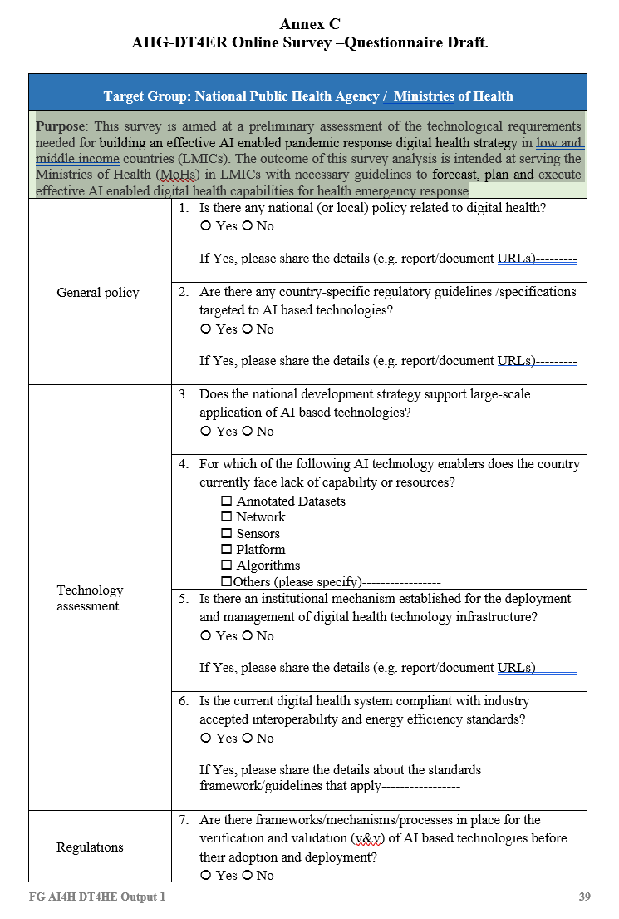
B - Questionnaire
Purpose: This survey is aimed at a preliminary assessment of the technological requirements needed for building an effective AI enabled pandemic response digital health strategy in low- and middle-income countries (LMICs).
The outcome of this survey analysis is intended at serving the Ministries of Health (MoHs) in LMICs with necessary guidelines to forecast, plan and execute effective AI enabled digital health capabilities for health emergency response.

Slide 11
Next Steps
Technical Enablement: identify minimum set of requirements for the technical enablement components such as network, data resource, computing capacities, etc.
Digital governance: considers governance factors on AI and other digital interventions on COVID-19 and other health emergencies.
Outcome Evaluation: Contains measures and indicators to evaluate the outcome and applicability of different AI and digital interventions.

Slide 12
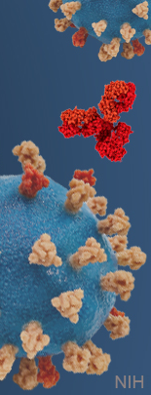
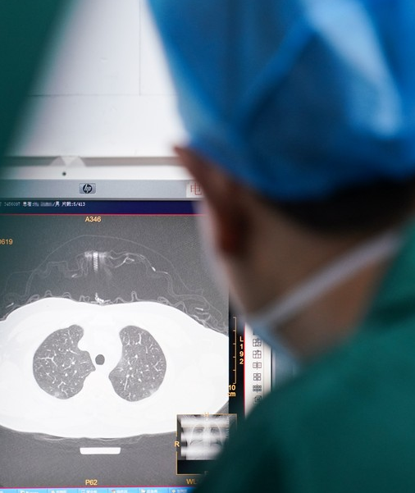
Thank you
contact：rivierea@paho.org, xushan@caict.ac.cn

Slide 13
Annex: How AHG serves FG & TGs
To give a broader landscape and integration of AI4H or DT4H on public health perspective
TG-Symptom
TG-Outbreaks
Enablement Factors
Prevention
Early detection
Surveillance
Information
Network
Early screening systems（e.g. point-of-entry syndrome screening）
Contact tracing
AI-powered epidemiological models
Information publication platform or dashboard
Fight misinformation
Wireless Communication, Internet, and Routers.
Preparedness
Training
Supply
Living Support
Data resource
Personnel capacity building (professional development for health workers)
Emergency supply chain
Medical waste system
Emergency support for life necessities and mental health
Data Resource, storage, curation, and integration to data repositories
TG-DiagnosticCT, TG-Histo, TG-Radiology
Computing capability
Response
Healthcare service
Delivery
R&D
Smartphones, Edge devices, Elastic Cloud Resources
Virtual assistants, chatbots, online service
Medical imaging diagnosis
Contactless delivery
Disinfection robot
Developments of drugs and vaccines
Algorithm
Recovery
Monitor
Supervised, unsupervised, and reinforcement learning.
Treatment monitoring
Service monitoring
Economic monitoring
Digital governance
Evaluation Criteria
governance factors on AI and other digital interventions in health emergencies.
measures and indicators to evaluate the performance and applicability.

