Slide 1
FGAI4H-N-046
E-meeting, 15-17 February 2022
Source: | WG-O
Title: | Publication of ​Focus Group Deliverables
Purpose: | Discussion
Contact: | Simão Campos, ITU | E-mail: simao.campos@itu.int
Contact: | Eva Weicken, Fraunhofer HHI | E-mail: eva.weicken@hhi.fraunhofer.de
Contact: | Matthias Gröschel, ITU | E-mail: matthias.groeschel@itu.int
Abstract: | This PPT contains a presentation on the publication of focus group deliverables.

Slide 2
Publication of Focus Group Deliverables
Simão Campos, Eva Weicken, Matthias Gröschel

Slide 3
Publishing Strategy of the Focus Group
July 2022: Publish 1st set of Deliverables
2022
July 2023: Publish 2nd set of Deliverables
2023
September 2023 Focus Group Transition point

Slide 4
Update on the maturity of Focus Group Deliverables
34 responses (no response: 11)

Slide 5
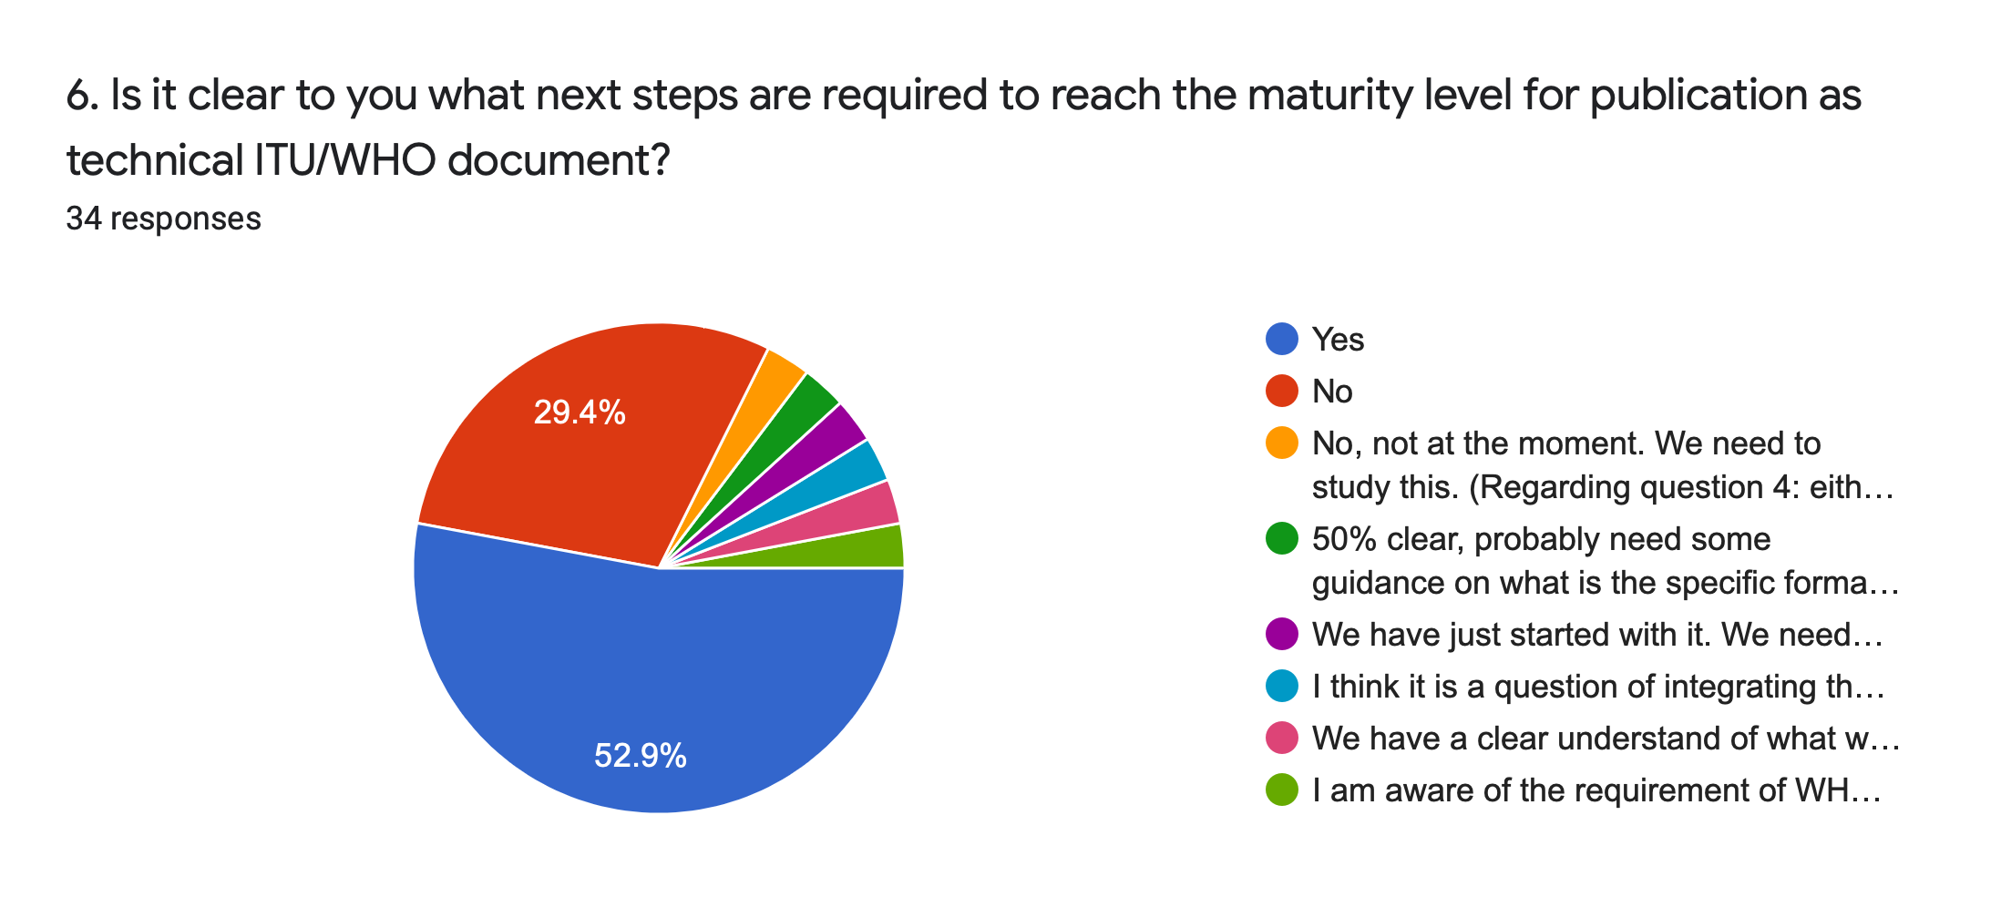
Update on the maturity of Focus Group Deliverables

Slide 6
Update on the maturity of Focus Group Deliverables
Q: What help do you need to get to ~80% maturity of your FG deliverable?
Review and Feedback of other Topic Group / Focus Group members
Expert help
Human resources / Research assistants
Updated figures/tables
More time
Funding
Help on next steps

Slide 7
Publication of your Deliverable

Slide 8
Let’s discuss your questions
What are your concrete next steps at Deliverable driver?
Publish both as ITU deliverable and later as academic paper?
…

