Slide 1
FGAI4H-N-043-A01
E-meeting, 15-17 February 2022
Source: | _SOURCE_
Title: | _MainDocTitle_ – Att.1: Presentation
Purpose: | Discussion
Contact: | Name | E-mail: aaa@b.c
Abstract: | This PPT summarizes the content of N-0xx with _DESCRIPTION_, for presentation and discussion during the meeting.

Slide 2
FGAI4H-N-043-A01
E-meeting, 15-17 February 2022
Source: | Editors DEL9.1
Title: | DEL9.1 Update - Att.1 Presentation
Purpose: | Discussion
Contact: | Manjeet Singh Chalga ICMR, New Delhi , India | E-mail: chalgams.hq@icmr.gov.in
Contact: | Khondaker A Mamun CMED Health Ltd., Dhaka Bangladesh | E-mail: mamun@cmed.com.bd
Contact: | Aveek De CMS – Social Impact Specialists, Bangalore , India | E-mail: aveek@cms-india.org
Contact: | Prashant Chugh , Rakesh Singh Rawat Himani Gandhi, Sameer Ranjan Bidisha Mandal C-DOT, New Delhi, India | E-mail: prashant@cdot.in E-mail: rakeshr@cdot.in E-mail: himani@cdot.in E-mail: sameer@cdot.in E-mail: bidisham@cdot.in
Abstract: | This PPT summarizes the content of N-043 for presentation and discussion during the meeting. Usage of AI in healthcare is a game changer and inevitable. AI-based mobile applications for healthcare are on rise. Since privacy regulations have become stringent globally, AI-based mobile applications in the health domain need to be carefully designed to ensure privacy and security of personal data. This presentation proposes a draft of set of privacy techniques for AI-based mobile apps.

Slide 3
Objectives:
to discuss on development of AI tool for Health using Mobile Applications & Cloud Applications
to provide a forum for open communication among various stakeholders,
to coordinate the benchmarking process in collaboration with the Focus Group management and working groups.

Slide 4
Key features required for development of AI tool for Health using Mobile Application
PAS 277:2015 Health and wellness apps. Quality criteria across the life cycle. Code of practice
Good practice guidelines on health apps and smart devices (mobile health or mhealth)
Guiding Principles of Practice and Transparency for Mobile Health Solutions (CTA-2073)

Slide 5
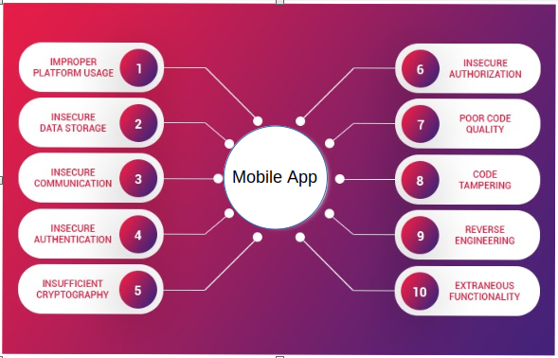
AI-based Mobile Apps for Healthcare : Security Concerns
Best Practices
Risk Analysis
Right Architecture
Minimal App Permission
Enhanced Data Security
Not Saving Password
Enforced Session Logout
Multi Factor Authentication
Is
Security
Enough
?

Slide 6
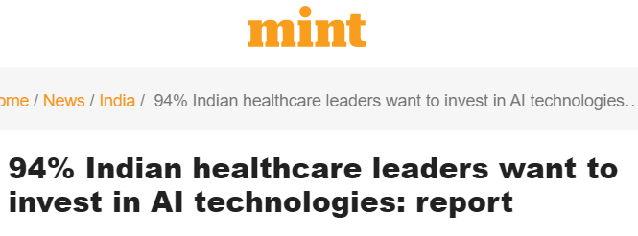
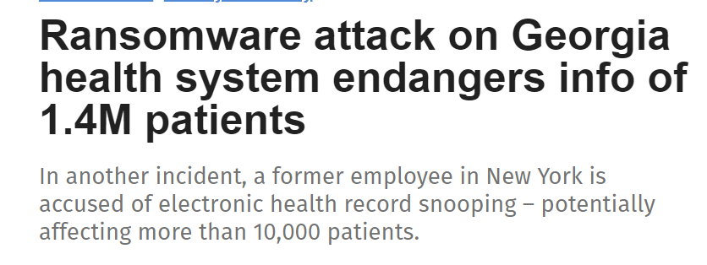
Need for Privacy in AI-based Mobile Apps for Health
Key Motivations
Shortage of Doctors and Diagnostic Centers in India
Recent AI Advances Worldwide in Diagnosis of Diseases
Policy push to telemedicine in India post-COVID-19
Health ID and NDHM pave way for standardized mobile applications
Standardized Applications & remote data analytics require stringent security and privacy
Increasing usage of Cloud for Healthcare Data storage and analytics
Lack of Medical Data records for AI modelling

Slide 7
Need for Privacy Enhancing Technologies (PETs) in Healthcare
Privacy Enhancing Technologies (PETs) refer to the set of techniques that are used to ensure that the data records can be used for AI algorithmic training and inference without disclosing the personal identifiable information (PII) of data records.
The objective of PETs is to respect the privacy and the security of the underlying data while still being able to train and use AI systems.
PETs give additional assurance to the medical data providers (individuals or diagnostic centers or hospitals) to provide medical data records for training and inference of AI-based algorithms for medical diagnosis.
There are multiple hospitals that have patient data. If all that data could be used for AI training and inference using PETs, then much better diagnosis algorithms can be developed and better diagnostic predictions can be provide to the patients

Slide 8
Privacy Enhancing Technologies (PETs)
REMOTE EXECUTION
Federated Learning
On Device Execution
ENCRYPTED EXECUTION
Homomorphic Encryption
Secure Multiparty Computation
DIFFERENTIAL PRIVACY
Centralized
Local

Slide 9
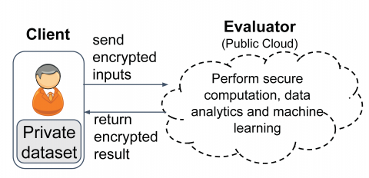
Homomorphic Encryption (H.E.) based Privacy Enhancing Technology
A form of Encryption which allows specific types of operation on ciphertext and generate an encrypted result which, when decrypted, matches the result of operations performed on the plaintext
Homomorphism - structure-preserving map between two algebraic structures (e.g. groups, rings or vector spaces) of the same type
Preserve the operations of the structures
Data owner can encrypt the data with a unique private key. Thus, personal data remains secure and private even when it is being used to train the AI algorithms and provide inference for medical diagnosis

Slide 10
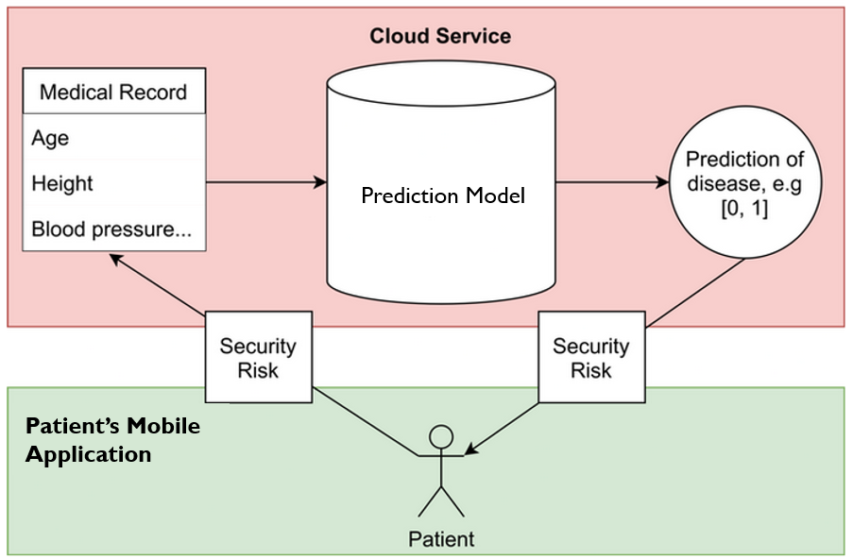
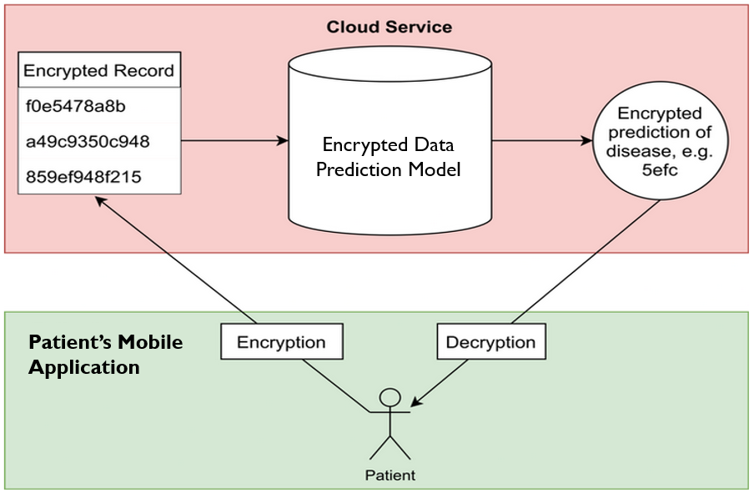
Proposed Workflows of AI-based Mobile Apps with HE-based Privacy Enhancing Technology
Standard workflow
Fully HE workflow

Slide 11
Ethical Issues for Mobile Application for Health
There are 17 principles mentioned in the “ICMR - National Ethical Guidelines For Biomedical And Health Research Involving Human Participants”
According to Principle of professional competence, the app must be developed in consultation with medical experts and contain accurate medical information.
All the guidelines related to Ethics issues must be followed

Slide 12
Thank you

