Slide 1
FGAI4H-N-033-A01
E-meeting, 15-17 February 2022
Source: | Editors DEL7.3
Title: | DEL7.3 update - Presentation
Purpose: | Discussion
Contact: | Luis Oala HHI Fraunhofer, Germany | E-mail: luis.oala@hhi.fraunhofer.de
Abstract: | This PPT contains a presentation of N-033.

Slide 2
Algorithm Auditing &
Quality Control
Operationalizing Evaluation (EP) & Reporting (RP)

Slide 3
overview
motivation
goals
process | tools
vision and next steps
closing remarks
discussion and panel

Slide 4
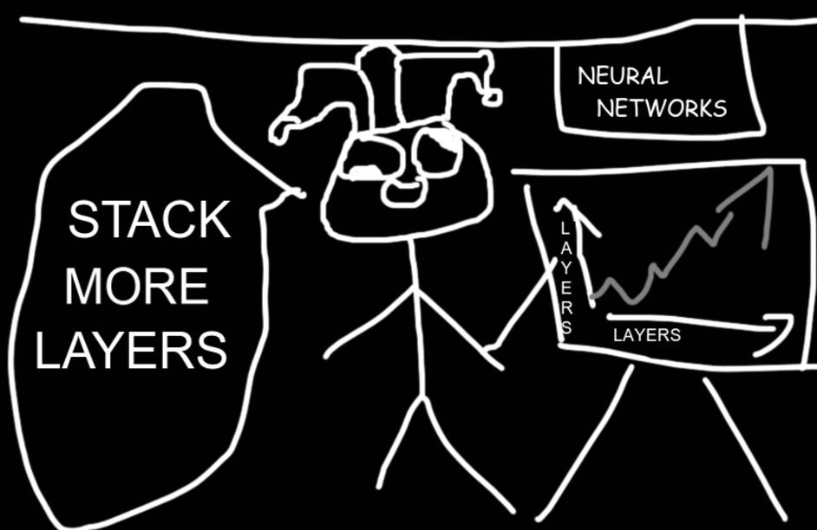
b. motivation 1: of clowns and interfaces
ML engineer

Slide 5
b. motivation 1: of clowns and interfaces
clinician
ML engineer
RCTs
RCTs
RCTs

Slide 6
b. motivation 1: of clowns and interfaces
regulatory
clinician
ML engineer
RCTs
82304
RCTs
RCTs
82304
82304

Slide 7
b. motivation 1: of clowns and interfaces
regulatory*
clinician*
ML engineer*
82304
RCTs
82304
RCTs
RCTs
82304
*This is a work of fiction. Any similarity to actual persons, living or dead, or actual events, is purely coincidental (;

Slide 8
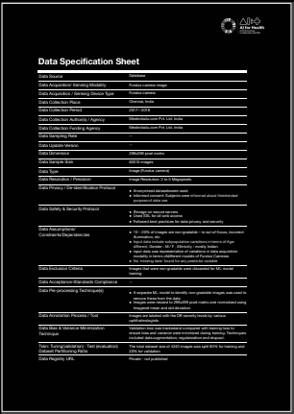
b. motivation 1: of clowns and interfaces
regulatory
clinician
ML engineer
82304
RCTs
82304
RCTs
RCTs
82304
report interface

Slide 9
b. motivation 2: laser in the chaos

Slide 10
b. motivation 2: laser in the chaos

Slide 11
b. motivation 2: laser in the chaos

Slide 12
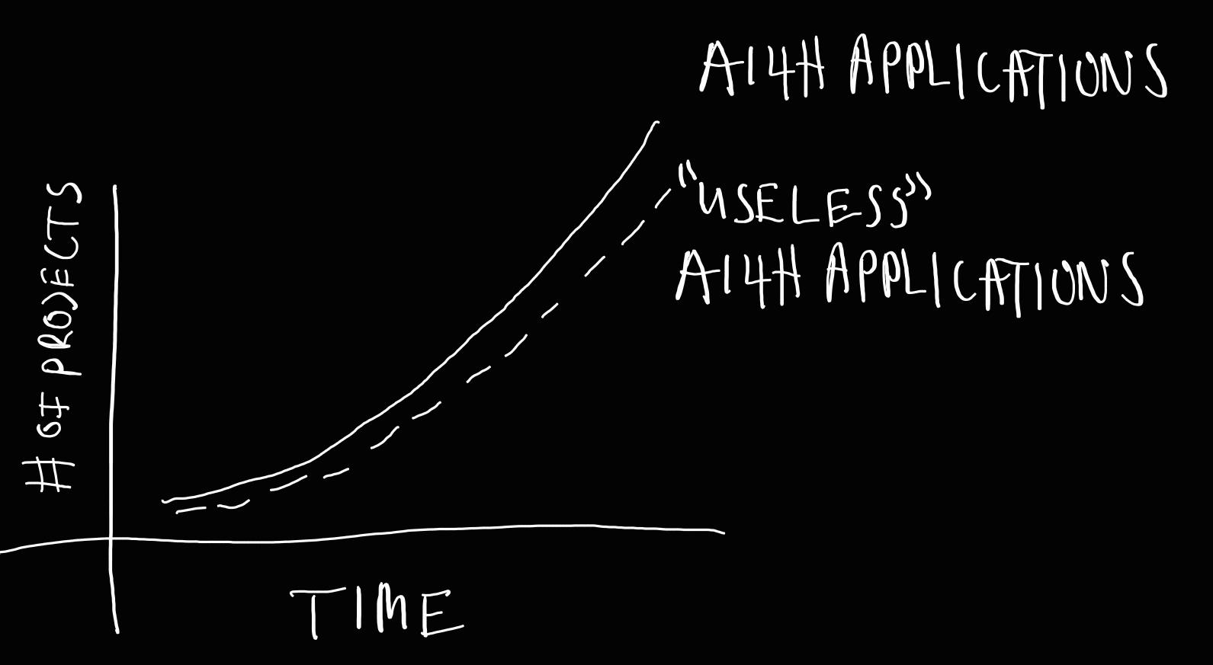
b. motivation 3: operations and clockworks

Slide 13
b. motivation 3: operations and clockworks

Slide 14
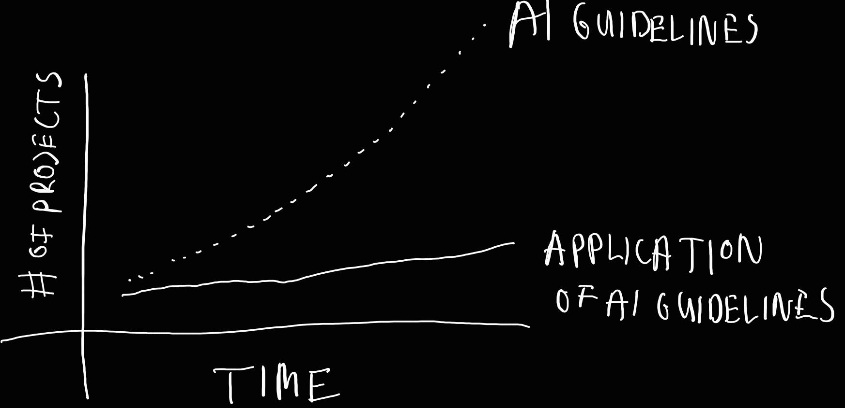
b. motivation 3: operations and clockworks

Slide 15
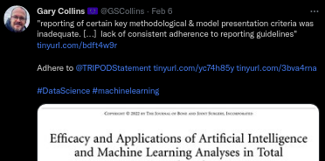
b. motivation 3: operations and clockworks

Slide 16
b. motivation 3: operations and clockworks
1. make integrated evaluation easier (methods, processes, software tools)
2. apply evaluation and reporting protocols -> develop the practice (“culture and job description”) of ai auditing

Slide 17
b. motivation
interfaces
laser in the chaos
clockworks

Slide 18
b. motivation
interfaces
laser in the chaos
clockworks

Slide 19
c. our goals
disentangle conflated ML4H/AI4H questions that have practical relevance and find convincing answers from which we can derive actionable insights
+
build infrastructure and interfaces supporting this activity
+
(maintain infrastructure and interfaces)

Slide 20
d. process
1. take inventory and disentangle

Slide 21
d. process
1. take inventory and disentangle
C
R
ML

Slide 22
d. process
ML4H/AI4H specific AND justified
1. take inventory and disentangle

Slide 23
d. process
ML4H/AI4H specific AND justified
1. take inventory and disentangle
covered by existing good practices

Slide 24
d. process
ML4H/AI4H specific AND justified
1. take inventory and disentangle
covered by existing good practices

Slide 25
d. process
ML4H/AI4H specific AND justified
1. take inventory and disentangle
sometimes amendments might be necessary
covered by existing good practices

Slide 26
d. process
ML4H/AI4H specific AND justified
Resources
TDDs
WG DELs (clinical, regulatory, ethics, DASH, DAISAM), in particular questionnaires and checklists
1. take inventory and disentangle
sometimes amendments might be necessary
covered by existing good practices

Slide 27
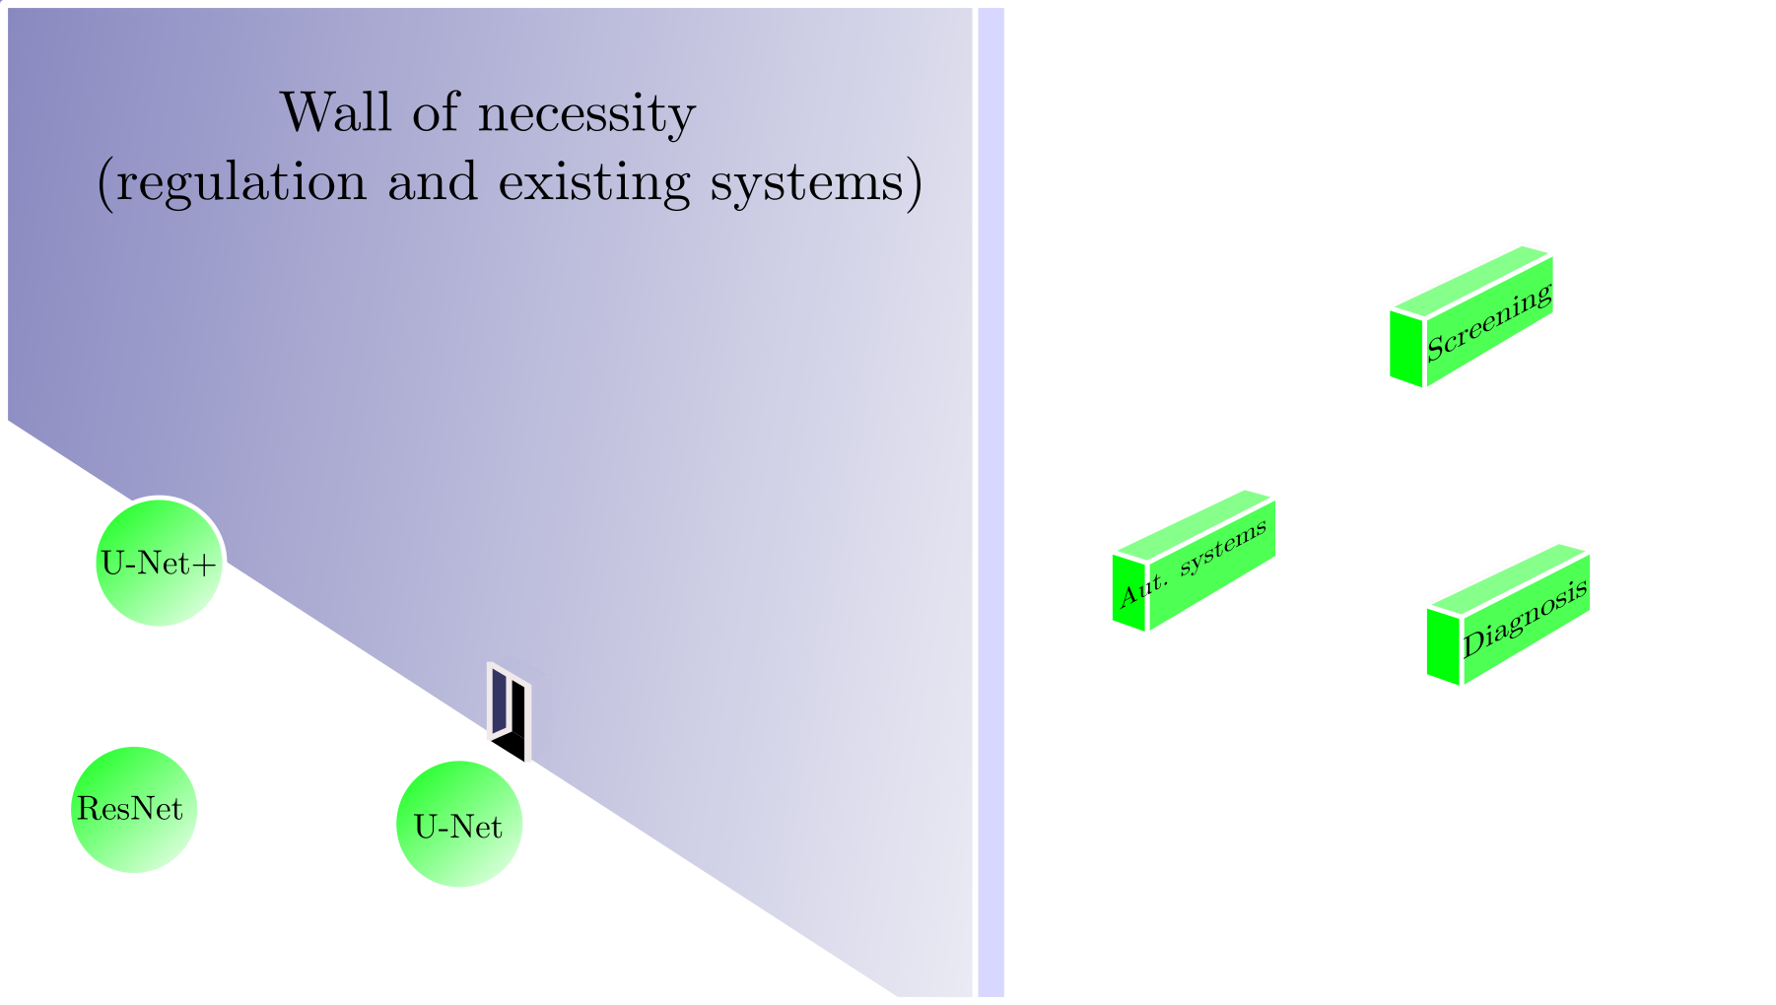
d. process
2. map and connect

Slide 28
d. process
2. map and connect
Resources
DEL 2
TDDs
WG DELs (clinical, regulatory, ethics, DASH, DAISAM), in particular questionnaires and checklists

Slide 29
d. process
3. workflow 1: explore and develop

Slide 30
d. process
3. workflow 1: explore and develop
notebook server
heavy duty computations
Compute
VM
TPU pods

Slide 31
d. process
3. explore and develop
Resources
mlflow repos
DEMO
notebook server
heavy duty computations
Compute
VM
TPU pods

Slide 32
d. process
4. solidify and converge (p for park)

Slide 33
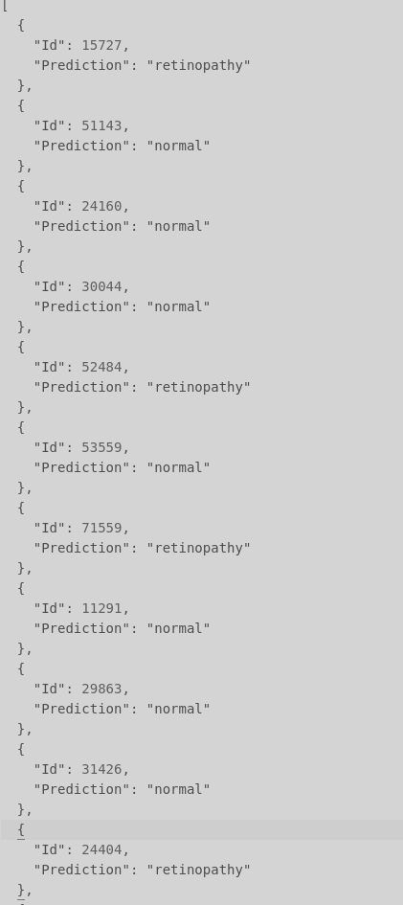
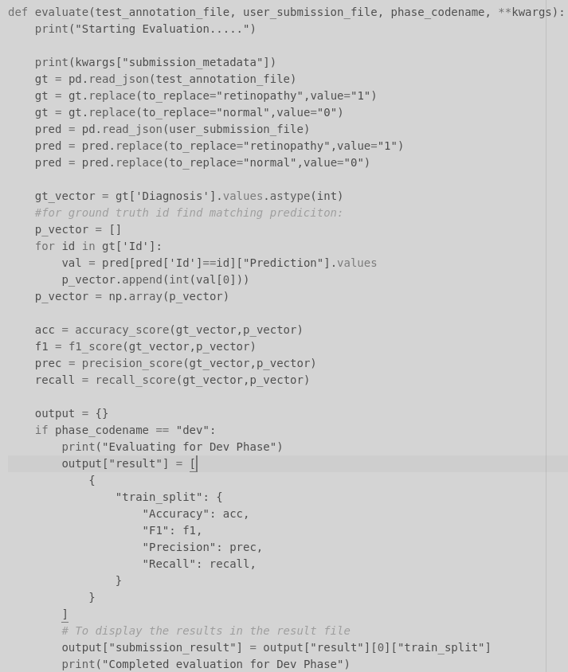
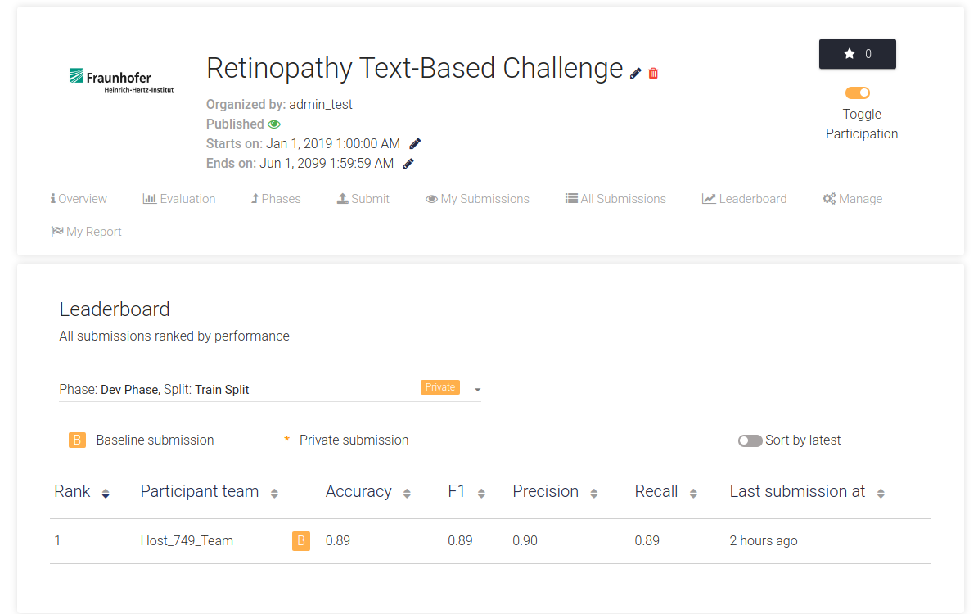
d. process
Resources
platform repo
starter repos
platform links
DEMO
4. solidify and converge (p for park)

Slide 34
d. process
5. use and report

Slide 35
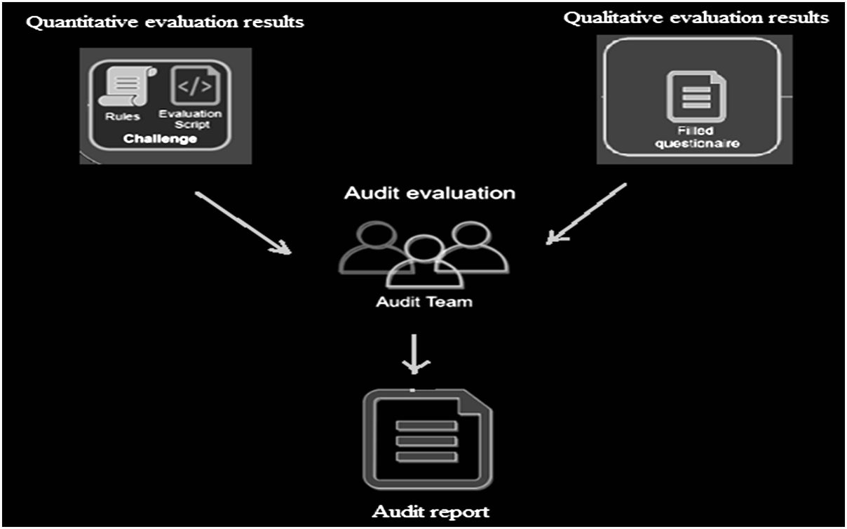
d. process
5. use and report
Resources
TDDs
WG DELs (clinical, regulatory, ethics, DASH, DAISAM), in particular questionnaires and checklists
DEMO (report and questionnaire)

Slide 36
d. process
6. (maintain and update)

Slide 37
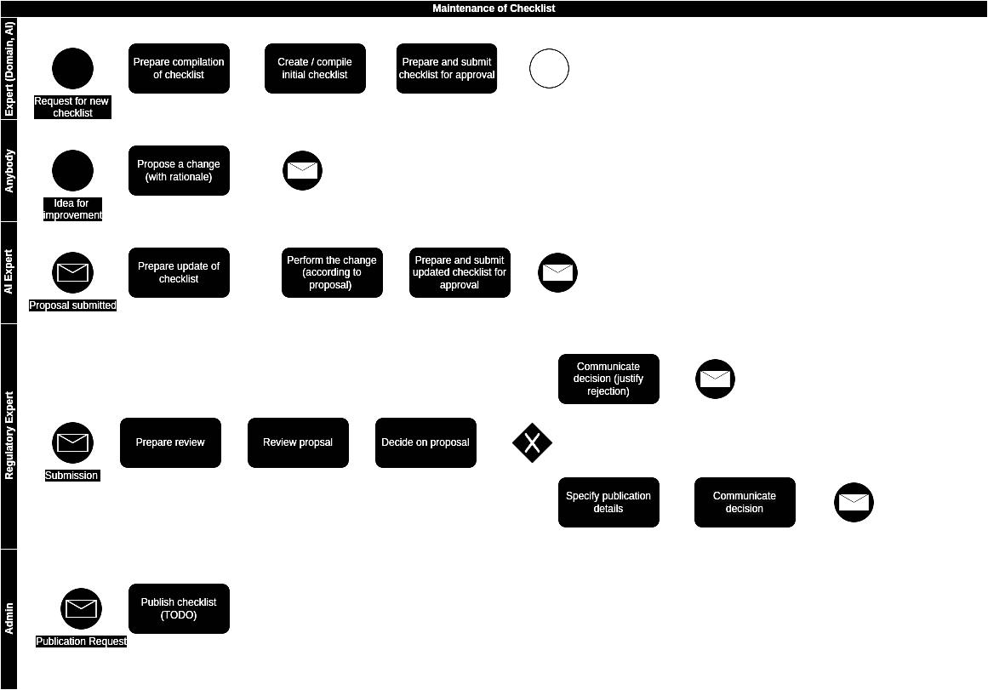
d. process
6. (maintain and update)
Resources
DEL 2.2

Slide 38
d. process - overview

Slide 39
d. process - overview
ai audit collaboration
WG DELs
TDDs
workflow 1: mlflow server workflow 2: park and use github: >50 members, >30 repos
github: >30 repos
old case reports
repo documentation
JOMS special issue
publications and reports
platform documentation
youtube accessible tutorials
process
descriptions
infrastructure
case-based experiment design
examples and documentation
audit playbook (in DEL 7.3)

Slide 40
e. vision and next steps

Slide 41
e. vision and next steps
grease the gears of the “hollywood” model

Slide 42
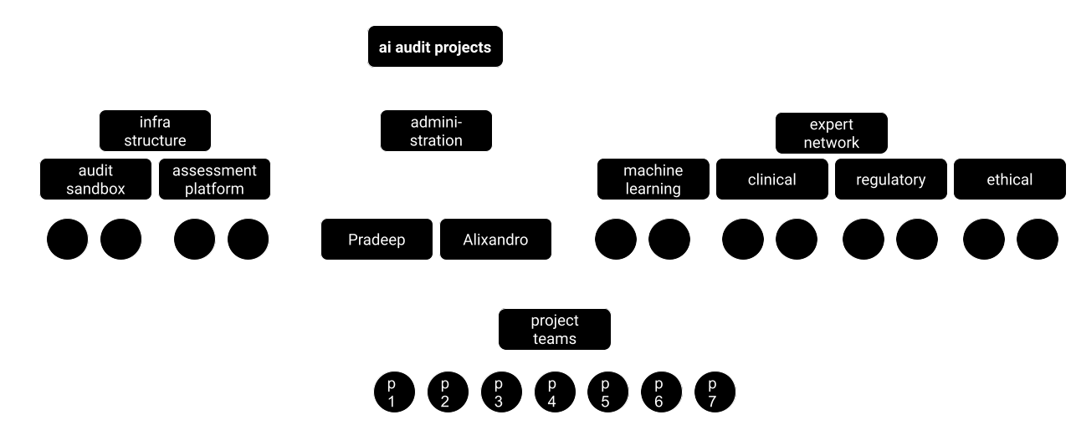
e. vision and next steps
grease the gears of the “hollywood” model

Slide 43
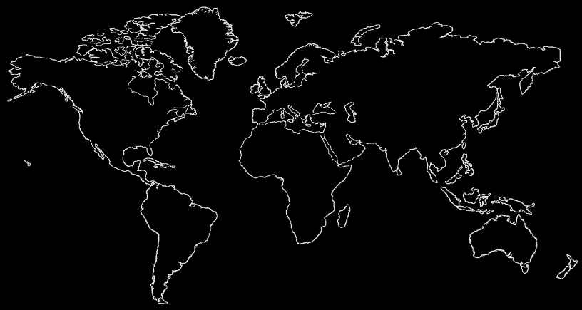
e. vision and next steps
grease the gears of the “hollywood” model

Slide 44
e. vision and next steps
grease the gears of the “hollywood” model
> 50 collaborators, across 11 audit teams, 8 of which are active

Slide 45
e. vision and next steps
grease the gears of the “hollywood” model
expand collaboration with AIMS
swift, short-term funding avenue for audit teams
> 50 collaborators, across 11 audit teams, 8 of which are active

Slide 46
e. vision and next steps
“SLA”s: adbullah will take over new responsibilities
continue and professionalize audit team support (communication bottlenecks, expanded office hours)
share release schedules
hand in feature requests in-time
“no deployment before christmas”

Slide 47
e. vision and next steps
institutionalize
what are our usps?
Notes:
fomo
response: we are not here to tell anyone, but belief we better provide one we can argue about than keeping things vague
money:
business vs institution
our thing: interfaces
we are not solving technical, the hard part in solving problems is dealing with the hard stuff: humans, mapping, glossaries

Slide 48
e. vision and next steps
snorkel (labelling), monai, activeloop (data storage and versioning), dvc (data versioning), anthropic (safe ml systems), kaggle (benchmark), latticeflow (safe ml systems), clearbox (safe ml systems), …
institutionalize
what are our usps?
Notes:
fomo
response: we are not here to tell anyone, but belief we better provide one we can argue about than keeping things vague
money:
business vs institution
our thing: interfaces
we are not solving technical, the hard part in solving problems is dealing with the hard stuff: humans, mapping, glossaries

Slide 49
e. vision and next steps
snorkel (labelling), monai, activeloop (data storage and versioning), dvc (data versioning), anthropic (safe ml systems), kaggle (benchmark), latticeflow (safe ml systems), clearbox (safe ml systems), …
institutionalize
what are our usps?
consensus-driven, semi-democratic
embedded in institutional landscape, trust and maintenance capacity -> needed
strong integration between institutional requirements and technical implementation
core/back office team: maintenance and coordination
cloud infra
flexible hollywood model for audit projects, potentially with compute budget
Notes:
fomo
response: we are not here to tell anyone, but belief we better provide one we can argue about than keeping things vague
money:
business vs institution
our thing: interfaces
we are not solving technical, the hard part in solving problems is dealing with the hard stuff: humans, mapping, glossaries

Slide 50
f. closing remarks and discussions (ctd)
needs of tg audit teams plenary meetings: trial audits, iteration 2, materials:
1. How to configure an audit challenge for specific sub-topics?
2. How to add new questions to the checklist ? ( future consideration- A masterlist from, with the help of a GUI the custom list of questions can be configured) . Currently customization is possible but we have to manually set the concerned parameter as 'true' or 'false' ib the challenge-configuration file
3.How to source undisclosed Test Data Set ? Can we create a TG classified data bank for undisclosed test datasets?
6.How can the audit framework be reconfigured to address the requirements of NON-ML based AI - systems ?e.g. expert systems as in TG-Symptoms use case
7.How to provide FG-AI4H authorized template support for ethical clearance and data sharing agreement with third party data donors? e.g. data agreement between TG-Dental with Corumbra school of health.

Slide 51
f. closing remarks and discussions (ctd)
needs of tg audit teams
8. How can we devise an exclusive test plan and procedure within the larger audit framework specifically for risk / failure mode assessment and to generate a risk assessment report?
9.How to support teams in audit conduct planning. (Teams have their own time constraints and a uniform timeline would not be feasible across the teams) .How to improve team communication. e.g how can we help teams schedule meetings ( e.g. a meeting scheduler utility).
10.How to provide technical support to teams who want to implement python functions for performance evaluation metrics computation? e.g. python implementations are available in public domain and we may have to organize a reference library for them so that they can easily find information
11. How to semi-automate some of the audit process steps in iteration-3 of trial audits?
12. How to support teams with audit report publication template customization tips/ support ( depends on the target publication journal rules)
13. How can audit deliverables be integrated as TDD updates. ( e.g. benchmark framework version update)
14. How to facilitate regulatory checklist manager support for TG use case developers
15. How to facilitate dockerized model based challenge submission mode

Slide 52
g. appendices
numbers and costs: see aws
projected costs: what it would allow us todo
TODO: use standardized symbols (people, infra)

