Slide 1
FGAI4H-N-032-A01
E-meeting, 15-17 February 2022
Source: | Editor DEL03
Title: | DEL03 update - Att.1 Presentation
Purpose: | Discussion
Contact: | Pradeep Balachandran | E-mail: pbn.tvm@gmail.com
Abstract: | This presentation contains the overview and the latest updates on the deliverable FG-AI4H DEL03-AI4H requirement specification.

Slide 2
System Requirements Specification(SRS): Significance
As a guidance document to the AI4H Topic Groups towards ‘requirements analysis’ in the pre-design stage of product development.
Planning Phase-Requirements Elicitation: How?
- Requirements analysis methodology follows
a collaborative team-oriented approach (e.g. Working Groups and Topic Groups within FG-AI4H )
AI Product Development Lifecycle as the basis (e.g. Data Collection to Data preparation to Data Training to Model Development to Model Testing to Model Deployment to Model Maintenance, etc.)

Slide 3
System Requirements Specification(SRS):Scope
As a result of the REUIREMENTS ELICITATION process,
Specify the high level AI4H system requirements across the entire AI4H process life cycle (i.e. from Data collection to Model Maintenance)
Functional requirements,
Performance requirements,
Operational requirements,
Interface requirements,
Safety and security requirements
Migration requirements,
Regulatory requirements, etc.
A sample performance requirement specification statement
“ The epileptic seizure event classification algorithm (shall/should/may) have a mean sensitivity of 80.2% ( 95% Confidence Interval, 75.2% - 86.5% ) and mean specificity of 89.3% ( 95% Confidence Interval, 81.3% - 95.7% ) “

Slide 4
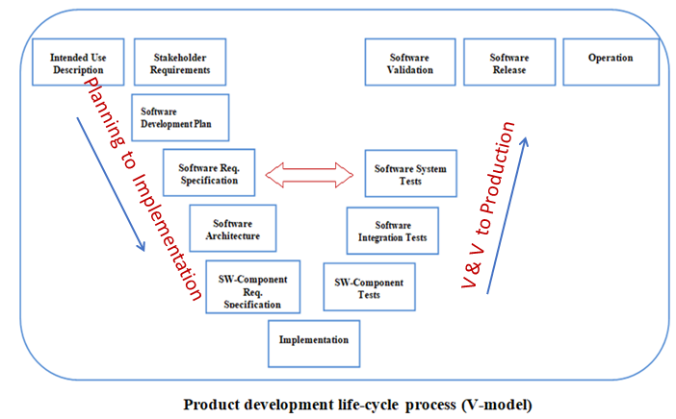
Utility of SRS for the Topic Groups
For the Topic Groups, how SRS can aid as a tool for system requirements traceability during Product Acceptance Testing
All TEST CASES should be TRACEABLE to REQUIREMENTS

Slide 5
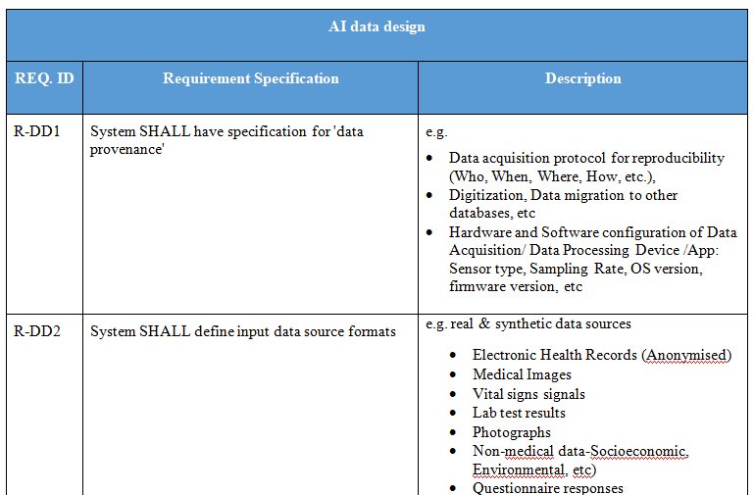
System Requirements Specification(SRS):Specimen format

Slide 6
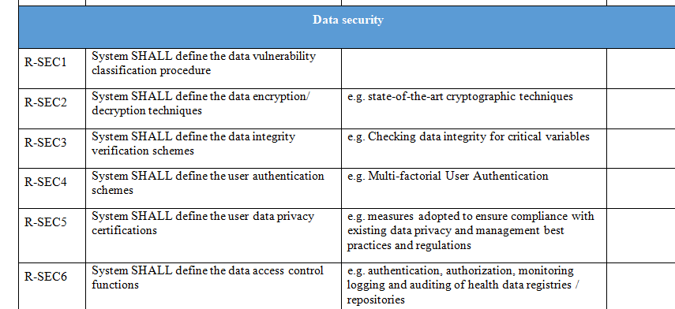
System Requirements Specification(SRS):Specimen format

Slide 7
SRS (DEL 03) Revision updates
Reconfigured DEL 03 AI4H system requirements into a separate ‘Requirements Traceability Matrix‘ which represents a mapping of TDD technical topics to AI4H Audit Requirements
Utility #1 : Requirements Traceability Matrix was proposed as an auxiliary tool for TDD audit process’
Are TDD inputs ‘ verifiable' as requirements for the AI4H audit evaluation?
Utility #2 : Requirements traceability matrix to provide reference inputs for ‘Test Plan Creation’ to aid AI4H Audits (e.g. Trial Audits 2.0 project) ’ over the AI4H assessment platform

Slide 8
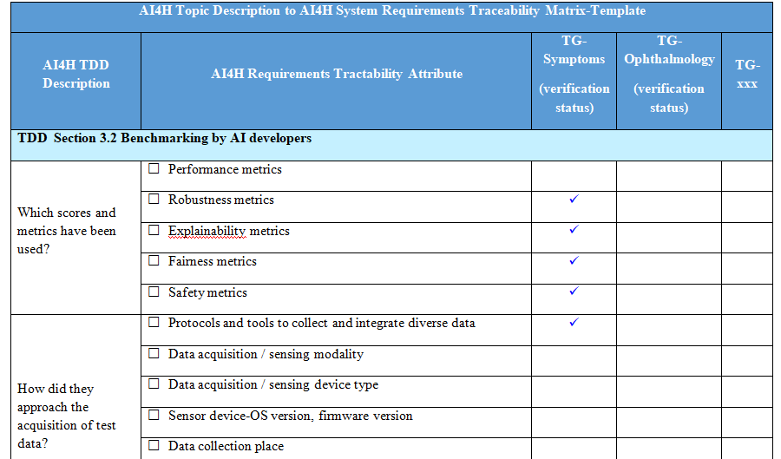
Requirements Traceability Matrix-Tool Template

Slide 9
SRS(DEL 03) Revision: Next Steps
Aim
How can we use this requirements traceability matrix to estimate the quality metric- ‘cost of SRS non-conformance’ during AI4H Audit and help towards minimizing that cost? ( during ‘system verification & validation’ or ‘acceptance testing’ )
2. How can we use this requirements traceability matrix to create ‘Test Plans/ Test Cases’ to support the following types of tests during AI4H Audit ?(e.g. Performance testing, UI testing, Model fairness & bias testing, Model risk severity testing, Model robustness testing, etc.)
How can requirements traceability matrix attributes be used as potential METADATA candidates under the Data Storage and Catalog Package of the AI4H assessment Platform ?(with reference to Ferath’s work on building Metadata repository)

Slide 10
SRS(DEL 03) Document: Maturity Status
Content maturity level: > 80 % in terms of the coverage of AI4H lifecycle requirements
Ready to undergo the following rounds of assessments before publication as a ITU document
peer review,
editorial review and
associated quality assurance review

Slide 11
Thank you

