Slide 1
FGAI4H-N-030
E-meeting, 15-17 February 2022
Source: | Editor DEL04
Title: | Cybersecurity and AI/ML Data Lifecycles Follow up
Purpose: | Discussion | Information
Contact: | Pat Baird, Philips Catherine Lowe, MedSec | E-mail: Pat.Baird@Philips.com E-mail: CatherineLowe@MedSec.com
Abstract: | Information: This presentation contains a follow up from the summary of Cybersecurity and AI/ML Risk Management for members at the “M”-Meeting

Slide 2
Cybersecurity AI/ML and Data Lifecycles
Intended audience includes people that are familiar with the presentation delivered at M-meeting.
NIST Cybersecurity Framework best practices and Risk Management
Cybersecurity should include security and privacy requirements within the architecture and design of clinical trials and healthcare AI/ML innovations.
Security and privacy is a joint responsibility and is required patient and CIA
Includes a summary of data planning requirements and stages that support the AI/ML Data Lifecycle. Lifecycle monitoring is critical to risk management and cybersecurity.

Slide 3
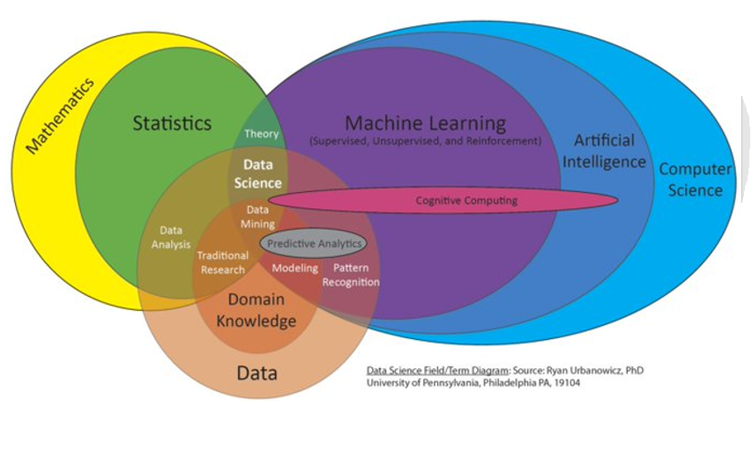
SaMD – Data Lifecycle
Safety Risk Management
Cybersecurity Risk Management
Privacy Risk Management
Notes:
This Venn diagram shows the overlap between the different domains that we are involved with – there’s a subset of AI that is machine learning, and there is a subset of statistics that is data science, and these items overlap in many ways, (CLICK for animations) and now you can see that even the data management process itself has different but overlapping processes to manage safety risk management, privacy risk management, and cybersecurity risk management.

Slide 4
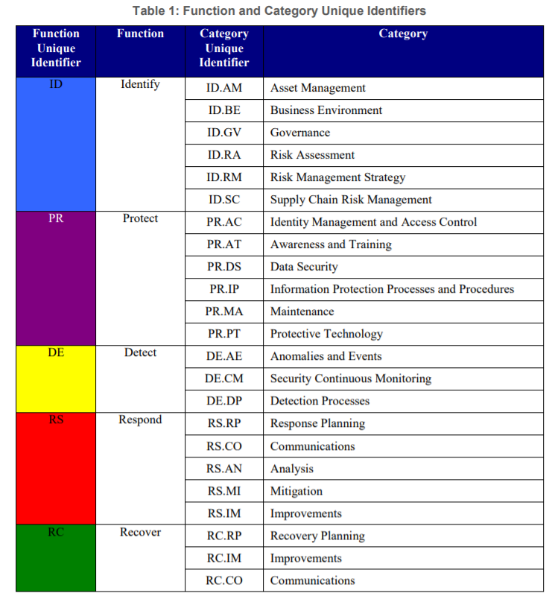
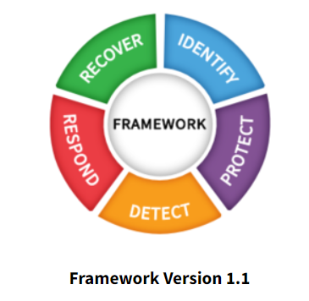
NIST Cybersecurity Framework 1.1
Machine learning methods should have requirements for anomaly detection by following a risk-based approach for potential security/privacy issues.

Slide 5
Clinical Investigations and Trials

Slide 6
Slide 1
Planning
Acquisition
Pre-processing
Training
Evaluation
Operations
Data Plan
Data Requirements and collection
Defined procedures for curating, augmenting and labelling
Data set partitioning and validation parameters
Testing (white box versus black box)
Performance and repeatability
Implementation for user and environment interactions
Data Plan: Planning is an important factor in medical device product development, and therefore a plan shall be in place for the acquisition and management of the data, AI model, data set and learning method.
Data Requirements: Not all data can be used for all purposes; there shall be a set of requirements regarding the data that will be used for training and validation.
Data Pre-processing: Data curating and augmenting of raw data to prepare for inputs into training and labelling
Data Labelling: Depending on the application, there may need to be a process step where experts are asked to annotate the data records. Critical to quality factors that contribute directly to the precision and accuracy shall be labeled.
Data Enrichment: Some applications may benefit if additional analysis is performed on the data. Similar to human annotation / labelling, additional processing of the data may lead to dataset improvements.
Data Storage: For purposes of version control, it is important to preserve the integrity of the data sets throughout the life of the product. This also includes considerations regarding cybersecurity.
Data Retirement: There will eventually be a point in time where the data set is no longer needed. This section includes specific requirements for the proper disposal of the data cycle

Slide 7
Question and Answer Discussion
“So all you renegades with too much time on your hands, stop fooling yourself and come sail away with this Blue Collar Man on a mission to use AI to rehumanize healthcare”
Notes:
Pat Q&A Wrap UP

