Slide 1
FGAI4H-N-028-A03
E-meeting, 15-17 February 2022
Source: | TG-Sanitation Topic Co-Driver
Title: | Att.3 – Presentation (TG-Sanitation)
Purpose: | Discussion
Contact: | Alex Radunsky | E-mail: Alex.Radunsky@mail.harvard.edu
Abstract: | This PPT summarizes the content of N-028-A01 with updates on ongoing testing and preparation for field data collection, for presentation and discussion during the meeting.

Slide 2
TG - Sanitation
Alex Radunsky, ScD MPH
Co-driver AI4H TG-Sanitation
Director Global Health and Policy, ITGH

Slide 3
Executive Summary
Problem statement - Community based data can help us predict diarrheal disease outbreaks before they occur.
Community engagement in eThekwini, South Africa
Commercial partner data access
Implementation of data collection system and validation
Project timeline
Other potential subtopics for TG-Sanitation (Pyrolysis waste treatment monitoring; wastewater surveillance for COVID-19)

Slide 4
Project timeline
Community Engagement
Requirements Capture
Design of Data Collection Infrastructure
Data Collection Rollout
2020
2021
2022
2023
AI specification and development
AI
Deployment & Validation
Meeting N

Slide 5
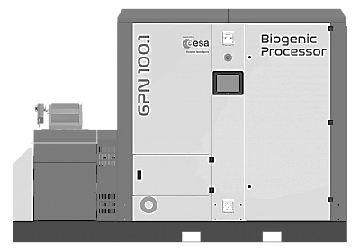
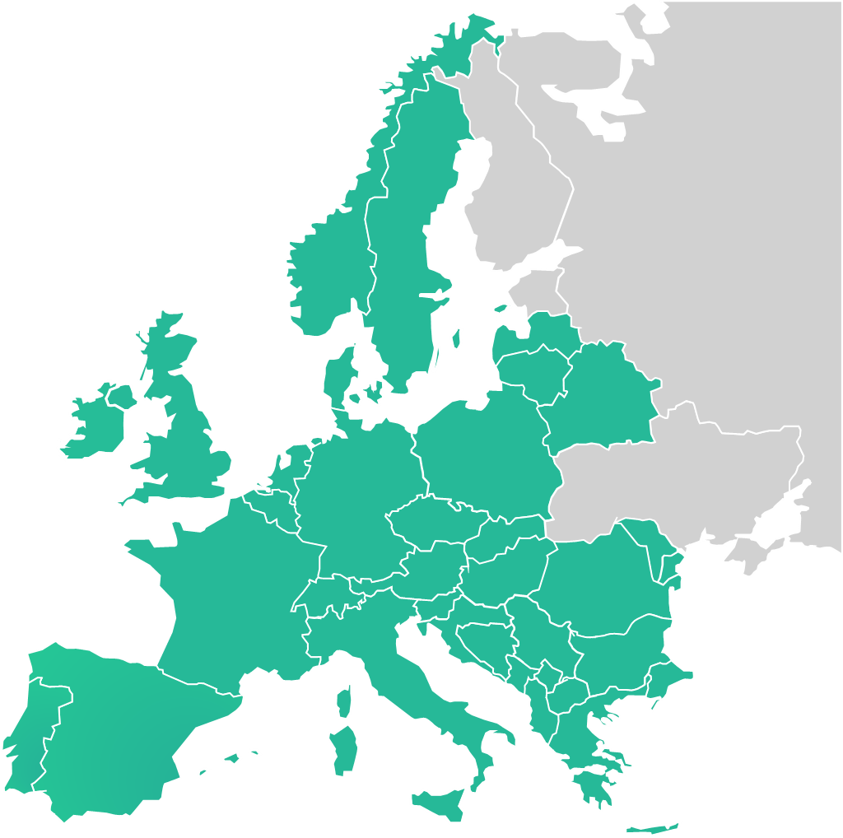
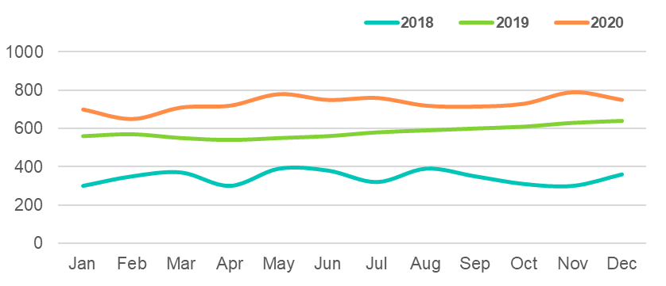
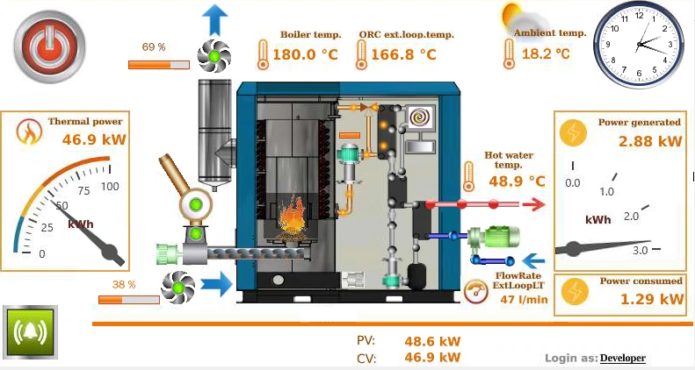
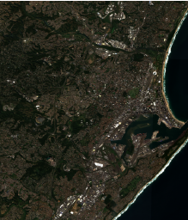
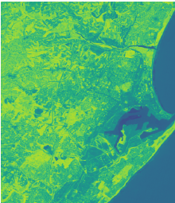
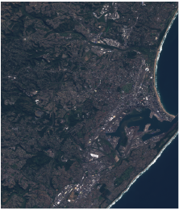
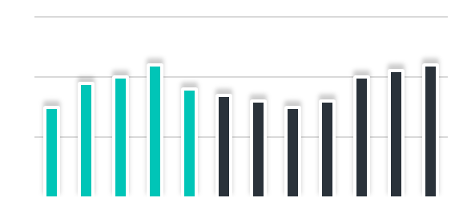
PYRNEXAT CLOUD
PYRNEXAT SMART MANAGEMENT PLATFORM)
PLANT OPERATION
IOT Sensors and controllers
DATA TRANSMISSION: Terrestrial, WIFI, LoRa, and Satcom
PYRNEXAT
CLOUD
MOBILE & WEB APPLICATIONS
Multi-modal data analyses, actionable insights and visualisations
PYRNEXAT
DEPLOYMENT ECOSYSTEM
IOT Sensors, controllers, Earth Observation data and GNSS data
DATA STORE
IOT PLATFORM
DIGITAL TWIN ENGINE
ANALYTICS/AI ENGINE
SERVICES/APPLICATIONS
REMOTE MANAGEMENT
PYRNEXAT
PYRNEXAT

Slide 6
Talking points
COVID wastewater monitoring as a potential subgroup
Data as an asset
Call for Participation
NYC event has been scheduled for June 30

Slide 7
APPENDIX Contributors
Khahlil Louisy klouisy@hks.harvard.edu
Rebecca Perez rebecca.perez@wadham.ox.ac.uk
Alex Radunsky alex.radunsky@mail.harvard.edu

Slide 8
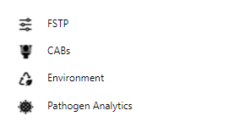
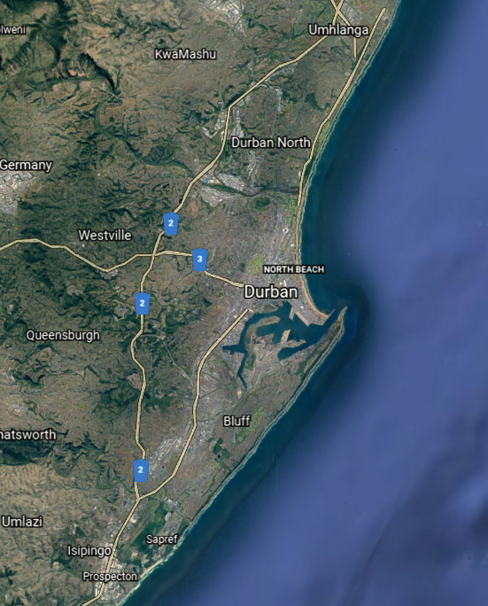
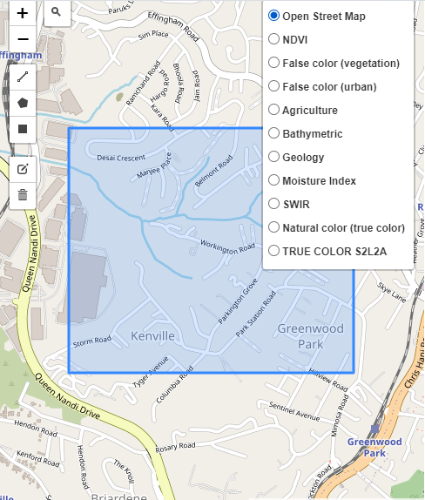
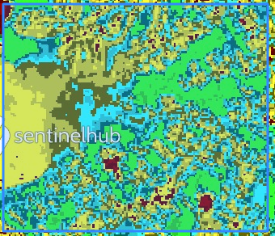
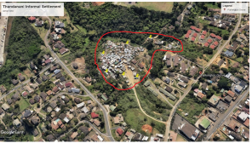
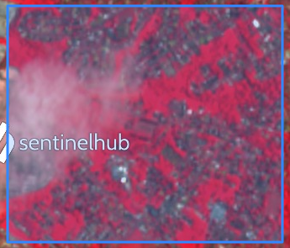
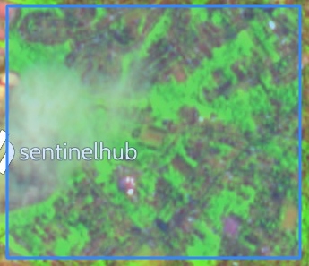
PYRNEXAT Demonstration Project
AI Pathogen and
Diarrhoea Detection
CAB Monitoring and
User Behaviour Analysis
Environmental Sensors/EO Data
AI Predictive Analytics
for Environmental/User Health

Slide 9
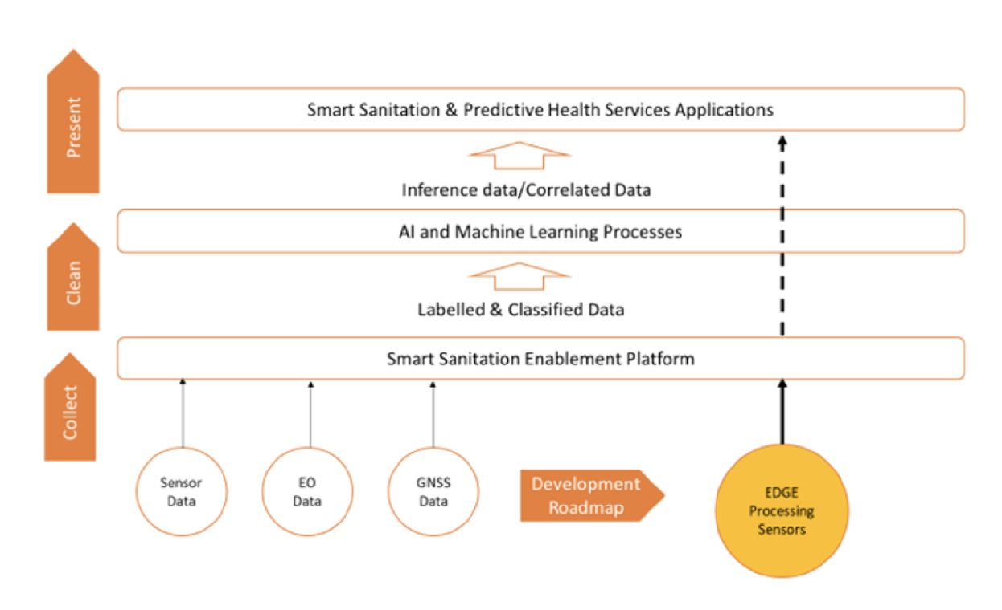
By developing high-frequency sanitation data collection, we expect to detect outbreaks early and enable action.
The key novel technology is an array of data streams that will provide a consolidated view of factors contributing to spread of diarrhoeal disease:
Granular measurement of CAB usage and disease detection therein
Area-level measurements of weather patterns and water level and quality
Supply chain KPIs of the sludge disposal and pyrolysis process
Satellite observations of land use, water levels and atmospheric composition
An AI to predict outbreaks will be developed during the course of our TG, incl. benchmarking and early validations of the model
The data streams are designed and will be rolling out during the early stages of the project
AI model under definition will be developed during the course of the FG
Target: Prediction of disease outbreaks in informal settlements around Durban, ZA
Notes:
Weather observations
Water level, turbidity and pathogen sampling
Atmospheric composition
Land use and water level
Community Ablution Block usage and edge-computed disease detection
Health surveys through hotspot-based apps
Process KPI’s from sludge treatment plant

Slide 10
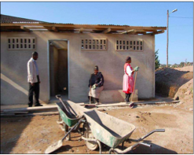
Community based data can help us predict diarrheal disease outbreaks before they occur.
Diarrheal disease is among the leading cases of death globally
These infectious diseases disproportionately impact children in low-income countries (WHO Global Health Estimates, 2021)
Waste management system
Watershed management system
Health System Access and utilization
Community Ablution Block

Slide 11
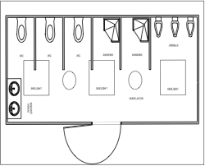
High frequency data collection across the watershed, waste management, CAB toilet, and community center will provide insight into transmission.
Automated testing vs. manual lab testing
Predicting outbreaks
Faster intervention in health care
Prevent transmission, prevent an outbreak

Slide 12
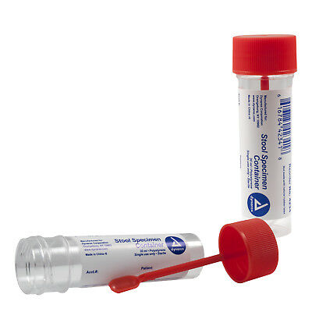
Detection currently relies on manual sample collection.
Outbreak detection
Direct markers (e.g. health system data)
Indirect markers (e.g. sales of antidiarrhoeal drugs)
(WHO, 2019a) (CDC, 2021)
Population level surveillance
Representative household survey (recent symptoms, diagnosis, treatment)
Manual sampling and laboratory testing of local water supply, river systems, stool samples
Detection of virus, bacteria, parasite by enzyme linked immunosorbent assay or rapid immunochromatographic test

Slide 13
Evaluation of smart sanitation technology through a human rights frameworks can better serve the vulnerable.
Review the work of technology legal scholars who have applied Human Rights frameworks to other technologies with the potential for systemic surveillance
Determine how major data privacy regulations, applies to smart sanitation technology
General Data Protection Regulation (GDPR)
Health Insurance Portability and Accountability Act (HIPAA)
Chinese Personal Information Protection Law (PIPL)
Identify and make policy recommendations

Slide 14
Ethical Guidelines & Technical Recommendations
A) Develop and B) apply ethical framework for AI predictive ML models for social good in sanitation.
Development
Risk-assessment of benchmarking AI in sanitation using social ecological model
Mapping core AI ethics principles (e.g., justice as fairness, autonomy as informational privacy; transparency as explainability) to mitigate ethical risk of predictive ML in sanitation
Assessment of these ethics principles as applied to sanitation in light of risk-assessment
Develop sub-criteria (guidelines) for ethical framework developed for AI in sanitation.
B. Application
Review literature on AI and ML on technical methods to apply principles developed above
Analysis and recommendations for AI applications in smart sanitation

