Slide 1
FGAI4H-N-026-A03
E-meeting, 15-17 February 2022
Source: | TG-MSK Topic Drivers
Title: | Att.3 - Presentation (TG-MSK)
Purpose: | Discussion
Contact: | Peter Grinbergs (EQL, UK) & Yura Perov (Independent Contributor, UK) | E-mail: tgmskorg@googlegroups.com (the email is read by Peter, Yura and their associate(s))
Abstract: | This PPT summarizes the status of work within TG-MSK, for presentation and discussion during the meeting.

Slide 2
Background & Relevance
“Musculoskeletal conditions comprise more than 150 diagnoses that affect the locomotor system; that is, muscles, bones, joints and associated tissues…” [1]
Painful MSK conditions affect 20-33% of the world's population [1].
According to the WHO, “[Musculoskeletal] conditions are the leading contributor to disability worldwide, with low back pain being the single leading cause of disability globally. ... MSK conditions significantly limit mobility and dexterity, leading to early retirement from work, reduced accumulated wealth and reduced ability to participate in social roles. The greatest proportion of non-cancer persistent pain conditions is accounted for by MSK conditions. ... MSK conditions are commonly linked with depression and increase the risk of developing other chronic health conditions” [1].
Up to 30% of consultations carried out by primary care doctors in the UK (as an example) are for MSK conditions [2].

Slide 3
Topic Group’s Goal
The topic group is dedicated to AI/ML applications for MSK medicine. It is dedicated to establishing standardised benchmarking guidelines.
That includes specifying input data and outputs of AI systems for different AI tasks for MSK medicine.
Relevant areas for the topic group: prevention strategies, triage (in particular identifying urgency), diagnosis, prognosis and treatment of musculoskeletal (MSK) conditions with the applications of artificial intelligence (AI) and machine learning (ML) approaches including computer vision (CV), augmented and virtual reality (AR/VR), natural language processing (NLP), natural language understanding and other approaches.

Slide 4
Topic Group Status
There are now 8 members in the topic group.
4* further topic group meetings happened since the last focus group meeting.
The fourth version of the Topic Description Document was created (using the new template). It is a work-in-progress.
* - excluding cancelled one(s).

Slide 5
The current focus
Prediction for and prevention of MSK conditions, including:
risk identification (e.g. probability estimation),
risk reduction (including new conditions, worsening of MSK condition states, etc.).

Slide 6
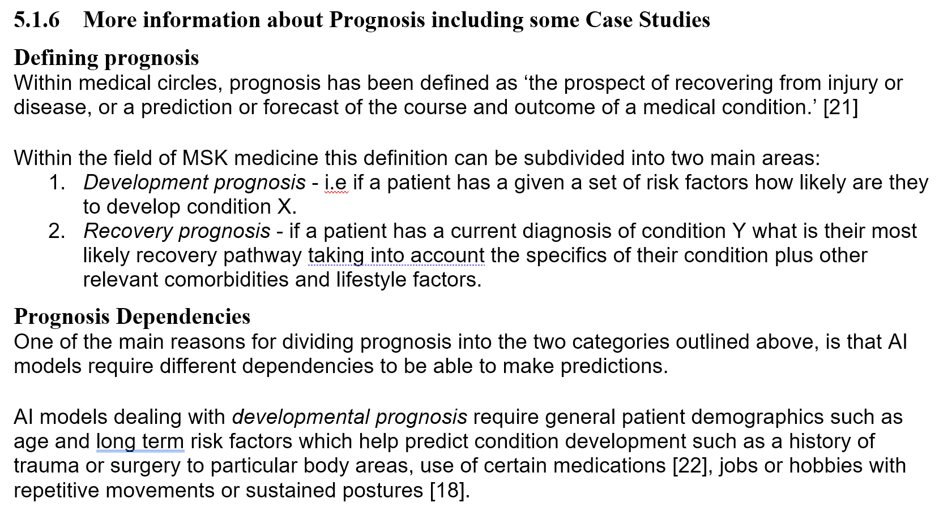
Updates to the TDD
This is a part of the new section.

Slide 7
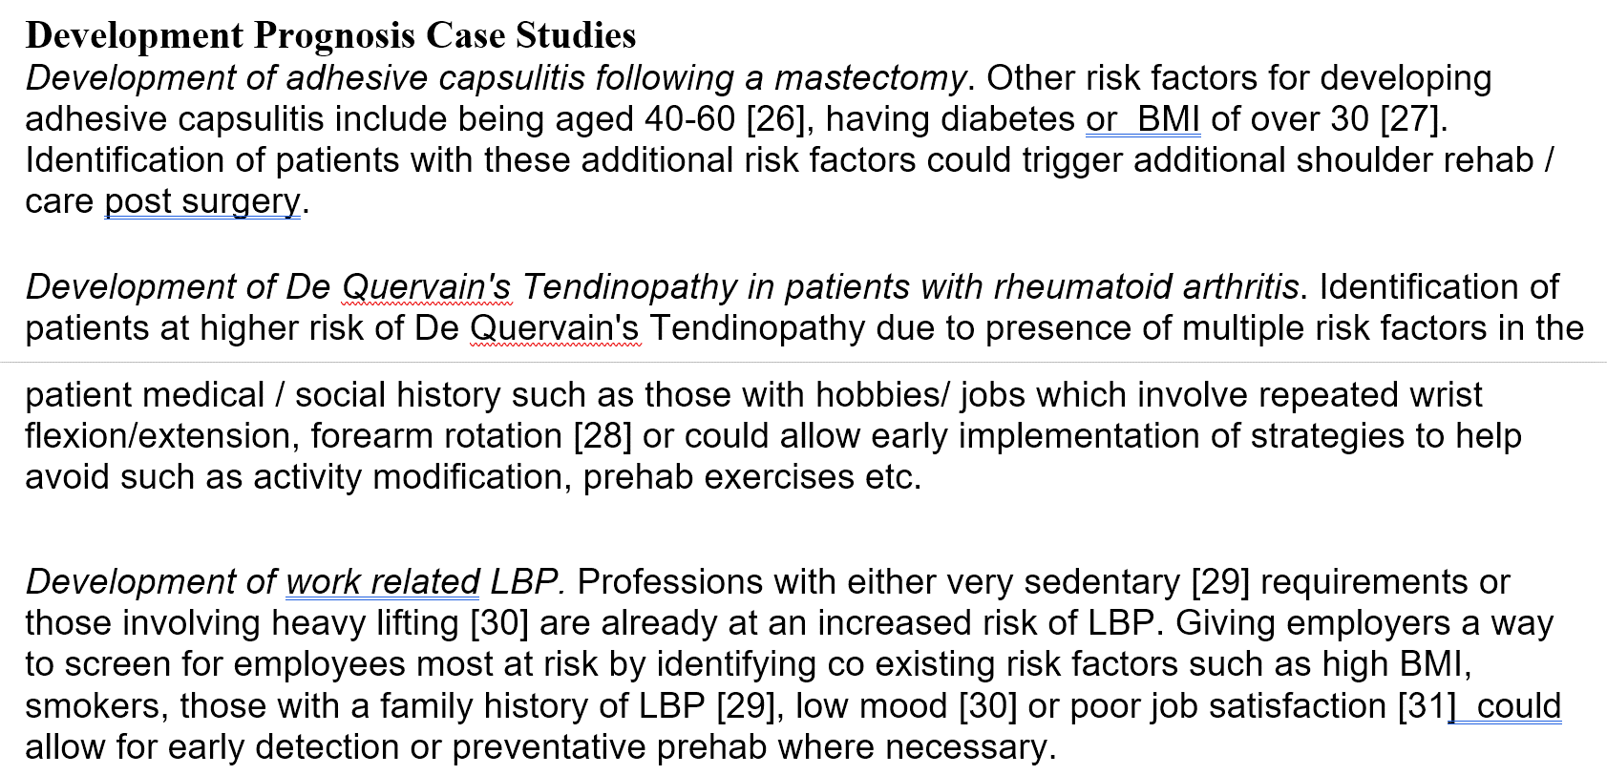
Updates to the TDD

Slide 8
Updates to the TDD

Slide 9
Updates: synthetic cases
8 cases with up to 53 ‘inputs’ and:
up to 8 ‘outputs’ for ‘a specific outcome for or chance of recovery, or condition deterioration or development, or new condition;’
up to 9 ‘outputs’ for a ‘next treatment or procedure recommended’

Slide 10
Next steps for the topic group
Focus on:
The first benchmark prototype
JSON representation of cases
Creating the first prototype
Sources of real cases for benchmarking, if possible
New collaborations and members
It would be good to be able to test the prototype with other parties soon
The topic description document work
The audit opportunity

Slide 11
References
[1] "Musculoskeletal conditions" on WHO website. https://www.who.int/news-room/fact-sheets/detail/musculoskeletal-conditions
[2] "Musculoskeletal" page on NHS England website. https://www.england.nhs.uk/elective-care-transformation/best-practice-solutions/musculoskeletal/

