Slide 1
FGAI4H-N-025-A03
E-meeting, 15-17 February 2022
Source: | TG-Endoscopy Topic Driver
Title: | Att.3 – Presentation (TG-Endoscopy)
Purpose: | Discussion
Contact: | Jianrong Wu Tencent Healthcare, China | E-mail: edwinjrwu@tencent.com
Abstract: | This PPT contains a presentation of TG-Endoscopy presented at Meeting N of the FG-AI4H (e-meeting), 15-17 February 2022.

Slide 2
Meeting N
Jianrong Wu (Tencent Healthcare, China)
edwinjrwu@tencent.com

Slide 3
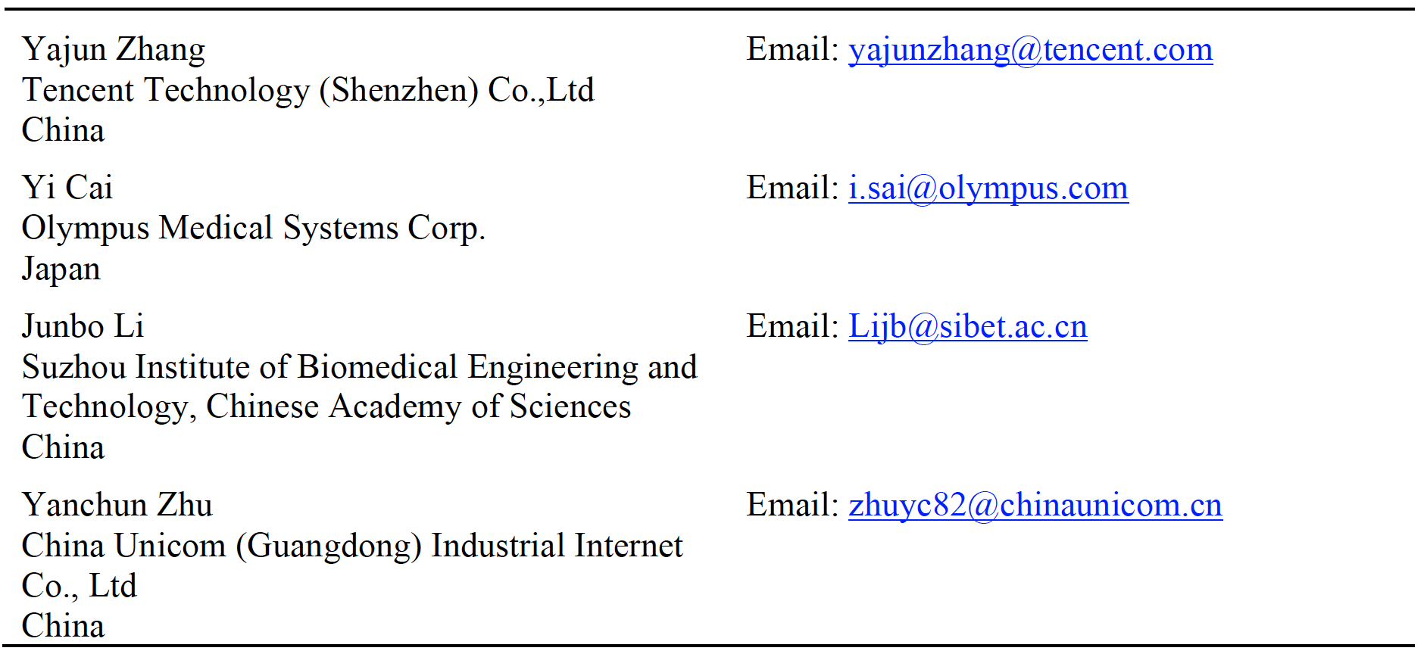
Participants
New
Contributors

Slide 4
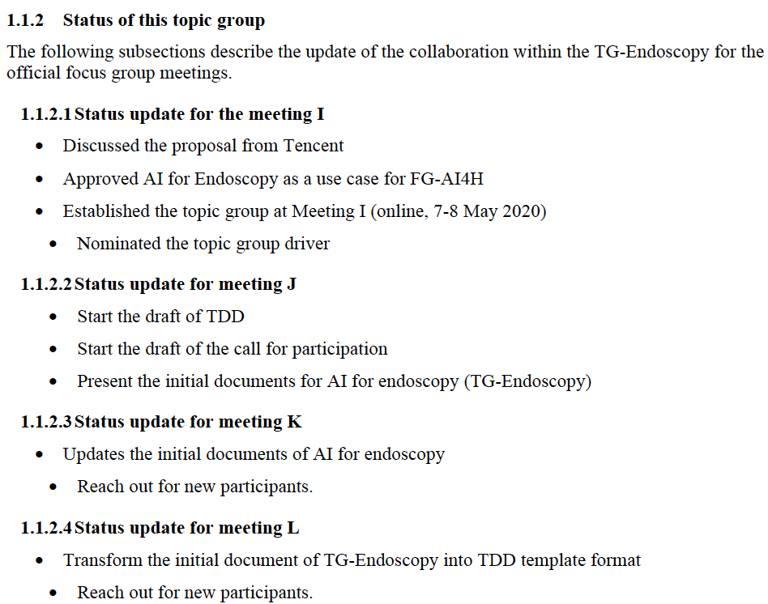
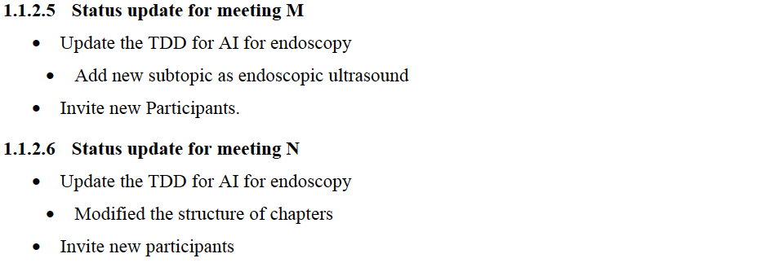
Progress overview

Slide 5
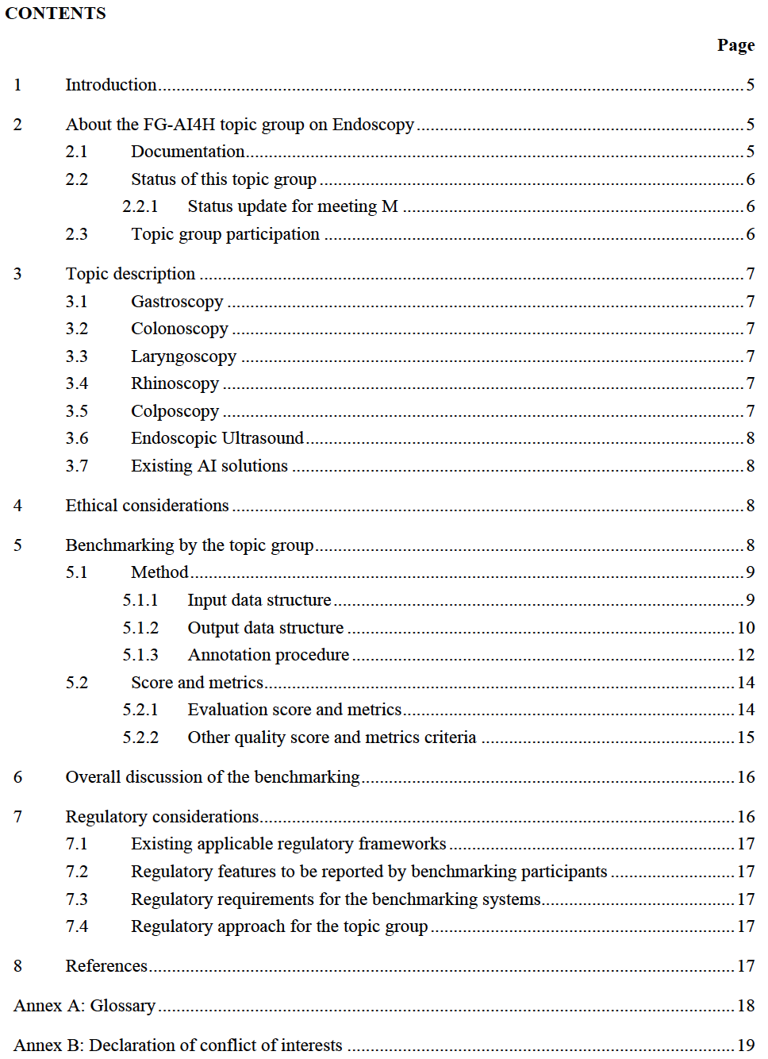
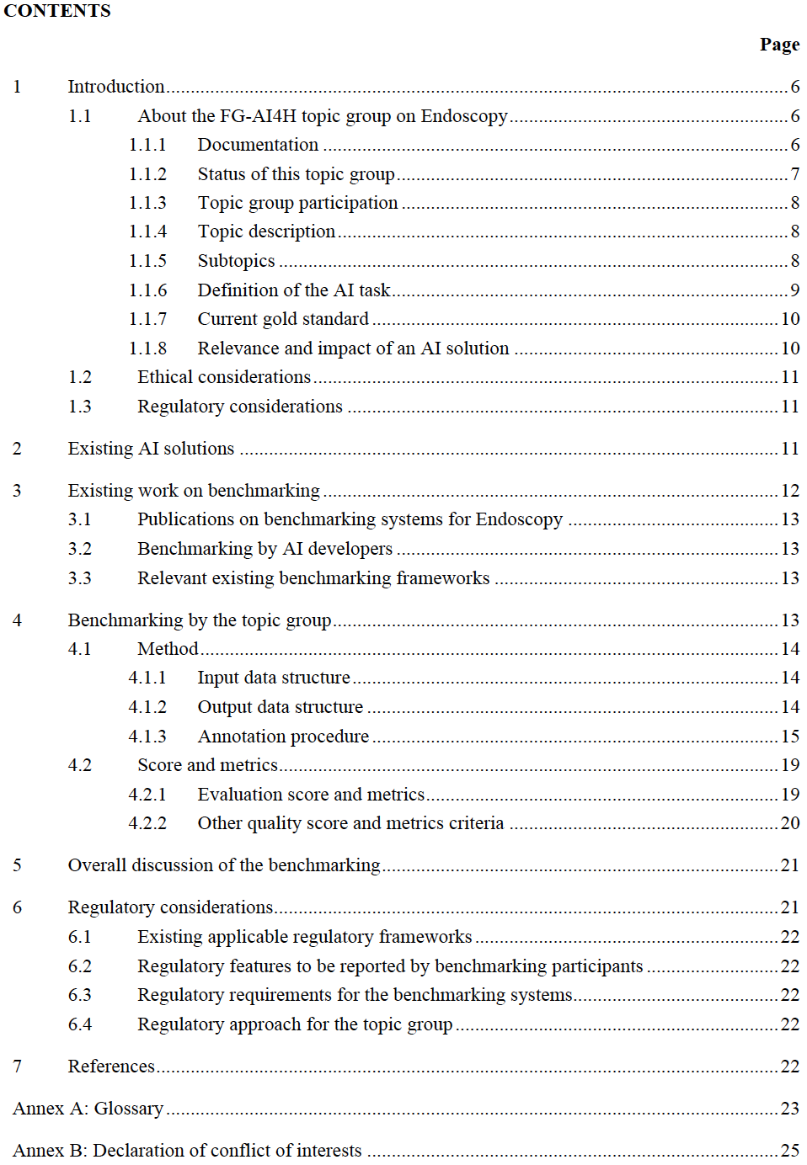
Updates to the CONTENTS
Previous
Current
Combined in one
New chapter
move
New chapter
Update content

Slide 6
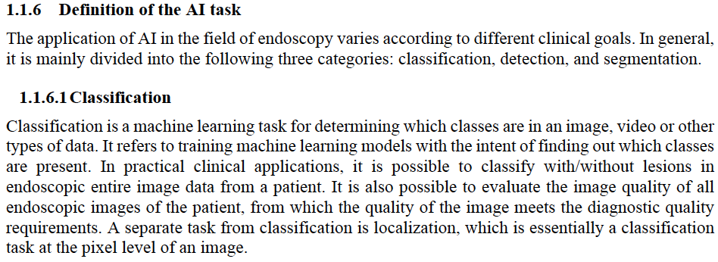
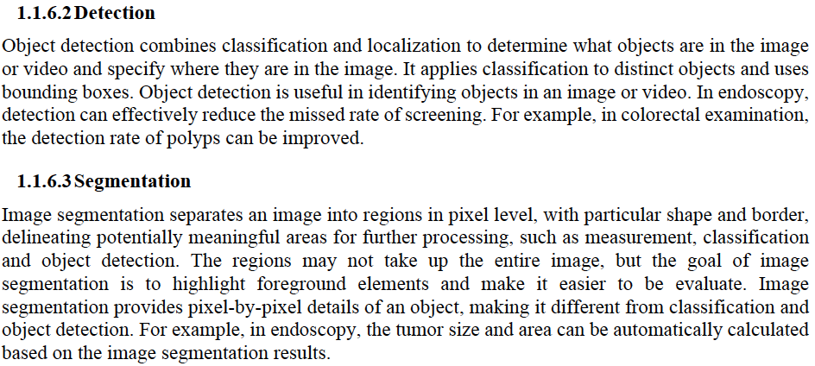
New Chapter – Definition of the AI task
To define the AI tasks of the endoscopy, and it could be summarized as classification, detection, segmentation.

Slide 7
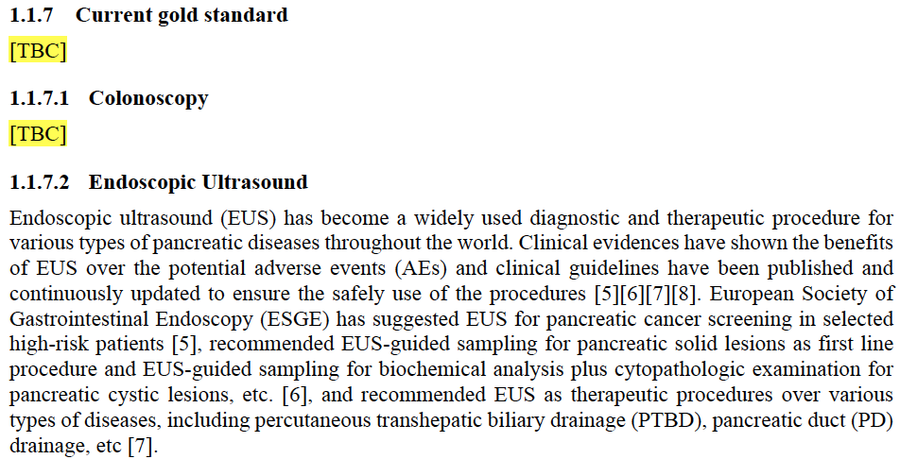
New Chapter – Current gold standard
To describe about gold standard of each subtopic.

Slide 8
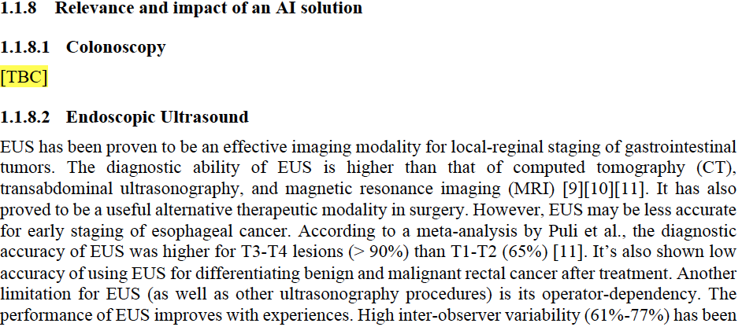
New Chapter – Relevance and impact of an AI solution
To describe about relevance and impact of each subtopic, such as with higher diagnostic ability, with higher efficiency, with less miss rate.

Slide 9
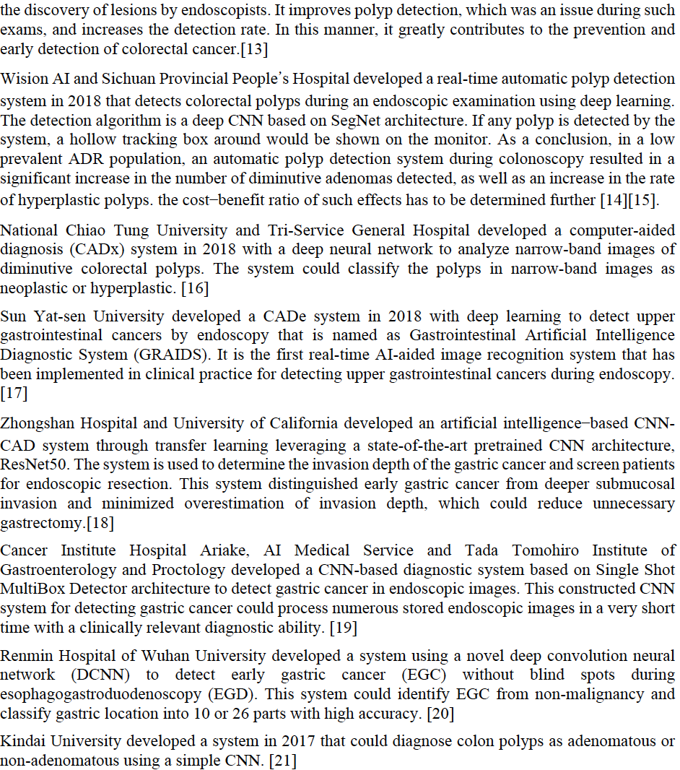
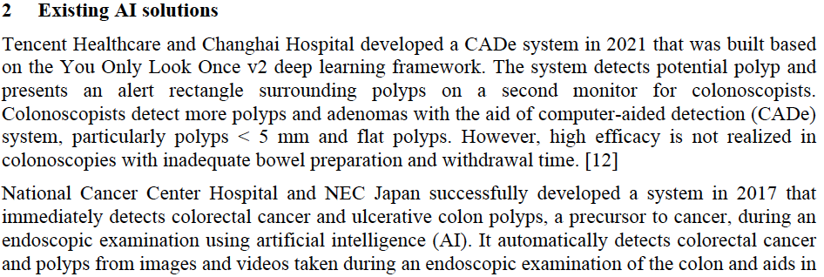
New Chapter – Existing AI solution
There are different AI solutions proposed by different team, including detection task as polyp detection and classification task as neoplastic vs hyperplastic for lesion.

Slide 10
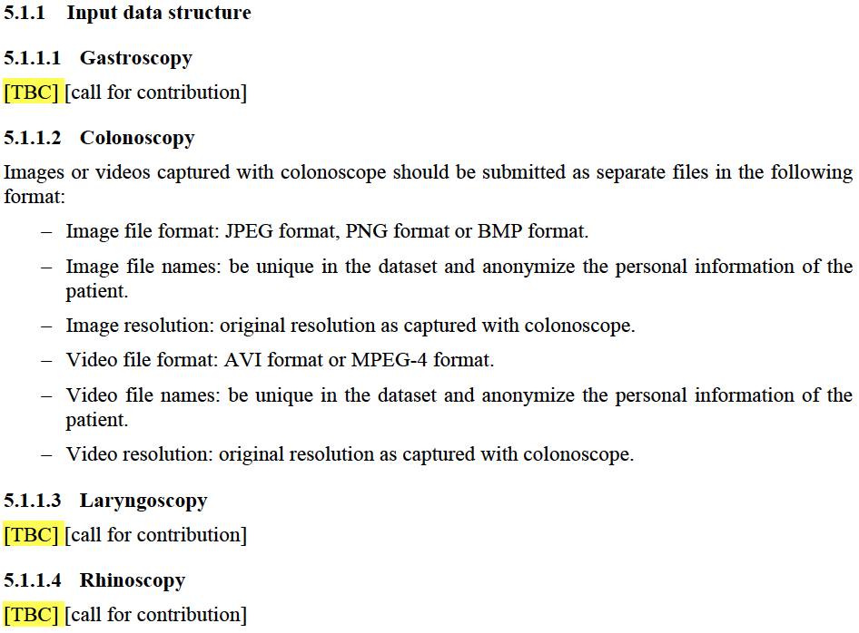
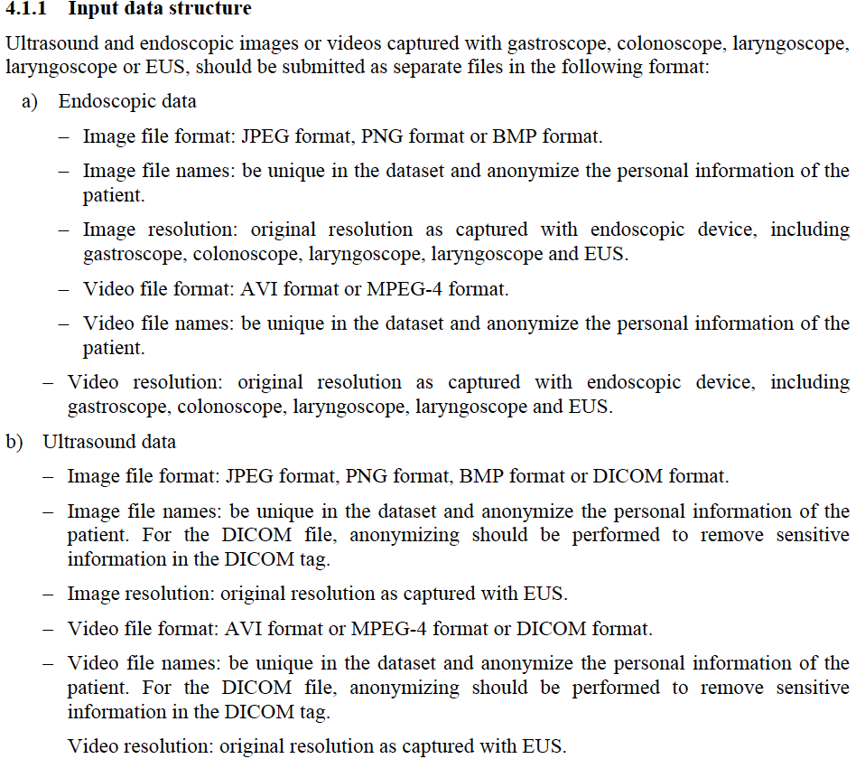
Updates to chapter Input data structure
The input data structure is described in type of data, including endoscopic data and ultrasound data, not in type of endoscope.
Previous
Current

Slide 11
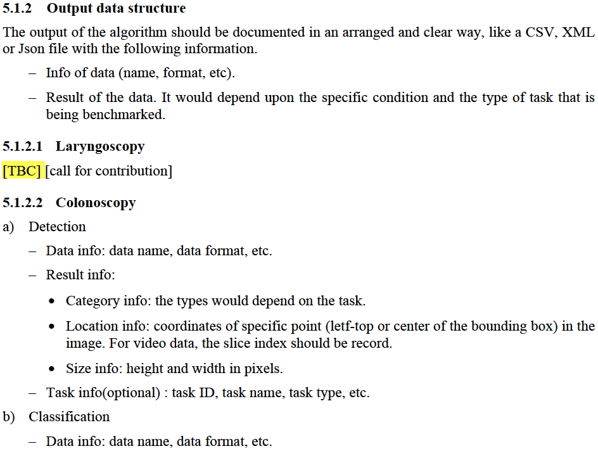
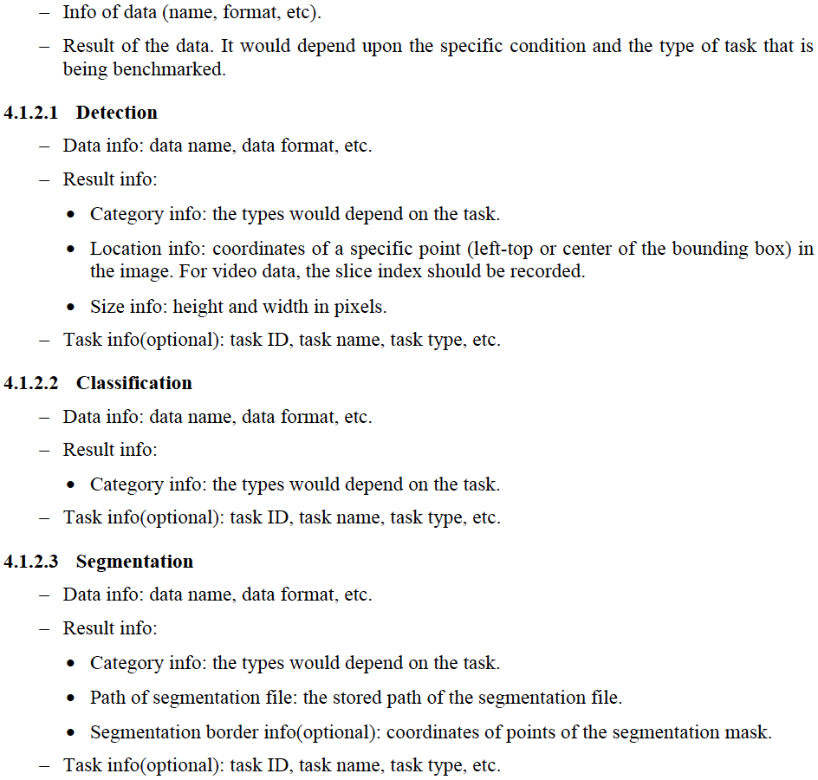
Updates to chapter Output data structure
The output data structure is described in type of tasks, including detection, classification and segmentation, not in type of endoscope.
Previous
Current

Slide 12
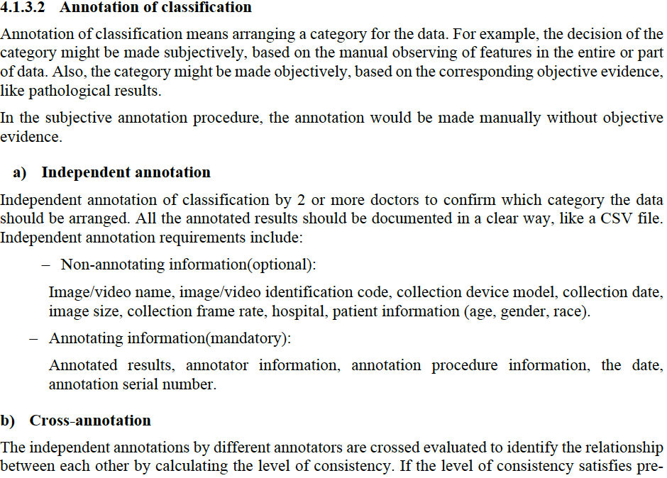
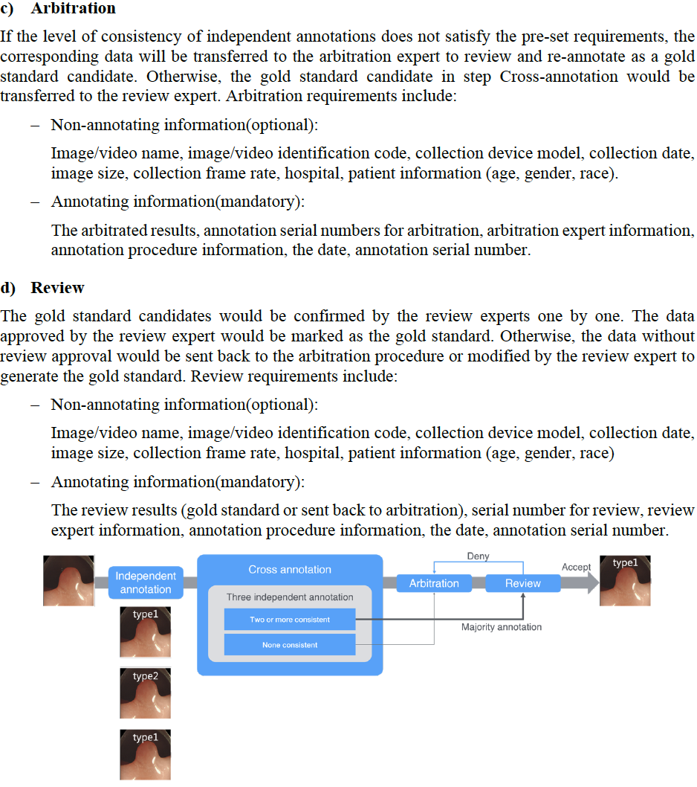
Updates to chapter Annotation of classification
Following the procedure of annotation of detection, there 4 steps in the annotation of classification.

Slide 13
Thanks

