Slide 1
FGAI4H-N-018-A03
E-meeting, 15-17 February 2022
Source: | TG-Outbreaks Topic Drivers
Title: | Att.3 – Presentation (TG-Outbreaks)
Purpose: | Discussion
Contact: | Stéphane Ghozzi Robert Koch Institute, Germany | E-mail: GhozziS@rki.de
Contact: | Auss Abbood Robert Koch Institute, Germany | E-mail: AbboodA@rki.de
Abstract: | This PPT contains a presentation about TG-Outbreaks.

Slide 2
FG AI4H Meeting N
TEAM G TG-Outbreak
Leader: Stéphane Ghozzi & Auss Abbood
Aiaudit partners: Junai Nabi,
Matt Arentz, Muhammad Abdullah

Slide 3
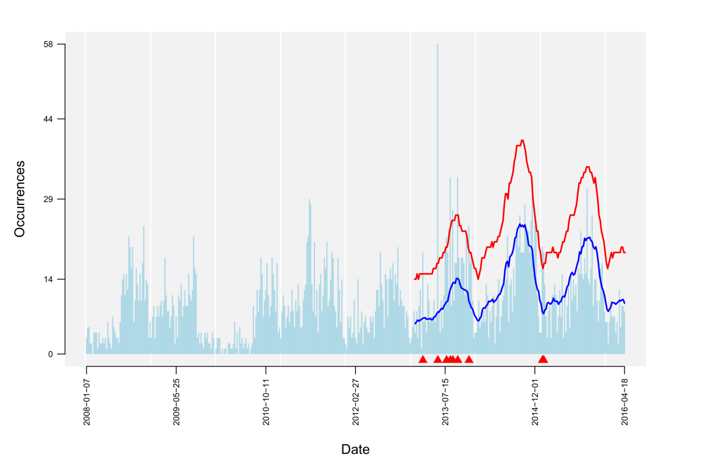
Objective
TRIAL AUDITS 2.0
Triangles: hint for an potential outbreak event

Slide 4
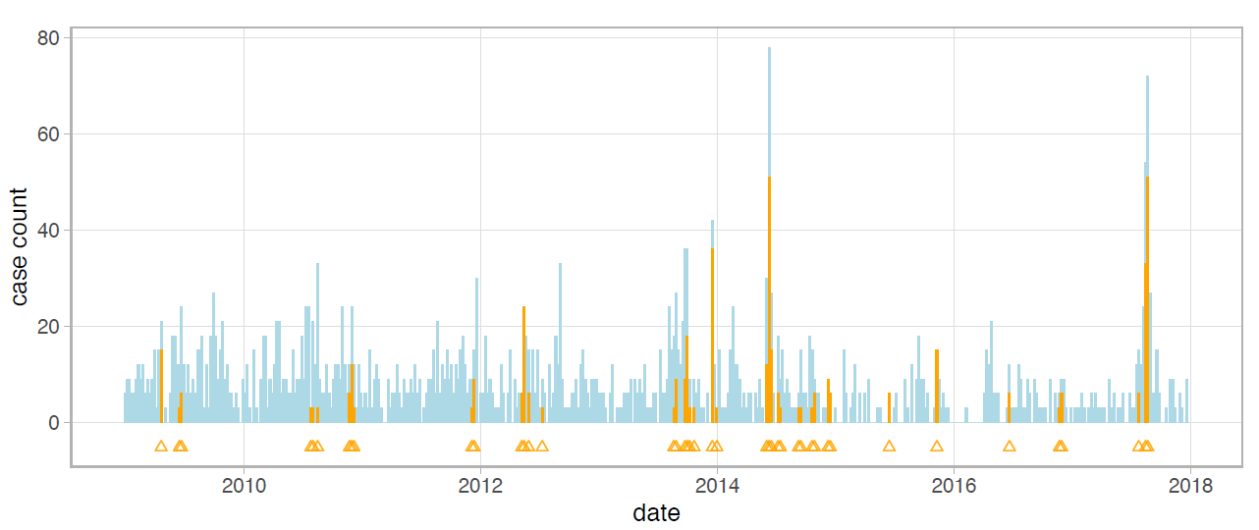
Objective
TRIAL AUDITS 2.0
Test Data: confirmed outbreak labels

Slide 5
Timeline
TRIAL AUDITS 2.0
Contacted almost 90 people
50 people are interested as of now from almost over 20 organizations and over 15 countries
Held calls to harmonize ideas and goals
Wrote an extensive review on methods and metrics in outbreak detection
Conducted a survey to find gaps in our review and to find most important use cases

Slide 6
First use case
TRIAL AUDITS 2.0
Outbreak label and diagnosis should be clear
Plenty of data should be available
Start with salmonella
Widespread and frequent
Data available
Diagnosis may be unprecise
Continue with Dengue and/or Ebola

Slide 7
Current standards
TRIAL AUDITS 2.0
Surveillance package for R
SaTScan software
Review of typically used data, algorithms, and metrics can found at TG Outbreaks collaboration site (https://extranet.itu.int/sites/itu-t/focusgroups/ai4h/tg/SitePages/TG-Outbreaks.aspx)

Slide 8
Special considerations
TRIAL AUDITS 2.0
How to compare algorithms that don’t share a strategy to:
Single case vs. aggregated data
Same aggregation vs. multiple testing
Including non-case/endemic case detection
Normal metrics are not enough. Additional weighting important
Timeliness
Outbreak size
Spatial accuracy

Slide 9
Example
TRIAL AUDITS 2.0

Slide 10
Example
TRIAL AUDITS 2.0

Slide 11
Example
TRIAL AUDITS 2.0

Slide 12
Outlook
TRIAL AUDITS 2.0
We’ve submitted our first simple benchmark
Checklist will be improved and added to benchmark
Test will be conducted to find risks and failures
Soon, interim findings will be generated
Improve our communication
Get more help, especially around organization (time zones, COVID-19, …)

