Slide 1
FGAI4H-N-016-A03
E-meeting, 15-17 February 2022
Source: | TG-Neuro Topic Drivers
Title: | Att.3 - Presentation (TG-Neuro)
Purpose: | Discussion
Contact: | Ferath Kherif CHUV - LREN Switzerland Marc Lecoultre Switzerland | E-mail: Ferath.kherif@chuv.ch
Abstract: | This PPT summarizes the status of work within TG-Neuro, for presentation and discussion during the meeting.

Slide 2
TG-Neuro
Aim: investigate machine learning-based diagnostics for neurodegenerative diseases (Alzheimer's disease, Parkinson's Disease, and related dementia syndromes, which are located within the neurological domain of the DSM V) based on real-world imaging and genetic information.
Relevance: As the population ages, the chance of becoming demented is on the rise. Current estimates suggest that there are approximately 48 million people worldwide suffering from dementia.
The social cost of care to 1% of world’s gross domestic product – GDP.
These statistics led the World Health Organization to classify neurocognitive disorders as a global public health priority.

Slide 3
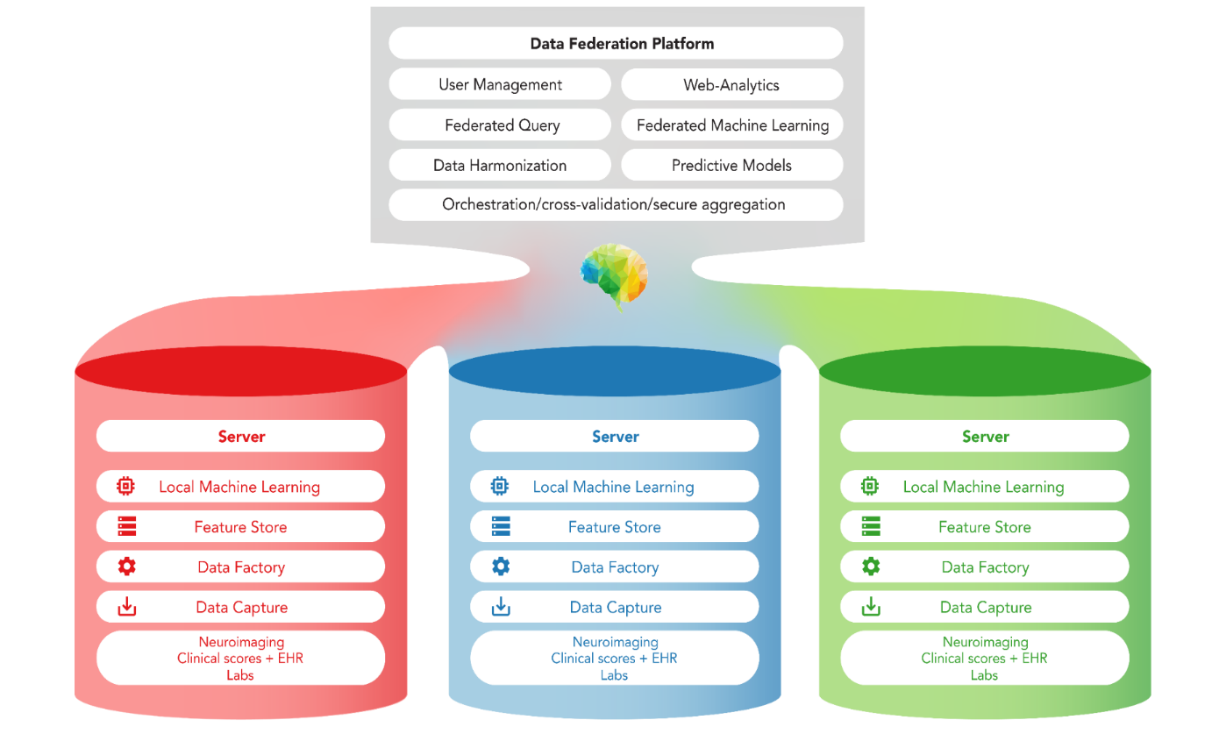
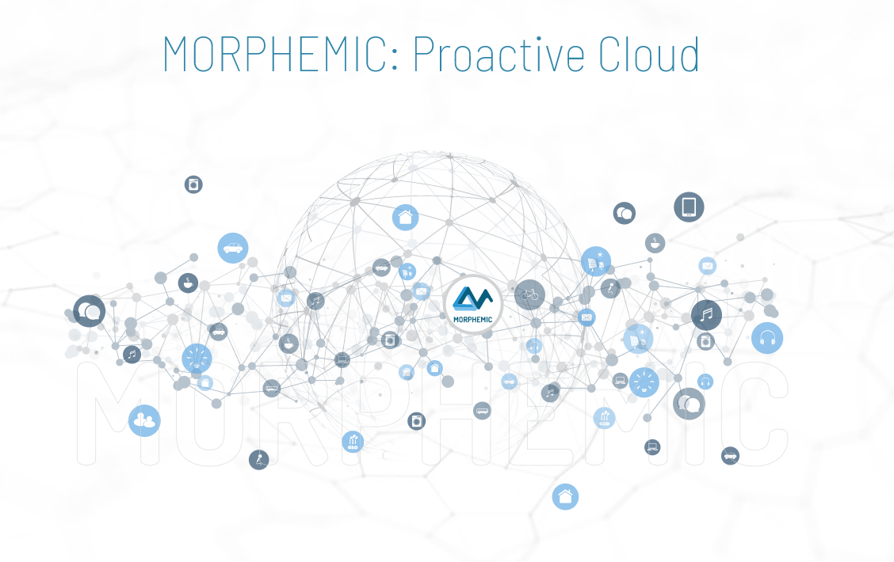
TG-Neuro Centralised and federated approach
Whole Brain images from MRI, PET or CT scans.
Image File Format: DICOM or NIFTI format
Image File Names: Images names will be anonymised to exclude any patient identifying information.
Image Resolution: the images will be supplied in their original resolution as captured from the MRI scanner
HUB
Count Vascular lesion
History
Genetic
Memory Score
Executive functioning scores
Co-morbidity symptoms
Verbal fluency
Delayed memory scores
Motor scores
Psychiatric questionnaires
Alcohol Use
Temperature
The diagnosis of cognitive disorders an disease severity:
Alzheimer's Diseas
Mild cognitive impairment (MCI)
Cognitively normal (CN)
Other Mixed Dementia (MD)
Morphemic Brain
Leverage the cloud technology

Slide 4
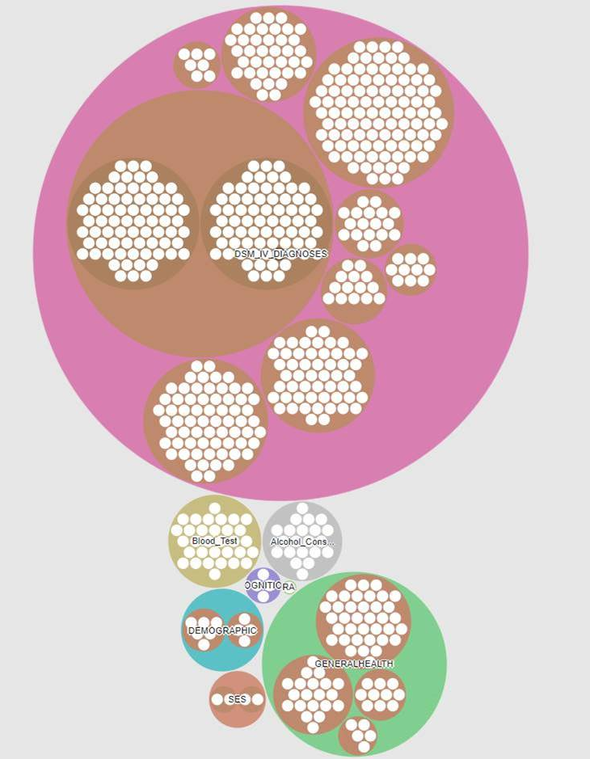
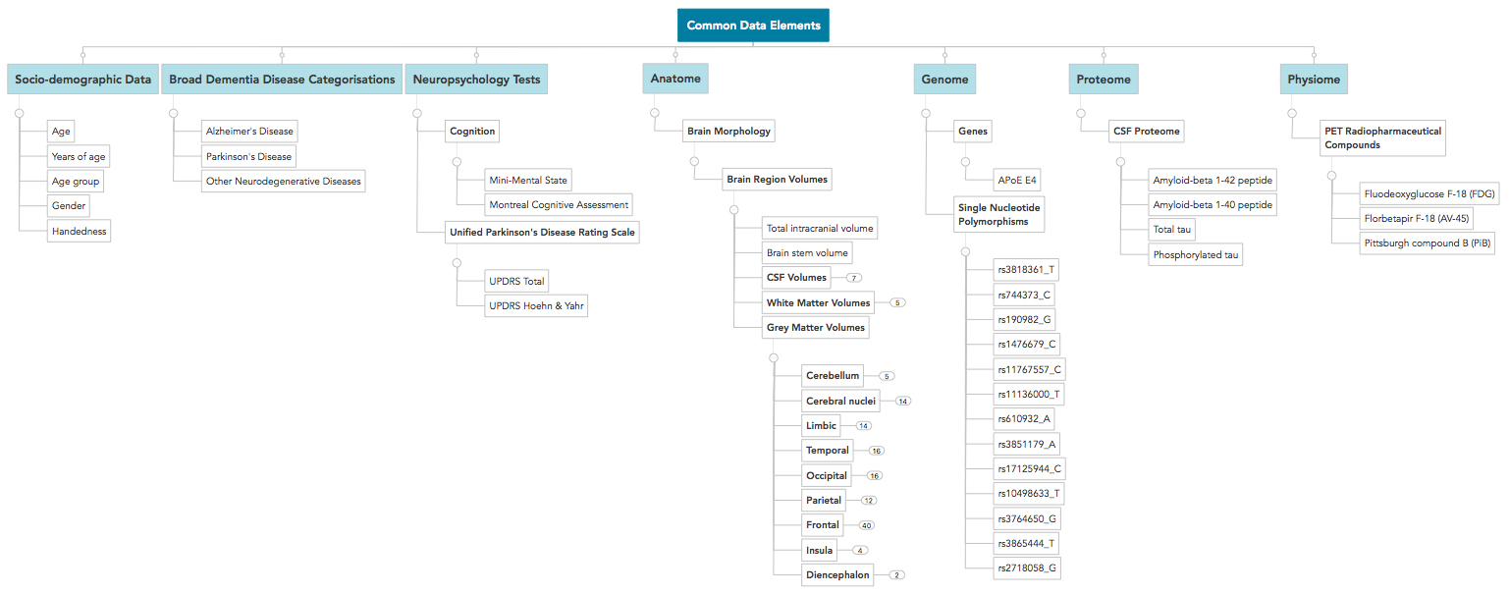
Data Catalogue (Dementia Use case)
First Metadata Model
Dementia and general Population Data

Slide 5
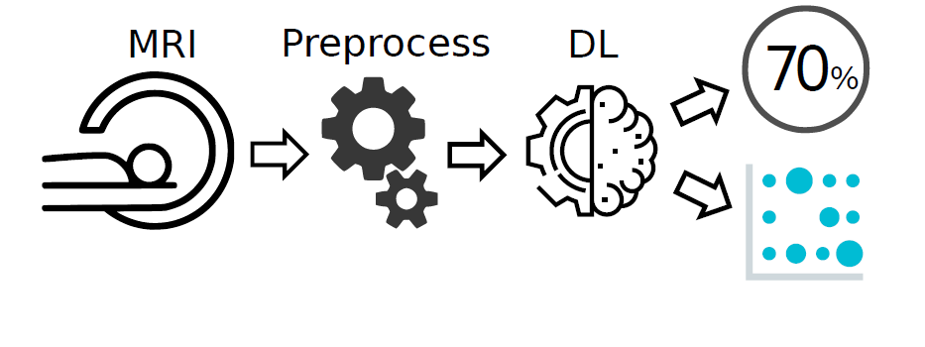
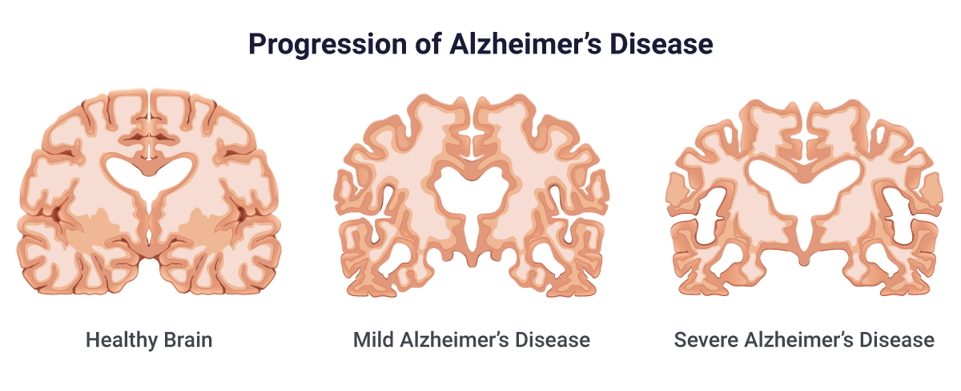
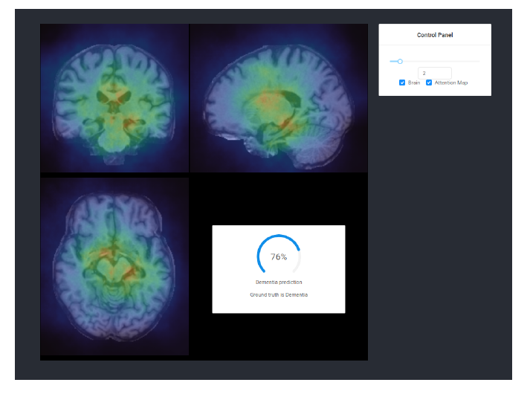
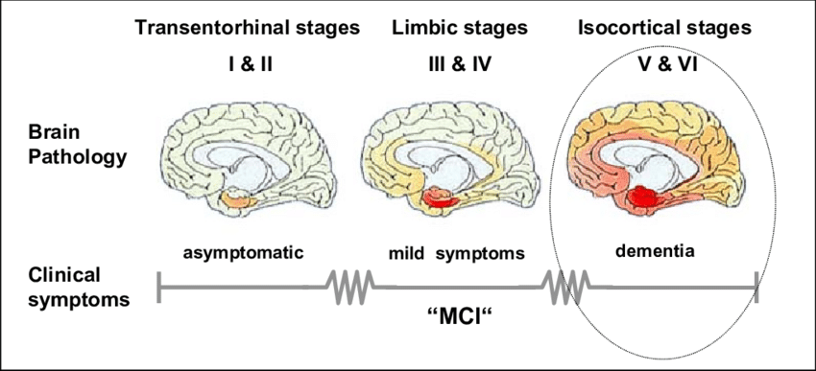
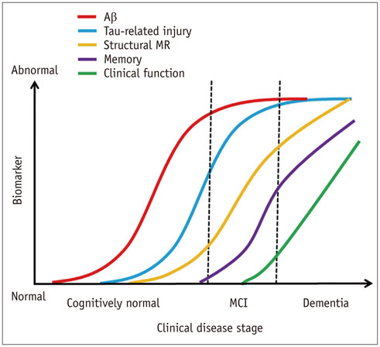
Achievements and challenges
clinical impact
Hardaware Implementation
Dynamic systems
Explainable AI
FPGA hardware acceleration

Slide 6
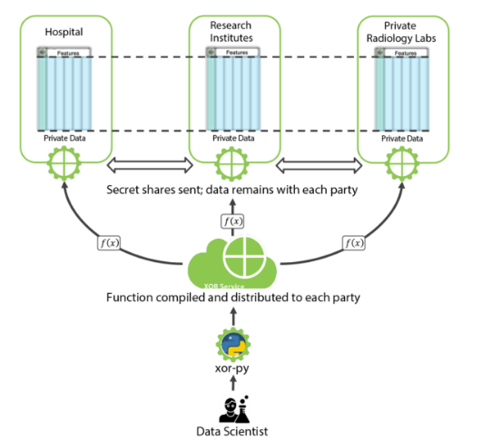
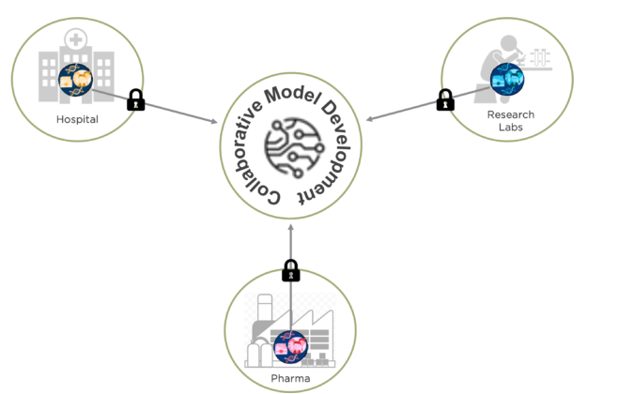
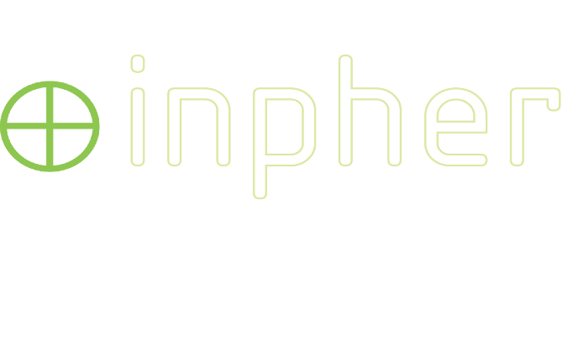
TG-Neuro Federated Learning (FL) and privacy-preserving machine learning (PPML)
In collaboration
Secure Multi-Party Computation

Slide 7
TG-Neuro Next steps
Attracting data providers who are also data users
Increasing the diversity and representativeness of the data, along the multiple dimensions such as
- psychiatric health
- gender
- geographic locations (environment factors, social, culture, ..)

