Slide 1
FGAI4H-N-012-A03
E-meeting, 15-17 February 2022
Source: | TG-Falls Topic Driver
Title: | Att.3 – Presentation (TG-Falls)
Purpose: | Discussion
Contact: | Pierpaolo Palumbo TG-Falls Topic Driver University of Bologna, Italy | E-mail: pierpaolo.palumbo@unibo.it
Abstract: | This PPT summarizes the status of the work within TG-Falls, for presentation and discussion during the meeting.

Slide 2
AI4H TG-Falls among the elderly
16th February 2022

Slide 3
Overview
Introduction
Topic Description Document
Benchmarking: AI Trial Audit Project 2.0
Review on datasets for sensor-based fall prediction

Slide 4
Overview
Introduction
Topic Description Document
Benchmarking: AI Trial Audit Project 2.0
Review on datasets for sensor-based fall prediction

Slide 5
Introduction
Falls are common, multifactorial, burdensome
Falls are preventable (RR ≈0.7-0.8)
falls
Global Burden of Disease, 2019, https://vizhub.healthdata.org/

Slide 6
AI systems for fall prevention and management
Fall prediction
G. V. Gade et al., “Predicting falls in community-dwelling older adults: a systematic review of prognostic models,” BMJ Open, vol. 11, no. 5, p. e044170, May 2021, doi: 10.1136/bmjopen-2020-044170.
Fall detection, classification
X. Wang, J. Ellul, and G. Azzopardi, “Elderly Fall Detection Systems: A Literature Survey,” Front. Robot. AI, vol. 7, p. 71, Jun. 2020, doi: 10.3389/FROBT.2020.00071/BIBTEX.
Fall prevention recommendation
S. Chaieb, A. Ben Mrad, and B. Hnich, “Interventions Recommendation System for Preventing future Falls in Older Adults,” Procedia Comput. Sci., vol. 192, pp. 192–201, Jan. 2021, doi: 10.1016/J.PROCS.2021.08.020.
T. F. Mebrahtu et al., “Effects of computerised clinical decision support systems (CDSS) on nursing and allied health professional performance and patient outcomes: a systematic review of experimental and observational studies,” BMJ Open, vol. 11, no. 12, p. e053886, Dec. 2021, doi: 10.1136/BMJOPEN-2021-053886.

Slide 7
Populations-settings
Community
Nursing homes
Hospitals
Older people
Cerebral palsy
Rehabilitation centres
Stroke
Parkinson’s disease
Workers at height
Amputees
Dementia
Africa
America
Asia
Fragile
Europe
Australia
Normal pressure hydrocephalus
...

Slide 8
AI input data
Clinical risk factors
S. Deandrea et al. “Risk Factors for Falls in Community-dwelling Older People: A Systematic Review and Meta-analysis,” Epidemiology, vol. 21, no. 5, pp. 658–668, 2010.
Environmental risk factors
S. Valipoor et al. “Falls in Older Adults: A Systematic Review of Literature on Interior-Scale Elements of the Built Environment,” J. Ageing Environ., vol. 34, no. 4, pp. 351–374, Oct. 2020, doi: 10.1080/02763893.2019.1683672.
Sensors (inertial, cameras, RF, etc.)
L. Montesinos, R. Castaldo, and L. Pecchia, “Wearable Inertial Sensors for Fall Risk Assessment and Prediction in Older Adults: A Systematic Review and Meta-Analysis,” IEEE Trans. Neural Syst. Rehabil. Eng., vol. 26, no. 3, pp. 573–582, Mar. 2018, doi: 10.1109/TNSRE.2017.2771383.
Available preventive interventions
D. C. Grossman et al., “Interventions to Prevent Falls in Community-Dwelling Older Adults. US Preventive Services Task Force Recommendation Statement,” JAMA, vol. 319, no. 16, p. 1696, Apr. 2018, doi: 10.1001/jama.2018.3097.
...

Slide 9
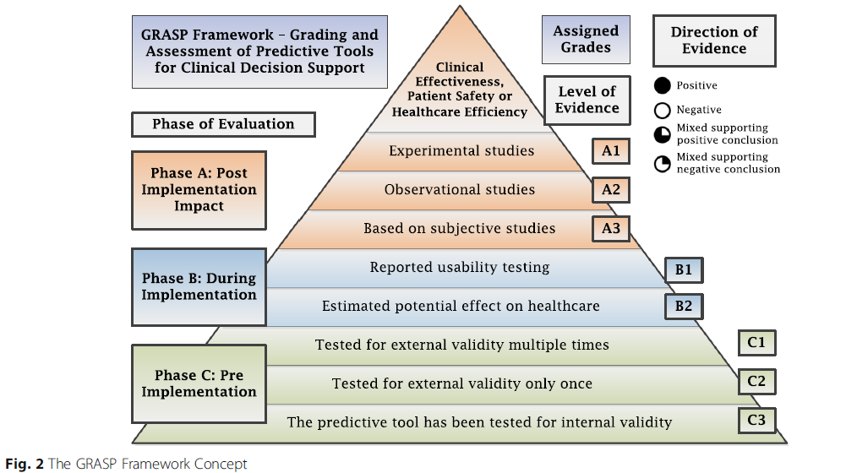
AI systems assessment
Technical evaluation
Clinical evaluation
Regulatory assessment
Ethical assessment
Sensitivity, specificity
Discriminative ability (AUC)
Calibration
Fairness
...
Predictive accuracy
Patient safety
Clinical effectiveness
Usability
Healthcare efficiency
...
M. Khalifa, F. Magrabi, and B. Gallego, “Developing a framework for evidence-based grading and assessment of predictive tools for clinical decision support,” BMC Med. Informatics Decis. Mak. 2019 191, vol. 19, no. 1, pp. 1–17, Oct. 2019, doi: 10.1186/S12911-019-0940-7.

Slide 10
AI systems | Target populations | Settings | Input data | Evaluation phases | Domains
Fall prediction | Older adults | Community | Clinical risk factors | Before implementation: internal, external validation | Sensitivity, specificity, calibration, discrimination...
Fall detection, pre-impact fall prediction | Parkinson’s disease | Hospitals | Environmental risk factors | During implementation: potential effect, usability | Potential effect
DSS/recommender systems for fall prevention | Stroke | Nursing homes | Inertial sensors | After implementation: clinical effectiveness, patient safety, healthcare efficiency | Usability
 | Amputees | Rehabilitation centres | Cameras |  | Clinical effectiveness
 | Dementia | ... | RF |  | Patient safety
 | ... |  | Force plates |  | Heathcare efficiency

Slide 11
Overview
Introduction
Topic Description Document
Benchmarking: AI Trial Audit Project 2.0
Review on datasets for sensor-based fall prediction

Slide 12
Topic Description Document
Domain: falls in older people
Task: one-year fall prediction
Gold Standard: prospectively recorded falls
Input data type: numerical (clinical data), signals (movement sensors)
Testing/ Training dataset: FallSensing (undisclosed), public datasets
Data annotation: NA
Algorithm: submitted by participants, TUG as reference
Evaluation: discrimination, calibration

Slide 13
Topic Description Document
One subtopic (fall prediction)
Completely missing:
§ 7. Overall discussion of the benchmarking
§ 8. Regulatory considerations

Slide 14
Overview
Introduction
Topic Description Document
Benchmarking: AI Trial Audit Project 2.0
Review on datasets for sensor-based fall prediction

Slide 15
Benchmarking: AI Trial Audit Project 2.0
Trial Audit Project 2.0
Coding (https://github.com/aiaudit-org/trial-audits-team-k-tg-falls)
FallSensing data (Fraunhofer Portugal AICOS, Coimbra Health School)
Questionnaire/checklist for qualitative assessment
Terms and conditions
Documentation for participants: description of FallSensing, technical constraints on submitted algorithms

Slide 16
Overview
Introduction
Topic Description Document
Benchmarking: AI Trial Audit Project 2.0
Review on datasets for sensor-based fall prediction

Slide 17
Review on datasets for sensor-based fall prediction

Slide 18
Review on datasets for sensor-based fall prediction
J. Howcroft, J. Kofman, and E. D. Lemaire, “Review of fall risk assessment in geriatric populations using inertial sensors.,” J. Neuroeng. Rehabil. 2013
L. Montesinos, R. Castaldo, and L. Pecchia, “Wearable Inertial Sensors for Fall Risk Assessment and Prediction in Older Adults: A Systematic Review and Meta-Analysis,” IEEE Trans. Neural Syst. Rehabil. Eng. 2018
A. Kristoffersson, J. Du, and M. Ehn, “Performance and Characteristics of Wearable Sensor Systems Discriminating and Classifying Older Adults According to Fall Risk: A Systematic Review,” Sensors 2021
D. J. Warrington, E. J. Shortis, and P. J. Whittaker, “Are wearable devices effective for preventing and detecting falls: an umbrella review (a review of systematic reviews),” BMC Public Health 2021
…
...
Review on datasets for Artificial Intelligence systems for fall prediction

Slide 19
Review on datasets for sensor-based fall prediction
PubMed
Web of Science
Scopus
Google Dataset Search Mendeley Data
IEEE DataPort
Physionet
Figshare
Dataverse
Dryad
Inclusion criteria
Datasets including at least 20 individuals
Datasets with information on falls at individual level (occurrence of at least one fall in a given time period, number of falls, date of first fall occurrence)
Datasets with individual-level features to be used as fall predictors
Datasets where the predicting features comprised at least one sensor-based feature. Included sensors were: inertial sensors, cameras, force platforms, others
Datasets where the information about falls was collected after the predicting features (prospective design)
Datasets described in at least one peer-reviewed article in English or Italian language
Review papers
Articles/datasets
Screening for eligibility
Feature extraction (1)
Access request
Feature extraction (2)

Slide 20
Review on datasets for sensor-based fall prediction
Paper | Review type | Journal (Index) | Search timeline | Search criteria | Inclusion criteria | Number of screened papers | Number of reported papers | Main findings/recommendations
Name (citation) | Systematic/Scoping/Narrative | AAA (Scopus) | up to August 2019 | "word1" AND "word2" | above 65 + No CI + fall outcomes | 150 | 18 | Most studies place sensors on low back
Dataset | Data access | Geographic location | Study design | Participant’s eligibility | Application domain | Number of participants | File type | File format | Link
Name (citation) | On request No answer to our request | France | Observational: Baseline + follow-up | Healthy Age Non-CI Non assistive devices | Was it primarily collected to assess falls? | 150 | Clinical records Physiological measures | .csv .mat | For public datasets
Dataset | Clinical Predictors | Sensor or tech-based predictors (sampling frequency) | Task | Sensor location | Fall data | Fall recording method | Follow-up time
Ireland Dataset | Falls history Medication | Accelerometer (100 Hz) Heart rate | TUG 7-day activity monitoring | Trunk | Number of falls For each fall event: date, time, location, injuries | Prospective Monthly phone calls | 6 months
Dataset | Article | Algorithm (citation) | Output | Accuracy | Feature selection | Validation method
Ireland Dataset | Enstein et al. 1915 Maxwell et al. 2022 | Elastic NN (XXX, YEAR) | Discrete Probability | % | Manual | Cross validation

Slide 21
Long-term strategy
Dataset review
Datasets for benchmarking
Benchmarking v1
Benchmarking v2
Formal methods for benchmarking
Consensus process

Slide 22
Next steps for publications
Topic Description Document
Benchmarking: AI Trial Audit Project 2.0
Review on datasets for sensor-based fall prediction

Slide 23
Thank you

