Slide 1
FGAI4H-N-010-A03
E-meeting, 15-17 February 2022
Source: | TG-Dental Topic Drivers
Title: | Att.3 - Presentation (TG-Dental)
Purpose: | Discussion
Contact: | Dr Joachim Krois | E-mail: joachim.krois@charite.de
Abstract: | This PPT summarizes the status of work within TG-Dental, for presentation and discussion during the meeting.

Slide 2
Meeting N TG-Dental Update
February 15–17, 2022
Falk Schwendicke, Joachim Krois, Tarry Singh, Jae-Hong Lee
Akhilanand Chaurasia, Robert André Gaudin, Sergio Uribe, Hossein Mohammad-Rahimi, Janet Brinz, Anahita Haiat, Gürkan Ünsal, Nielsen Santos Pereira, Ulrike Kuchler, Shankeeth Vinayahalingam, Balazs Feher, Francesc Perez Pastor, Lisa Schneider, Chen Nadler, Sahel Hassanzadeh-Samani, Parisa Motie, Ragda Abdalla-Aslan, Teodora Karteva, Jelena Roganovic, Kunaal Dhingra, Prabhat Kumar Chaudhari, Olga Tryfonos, Marja Laine, Rata Rokhshad, Fatemeh Sohrabniya, Zeynab Pirayesh, Shada Alsalamah, Sakher AlQahtani, Revan Birke Koca-Ünsal, Lubaina T. Arsiwala

Slide 3
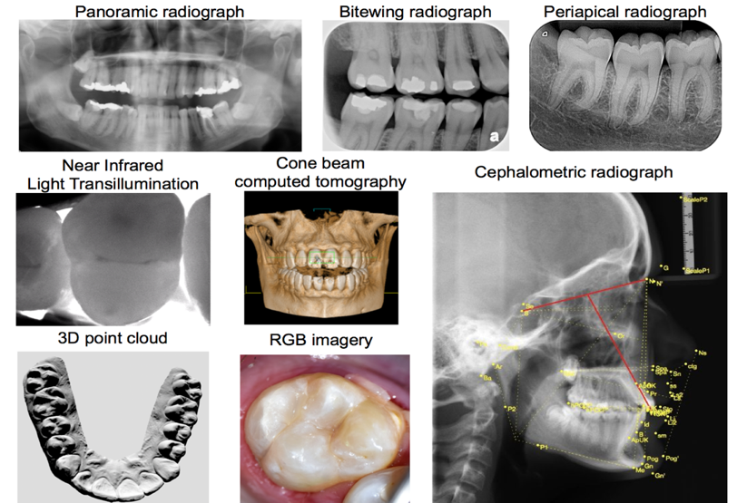
TG-Dental – An overview
Dental Diagnostics and Digital Dentistry
Established at Meeting G (New Delhi, India)
Data modalities
Imaging
Dental history
Clinical investigation
further physical or (bio)chemical or microbiological assessments

Slide 4
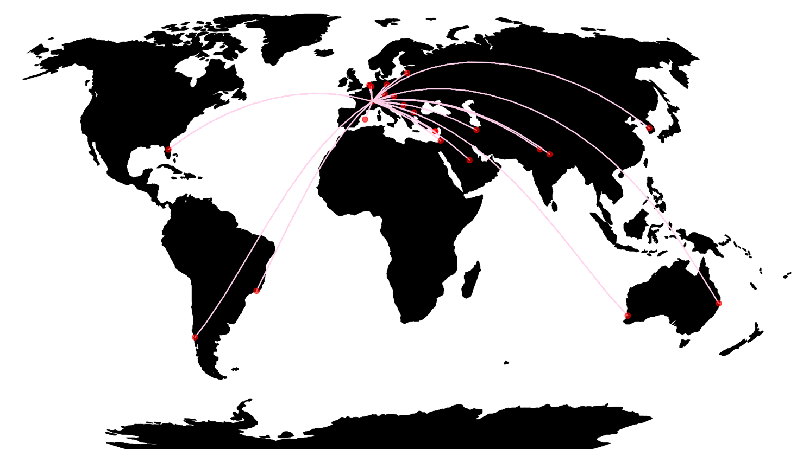
TG-Dental – Contributors
34 members
18 countries
5 continents
16
18
Notes:
Shank, Ulrike and Balazs is missing

Slide 5
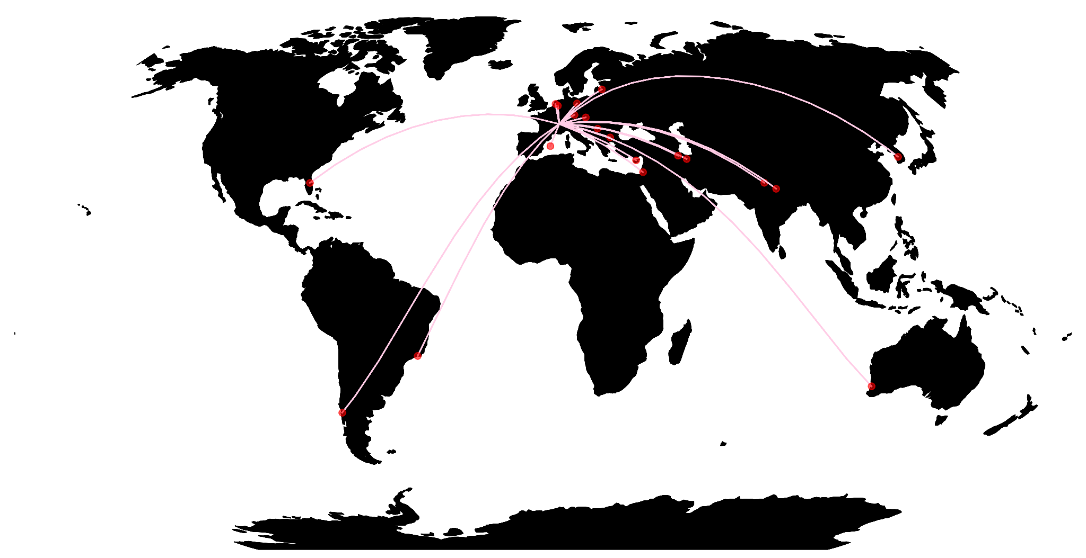
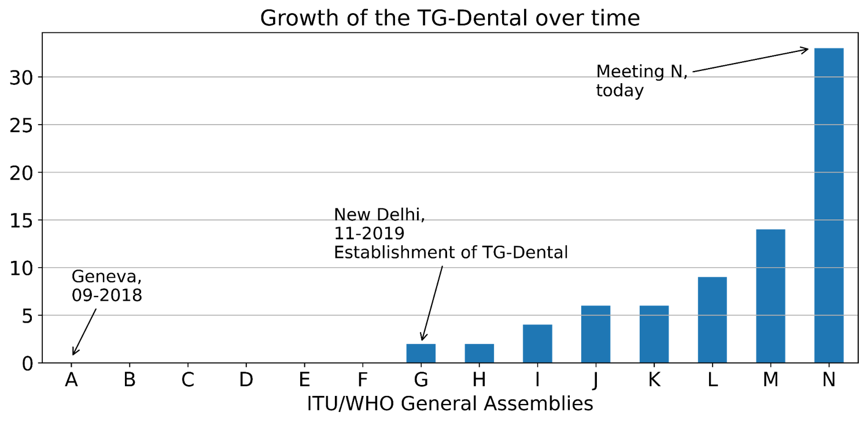
TG-Dental – Contributors
Notes:
Shank, Ulrike and Balazs is missing

Slide 6
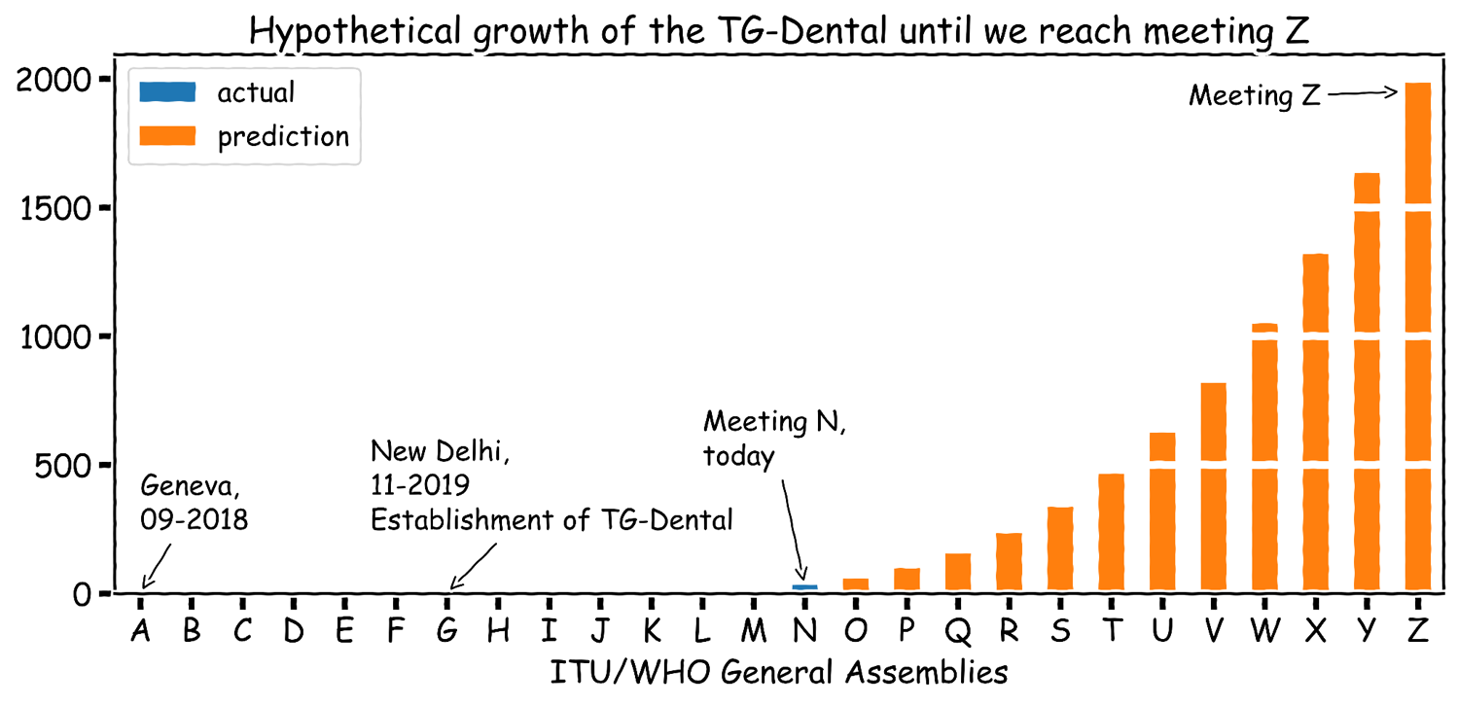
TG-Dental – Contributors
Notes:
Shank, Ulrike and Balazs is missing

Slide 7
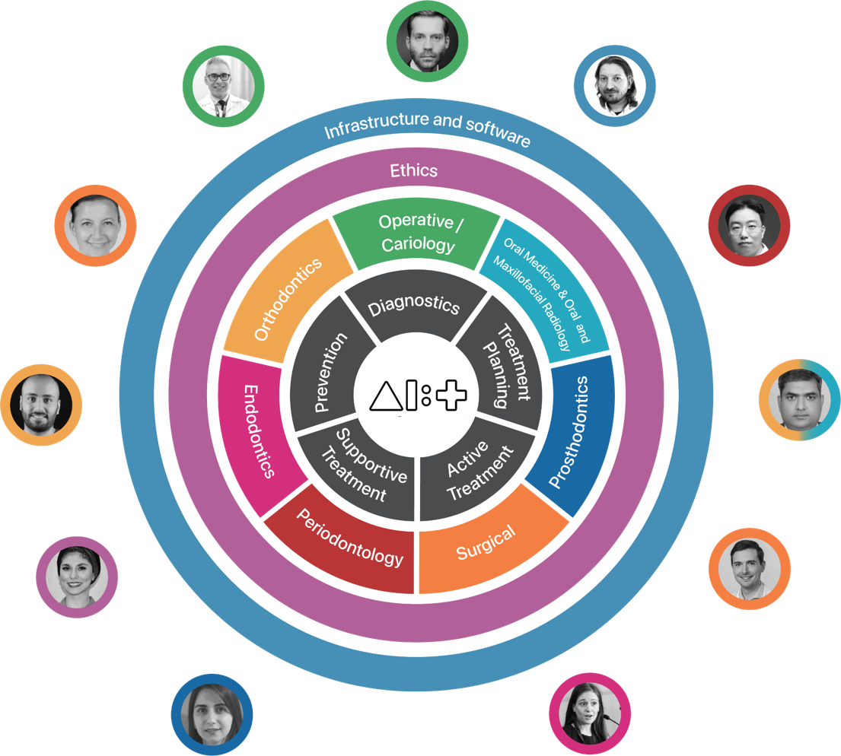
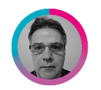
TDD – Section 3: Topic description and subtopics

Slide 8
Activities since Meeting M
Welcoming nineteen new members to the topic group
Advancing TDD subtopics and adding the Endodontics subtopic group (section 3 in TDD)
Established a team to contribute to Ethics (section 4 in TDD)
[ongoing] Establishment of a benchmark dataset for tooth classification, detection and segmentation
[ongoing] Evaluation of annotation accuracy of dental expert for caries detection on bitewing radiographs
Participation in FG-AI4H Trial Audits 2.0 project
Exploration of public reachout via an own website (knowledge hub)
Establishment of research cooperations, which are preparing joint peer-review publications
Systematic reviews (ethics, implant research, caries detection, …)
“Automated Detection and Classification Of Jaw Cysts Using Deep Learning” (submitted)

Slide 9
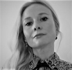
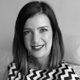
Welcoming nineteen new members to the topic group
Chen Nadler Oral-Maxillofacial Imaging Unit, Hadassah Medical Center, Faculty of Dental Medicine, Hebrew University of Jerusalem, Israel
Rata Rokhshad
Dental material center, Azad tehran University
Iran
Kunaal Dhingra
Periodontics Division, Centre for Dental Education and Research, All India Institute of Medical Sciences, New Delhi, India
Parisa Motie
Student Research Committee, school of dentistry
Shahid Beheshti University of Medical Sciences
Tehran, Iran
Fatemeh Sohrabniya
Research Committee , Shiraz University of Medical Science
Iran
Francesc Perez Pastor
Collaborating Prof. Master Orthodontics UB
IDISBA Palma, Mallorca, Spain
Teodora Karteva
Operative Dentistry & Endodontics
Department of Operative Dentistry & Endodontics, Medical University - Plovdiv, Bulgaria
Dr. Prabhat Kumar Chaudhari
Division of Orthodontics and Dentofacial Deformities, Centre for Dental Education and Research (CDER), All India Institute of Medical Sciences (AIIMS), New Delhi, India.
Prof. Marja Laine
Chair Periodontology Department
ACTA (Academic Center for Dentistry Amsterdam)
The Netherlands
Zeynab Pirayesh
Department of Orthodontics, School of Dentistry, Zanjan University of Medical Sciences, Zanjan, Iran.
Olga Tryfonos
Periodontology Department
ACTA (Academic Center for Dentistry Amsterdam)
The Netherlands
Jelena Roganovic
Associate professor
Department of Pharmacology in Dentistry, University of Belgrade, Serbia
Lisa Schneider Charité – Universitätsmedizin Berlin Germany
Ragda Abdalla-Aslan
Department of Oral and Maxillofacial Surgery, Rambam Health Care Campus, Haifa
Department of Oral Medicine, Sedation and Maxillofacial Imaging, Hebrew University-Hadassah School of Dental Medicine, Jerusalem, Israel
Sahel Hassanzadeh-Samani
Dentofacial Deformities Research Center, Shahid Beheshti University of Medical Sciences
Tehran, Iran
Sakher AlQahtani
Associate Professor, College of Dentistry, King Saud University;
Honorary Professor, University of Queensland
Shada Alsalamah
Technical Officer, Digital Health and Innovations Department, World Health Organization, Geneva, Switzerland;
Assistant Professor, College of Computer and Information Sciences, King Saud University, Saudi Arabia, Riyadh.
Revan Birke Koca-Ünsal
Assistant Professor, Department of Periodontology, Faculty of Dentistry, University of Kyrenia, Kyrenia, Cyprus
Lubaina T. Arsiwala
Associate researcher
Charité – Universitätsmedizin Berlin Germany

Slide 10
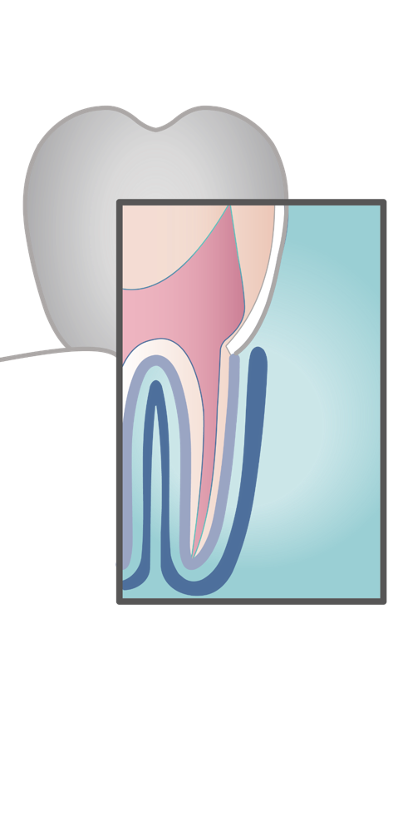
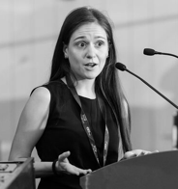
Advancing TDD subtopics and adding the Endodontics subtopic group (section 3 in TDD)
TEODORA KARTEVA (PI)
Contributors
Olga Tryfonos
Lubaina Arsiwala
Manal Hamdan
Nielsen Pereira
Rata Rokhshad
Revan Birke Koca-Ünsal
Operative Dentistry & Endodontics
Department of Operative Dentistry & Endodontics, Medical University - Plovdiv
Bulgaria
Endodontics is the art & science of retaining a natural tooth. Machine learning algorithms can improve the diagnosis, treatment, and prognosis of pulpal and periapical diseases as they assist clinicians in their exploration of the winding pathways of the pulp.

Slide 11
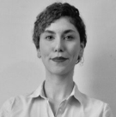
Established a team to contribute to Ethics (section 4 in TDD)
RATA ROKHSHAD (PI)
Contributors
OLGA TRYFONOS
JANET BRINZ
JELENA ROGANOVIC
KUNAAL DHINGRA
NIELSEN PEREIRA
PRABHAT KUMAR CHAUDHARI
SHANKEETH VINAYAHALINGAM
Dental material center
Azad Tehran University Iran
Data protection
Communication
Currently working on
Data Diversity
Data Quality

Slide 12
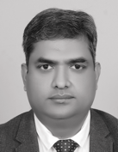
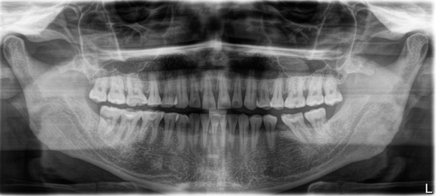
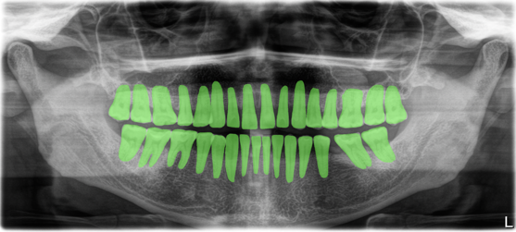
Establishment of a benchmark dataset for tooth classification, detection and segmentation
Multi-center benchmark study (MCBS)
Establish a dataset of high heterogeneity and bias
Establish a process to generate ground truth labels
Multi-center modelling with the goal to establish most influential biases (population characteristics, dental status, X-ray machinery, etc)
AKHILANAND
CHAURASIA
PI of Oral Medicine an
Maxillofacial Radiology King George Medical University
Lucknow, India
Dataset
Dental panoramic radiographs
Collected according to defined data specification requirements (yet unpublished)
1996 images (continuously expanding)
7 centers from 5 countries
24 annotators
1673 (84%) images have been annotated, resulting in approx. 41,800 tooth masks!

Slide 13
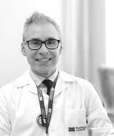
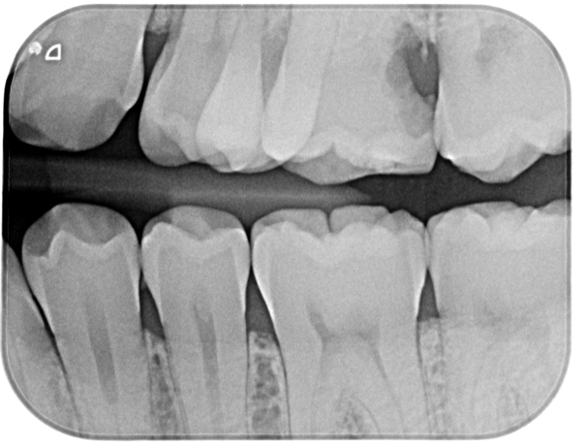
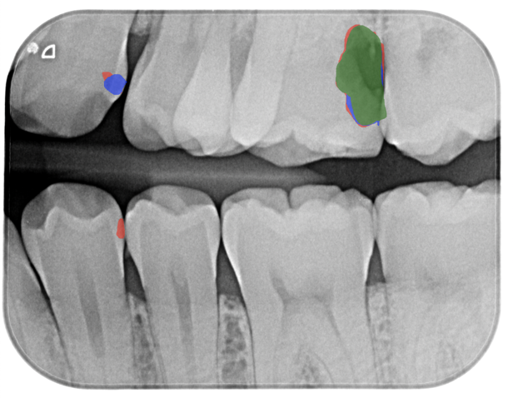
Evaluation of annotation accuracy of dental expert for caries detection on bitewing radiographs
Dataset
Dental bitewing radiographs
Collected according to defined data specification requirements
880 images
3 annotators
SERGIO URIBE
PI Operative and Cariology
Riga Stradins University, Riga, Latvia
Universidad Austral de Chile, Valdivia, Chile
Original
Annotated

Slide 14
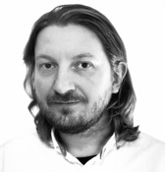
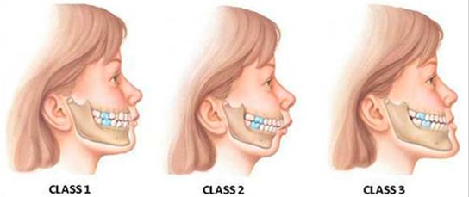
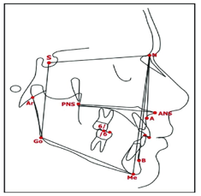
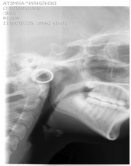
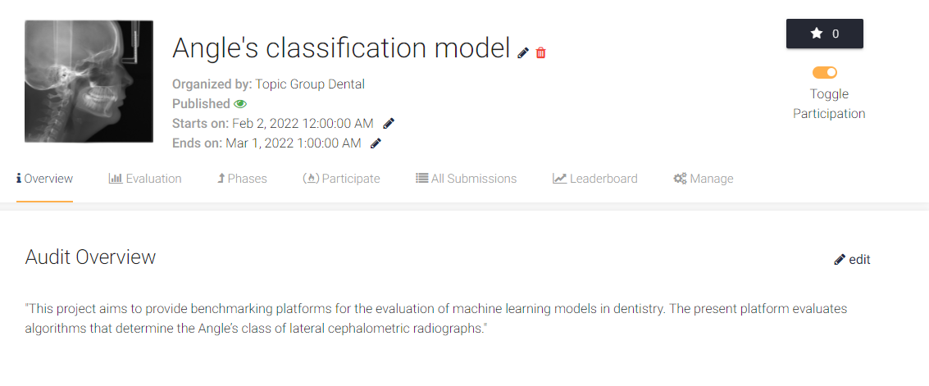
Participation in FG-AI4H Trial Audits 2.0 project
Prediction of Angle‘s classification
JOACHIM KROIS
Topic Driver
Charité – Universitätsmedizin Berlin
Berlin, Germany
Contributors
AKHILANAND CHAURASIA
ANAHITA HAIAT
FALK SCHWENDICKE
NIELSEN SANTOS PEREIRA
JOHANNES TANNE
HOSSEIN MOHAMMAD-RAHIMI
SHANKEETH VINAYAHALINGAM
https://github.com/aiaudit-org/trial-audits-team-i-tg-dental
https://github.com/TG-Dental

Slide 15
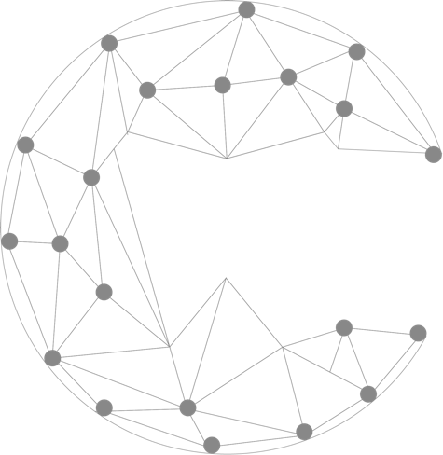
Exploration of public reachout via an own website (knowledge hub)
TEODORA KARTEVA
Operative Dentistry & Endodontics
Department of Operative Dentistry & Endodontics, Medical University - Plovdiv
Bulgaria
What we do
Benchmarking
Our main goal is to establish standardised benchmarking of Endodontic artificial intelligence systems​. We are excited - benchmarking is expected to yield more robust models and algorithms and to allow transparency and collaboration.
Get the conversation going
Artificial intelligence algorithms are coming to the daily Endodontic practice - let's get to know them!
Collaboration
Autodontics is an open platform that connects dentists from all around the world -from novices to experts.

Slide 16
Outputs
TDD – Topic description document (FGAI4H-N-010-A01)
Call for Topic Group Participation “Dental Diagnostics and Digital Dentistry” (FGAI4H-N-010-A02)

Slide 17
Next steps
-) Further develop the subtopics in the TDD for publication
-) Publication(s) related to the Multi-Center Benchmark Study
-) FG-AI4H Trial Audits 2.0 project
Section in TDD | Completeness
Sec 1. Introduction | 100%
Sec 2. About the FG-AI4H topic group on Dental Diagnostics and Digital Dentistry | 100%
Sec 3. Topic description | 85%
Sec 4. Ethical considerations | 10%
Sec 5. Existing work on benchmarking | 2%
Sec 6. Benchmarking by the topic group | 25%
Sec 7. Overall discussion of the benchmarking | 0%
Sec 8. Regulatory considerations | 0%

Slide 18
Thank you!
February 15–17, 2022
Falk Schwendicke, Joachim Krois, Tarry Singh, Jae-Hong Lee
Akhilanand Chaurasia, Robert André Gaudin, Sergio Uribe, Hossein Mohammad-Rahimi, Janet Brinz, Anahita Haiat, Gürkan Ünsal, Nielsen Santos Pereira, Ulrike Kuchler, Shankeeth Vinayahalingam, Balazs Feher, Francesc Perez Pastor, Lisa Schneider, Chen Nadler, Sahel Hassanzadeh-Samani, Parisa Motie, Ragda Abdalla-Aslan, Teodora Karteva, Jelena Roganovic, Kunaal Dhingra, Prabhat Kumar Chaudhari, Olga Tryfonos, Marja Laine, Rata Rokhshad, Fatemeh Sohrabniya, Zeynab Pirayesh, Shada Alsalamah, Sakher AlQahtani, Revan Birke Koca-Ünsal, Lubaina T. Arsiwala

