Slide 1
FGAI4H-N-009-A03-R01
E-meeting, 15-17 February 2022
Source: | TG-DiagnosticCT Topic Driver
Title: | Att.3 – Presentation (TG-DiagnosticCT)
Purpose: | Discussion
Contact: | QI Ji | E-mail: qji@infervision.com
Abstract: | This PPT contains a research about lung tumor detection, updates on three indicators for secondary benchmarking metrics and future plans for further indicators and methods.

Slide 2
Purpose of the TG
Establish a standardized assessment framework for the evaluation of AI-based methods for medical applications
Propose a benchmark for AI in volumetric Chest CT which include data format, desired data for AI training and testing as well as AI performance evaluation methodologies.
Structure and Content
Include a general review of a specific area of Chest CT lung cancer detection
Relevant existing AI solutions
AI Input Data Structure and Output Data Structure
Test Data Labels
Score and Metrics : updated
Available Public Data and Undisclosed Test Data Set Collection
Reporting Methodology

Slide 3
Chest CT
A chest computed tomography (CT) scan is an imaging test that takes detailed pictures of the lungs and the inside of the chest. Computers combine the pictures to create a 3-D model showing the size, shape, and position of the lungs and structures in the chest.

Slide 4
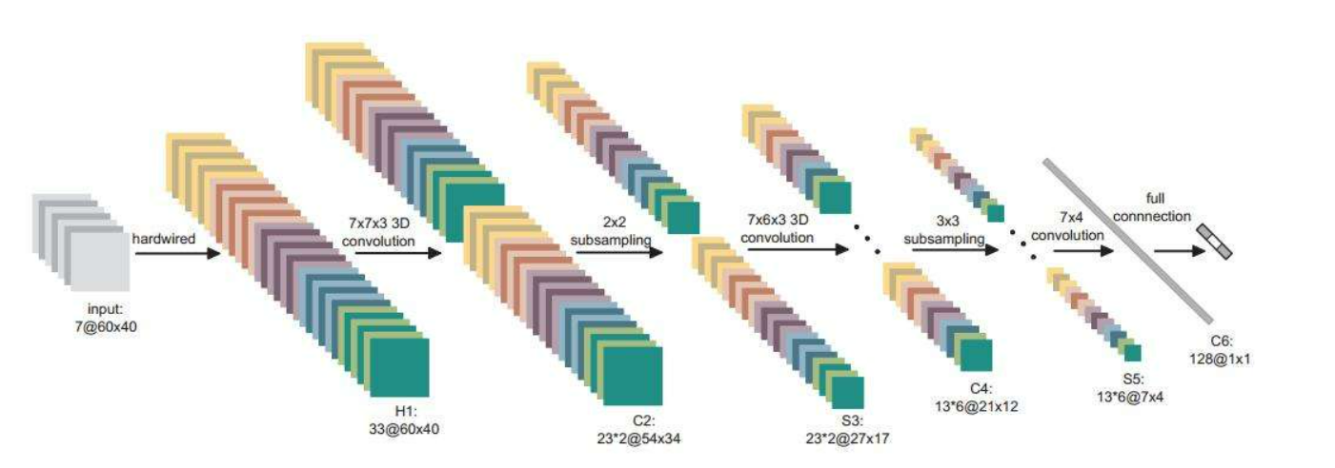
AI on lung tumor detection
Artificial intelligence (AI) products have been widely used for the clinical detection of primary lung tumors. However, their performance and accuracy in risk prediction for metastases or benign lesions remain underexplored.
A example of 3D convolutional neural network (CNN) architecture

Slide 5
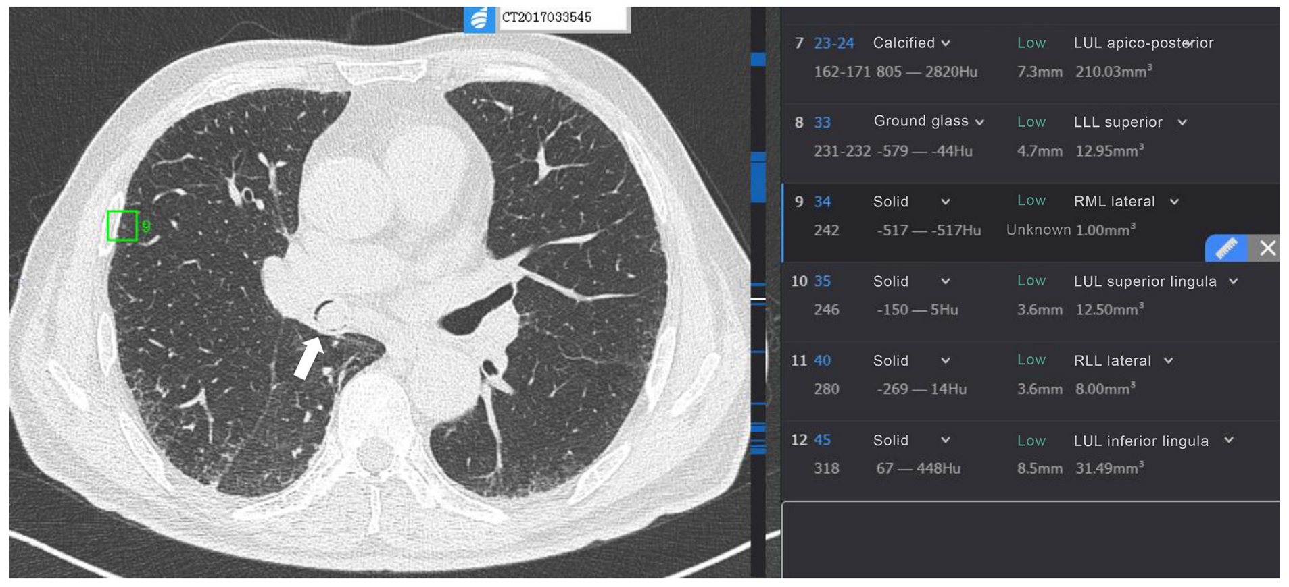
Cases on InferRead CT Lung Research (ICLR)

Slide 6
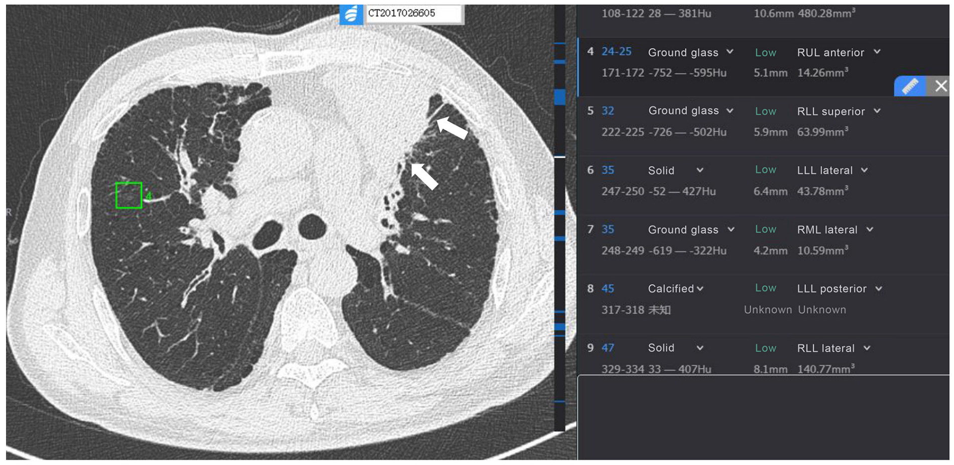
Cases on InferRead CT Lung Research

Slide 7
Assessing the predictive accuracy of lung cancer, metastases, and benign lesions using an artificial intelligence-driven computer-aided diagnosis system
Research sites:
Department of Radiology, Fifth Affiliated Hospital of Sun Yat-sen University
Guangdong Provincial Key Laboratory of Biomedical Imaging in Fifth Affiliated Hospital of Sun Yat-sen University
Department of Radiology, The First Affiliated Hospital of Nanchang University
Jiangxi Province Medical Imaging Research Institute
Software from InferVision Medical Technology
Funding: Guangdong Ministry of Education Industry-University-Research Project

Slide 8
Method
A retrospective study
486 consecutive resected lung lesions
From September 2015 to November 2018
Using the ICLR software
Based on a 3D convolutional neural network (CNN) with DenseNet
Two resident doctors independently graded each leison
The performances of the AI compared to the radiologists

Slide 9
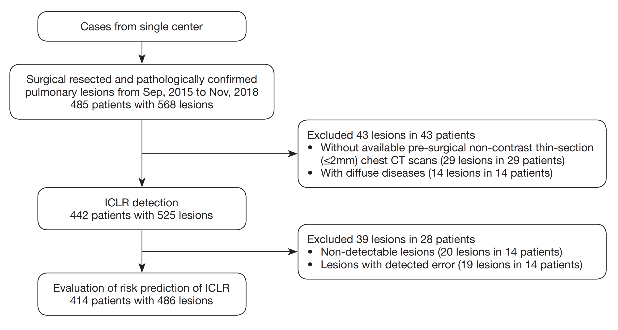
Study workflow for patient recruitment

Slide 10
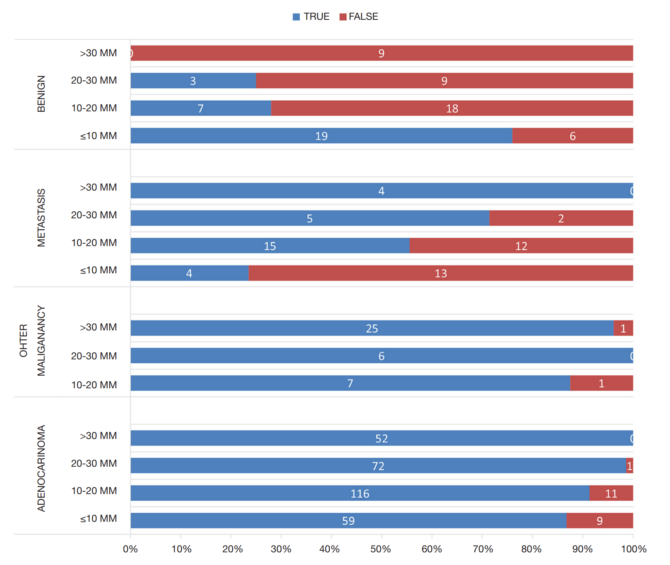
The Accuracy of the ICLR

Slide 11
Assessing the predictive accuracy of lung cancer, metastases, and benign lesions using an artificial intelligence-driven computer-aided diagnosis system
Conclusion:
The accuracy of the ICLR for risk prediction is very high for primary lung cancers but poor for metastases and benign lesions.

Slide 12
Assessing the predictive accuracy of lung cancer, metastases, and benign lesions using an artificial intelligence-driven computer-aided diagnosis system
Quantitative Imaging in Medicine and Surgery
doi: 10.21037/qims-20-1314

Slide 13
Secondary Benchmarking Metrics
In addition to the primary benchmarking metrics, other performance metrics relevant to the task at hand should be included as secondary benchmark metrics.
Robustness
Reproducibility
Generalization

Slide 14
Robustness
Evaluate various factors
Obtain or simulate relevant data

Slide 15
Robustness
Adversarial testing for hardware changes
Adversarial testing for software pre-processing
Adversarial testing for spoofing attacks
Stress test

Slide 16
Stress Test
Stress testing is to test the performance, reliability, stability, etc. of an algorithm model in the simulation of long-term extreme inputs or environments that may be encountered in practical applications.
The selection of stress test samples can follow the following principles:
a) images with older subjects;
b) imaging of specific diseases;
c) images with artifacts but meeting data quality requirements;
d) the layer thickness of the image is extremely large or small;
e) the image series contains a very large number of images;
f) with implants (interfering items);
g) with complications;
h) multiple, diffuse lesions.

Slide 17
Reproducibility
Testers should repeat the test on the same test set, and the number of tests should not be less than three times.

Slide 18
Generalization
Generalization ability refers to the ability of the algorithm to adapt to unfamiliar samples.
Analyze the differences between the training set and real-world samples
Verify the generalization ability of the algorithm

Slide 19
Future Plans
More discussion on different indicators and explanation
Nodule characterization indicators: size measurement, density, classification and malignancy

Slide 20
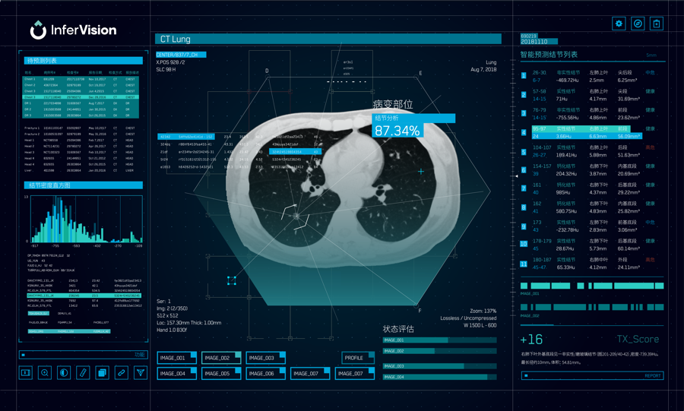
Thank You
qji@infervision.com

