Slide 1
FGAI4H-N-006-A03
E-meeting, 15-17 February 2022
Source: | TG-Cardio Topic Driver
Title: | Att.3 – Presentation (TG-Cardio)
Purpose: | Discussion
Contact: | Benjamin R. Henri Muthambi, DrPH, MPH TG-Cardio Topic Driver Institutes of Institutes of Epidemiology & Public Health, Inc. South Africa & USA | E-mail: brm5-@-caa.columbia.edu
Abstract: | This PPT summarizes the status of work within TG-Cardio, for presentation and discussion during the meeting.

Slide 2
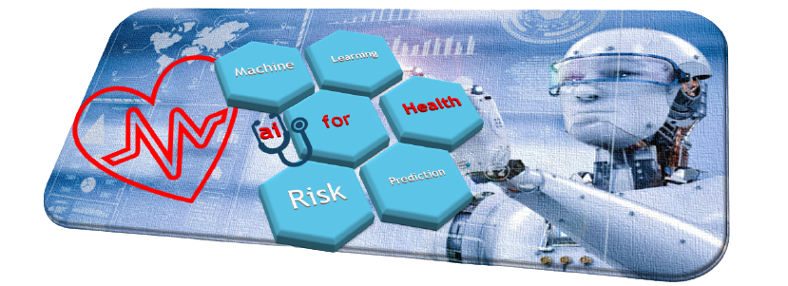
Status Update [ fg-ai4h MEETING N ] FEB-16-2022 fg-ai4h tOPIC GROUP | tg-cardio ai use in cARDIOVASCULAR DISEASE (CVD) management
UPDATE SUBMITTED BY
DR. BENJAMIN MUTHAMBI www.linkedin.com/in/bmuthambi
Snr Scholar-in-Residence/MANAGING DIRECTOR
IEPH/Institutes of Epidemiology & Public Health
-

Slide 3
Tg-cardio | multiple subtopics in Expanded scope
SUBTOPIC #1 – CLINICAL PREDICTIONS | CVD Risk Prediction using AI
SUBTOPIC #2 – CARDIAC IMAGE ANALYSIS | AI-assisted Coronary CT Image Processing/​Recognition​ for Coronary Artery Disease (CAD) Diagnosis in Coronary Computed Tomography Angiography (CCTA)
SUBTOPIC #3 – INTELLIGENT ROBOTS | e.g. Surgical Robot Technologies incl. AI-assisted Minimally Invasive Cardiac Surgery​
SUBTOPIC #4 – PRECISION MEDICINE | e.g. AI-assisted Individualized Medicine and healthcare customized for each patient

Slide 4
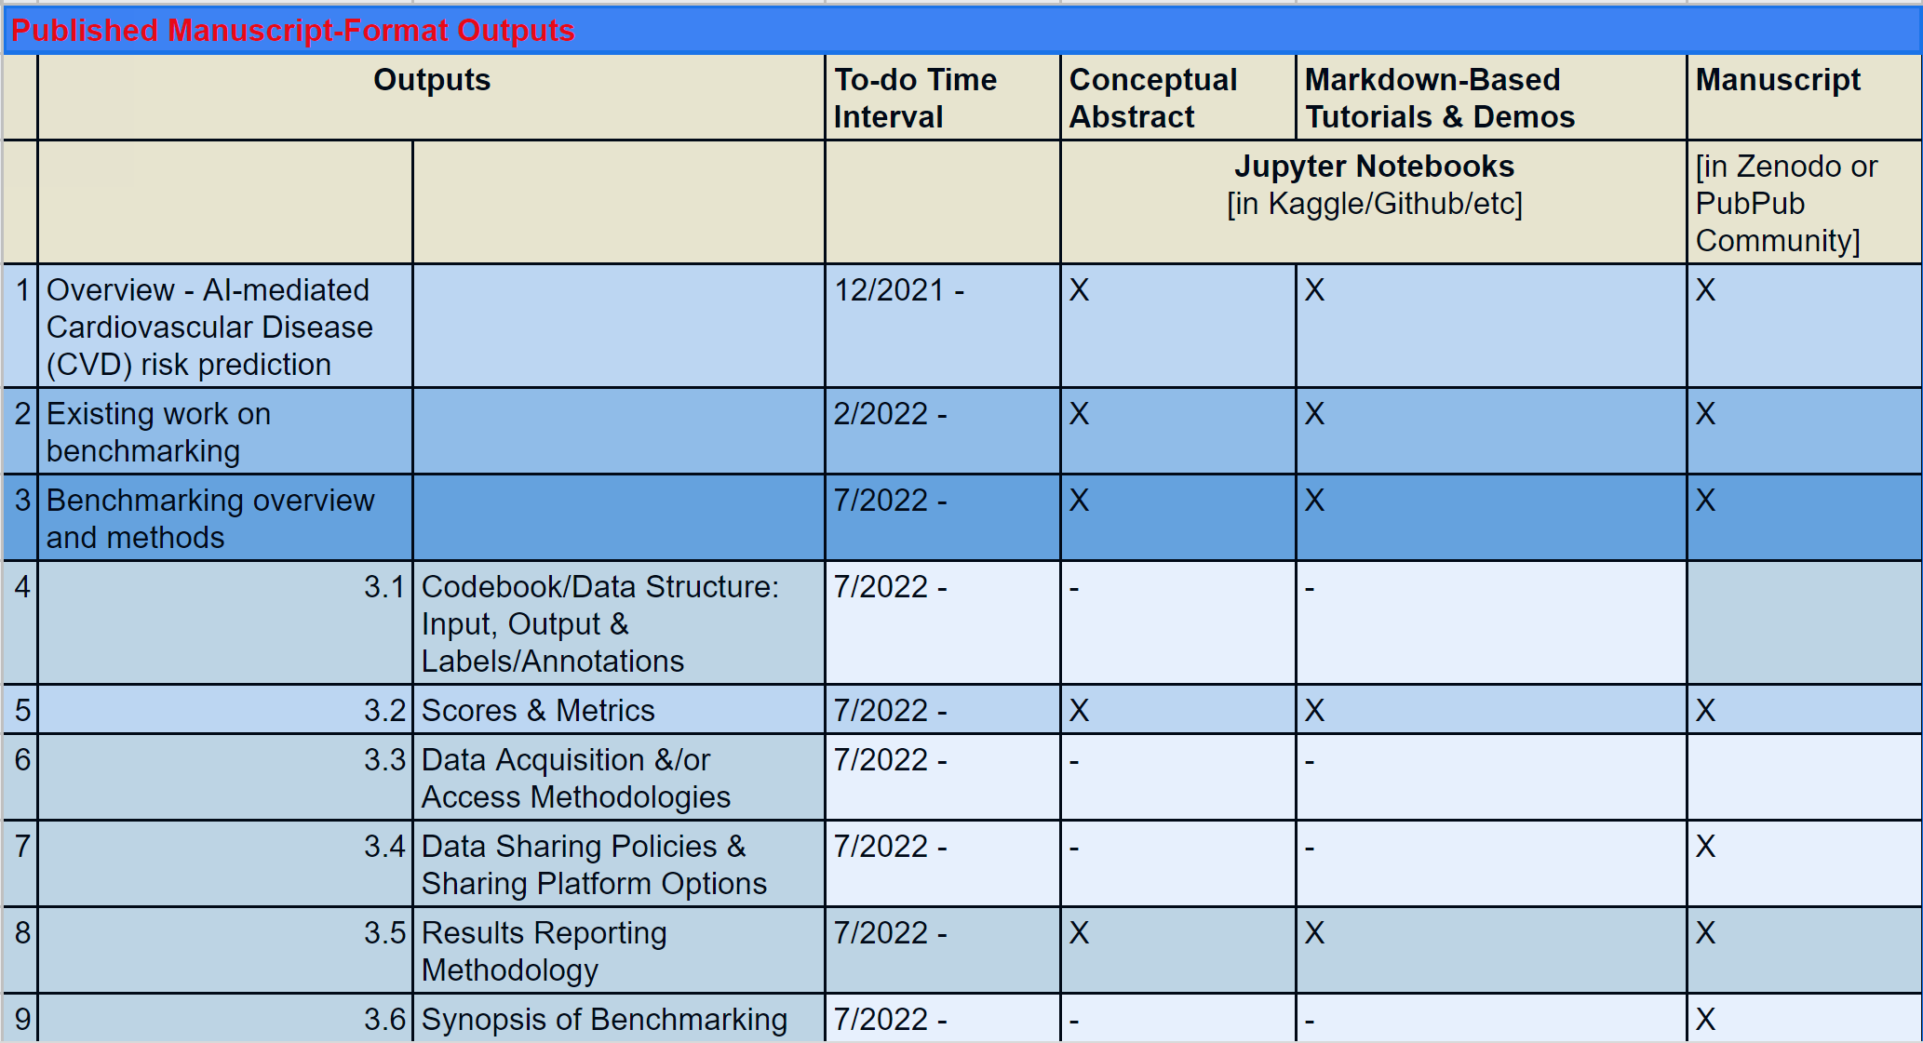
Published Manuscript-Format Outputs

Slide 5
SIGN-UP SHEET FOR SELECTION OF SECTION OF TDD THAT topic GROUP MEMBERS WIsH TO CONTRIBUTE TO
TOPIC GROUP MEMBERS INTERESTED IN PARTICIPATING IN THE DRAFTING OF OUTSTANDING SECTIONS OF THE TDD RELEVANT TO TG-CARDIO'S SUBTOPIC A: AI USE IN CARDIOVASCULAR DISEASE RISK PREDICTION:
Please click on the hyperlink below to request access to this Google Sheet in which you can enter your name & email address (Column A: Cells A9 - A17, colored green) and tentative to-do timeframe (Column B: Cells B9 - B17, colored green) in the row corresponding with the sections of the TDD draft that you'd like to volunteer to work on: https://docs.google.com/spreadsheets/d/1pCfSoZ2gBKzO-GJWdhETy1165tFVUeUOH0-B_7PCElk/edit#gid=0

