Slide 1
FGAI4H-M-057
E-meeting, 27-29 September 2021
Source: | Editor DEL5.6 Updated DEL5.6: Data sharing practices – Progress report
Title:
Purpose: | Discussion
Contact: | Ferath Kherif CHUV - LREN Switzerland | E-mail: Ferath.kherif@chuv.ch
Abstract: | This PPT discusses the latest updates made on the deliverable Updated DEL5.6: Data sharing practices + Data sourcing.

Slide 2
Data Sharing and Data sourcing

Slide 3
Data Sharing and Data sourcing
Initial draft describes the objectives and proposes an initial outline of the planned deliverable “Data Sharing Practices”
This deliverable aims to provide an overview of the existing best practices for data sharing of health-related data, including the requirement to enable secure data sharing and issues related to data governance.
The documents described established solutions and novel
approaches based on distributed and federated environments.

Slide 4
Data Sharing Principles
Sharing medical data at scale is necessary to improve the development and adoption of artificial intelligence solutions for healthcare and to make these solutions more robust.
Negotiate the balance between potential harm from sharing critical data and the potential benefit of improving care.

Slide 5
Data Sharing Principles
Sharing data for appropriate and authorised purposes. Why the data is being used
Sharing data only with authorised users. Who is using the data
Using data in a safe and secure environment.
Applying appropriate protections to the data. Where the data is being used
Ensuring public outputs from data sharing projects do not identify the people or organisations in the data.

Slide 6
Data Sharing and Data sourcing
Necessary steps and requirements to enable secure data sharing
Methods for Data sourcing
Centralized data sources
Distributed data sources

Slide 7
Data Sharing and Data sourcing
Necessary steps and requirements to enable secure data sharing
Roles and responsibilities of the data providers, data processors & data receivers
Data anonymization and de-identification
Data minimization
Data confidentiality, Data security and privacy
Protection and Privacy assessments.
Responsibilities of data providers and data receivers
Necessary steps and requirements to enable secure data sourcing
Description of data
Data ingestion and update
Results and dissemination of results including IA models

Slide 8
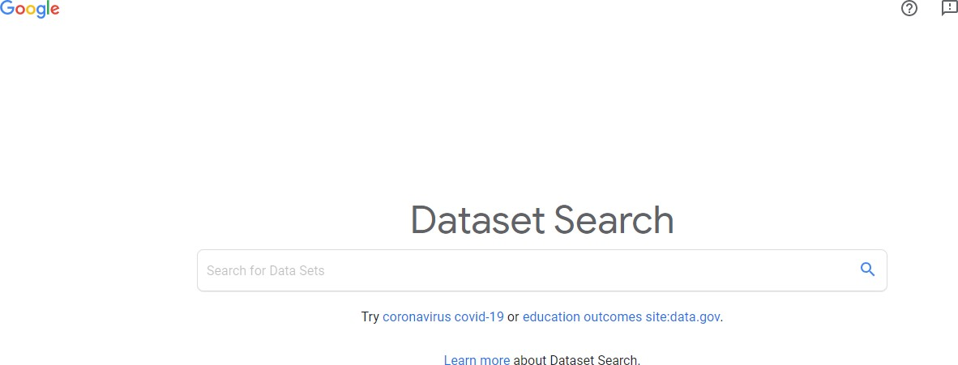
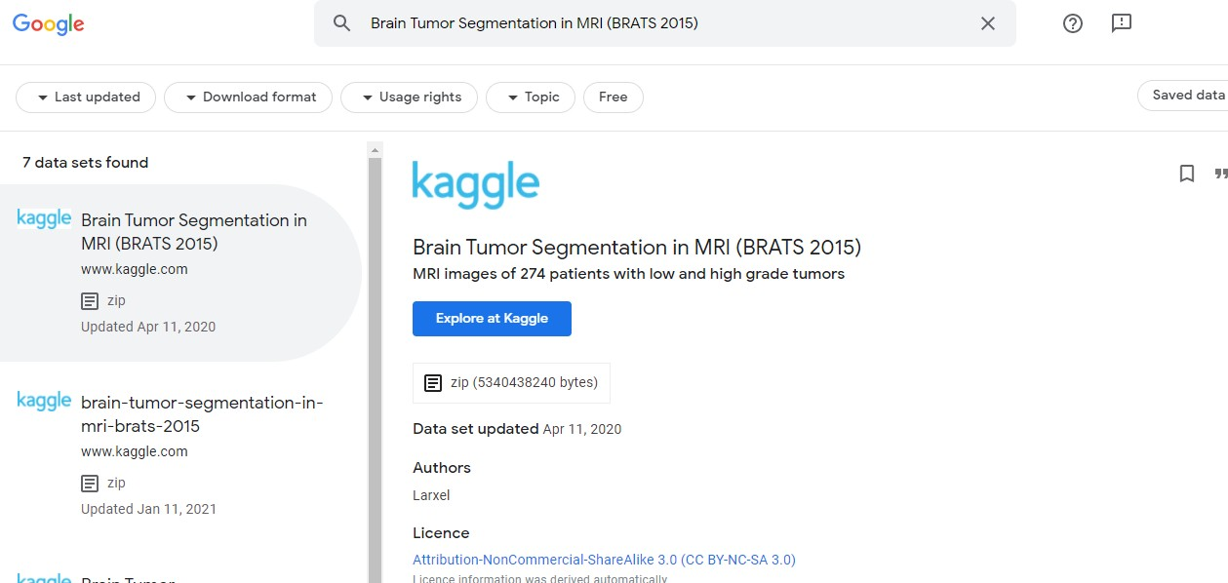
Best practices for data sharing/Sourcing Methods
Data Catalogue & Search

Slide 9
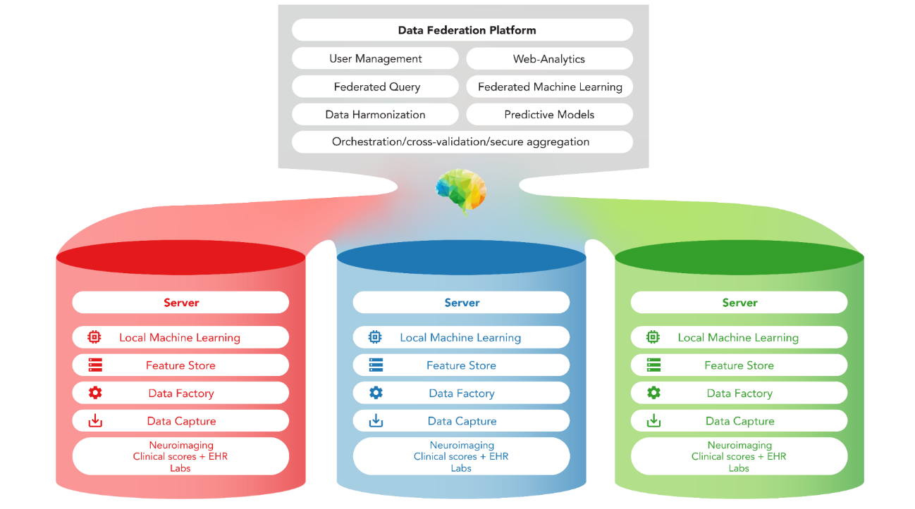
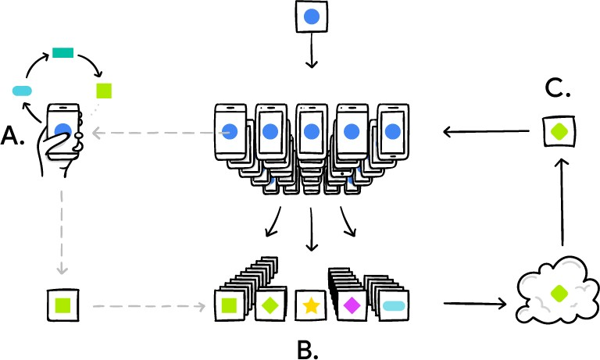
Data Sourcing scenarios
Data is accessible in public repositories (e.g. Open Research Data)
Data is stored in local private databases (e.g. Hospitals)
HUB
Federated approaches (e.g. Multi-party computation)
Hospital 1
Hospital 2
Hospital 3

Slide 10
Data Sourcing scenarios
Data is accessible in public repositories (e.g. Open Research Data)
Data is stored in local private databases (e.g. Hospitals)
Data Catalogue

Slide 11
RoadMap
Federated Data catalog
Ferath Kherif Shobha Iyer Shruti Choudhary
Data Acquisition
Data Storage
Data Annotation
Inference
Assessment
Reporting

Slide 12
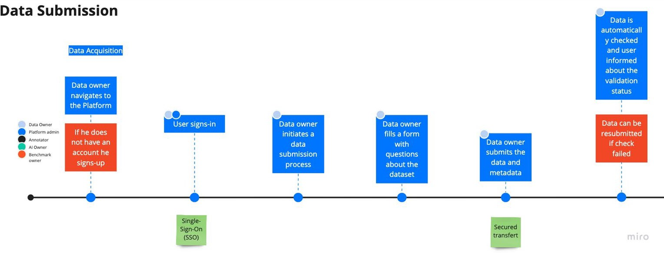
Data Submission
Data Sourcing
Data Catalog-ing

Slide 13
Sr No | Tasks name | Description | Status
1 | Data ingestion pipeline- capturing metadata | The best practices for automating the extraction of metadata from headers or during pre-processing should be defined and presented. | Ongoing End Date (v1): 28.04.2021
2 | Metadata capture form- develop draft (DS and Clinical input for questionnaire) | Develop a business process to capture the metadata from domain experts (clinicians and data scientists). Collaborate with experts (Topic groups leaders) to establish, improve, and test the metadata workflow. | Ongoing End Date (v1): 28.04.2021
3 | Metadata capture form- DI pipeline | We will demonstrate what is required to complete step 1 (Data Ingestion) pipeline- capturing metadata) and apply this approach to an exemplary dataset. | Ongoing End Date (v1): 05.05.2021
4 | Identify public datasets-10 (include imaging data, vitals, etc) | Select ten examples that should reflect the diversity of sizes, application domains, and other aspects of public datasets. | Ongoing End Date (v1): 28.04.2021
5 | Structure Metadata for public datasets | We will demonstrate what is required to complete step 2-3 and apply this approach to the selected datasets. | Ongoing End Date (v1): 15.05.2021
6 | Ingest Data with associated metadata | TBD
7 | Test ingestion of some metadata as part of data ingestion | TBD
8 | Fill associated metadata form | TBD
9 | Identify research papers with related AI algorithm | TBD
10 | Do a quick relevant datasearch using metadata tags | TBD
11 | Customer Feedback- Clinical Evaluation and Data Science Team | TBD

Slide 14
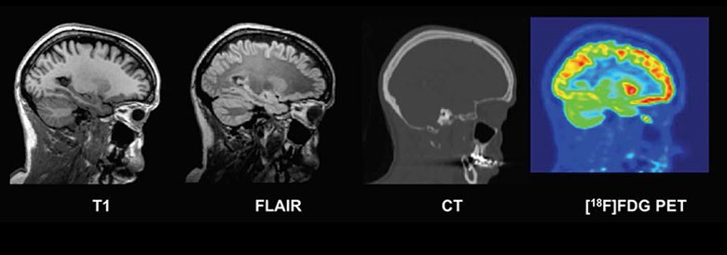

Slide 15
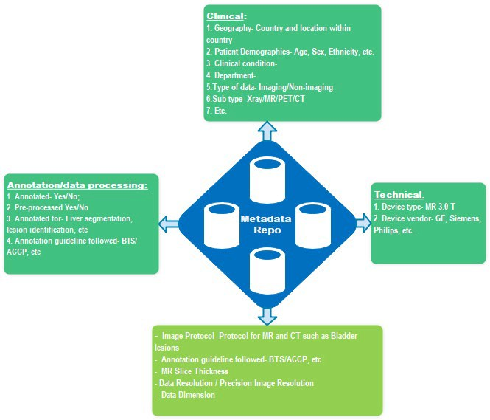
Metadata Components
Basic
Data Catalog
Advanced

Slide 16
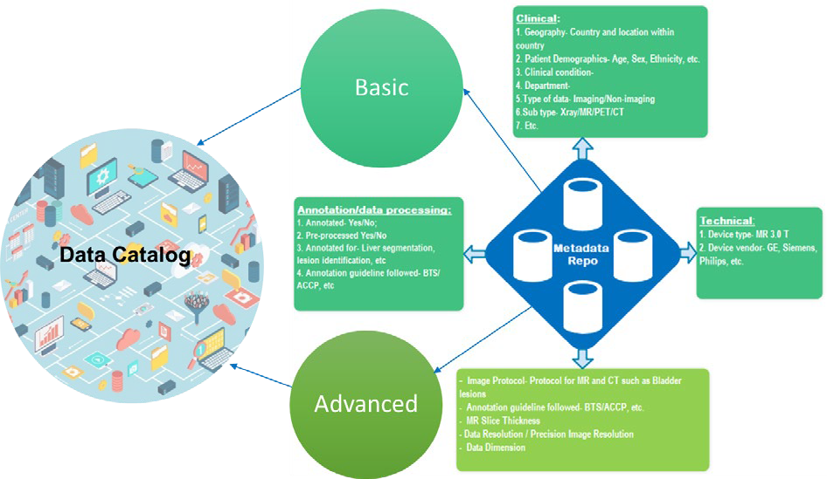
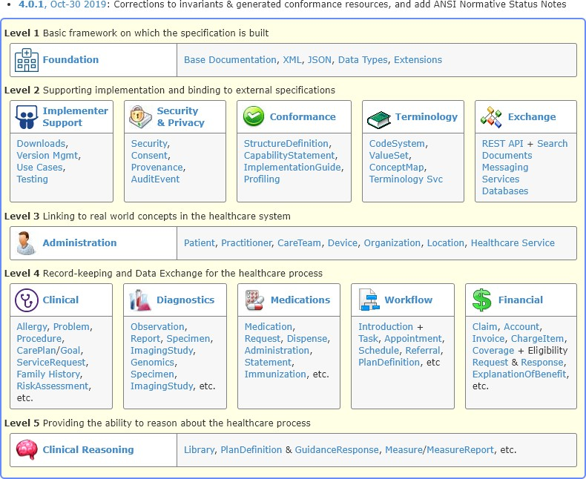
Metadata Components

Slide 17
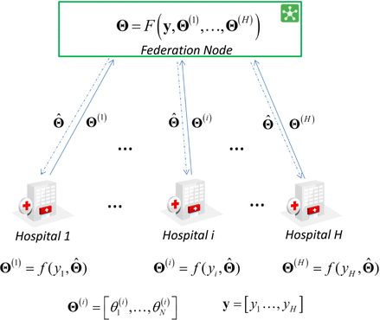
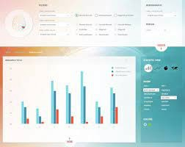
Best practices for data sharing/Sourcing Methods
Explore and test exiting software implementation for master data management
Mobi https://mobi.inovexcorp.com
Apache Atlas https://atlas.apache.org
Egiria https://egeria.odpi.org
Magda https://magda.io
Obiba https://www.obiba.org/
Amazon Glue ETL
Medical Informatics platform-LREN CHUV-Research toolkit

Slide 18
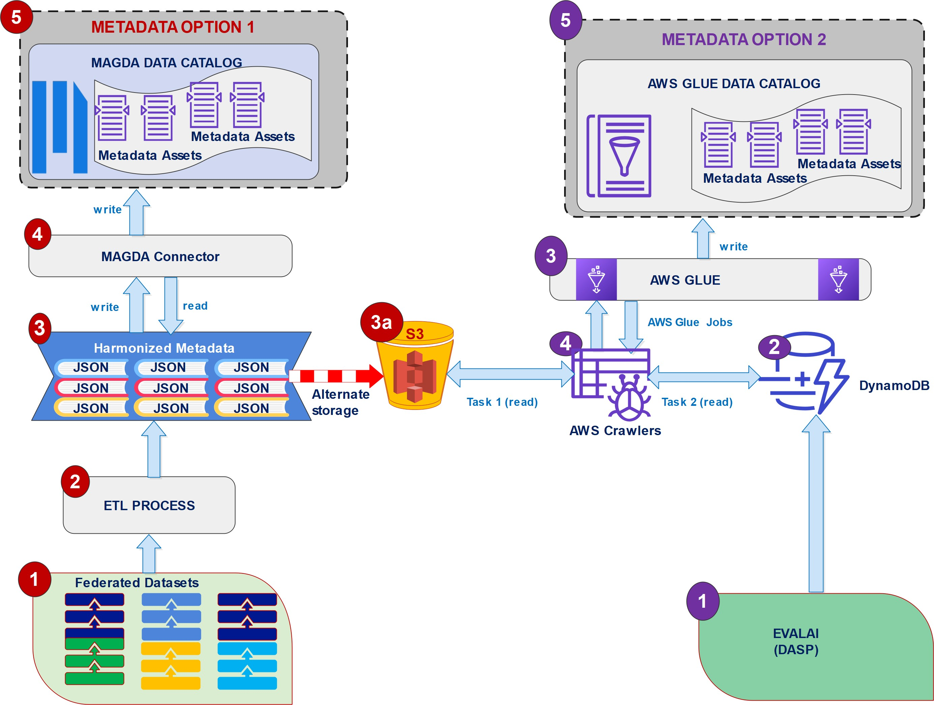
MVP

Slide 19
MVP

Slide 20
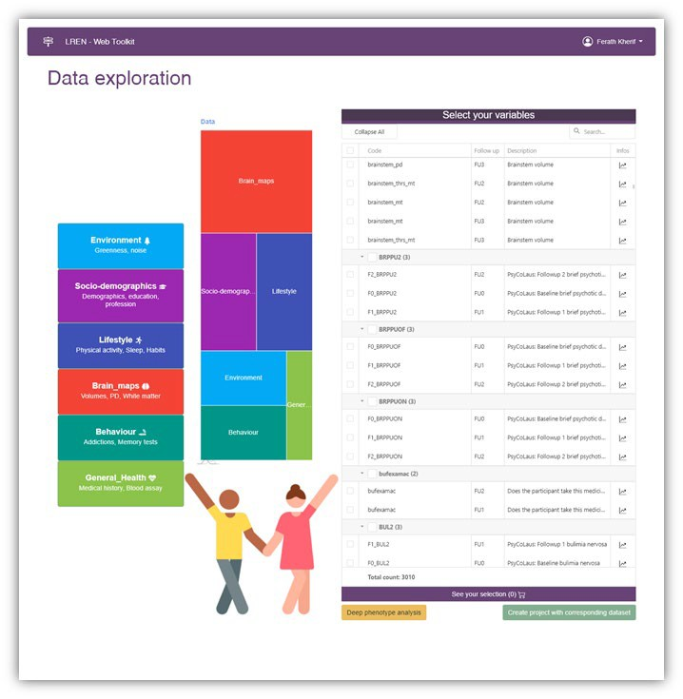
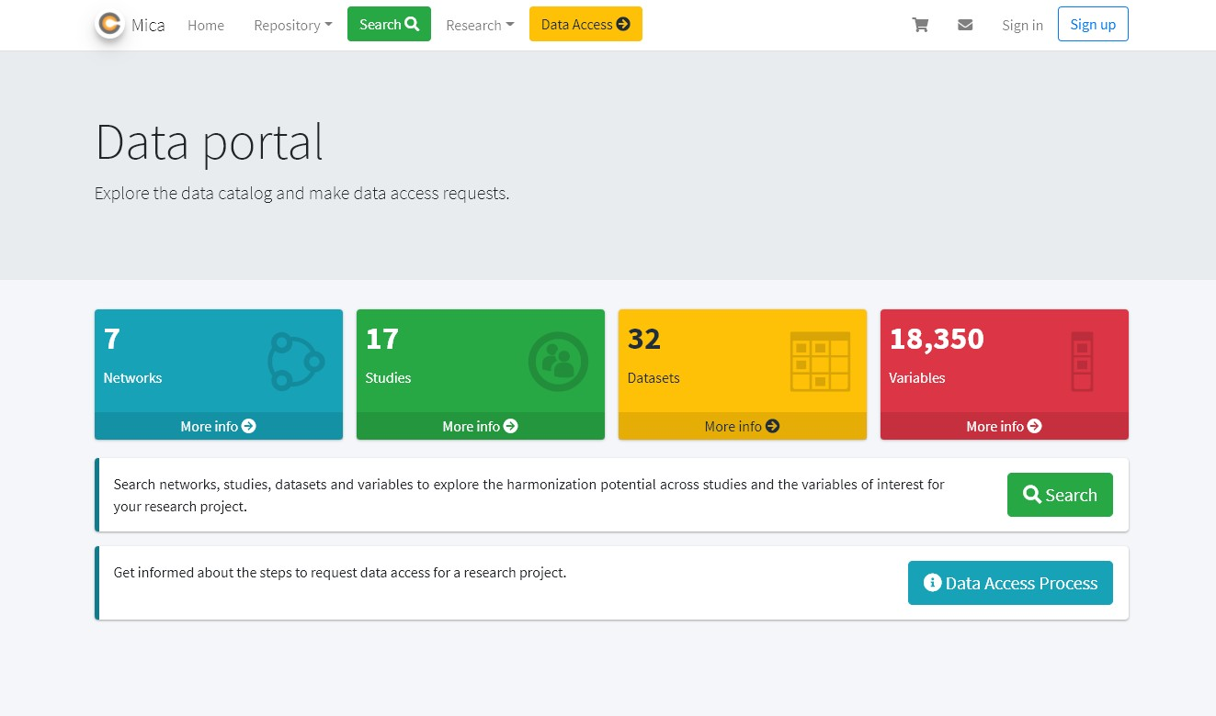
Demo

Slide 21
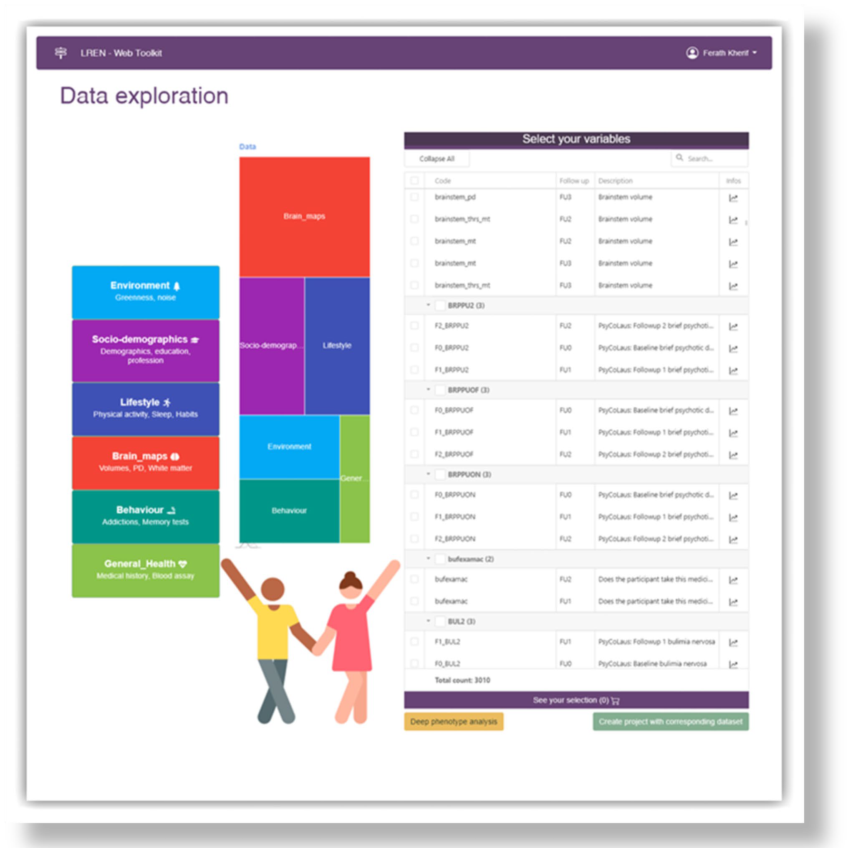
MVP: Data sourcing
Data sourcing Across multiple locations
Integrate multiple information

Slide 22
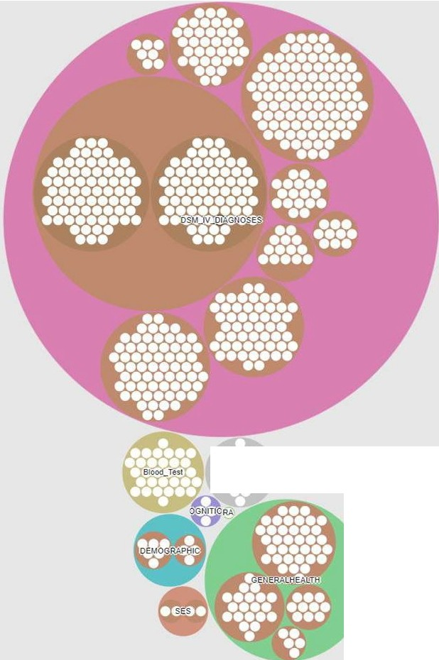
A1cohol_Co ,..

Slide 23
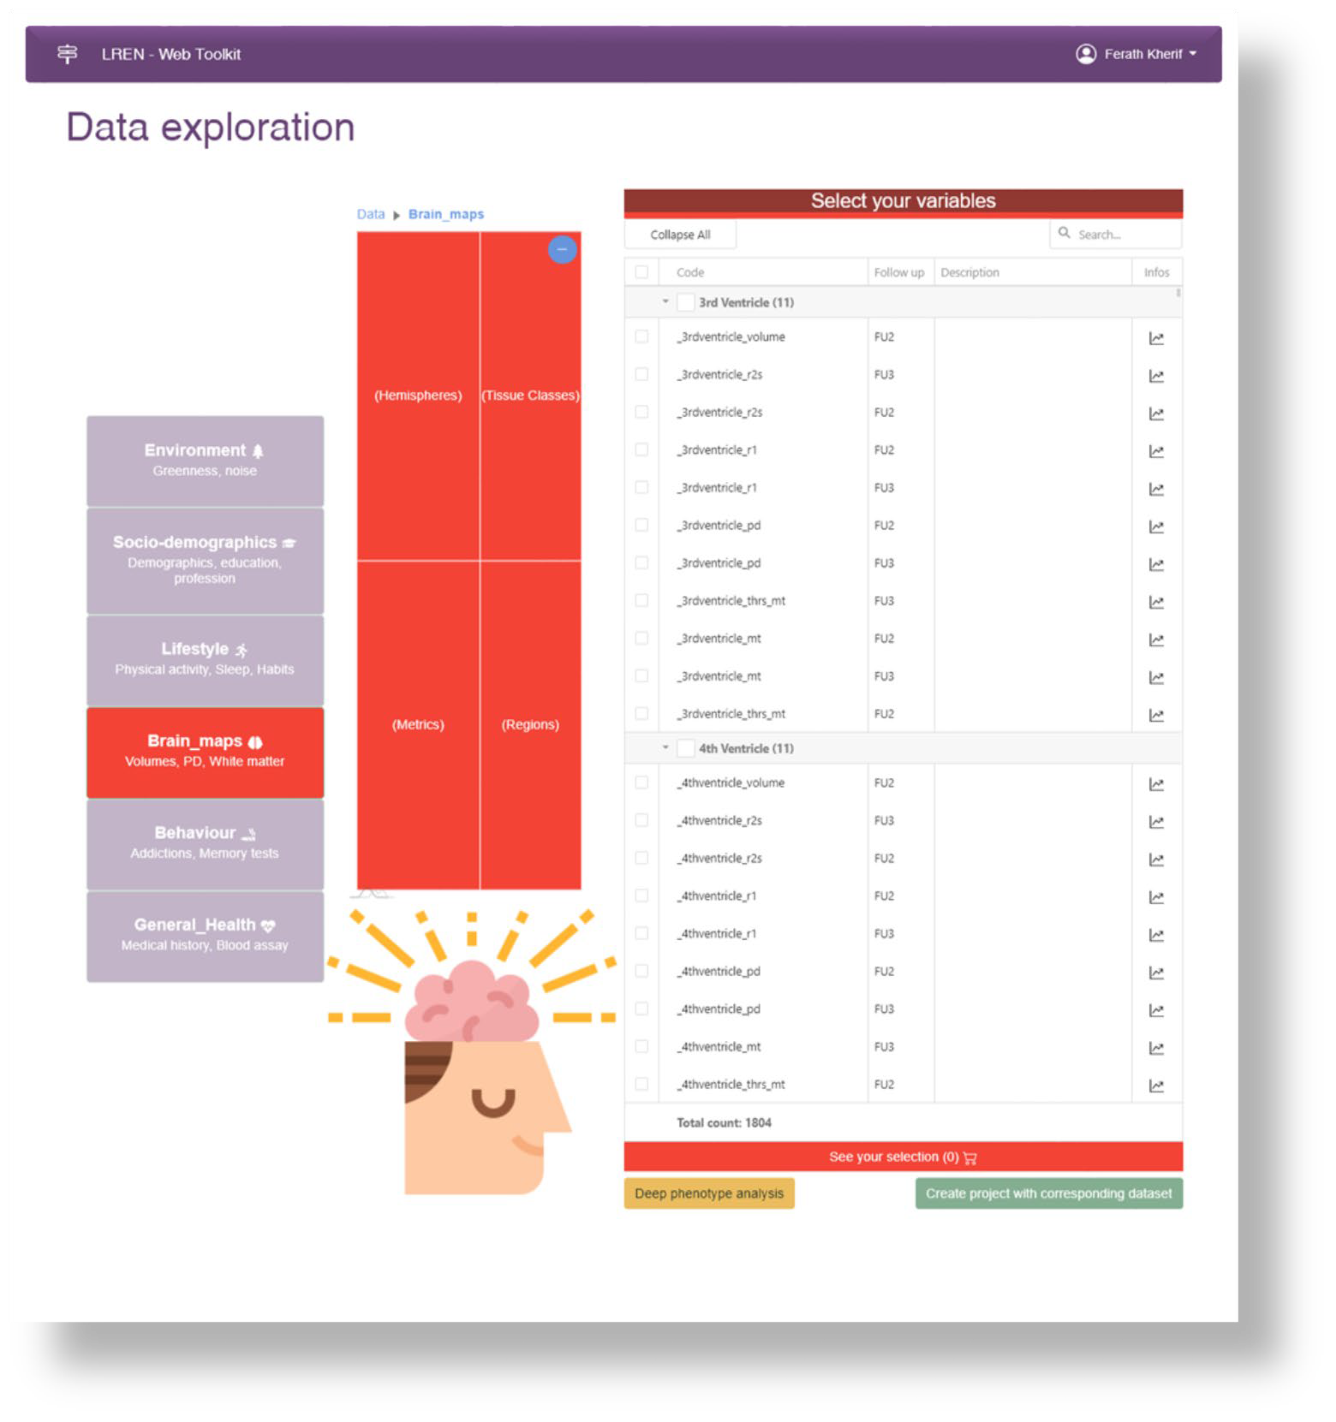
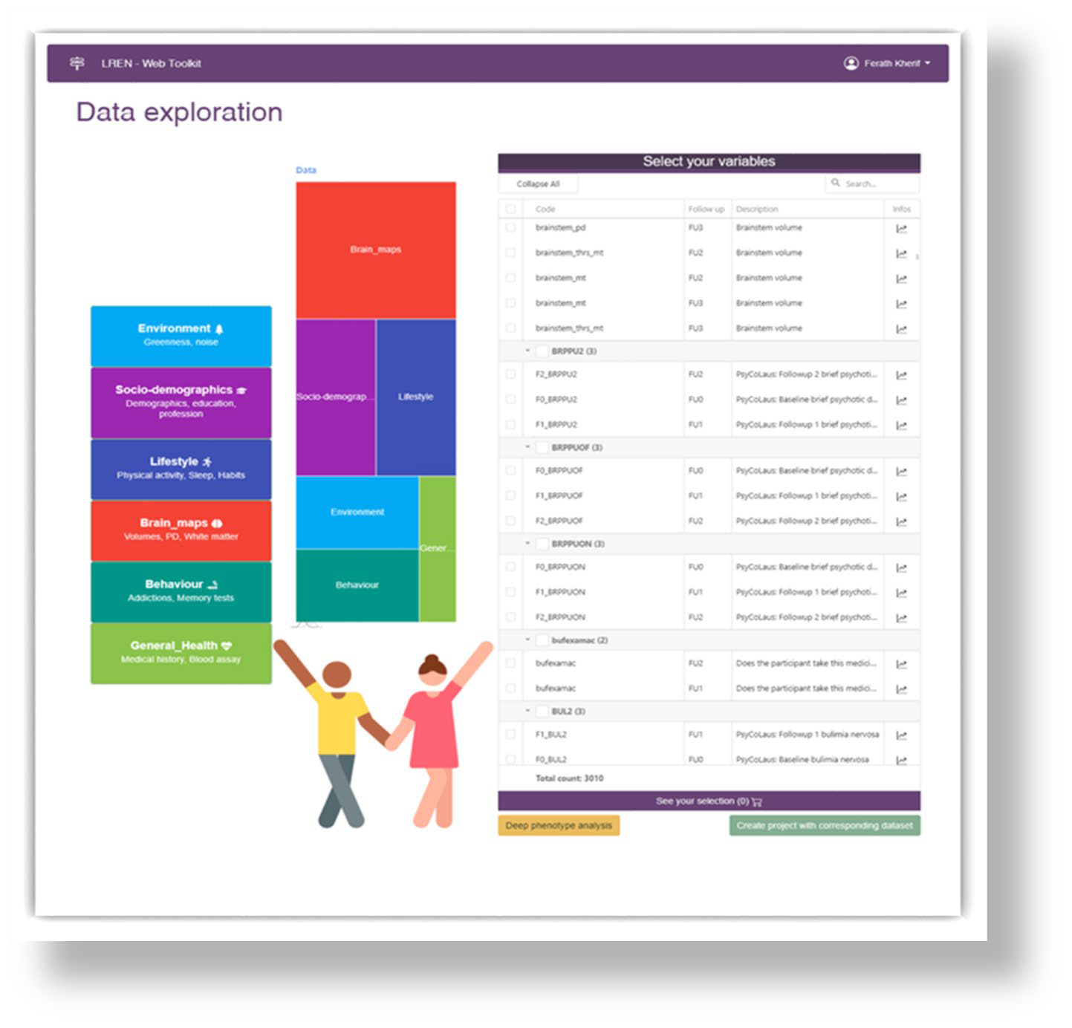
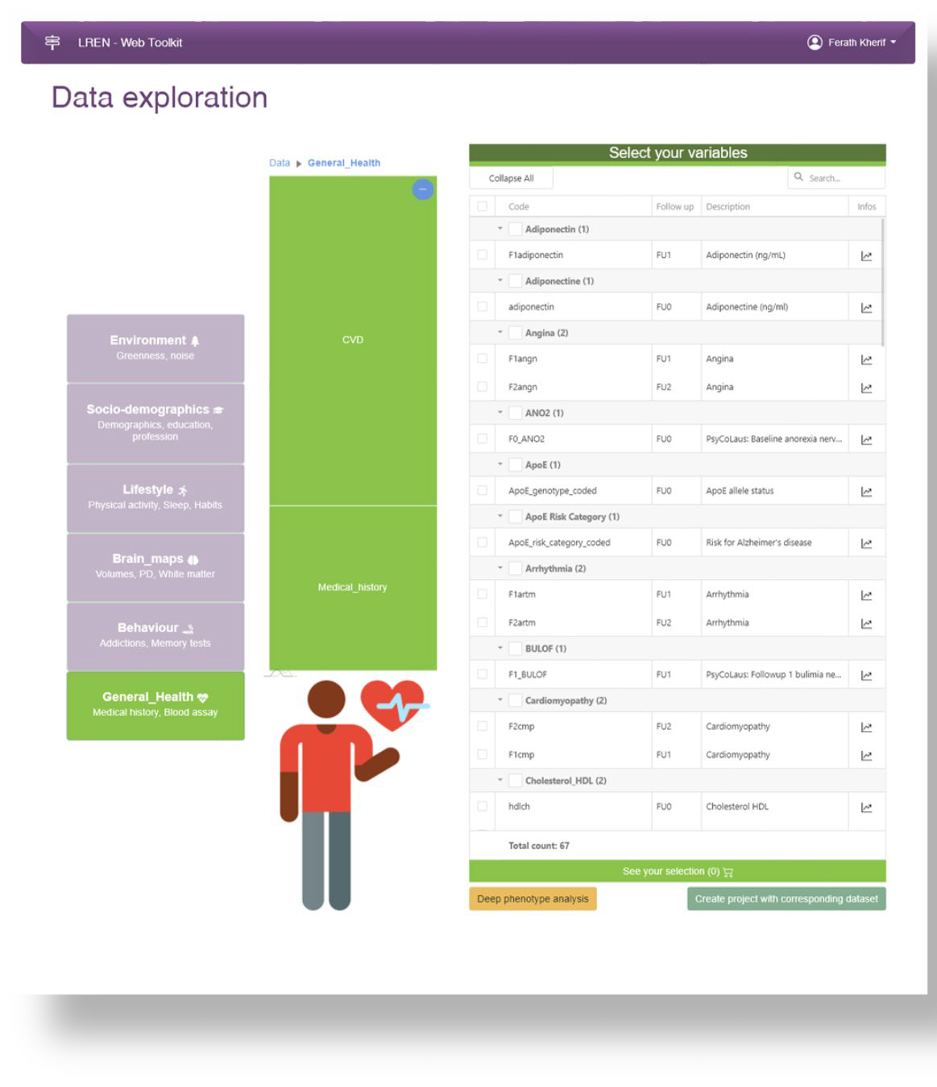
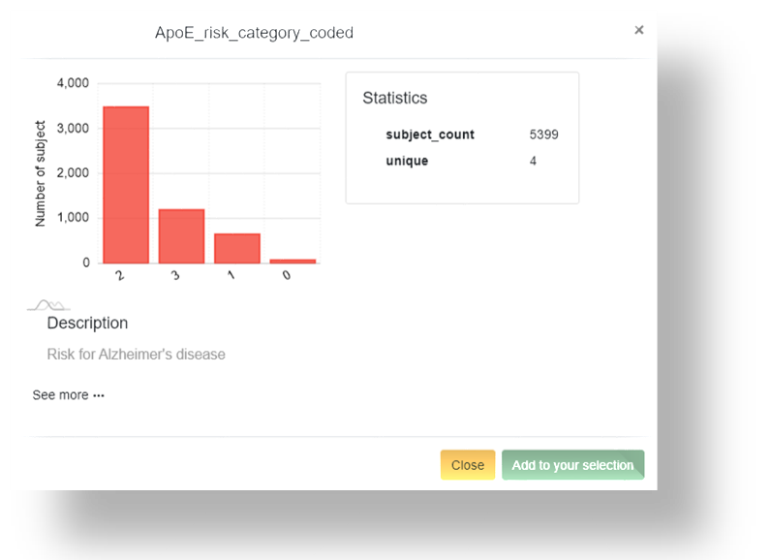
MVP: Data sourcing

Slide 24
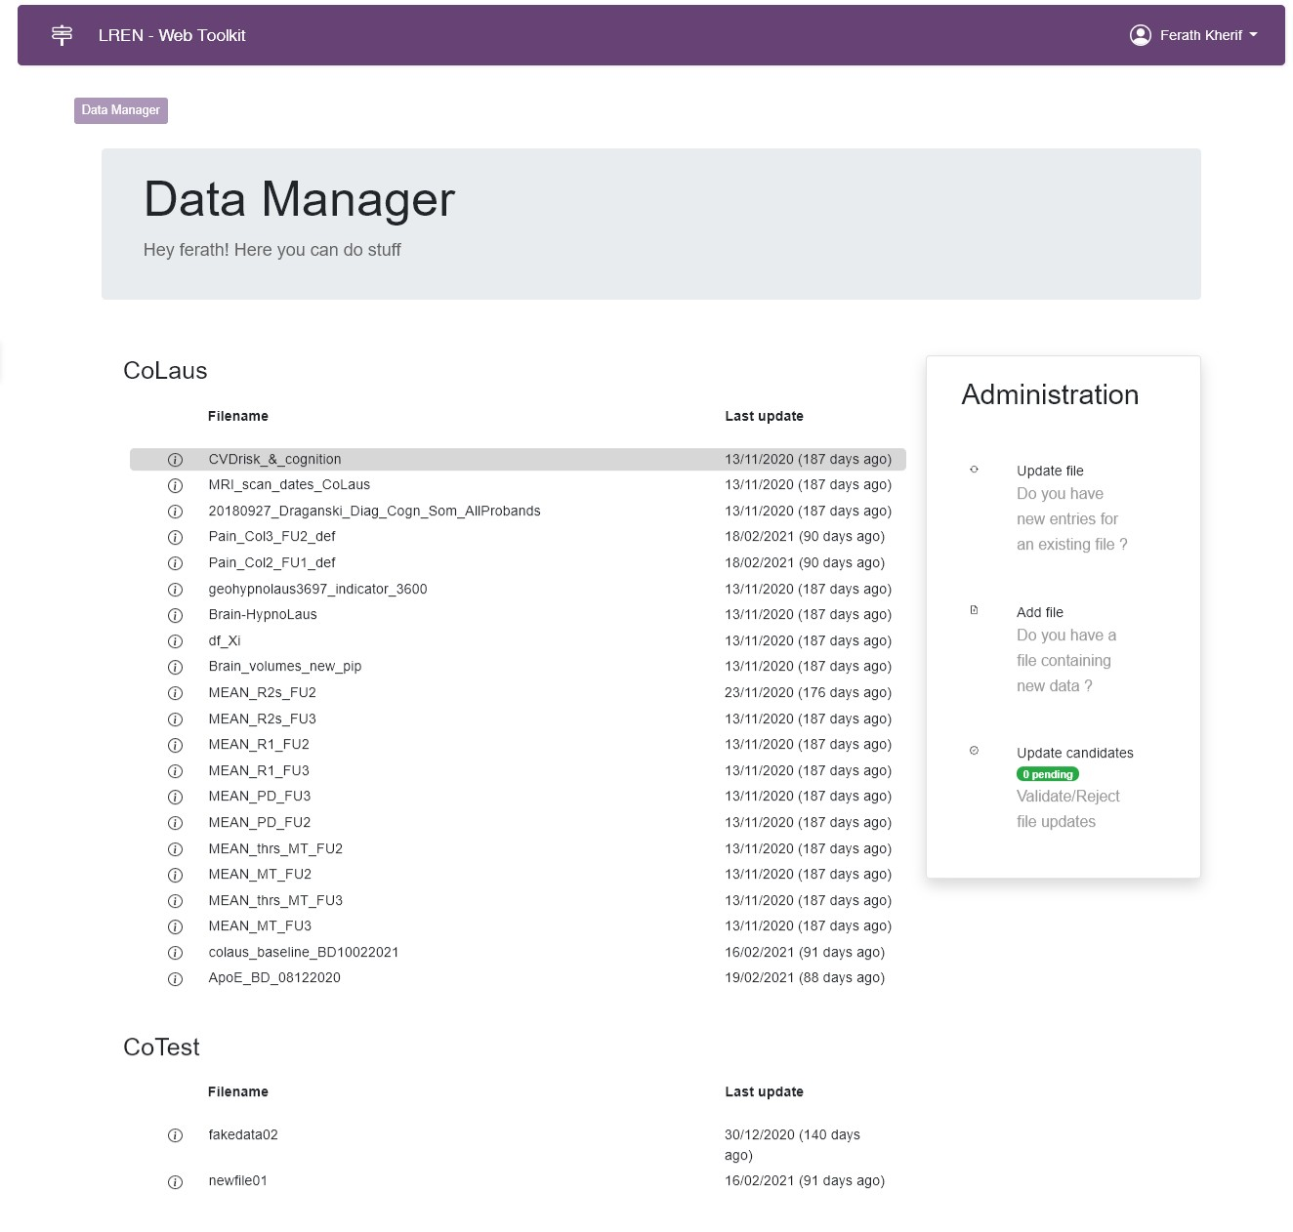
MVP: Data sourcing in Brain diseases

Slide 25
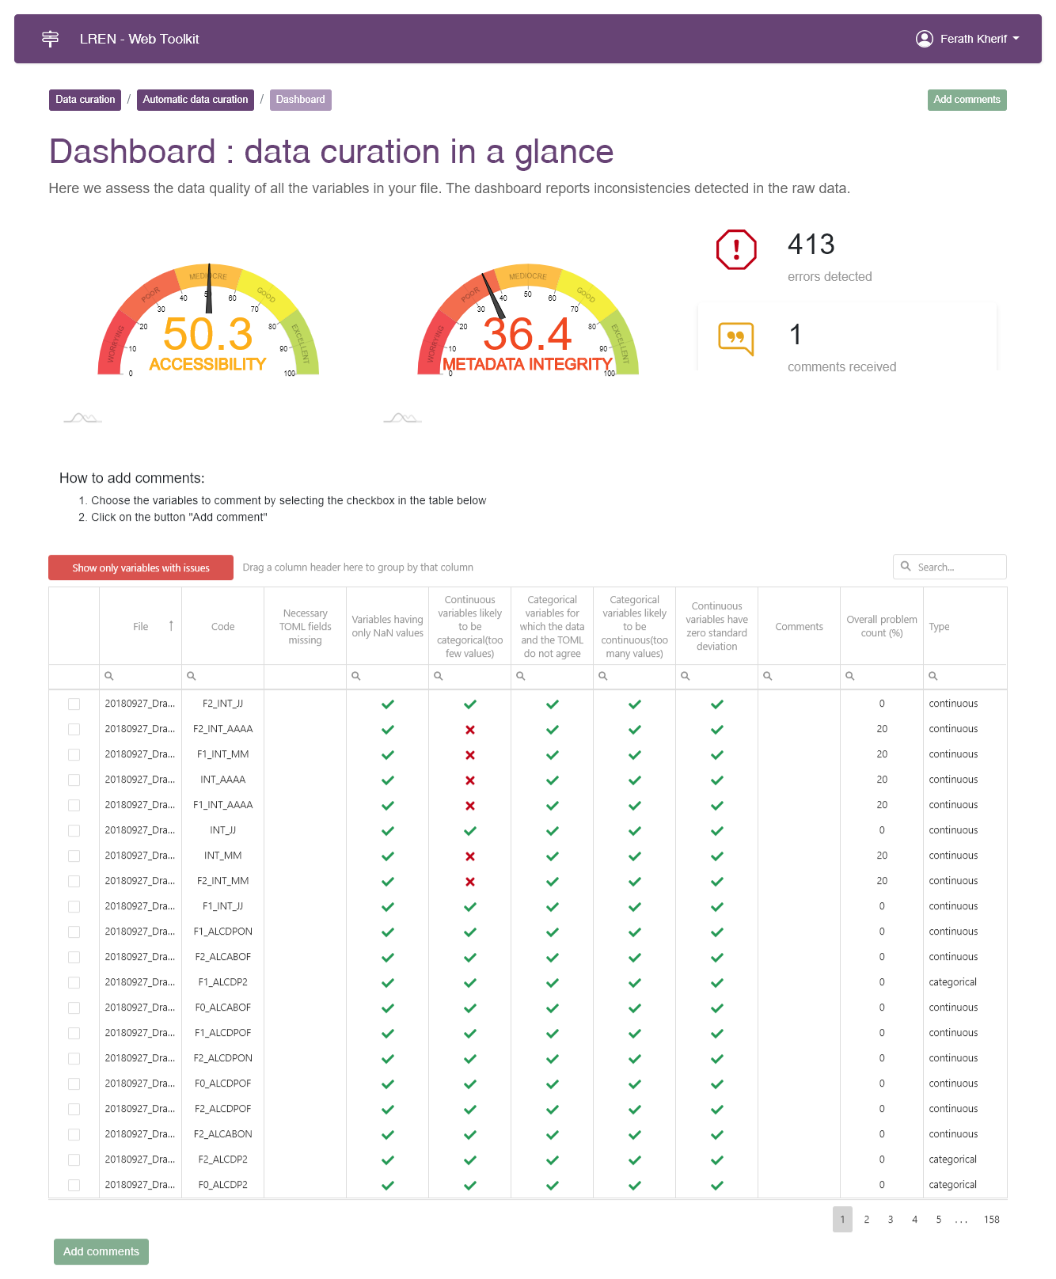
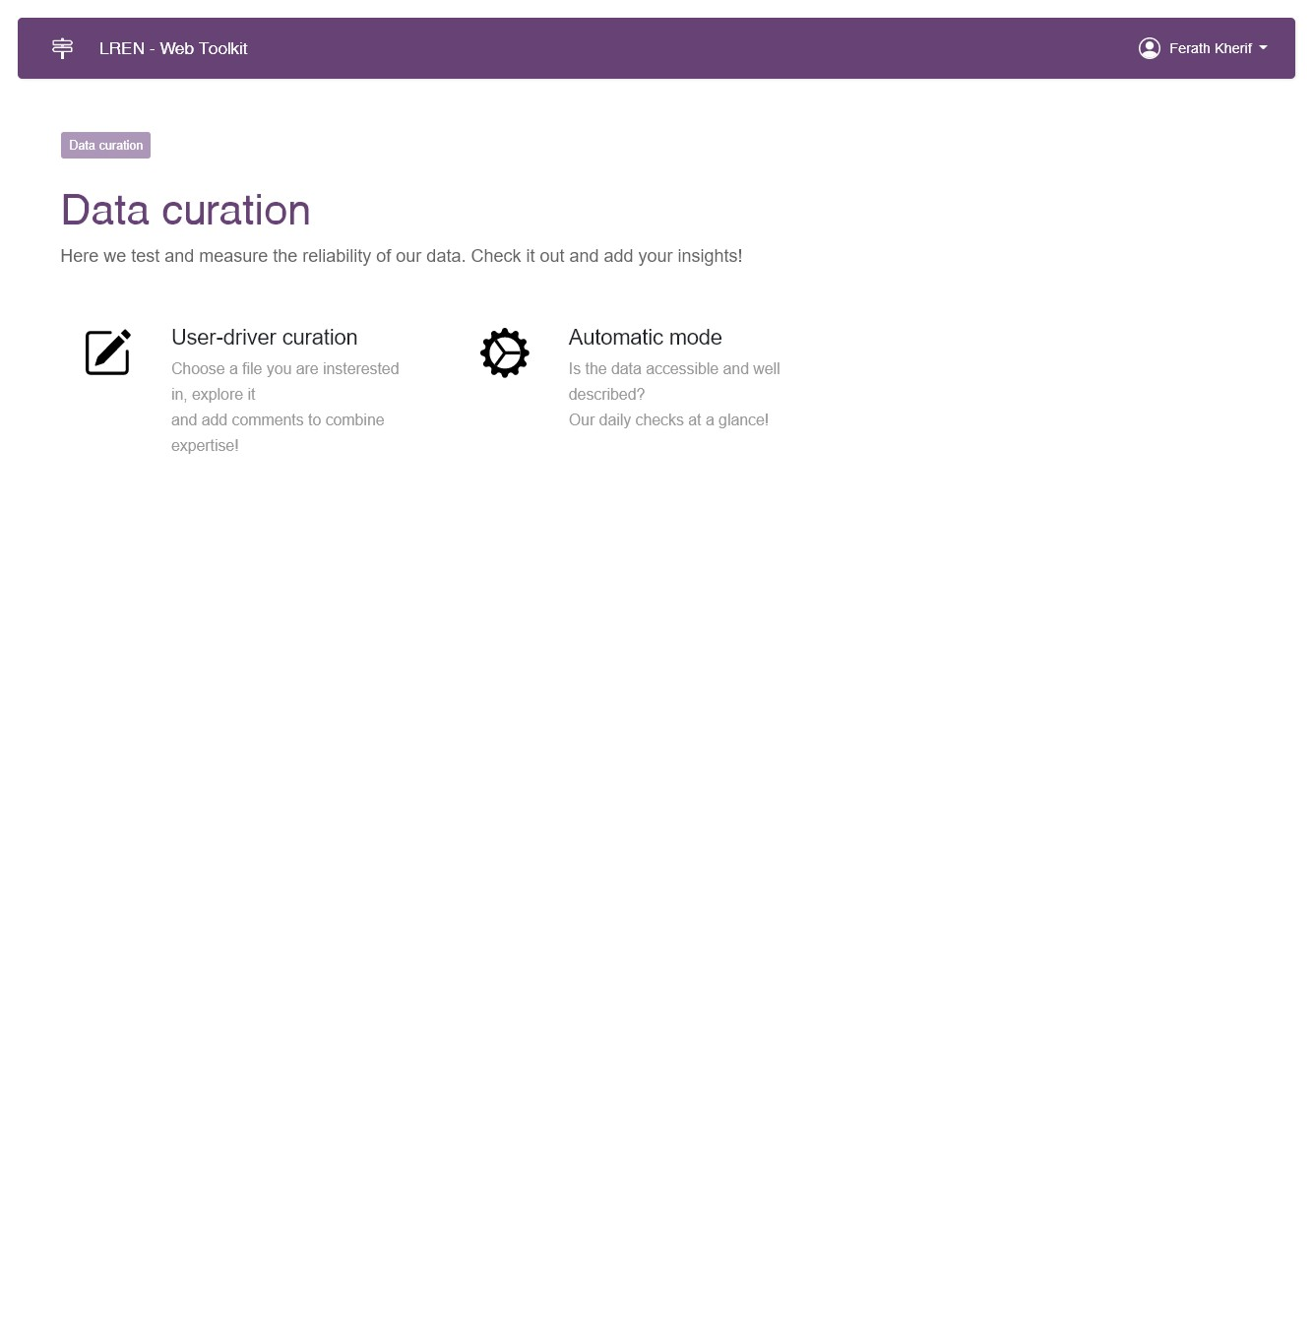
MVP: Data sourcing
Data Quality
DACQORD Principle

Slide 26
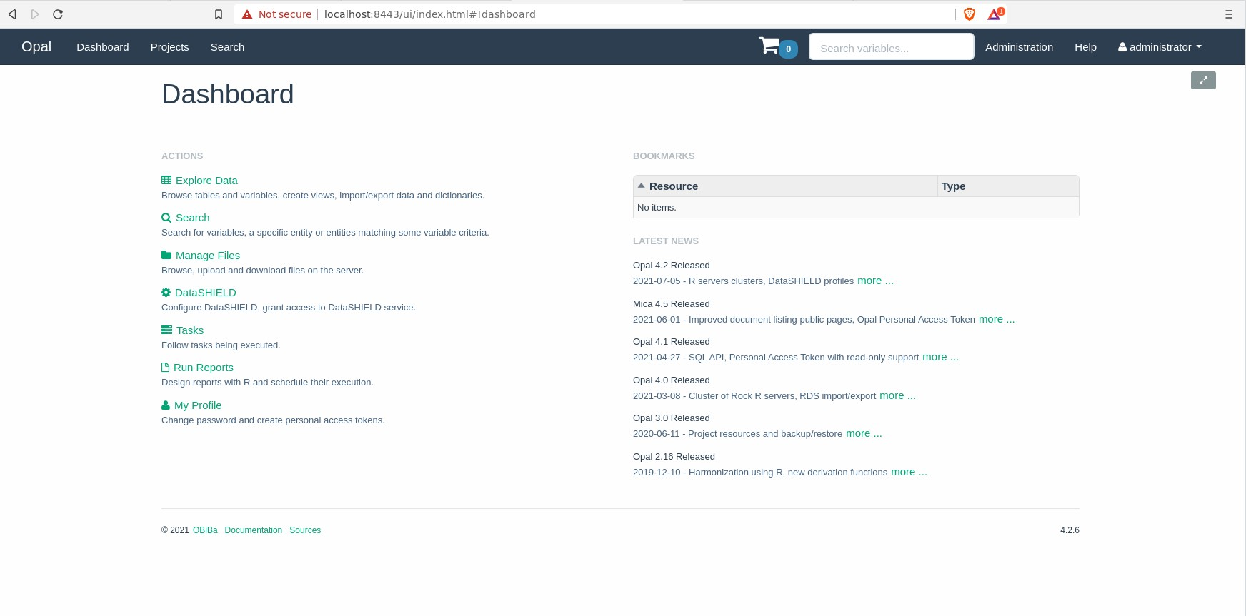
MVP: Data sourcing
Data Quality
DACQORD Principle

Slide 27
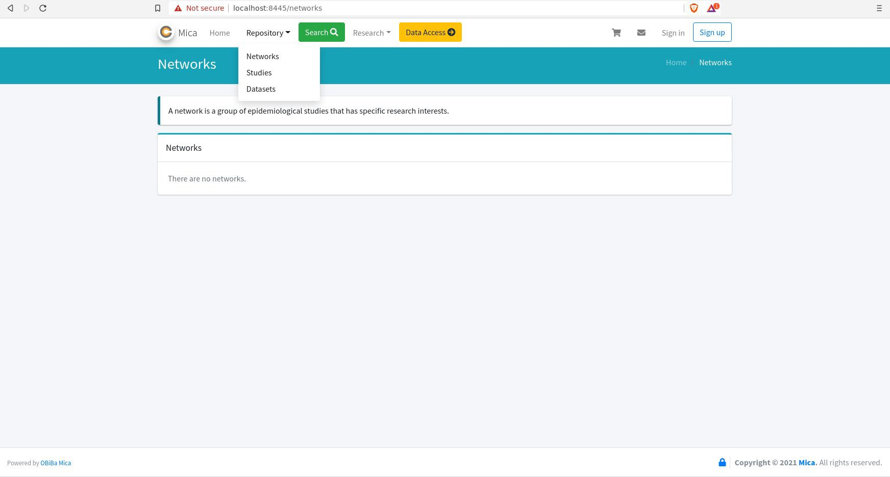
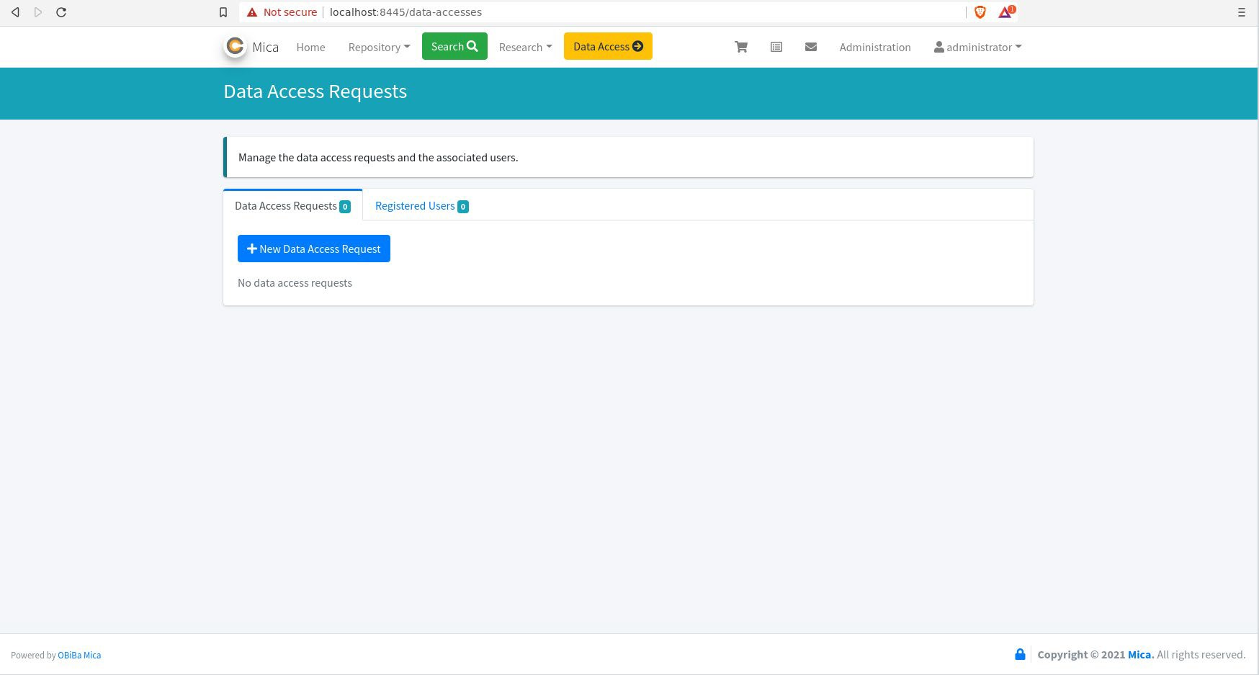
MVP: Data sourcing
Data Quality
DACQORD Principle

Slide 28
TOPIC
L2
Cohort/ study 1
Cohort/ study 2
L1
Dataset 1
Dataset 2
Dataset 3
Variables
Data- images
Variables
Data- images
Variables
Data- images

Slide 29
Integrate public datasets-10 (include imaging data, vitals, etc)
Select ten examples that should reflect the diversity of sizes, application domains, locations, and other aspects of public datasets.

Slide 30
Thanks for your attention
Contact Ferath.kherif@chuv.ch

