Slide 1
FGAI4H-M-056
E-meeting, 28-30 September 2021
Source: | Editor DEL08
Title: | DEL08: AI4H scale-up and adoption - Progress Report
Purpose: | Discussion
Contact: | Sameer Pujari FG-AI4H vice-chair WHO | E-mail: pujaris@who.int
Abstract: | This PPT contains a progress report on DEL08.

Slide 2







Del08 : Scaled Implementation of AI4Health
Implementation roadmap
Sameer Pujari
Vice Chair WHO ITU Ai for health focus group
Department of Digital health and innovations
World Health Organisation
sameer_pujari

Slide 3
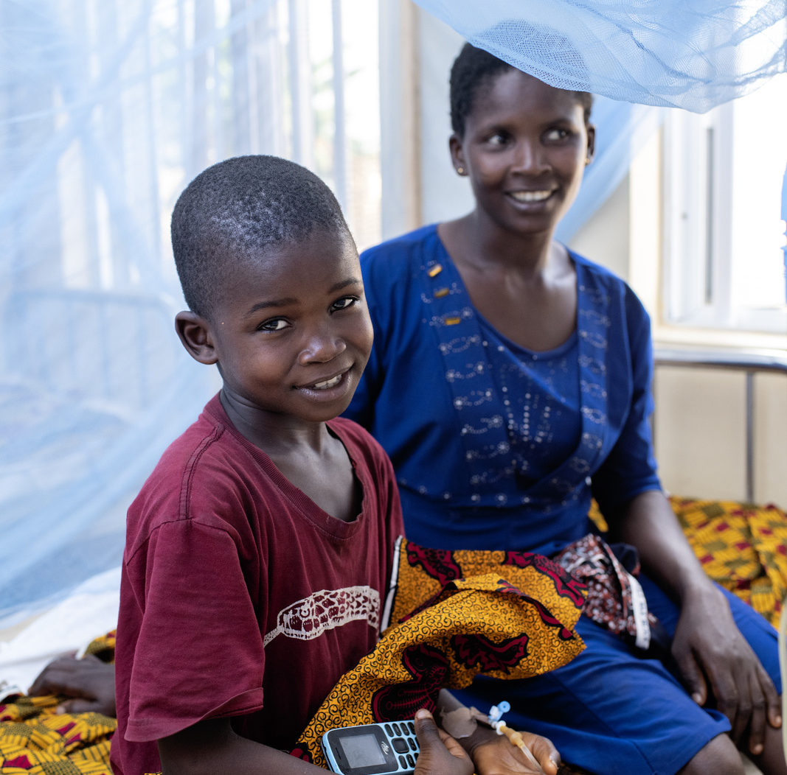
Global Strategy on Digital Health 2020 – 2025 :
Vision
To improve health for everyone, everywhere by accelerating the development and adoption of appropriate digital health solutions to achieve the health related SDGs.

Slide 4
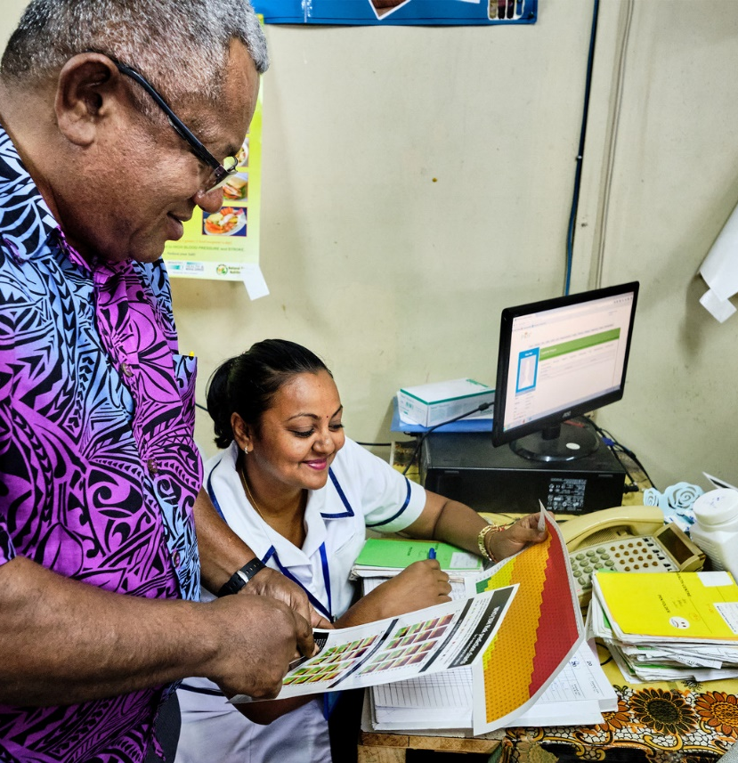

4 Strategic Objectives
SO1.
Promote global collaboration and advance the transfer of knowledge on digital health
SO2.
Advance the implementation of national digital health strategies
SO3.
Strengthen governance for digital health at global, regional and national levels
SO4.
Advocate people-centred health systems that are enabled by digital health
4

Slide 5
Overview
The roadmap activities agreed by Member States under the Global Strategy on Digital health
SO1-ST01-Analyse digital health network landscape
SO1-ST02-Provide policy dialogue for digital prioritization at national level
SO2-ST04-Capacity building for strategy implementation and investment
SO2-ST05-Digital health maturity model
SO3-ST01-Criteria for impact assessment
SO4-ST06-Develop an ethics framework for technologies for health

Slide 6
How to align and document activities in the Roadmap
Step 02
Prioritize and identify challenges
Assess each initiative across criteria and stakeholder
Step 03
Plan
Create Action plan
(Who, What, When Why and How)
Step 04 Implementation cycle
Implement & Evaluate, Innovate, Iterate
Step 01
Mapping existing initiatives

Slide 7
Step 01 : Mapping existing initiatives
Overarching principles
Region/country-specific principles for adaptation
Universal connectivity, Information security, etc.
5
Gender equality and health equity
4
Strategic linkages
1
Relevant factors of inequality to be assessed
“do no harm”
Access for specific population groups is guaranteed
Linkage to outcomes of the existing policy framework and organizational mandate
SDGs
GPW13 – Triple billions
UN digital cooperation roadmap
Region priorities and policy framework
02
National interoperable digital health ecosystem
3
The information technology health infrastructures are both interoperable among each other
Allow for differences in national legislation and policies, capable of sharing health data with infrastructures of other countries
Data governance
Economics of health data use
General regulatory and legal requirements that guarantees data protection, confidentiality and integrity of personal health data
2
Notes:
Data governance
The information technology health infrastructure to be applied within an interoperable digital health ecosystem will be based on commonly agreed use cases in the public health-care sector, its functional requirements and a set of functional and technical specifications, standards and profiles derived thereof needs to be established on a sound legal and regulatory framework that guarantees data protection, confidentiality and integrity of personal health data and system availability.
Member States will join forces on a global coordinated approach regarding the economics of health data use, particularly regarding the health data that are generated and shared by the public sector or by the people.
Due to their sensitivity, health data are to be classified as sensitive personal data that require a high safety and security standard. A common set of general legal requirements will be approved by the Member States as part of the WHO guideline on global interoperability standards for digital health serving as the basis for orientation for a national legal and regulatory framework....

Slide 8
Step 02 : Prioritise and enable initiatives
Key questions to awswer prior to initiative priotisation
Facilitate
Which health issues does the initiative tackle? For what end users?
Which strategic objectives and outcomes do we aim to achieve through implementation?
To what extent countries are digitally mature to implement?
Enable
02
Which area of core capacity will be strengthened through implementation?
How much efforts, resource and time are needed for planning and execution, with what impact to deliver?
Co-create measurable values
What level of tangible value do we aim to create through implementation?

Slide 9
Step 02 : Prioritise and enable initiatives
Engage key actors to co-create value-driven initiatives
Co-create measurable values
Facilitate
Capacity building
Change management
Enable
Aligned with country priorities
Achieving short term DH objectives
Digital health maturity
Policy dialogues
Evidence collection
Four-level of knowledge captured
Governance & guidance
Resource alignment
Dissemination
02

Slide 10
Co-creation of initiatives
Member States
WHO
Partners
End users
Step 02 : Prioritise and enable initiatives
Two-sided value exchange
Proof of concept
Operational knowledge
Emerging needs
Structured request
Increased promotion to guiding principles
High-level knowledge (meta and guidance)
Global concensus
High visiblity
Advocacy in specific health topics
02
Core capacity strengthened
Increasing digitally matured health system
Targeted investment
Crowdsourcing
Concrete ouputs against DHS implementation
Acceleration of GPW13
Organizational change
Case studies for policy making

Slide 11
Step 03 : Create action plan for each initiative
Initiative Example: AI Scale up
Who (the team) : Key actors to involve
What: activities and outputs
For whom: end users
When: timeline and milestones
Global Strategy linkages
How
Strategic linkages
Knowledge management
Data governance
Stakeholder engagement
03
Existing capability and no need to improve - Strong
National interoperable digital health ecosystem
Existing capability, “low level” of improvement - Satisfactory
Leadership
Gender equality and health equity
Existing capability, “medium level” of improvement - Developing
Financing
Existing capability, “high level” of improvement- Emergent
Region/country-specific principles for adaptation
The capability currently does not exist
2022-Q1 | 2022-Q2 | 2022-Q3 | 2022-Q4 | 2023-Q1 | 2023-Q2 | 2023-Q3 | 2023-Q4
Capability states

Slide 12
Step 03 : Action plan
Initiative Example
Diabetic retinopathy
Who (the team)
What (components)
Where (location)
WHO secretariat
Member States
Country level
Tools
When (timeline)
Short term (1-2 years)
Complete before end of 2021
Required capability
How
Knowledge management
Stakeholder engagement
03
Leadership
2021-Q1 | 2021-Q2 | 2021-Q3 | 2021-Q4 | 2022-Q1 | 2022-Q2 | 2022-Q3 | 2022-Q4
Pilot and operational plan structured
Training and prep for launch
Implementation and evaluation
Self assessment and enhancement tools added
Evaluate, Innovate and Iterate

Slide 13
Step 04 : Implementation Cycle (based on country specific digital maturity)
1. Implement
2. Evaluate
Implement
Evaluate
Co-create and sustain
Evidence-based
Operational challenges
Outputs and outcomes
Impact
04
4. Iterate
3. Innovate
Iterate
Innovate
Take a new cycle of actions based on what has been experienced, measured and learned
To mitigate emerging challenges
To respond to new requests
To improve health outcomes
To enhance impact

Slide 14

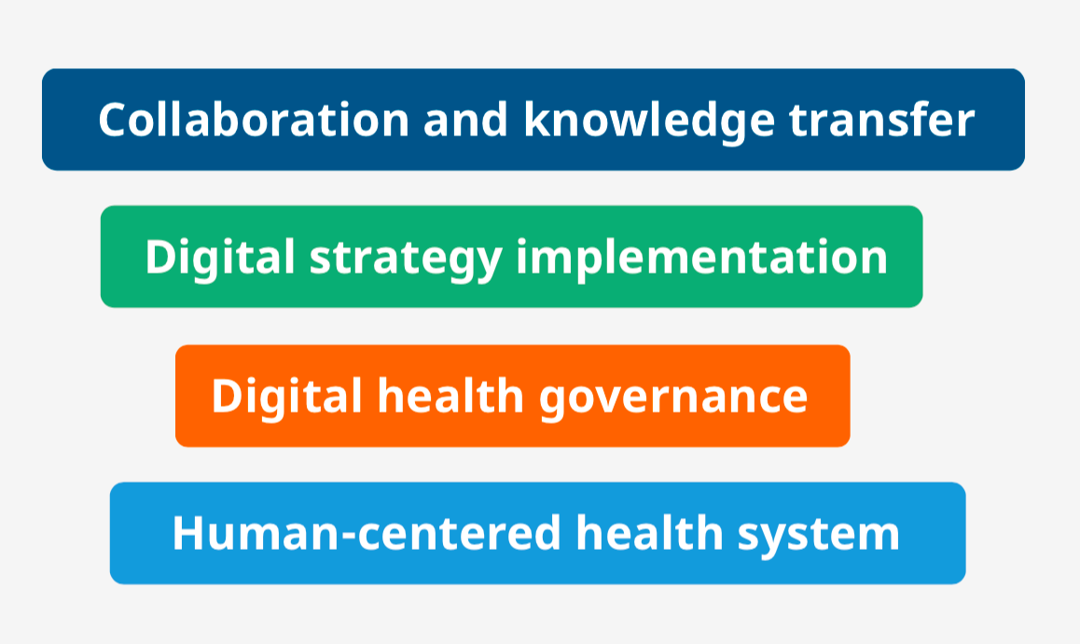

Slide 15







Country A
Share
Health priorities
Promote partnership coordination and resource mobilization
01.
Achieving and sustaining UHC
02.
Promote health and scale up priority
interventions through the life course
03.
The country action plan one pager
Download
Country stories
9
Ongoing initiatives
Explore
10
Levelling-ups of Digital health maturity indicators
Explore
Dynamic digital health maturity model
12
Knowledge products
Explore

Slide 16








32
Ongoing initiatives
Story of the month
本月国家项目推荐
Explore initiatives (below are fictional samples)
Share
Member States
Digital literacy at fingertips
Leading actor: Country A
Key words: Health emergencies, capacity building
Help her hear
Leading actor: Country B
Key words: Rehabilitation, disability
Interoperable hospital
Leading actor: Country C, D, E
Key words: Diagnostics, Artificial intelligence
Strategic objective: SO1
Strategic objectives: SO3, SO4
Strategic objectives: SO2, SO3
Dynamic digital health maturity model
WHO secretariat
Partners
By 2023
Share your initiatives

Slide 17
Next Steps
Advocate and build capacity
  Workshops and trainings
Support Implementation and scale
Support governance
  Ethics, regulations, governance
Enable human centred approach

Slide 18


We need to ensure that the Ai4health is safe, sustainable and leaves no one behind.
Thank you.
Anup, visually impaired pupil listening at Resource centre for children with visual impairments, Jharkhand, India.
Credit: WHO/NOOR/Arko Datto
Notes:
The roadmap is structured so together we can ensure that the Digital Health is safe, sustainable and leaves no one behind. We look forward to supporting you all.

