Slide 1
FGAI4H-M-046
E-meeting, 28-30 September 2021
Source: | UNODC
Title: | International Standards for treatment of drug use disorders and Quality Assurance mechanisms: Digital solutions
Purpose: | Discussion
Contact: | Elizabeth Sáenz Liaison Officer, Geneva Prevention, Treatment, and Rehabilitation Section UN Office on Drugs and Crime | E-mail: elizabeth.saenz@un.org
Abstract: | This PPT contains an introduction to the UNODC work on International Standards for treatment of drug use disorders and Quality Assurance mechanisms, and three ideas for future projects.

Slide 2
International Standards for treatment of drug use disorders and Quality Assurance mechanisms:
Digital solutions
Elizabeth Sáenz, MD, MPHDC, MCH.
Liaison Officer Geneva
Prevention, Treatment, and Rehabilitation Section
United Nations Office on Drugs and Crime
Notes:
I would like to thank the organizers for inviting UNODC to this important event and having the opportunity of presenting the work on drug prevention and treatment of substance use disorders to this distinguished audience of addiction medicine specialists.
Each person counts is the motto that the Prevention Treatment and Rehabilitation Section of UNODC adopted last year during a Side event at the Commission of Narcotic Drugs which in our opinion embodies the spirit of the whole spectrum of our efforts and interventions aimed at improving the life of people affected by drug use and drug use disorders.

Slide 3

Global situation – drug use
275 million people (15-64), or 1 in 18 people used drugs at least once/previous year to
5.5% of the global population aged 15-64.
36.3 million people suffer from drug use disorders.
They require treatment.

Slide 4
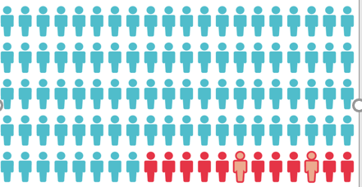
Drug use treatment - access
1:8

Slide 5
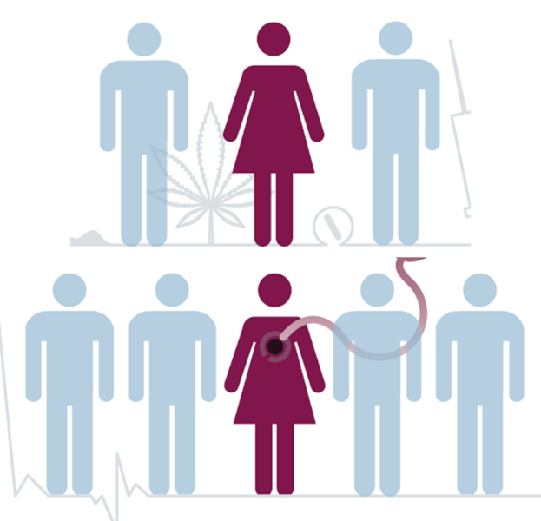
Treatment access – men and women
While 1:3 people who use drugs is a woman, only 1:5 people in treatment is a woman
Women =
  higher levels of stigma and discrimination
  less services for women

Slide 6
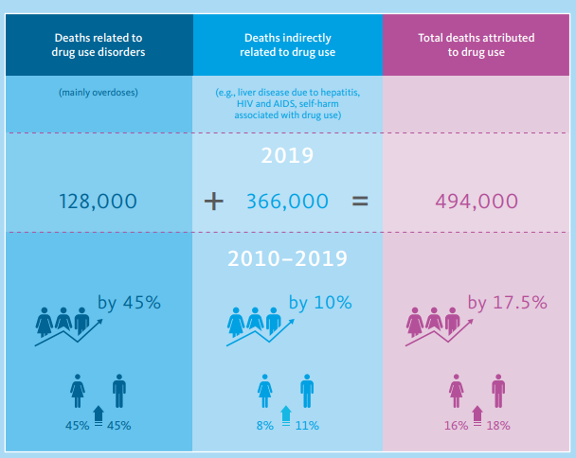
Drug related deaths

Slide 7
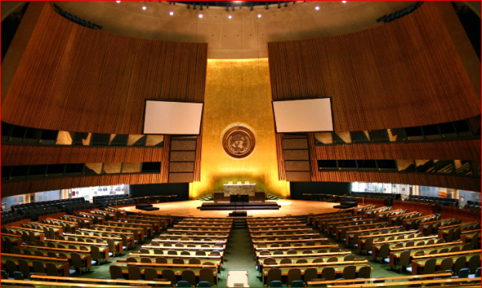
UNGASS 2016:
UN General Assembly Special Session on Drugs
Agreement to “Promote and implement the standards on the treatment of drug use disorders developed by the United Nations Office on Drugs and Crime and the World Health Organization and other relevant international standards,(…)
and provide guidance, assistance and training to health professionals on their appropriate use, and
consider developing standards and accreditation for services at the domestic level to ensure qualified and scientific evidence-based responses

Slide 8
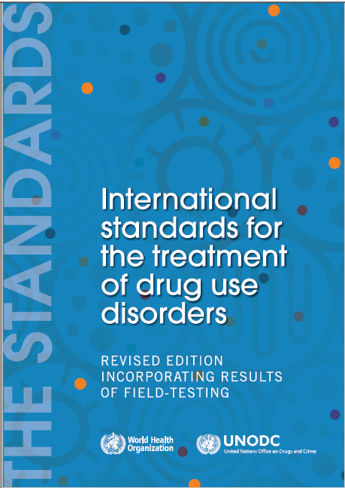
International Standards for the Treatment of Drug Use Disorders (2020)
Notes:
https://www.unodc.org/documents/drug-prevention-and-treatment/UNODC-WHO_International_Standards_Treatment_Drug_Use_Disorders_April_2020.pdf

Slide 9
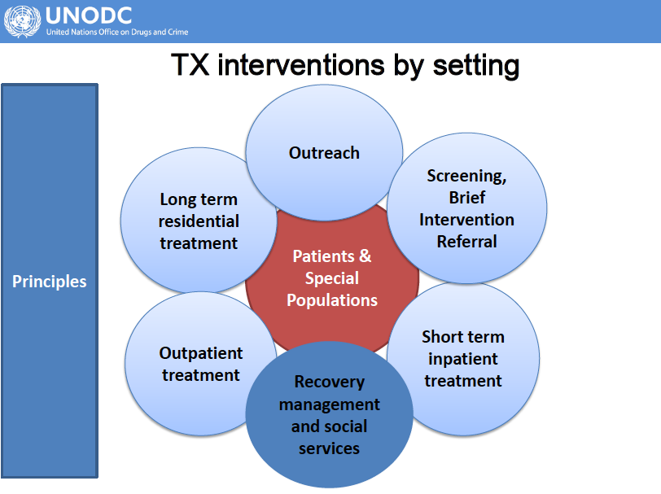
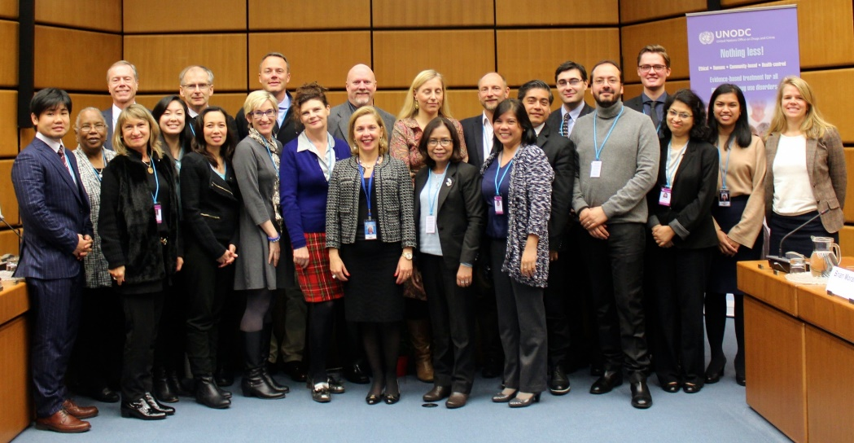
Development of UNODC
Quality Assurance tools
International expert group convened in Vienna Nov. 2016
Members reviewed and made recommendations on how to assess quality sections of ‘the International Standards’

Slide 10
Development of UNOCD QA tools: conclusions
The International expert group recommended
‘The International Standards’ is a mix of local system guidance, clinical guidelines for drug treatment services and standards. QA tools should separate the elements
Drug service standards have core elements applicable to all types or modalities of services: management; care; patients rights and responsibilities and optional elements: interventions, setting, target group
Drug treatment system standards could be separated
Development of full accreditation system was thought not feasible at this stage due to: the range of systems already in place in different countries; accreditation requires resources and can be litigious; and vast range in ‘readiness’ for QA

Slide 11
Development of UNOCD QA tools: actions
A consultant was appointed from the expert group
The consultant worked with the expert group and UNODC/WHO to develop QA tools by the end of March 2017.
Two sets of QA tools were developed: SERVICES & SYSTEM
Expert group were unable to agree on what standards and criteria were ‘essential’.
SYSTEM SERVICE

Slide 12
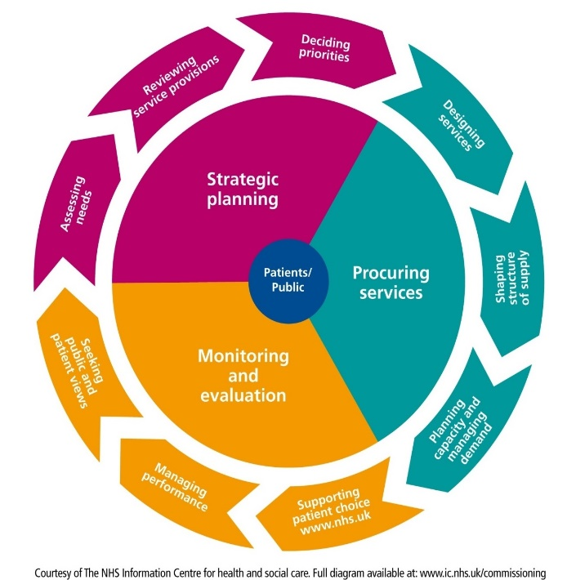
System standards to encourage system planning, funding & monitoring in line with WHO/UNODC
System 1: A local strategic partnership group plans and co-ordinates the local drug treatment system in line with UN/WHO ‘International Standards
System 2: There is a routine local assessment of need for drug treatment
System 3: There is a local 3-5 year strategic plan for a drug treatment system in line with ‘International Standards’
System 4: Drug treatment is planned and funded
in line with ‘International Standards’
System 5: Local planners and funders
support on-going system
quality improvement

Slide 13
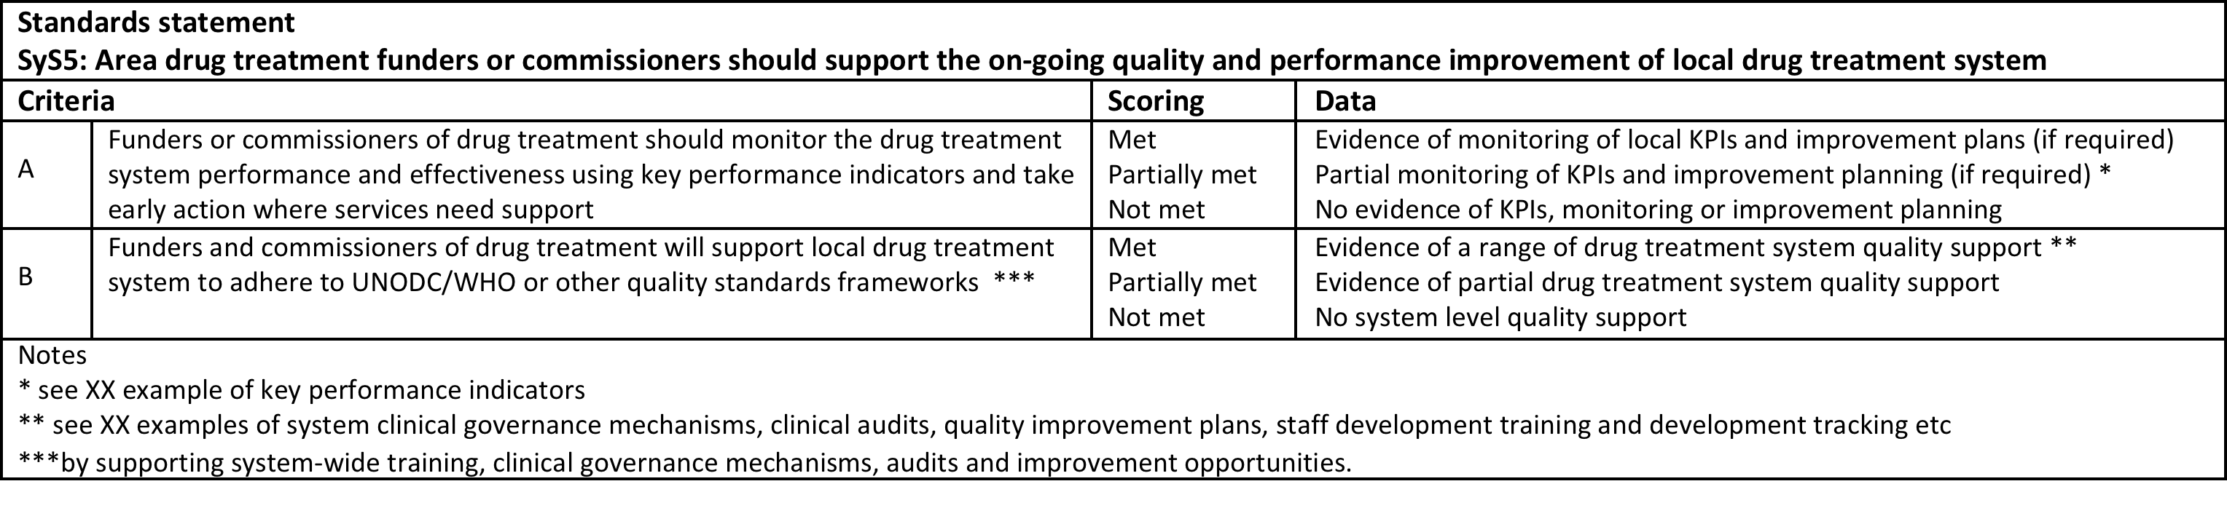
Structure of UNODC quality assurance tools
Standard statements criterion that are measurable
Criteria
Standard
statement
Scoring
Evidence
or data
Notes

Slide 14



Evidence is critical to objectively assess services
Evidence required from a drug treatment services includes:
Service documents:
  Annual plans, financial documents, clinical protocols, policies and procedures etc
Service monitoring data
2 surveys
  Patients survey (30 current patients)
  Staff survey (up to 30 current staff)
2 audits
  Patient records or case notes
  Staff human resource records

Slide 15
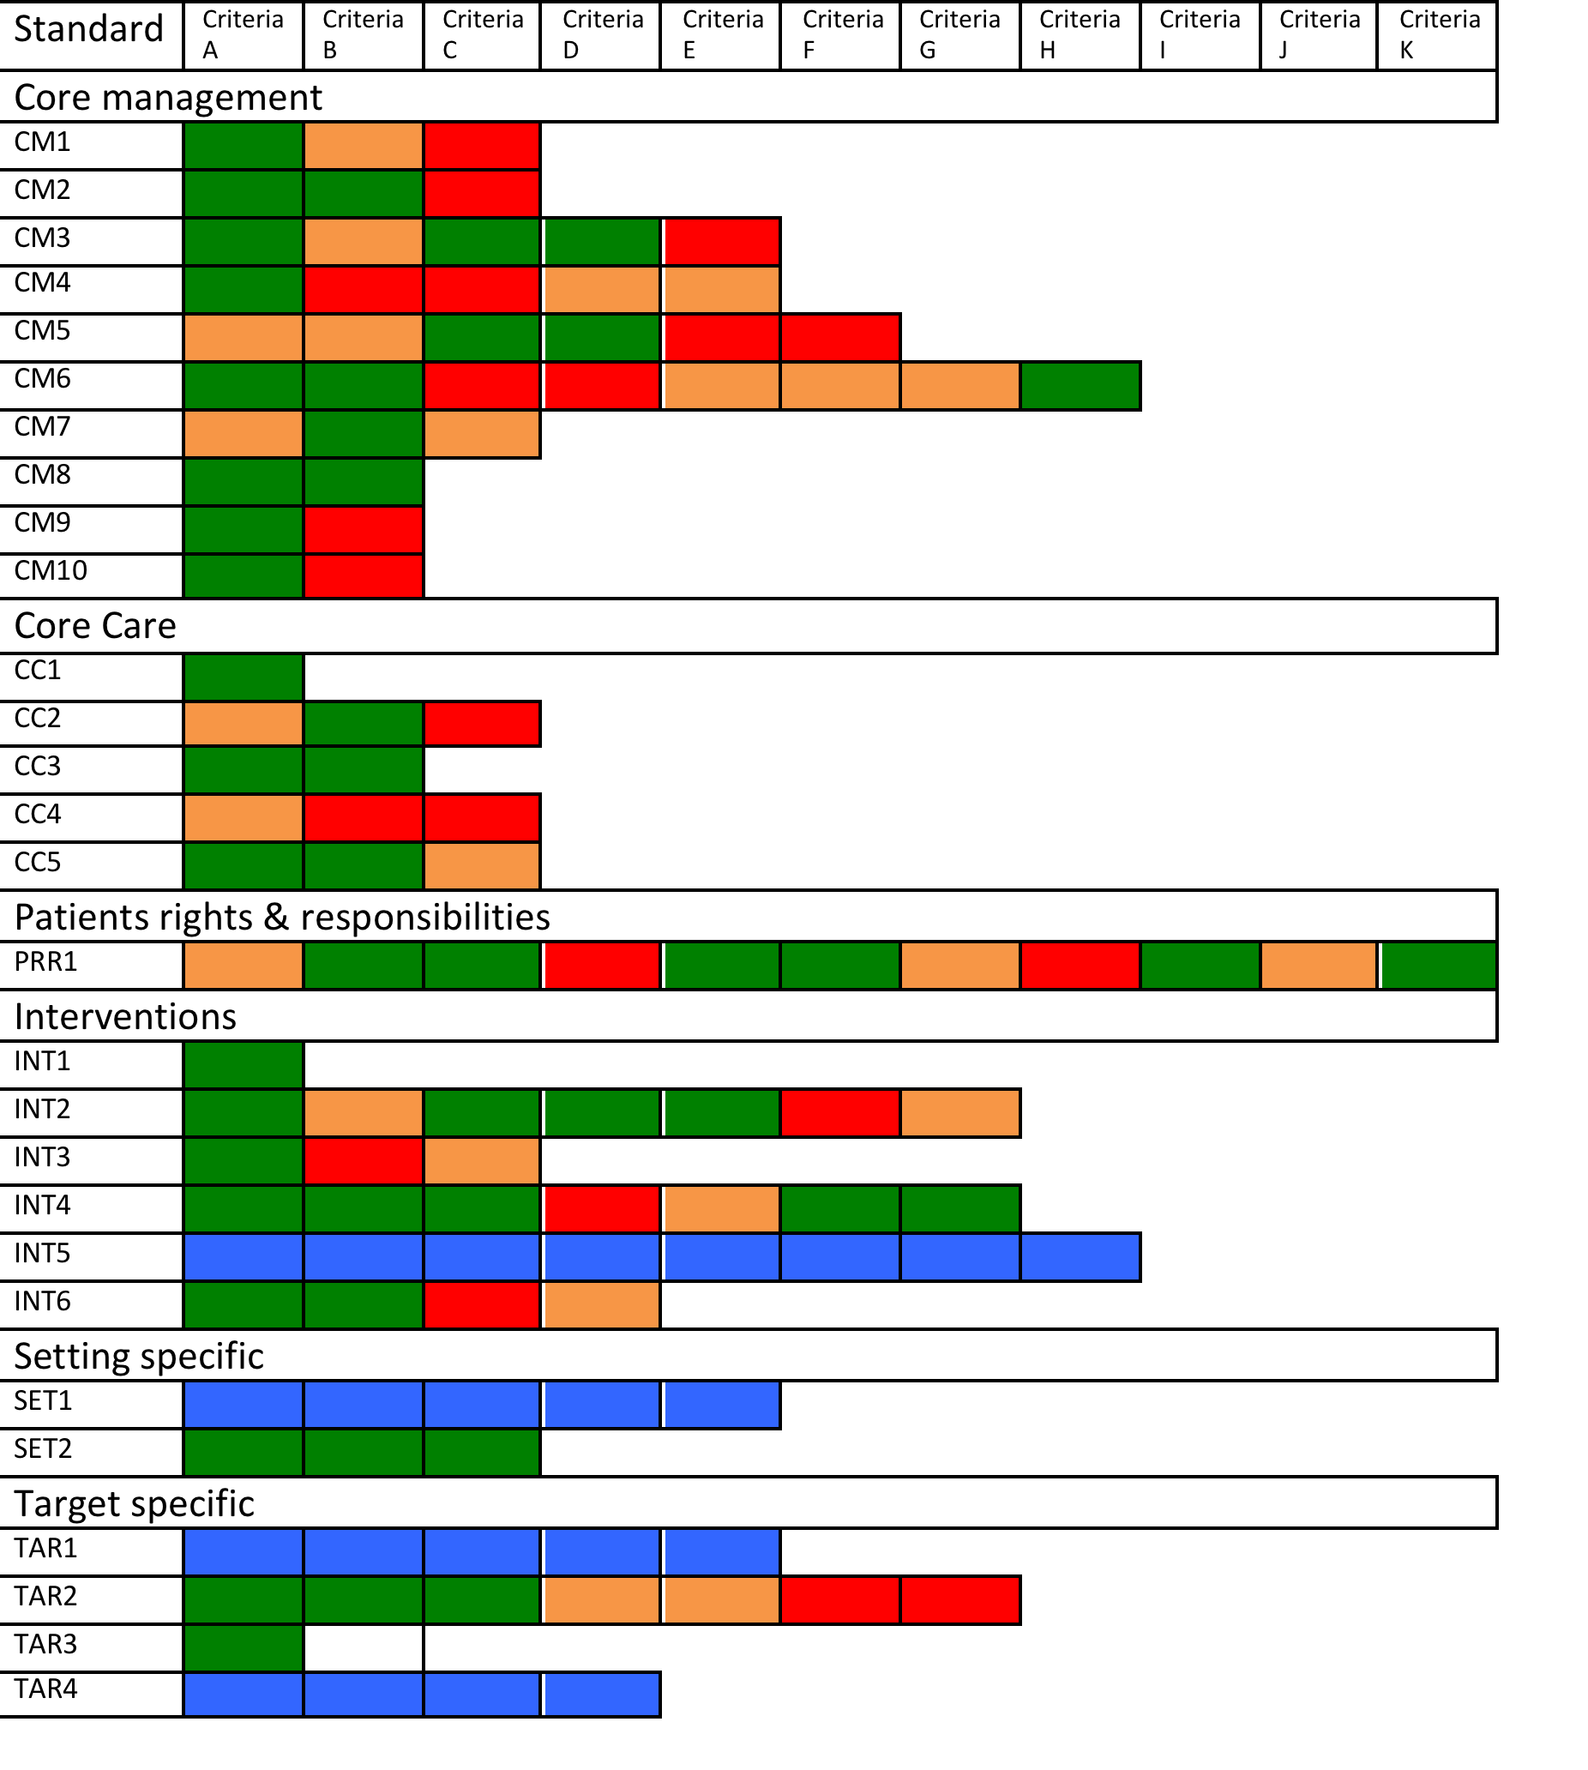
Rating a service against standards creates a ‘scorecard BRAG rating’
% or BRAG rating
(Blue/Red/Amber/Green)
Blue = Not Applicable
Red = Not met
Amber = Partially met
Green = Met
Then request services create action plans to improve Red and Amber areas of service provision

Slide 16
Establishment of a QA cycle
Key aim is to encourage drug treatment services to establish QA cycles
Use evidence-based QA methods to improve quality
Identify standards
Collect data /evidence
Compare to standards
Plan improvement
Implement change
Monitoring/ re-audit

Slide 17

Customizable benchmarking tool
Inspired by Quality Assurance Mechanisms and Tools
Identify gaps and develop improvement plans
Generate scoreboard based on collected data
Compatible with most systems and devices
Proposal #1
Digital Quality Assurance System

Slide 18
The Alcohol, Smoking and Substance Involvement Screening Test (ASSIST)
Open access and judgement-free process
Completely anonymous with no data storage
Obtain result instantly and have the option to review it again on UNODC’s website
Proposal #2
Self-Screening Kiosk

Slide 19
Not enough public information on DUD
Lack of regulation
Help identifying criteria for quality treatment services
Link to kiosk by using anonymous code
Proposal #3
Chatbot on UNODC Website

Slide 20
Conclusions: general
The ‘International Standards’ and UNODC QA Tools (IS&QAT) are ambitious and can be overwhelming
An incremental, step by step approach will still require adaptation by different countries
COVID 19 has accelerated the need to digitalize the provision of drug treatment services = Opportunity
Innovation and digitalization may enhance managerial as well as therapeutic interventions in drug treatment services
Questions: Feasibility, Sustainability, Data safety?

Slide 21

The International Standards and QA Tools will
improve the quality and effectiveness of drug treatment.
Digital solutions help us save lives

Slide 22

Thank you!
elizabeth.saenz@unodc.org
www.unodc.org/treatment
@DrElisaenz
Notes:
22

