Slide 1
FG-AI4H-M-044-A01
E-meeting, 28-30 September 2021
Source: | Editors
Title: | Overview of the FG-AI4H deliverables – Att.1: Presentation
Purpose: | Admin
Contact: | Shan Xu, CAICT, China | E-mail: xushan@caict.ac.cn
Abstract: | This PPT contains a presentation of DEL00 presented at Meeting M of the FG-AI4H (e-meeting), 28-30 September 2021.

Slide 2
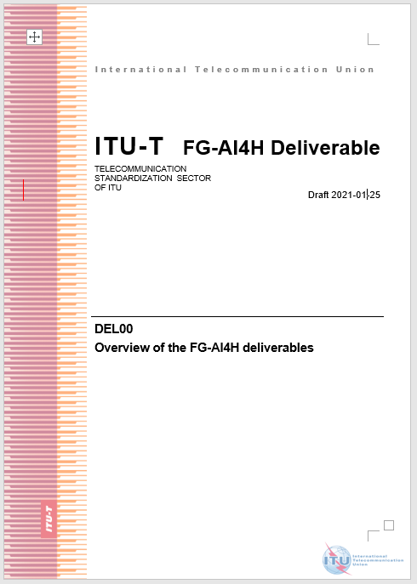
Abstract
This document provides a summary of all planned deliverables in FG-AI4H, including 9 generalized specifications on ethics, regulatory, requirement, data, training, evaluation, application, etc., and 24 topic description documents on specific use cases with corresponding AI/ML tasks.
This document is to give a comprehensive overview on the structure, progress, corresponding scopes and relationship on those deliverables, to avoid conflict and facilitate collaborations

Slide 3
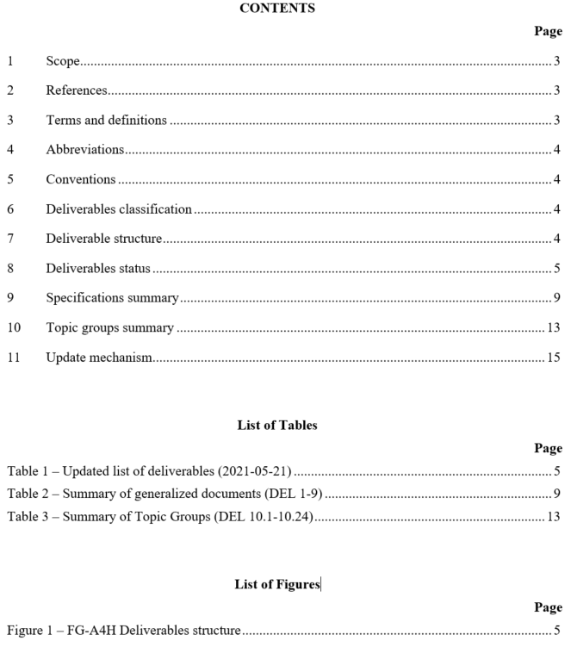
Contents
This document contains Version 4 of the Deliverable DEL00 on "Overview of the FG-AI4H deliverables" [approved at the ITU-T Focus Group on AI for Health (FG-AI4H) meeting held in Draft 2020-05-20, with version 2 in the meeting I, version 3 in the meeting K].
This version is based on the update on FG-AI4H meeting K, 27-29 Jan (A revision marked version is found in document FG-AI4H-M-XX).

Slide 4
Introduction
May 2018: idea at AI for Good, Geneva
July 2018:
Formal creation, Ljubljana
September 2018: Meeting A, WHO HQ
November 2018: Meeting B, New York
The ITU/WHO Focus Group on artificial intelligence for health (FG-AI4H) was established by ITU-T Study Group 16 at its meeting in Ljubljana, Slovenia, 9-20 July 2018.
This group is committed to establish a standardized assessment framework for the evaluation of AI-based methods for health, diagnosis, triage or treatment decisions.
A list of deliverables for the FG-AI4H was planned and expert groups were established, with 9 deliverables (DEL 1-9) on generalized consideration and 24 topic groups (DEL 10.1-10.24).
January 2019: Meeting C, EPFL
April 2019: Meeting D,
Shanghai World Expo
May 2019:Meeting E,
AI for Good, Geneva
September 2019: Meeting F, Zanzibar
November 2019: Meeting G, New Delhi
January 2020: Meeting H, Brasilia
Mar 2020: Meeting I, Singapore (IMDRF)
May 2020: Meeting I, Virtual meeting
Sep 2020: Meeting J, Virtual meeting
Jan 2021: Meeting K, Virtual meeting
May 2021: Meeting L, Virtual meeting
Sep 2021: Meeting M, Virtual meeting
To be continued…

Slide 5
Deliverables classification
Generalized specifications (DEL 1-9): focus on generalized specifications including ethics, regulatory, requirement, data, training, evaluation, application, etc. Each part is interconnected to form a life cycle process of AI-based methods for health.
Topic groups (DEL 10.1-10.24): focus on use cases in specific health domains with corresponding AI/ML tasks. Each case can be regarded as an example of a whole process recommended by generalized specifications (DEL 1-9), and profiled in a specific application scenario.
Generalized specifications (DEL 1-9)
Topic groups (DEL 10.1-10.24)

Slide 6
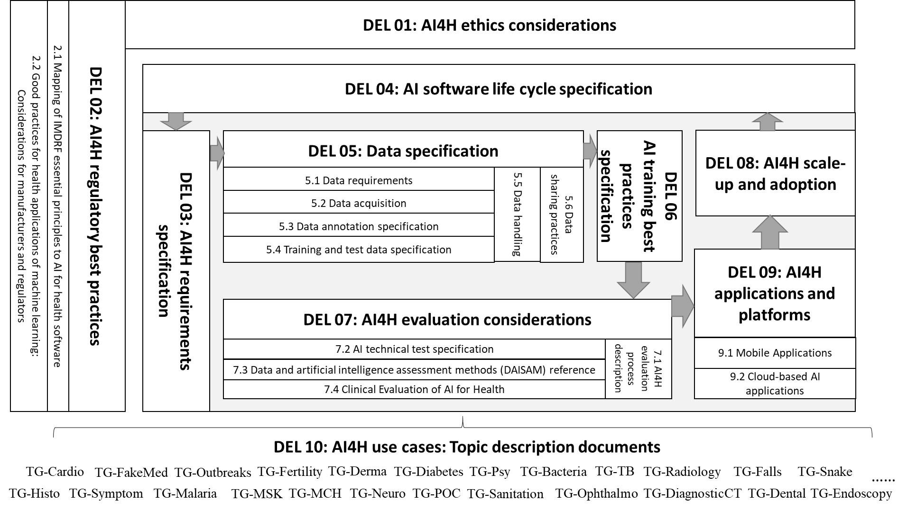
Figure 1 – FG-A4H Deliverables structure

Slide 7
Table 1 – Updated list of deliverables (2021-05-21)
No. | Deliverable | Updated draft editor | Availability*
0 | Overview of the FG-AI4H deliverables | Shan Xu (CAICT, China) | L-039
1 | AI4H ethics considerations | Andreas Reis (WHO) | K-028 (K-028-A01)
2 | AI4H regulatory best practices | Jackie Ma (Fraunhofer HHI, Germany), Khair ElZarrad & Rose Purcell (FDA, USA) | L-047
2.1 | Mapping of IMDRF essential principles to AI for health software | Luis Oala (Fraunhofer HHI, Germany), Pradeep Balachandran (Technical Consultant eHealth, India), Pat Baird (Philips, USA), Thomas Wiegand (Fraunhofer HHI, Germany) | G-038, G-038-A01
2.2 | Good practices for health applications of machine learning: Considerations for manufacturers and regulators | Pradeep Balachandran (India) and Christian Johner (Johner Institut, Germany) | L-037
3 | AI4H requirement specifications | Pradeep Balachandran (India) | L-038
4 | AI software life cycle specification | Pat Baird (Philips, USA) | J-033 (L-046)
5 | Data specification | Marc Lecoultre (MLlab.AI, Switzerland) | G-205
5.1 | Data requirements | [Marc Lecoultre (MLlab.AI, Switzerland)]** | I-044
5.2 | Data acquisition | Rajaraman (Giri) Subramanian (Calligo Tech, India), Vishnu Ram (India) | G-205-A02
5.3 | Data annotation specification | Shan Xu (CAICT, China), Harpreet Singh (ICMR, India), Sebastian Bosse (Fraunhofer HHI, Germany) | K-048
5.4 | Training and test data specification | Luis Oala (Fraunhofer HHI, Germany), Pradeep Balachandran (India) | I-034 (L-045)
5.5 | Data handling | Marc Lecoultre (MLlab.AI, Switzerland) | I-045
5.6 | Data sharing practices | Ferath Kherif (CHUV, Switzerland), Banusri Velpandian (ICMR, India), WHO Data Team | L-044
6 | AI training best practices specification | Xin Ming Sim and Stefan Winkler (AI Singapore) | K-037
7 | AI for health evaluation considerations | Markus Wenzel (Fraunhofer HHI, Germany) | L-036
7.1 | AI4H evaluation process description | Sheng Wu (WHO) | G-207-A01
7.2 | AI technical test specification | Auss Abbood (Robert Koch Institute, Germany) | I-027 (L-051)
7.3 | Data and artificial intelligence assessment methods (DAISAM) reference | Luis Oala (Fraunhofer HHI, Germany) | K-045 (L-052)
7.4 | Clinical evaluation of AI for health | Naomi Lee (Lancet, UK), Eva Weicken (Fraunhofer HHI, Germany), Shubhanan Upadhyay (ADA Health, Germany) | L-040
8 | AI4H scale-up and adoption | Sameer Pujari (WHO), Yu ZHAO and Javier Elkin [Previously: Robyn Whittaker (New Zealand)] | – (K-052)
9 | AI4H applications and platforms | Manjeet Chalga (ICMR, India), Aveek De (CMS, India) | L-050
9.1 | Mobile applications | Khondaker Mamun (UIU, Bangladesh), Manjeet Chalga (ICMR, India) | I-048
9.2 | Cloud-based AI applications | Khondaker Mamun (UIU, Bangladesh) | I-049
Colour codes indicate deliverable drafting status (as of the issuance of this document) as "active" (green) and "unclear whether active" (blue).

Slide 8
No. | Deliverable | Updated draft editor | Availability*
10 | AI4H use cases: Topic description documents | Eva Weicken (Fraunhofer HHI, Germany) | L-004
10.1 | Cardiovascular disease management (TG-Cardio) | Benjamin Muthambi (Watif Health, South Africa) | L-006-A01
10.2 | Dermatology (TG-Derma) | Weihong Huang (Xiangya Hospital Central South University, China) NOTE – Maria Vasconcelos (Fraunhofer, Portugal) resigned from the role. | L-007-A01
10.3 | Diagnosis of bacterial infection and anti-microbial resistance (TG-Bacteria) | Nada Malou (MSF, France) | L-008-A01
10.4 | Falls among the elderly (TG-Falls) | Pierpaolo Palumbo (University of Bologna, Italy); Inês Sousa (Fraunhofer Portugal) | L-012-A01
10.5 | Histopathology (TG-Histo) | Frederick Klauschen (LMU Munich & Charité Berlin, Germany) | L-013-A01
10.6 | Malaria detection (TG-Malaria) | Rose Nakasi (Makerere University, Uganda) | L-014-A01
10.7 | Maternal and child health (TG-MCH) | Raghu Dharmaraju (Wadhwani AI, India) and Alexandre Chiavegatto Filho (University of São Paulo, Brazil) | L-015-A01
10.8 | Neurological disorders (TG-Neuro) | Marc Lecoultre (MLlab.AI, Switzerland) | L-016-A01
10.9 | Ophthalmology (TG-Ophthalmo) | Arun Shroff (MedIndia) | L-017-A01
10.10 | Outbreak detection (TG-Outbreaks) | Auss Abbood (Robert Koch Institute, Germany) and Stéphane Ghozzi (HZI, Germany) | L-018-A01
10.11 | Psychiatry (TG-Psy) | Nicolas Langer (ETH Zurich, Switzerland) | L-019-A01
10.12 | AI for radiology (TG-Radiology) | Darlington Ahiale Akogo (minoHealth AI Labs, Ghana) | L-023-A01
10.13 | Snakebite and snake identification (TG-Snake) | Rafael Ruiz de Castaneda (UniGE, Switzerland) | L-020-A01
10.14 | Symptom assessment (TG-Symptom) | Henry Hoffmann (Ada Health, Germany) | L-021-A01
10.15 | Tuberculosis (TG-TB) | Manjula Singh (ICMR, India) | L-022-A01
10.16 | Volumetric chest CT (TG-DiagnosticCT) | Kuan Chen (Infervision, China) | L-009-A01
10.17 | Dental diagnostics and digital dentistry (TG-Dental) | Falk Schwendicke and Joachim Krois (Charité Berlin, Germany); Tarry Singh (deepkapha.ai, Netherlands) | L-010-A01
10.18 | Falsified Medicine (TG-FakeMed) | Franck Verzefé (TrueSpec-Africa, DRC) | L-011-A01
10.19 | Primary and secondary diabetes prediction (TG-Diabetes) | Andrés Valdivieso (Anastasia.ai, Chile) | L-024-A01
10.20 | AI for endoscopy (TG-Endoscopy) | Jianrong Wu (Tencent Healthcare, China) | L-025-A01
10.21 | AI for Musculoskeletal medicine (TG-MSK) | Peter Grinbergs (EQL, UK), Yura Perov (UK) | L-026-A01
10.22 | AI for human reproduction and fertility (TG-Fertility) | Susanna Brandi, Eleonora Lippolis, (Merck KGaA, Darmstadt, Germany) | Proposal: L-034 (Merck KGaA, Darmstadt, Germany)
10.23 | AI in sanitation for public health (TG-Sanitation) | Khahlil Louisy (Institute for Technology & Global Health, ITGH, US), Alexander Radunsky (ITGH, US) | Proposal: L‑035 (ITGI, US)
10.24 | AI for point-of care diagnostics (TG-POC) | Nina Linder, University of Helsinki, Finland | Proposal: L‑033 (Helsinki Univ., Finland)

Slide 9
Deliverables status (continued)
Table 1.1 – Possible future Deliverables (2021-05-21)
No. | Deliverable | Updated initial draft editor | Reference
– | Open Code Initiative reference software implementation | Marc Lecoultre (MLlab.AI, Switzerland) | K-043
– | Guidance on digital technologies for COVID health emergency | Shan Xu (CAICT, China), Ana Riviere-Cinnamond (PAHO) | K-042
– | Risk management in AI for health | Pat Baird (Philips, USA) | K-034

Slide 10
Summary of generalized documents
Generalized specifications (DEL 1-9)
To better coordinate and avoid possible conflicts within FG-AI4H, a summary table of all generalized documents (DEL 1-9) is given below.
The working score of each deliverable was summarized from the latest version (as of 2021-09-28) stored in the FG-AI4H collaboration area at https://extranet.itu.int/sites/itu-t/focusgroups/ai4h/SitePages/Deliverables.aspx
Topic groups (DEL 10.1-10.24)

Slide 11
Table 2 – Summary of generalized documents (DEL 1-9)
Deliverable |  | Scope | Last update
1- AI4H ethics considerations |  | The rapidly developing field of AI raises a number of ethical, legal and social concerns, e.g. regarding equitable access, privacy, appropriate uses and users, liability and bias and inclusiveness. These issues are trans-national in nature, as capturing, sharing and using data generated and/or used by these technologies goes beyond national boundaries. Many questions remain unanswered concerning the ethical development and use of these technologies, including how low- and middle-income countries will benefit from AI developments. This document is to develop a harmonised ethics guidance for the design and implementation of AI in global health. | 5/18/2020
2- AI4H regulatory best practices |  | This document is aimed as a general, high-level, and nonexclusive overview of key regulatory considerations’ topic areas delivered by the WG-RC on AI for health. It highlights some of the key regulatory principles and concepts, such as risk/benefit assessments and considerations for the evaluation and monitoring of the performance of AI solutions. | 9/23/2021
2.1 | Mapping of IMDRF essential principles to AI for health software | This document provides a number of new aspects that have not been considered when developing the regulatory framework for software as a medical device (SaMD) as described by the IMDRF Essential Principles (EPs) in “Essential Principles of Safety and Performance of Medical Devices and IVD Medical Devices”, IMDRF Good Regulatory Review Practices Group, IMDRF GRRP WG/N47 FINAL, 31 October 2018. This document provides a suggested mapping of the EPs to related aspects of AI4H software. Its purpose is to cover all aspects considered in the regulation of SaMDs and whether and if yes, how they are applicable to AI4H. | 5/18/2020
2.2 | Good practices for health applications of machine learning: Considerations for manufacturers and regulators | This document recommends a set of good machine learning practice guidelines to the manufacturers and regulators of data driven Artificial Intelligence based healthcare solutions on conducting comprehensive requirements analysis and streamlining conformity assessment procedures for continual product improvement in an iterative and adaptive manner. This set of good machine learning practice guidelines gives prime priority to the factor of patient safety and focuses on a streamlined process for risk minimization and quality assurance for AI/ML based health solutions and tries to establish a system of transparency and accountability of all the processes involved in AI/ML based health solutions. | 5/17/2021
3- AI4H requirements specification |  | This document is to define the System Requirement Specifications (SyRS) that explains the informational, functional, behavioural and operational aspects a generic AI for health (AI4H) system. SyRS serves as the basis and helps to create system design, system verification and validation plans and procedures. System requirements analysis methodology follows a collaborative team-oriented approach, involving all the working groups and topic groups of AI4GH FG, to help the project team identify, control and track various requirements and changes to those requirements during the AI4H system development lifecycle. | 9/24/2021
4-AI software life cycle specification |  | This deliverable includes the following considerations: a) Identification of all standards and best practices that are relevant for the AI for health software life cycle. Similar to other software life cycle processes, the AI software life cycle process needs to be specified. b) Summary and critical review of the identified documents including a discussion of their limits/gaps and need for action. C) Identification of life cycle steps that are specific/characteristic for AI for health software, such as training and test procedures based on data that potentially need to be annotated. d) Specification of the AI for health software life cycle and definition of best practices for the different life cycle steps in one document (under consideration of a, b, and c). Overview and examples of best practices | 9/28/2020

Slide 12
Table 2 (continued)– Summary of generalized documents (DEL 1-9)
Deliverable |  | Scope | Last update
5-Data specification |  | This document combines a set of six separate deliverables as umbrella, which address six important aspects related to data specification when used for artificial intelligence (AI) and machine learning (ML) models/methods for health purposes. Each editor will propose an initial outline (=Table of Contents), define the objectives of the future deliverable, and collect a bibliography of existing literature and material relevant for the development of the respective document. A short call for participation, the expertise profile of potential contributors, a time plan, and a brief characterisation of the target audience serve as preface. | 6/17/2020
5.1 | Data requirements | This document lists acceptance criteria for data submitted to the FG-AI4H and states the governing principles and rules. These principles are crucial because the core of the benchmarking framework for AI for health methods will be an undisclosed test data set – per use case of each topic area to be defined – that will not be made accessible to the AI developers. | 5/19/2020
5.2 | Data acquisition | This document presents a framework for public healthcare data acquisition and management model based on standard protocol for its easy adoption by any country or international health organizations. This paper assumes basic digitization of electronic health record (EHR) at basic health facilities. There is a gap in developing an integrated and comprehensive framework that addresses the use of EHR in a standardized way for public health, privacy issue by anonymizing patient specific information, fusing multiple records with slight changes in the same information, augmenting a broad spectrum of contextual data, and so on. | 5/19/2020
5.3 | Data annotation specification | This document is committed to give a general guideline of data annotation specification, including definition, background and goals, framework, standard operating procedure, scenario classifications and corresponding criteria, as well as recommended metadata, etc. A questionnaire is attached to seek input and collaboration with topic groups in FG-AI4H regarding data annotation. | 1/27/2021
5.4 | Training and test data specification | This document is intended to guide the target audience with a systematic way of preparing technical requirements specification for datasets used in training and testing of machine ML models This document explains the best practices of data quality assurance aimed at minimizing the data error risks during the training and test data preparation phase of machine learning process lifecycle. The training and test data requirement specifications follow the data integrity, data security and data safety norms of the AI data governance lifecycle process. | 5/20/2020
5.5 | Data handling | This document outlines how data will be handled, once they are accepted. Health data are one of the most valuable and sensitive types of data. Handling this kind of data is often associated with a strict and factual framework defined by data protection laws. There are two major issues that the data handling policy should address: (a) compliance with regulations dealing with the use of personal health data; and (b) non-disclosure of the undisclosed test data held by FG-AI4H for the purpose of model evaluation. | 4/1/2020
5.6 | Data sharing practices | This document aims to provide an overview of the existing best practices for data sharing of health-related data, including the requirement to enable secure data sharing and issues related to data governance. The documents described established solutions and novel approaches based on distributed and federated environments. | 5/19/2021

Slide 13
Table 2 (continued)– Summary of generalized documents (DEL 1-9)
Deliverable |  | Scope | Last update
6-AI training best practices specification |  | This document aims to provide best practices for training and documentation so as to facilitate maximum performance and transparency. This document provides a review of the different aspects of AI model training pipeline. The first part discusses the best practices for data pre-processing aspects, while the second part discusses the best practices for AI model training aspects. | 1/25/2021
7-AI for health evaluation considerations |  | This introduction with considerations on the evaluation of AI for health sets the scene for the five related documents DEL07.1-5. In this document, an overview of the deliverables DEL7.1-5 is given, preliminary considerations on the evaluation process are being made, characteristics of health AI validation and evaluation that are novel are identified, and the concept of standardized model benchmarking is introduced. Moreover, requirements for a benchmarking platform are considered in detail and best practices for the health AI model assessment are collected from selected sources. | 9/24/2021
7.1 | AI4H evaluation process description | The AI4H evaluation process description serves as overview of the state of the art of AI evaluation principles and methods and a forward-looking initiator for the evaluation process of AI4H. This process description includes a review of existing evaluation principles and methods, evaluation need and solutions specific for AI4H. It will also look into ethics and risks aspects of AI4H evaluation. Furthermore, based on the fundamentals of AI, the description will gain insights on the direction of how the current evaluation methods evolve towards the concept of REAL AI. | 5/20/2020
7.2 | AI technical test specification | This document specifies how an AI can and should be tested in silico. Among other aspects, best practices for test procedures known from (but not exclusively) AI challenges will be reviewed in this document. Important testing paradigms that are not exclusively related to AI applications should be mentioned too. | 5/20/2020
7.3 | Data and artificial intelligence assessment methods (DAISAM) reference | This document provides a summary of how to understand and identify algorithmic bias at different stages of the AI-based product that may have critical implications when the algorithm is applied in a real-world clinical setting. The aim is to train the most accurate model for each group without harming any minority group of patients. Furthermore, methods to mitigate bias according to the problem at hand are provided. These guidelines aim to provide a framework for technologists that build health related AI based products to investigate the presence of algorithmic bias. | 5/21/2020
7.4 | Clinical evaluation of AI for health | This document is to outline the current best practices, the principles and outstanding issues for further considerations related to clinical evaluation of AI health technologies. It serves as the output document of the WHO/ITU Focus Group on AI for Health (FG-AI4H) Working group on Clinical Evaluation of AI for Health (WG-CE). | 9/24/2021
8-AI4H scale-up and adoption |  | TBD | ——
9-AI4H applications and platforms |  | This document contains a discussion on development of AI tool for Health using Mobile Applications & Cloud-based AI applications. This document describes type of mobile applications and the development of App based system for disease surveillance in the health sector. | 5/20/2020
9.1 | Mobile applications | This document contains a draft set of rules for development of AI tool for Health using Mobile Applications, their testing and benchmarking. It is to prepare the rules for development of AI tool for Health using Mobile Applications, and discuss the regulatory/ethical rules for Mobile Apps with AI for Healthcare. | 5/21/2021
9.2 | Cloud-based AI applications | This document contains a draft set of rules for development of Cloud-based AI applications, their testing and benchmarking. It is to discuss on technology, security and legal issues related to cloud-based AI tools, and to provide a forum for open communication among various stakeholders. | 5/21/2020

Slide 14
Summary of Topic Groups
To provide a quick overview of the specific health domains with corresponding AI/ML tasks considered in FG-AI4H, a summary table of all Topic Description Documents (TDD) is given below.
Key messages includes health domain, task classification, gold standard, input data type, testing/training dataset, data annotation, algorithm, evaluation, etc.
These information listed below were obtained from 7 responses of a questionnaire to all TG drivers (https://forms.gle/3fYrm3SZSrNQu3eeA), the remaining blank will be filled through a comprehensive review of all TDDs.
Generalized specifications (DEL 1-9)
Topic groups (DEL 10.1-10.24)

Slide 15
Table 3 – Summary of Topic Groups (DEL 10.1-10.24)
Topic Groups (Examples) | Domain (Cardiovascular/ Dermatology/ Histopathology/‌etc.) | Task (Classification/ detection/ segmentation/ prediction/‌etc.) | Gold Standard (state-of-the-art task intervention method) | Input data type (Text/ Image/ video/ audio/ numerical/‌etc.) | Testing/ Training dataset (Public dataset/ Collected by myself/‌etc.) | Data annotation (Procedure/ annotator number/ tool/‌etc.) | Algorithm (specific model used in this TG) | Evaluation (Metrics used in this TG)
TG-Bacteria | Diagnoses of bacterial infection and anti-microbial resistance | TBD | TBD | TBD | TBD | TBD | TBD | TBD
TG-Cardio | cardiovascular disease | prediction | TBD | Quantitative & qualitative data (structured) | De-identified retrospective secondary data from healthcare/EMR & research data repositories | Structured data are used, thus simple R programming is used to recode structured data to required standardized labels. | TBD | TBD
TG-Dental | Dental diagnostics and digital dentistry | Classification/ detection/ segmentation/ prediction | Histology, Cross-image validation, human annotations | 2D Image, 3D Image, Video, Text | Self-built | Custom made tool | TBD | TBD
TG-Derma | Dermatology | TBD | TBD | TBD | TBD | TBD | TBD | TBD
TG-Diabetes | Primary and secondary diabetes prediction | TBD | TBD | TBD | TBD | TBD | TBD | TBD
TG-DiagnosticCT | Volumetric chest computed tomography | TBD | TBD | TBD | TBD | TBD | TBD | TBD
TG-Endoscopy | Endoscopy | Classification/ detection/ segmentation | Pathological report, Cross annotation by doctors | 2D Image, Video | Public dataset， self-built | Cross annotation, Self-built annotation tool | TBD | TBD
TG-FakeMed | AI-based detection of falsified medicine | Classification/ detection/ prediction | TBD | 2D Image, Text | Self-built | TBD | TBD | TBD
TG-Falls | Falls among the elderly | TBD | TBD | TBD | TBD | TBD | TBD | TBD
TG-Fertility | human reproduction and fertility | TBD | TBD | TBD | TBD | TBD | TBD | TBD
TG-Histo | Histopathology | TBD | TBD | TBD | TBD | TBD | TBD | TBD
TG-Malaria | Malaria detection | TBD | TBD | TBD | TBD | TBD | TBD | TBD

Slide 16
Table 3(continued) – Summary of Topic Groups (DEL 10.1-10.24)
Topic Groups (Examples) | Domain (Cardiovascular/ Dermatology/ Histopathology/‌etc.) | Task (Classification/ detection/ segmentation/ prediction/‌etc.) | Gold Standard (state-of-the-art task intervention method) | Input data type (Text/ Image/ video/ audio/ numerical/‌etc.) | Testing/ Training dataset (Public dataset/ Collected by myself/‌etc.) | Data annotation (Procedure/ annotator number/ tool/‌etc.) | Algorithm (specific model used in this TG) | Evaluation (Metrics used in this TG)
TG-MCH | Maternal and child health | TBD | TBD | TBD | TBD | TBD | TBD | TBD
TG-MSK | Musculoskeletal medicine | TBD | TBD | TBD | TBD | TBD | TBD | TBD
TG-Neuro | Neurological disorders | Classification/ detection/ prediction | Post-mortem pathology evaluation, and biological markers. | 2D Image, 4D Image, clinical scores, genetics and biomarkers (e.g. csf) | Public dataset, self-built. | Manual | TBD | TBD
TG-Ophthalmo | Ophthalmology | Classification/ detection/ segmentation/ | Pathological report, Cross annotation by doctors | 2D Image, 3D Image, Text | Public dataset, self-built | Cross annotation, Self-built annotation tool | TBD | TBD
TG-Outbreaks | Outbreak detection | TBD | TBD | TBD | TBD | TBD | TBD | TBD
TG-POC | point-of care diagnostics | TBD | TBD | TBD | TBD | TBD | TBD | TBD
TG-Psy | Psychiatry | TBD | TBD | TBD | TBD | TBD | TBD | TBD
TG-Radiology | Radiology | TBD | TBD | TBD | TBD | TBD | TBD | TBD
TG-Sanitation | Sanitation for public health | TBD | TBD | TBD | TBD | TBD | TBD | TBD
TG-Snake | Snakebite and snake identification | Classification | Snake expert (herpetologist) identification | 2D Image | Public dataset, self-built. | Expert identification, crowdsourcing | TBD | TBD
TG-Symptom | Symptom assessment | Classification | Average doctor opinion. | Text, semantically structured cases. | Self-built. | a new case-creation tool | TBD | TBD
TG-TB | Tuberculosis | TBD | TBD | TBD | TBD | TBD | TBD | TBD

Slide 17
Update mechanism
This document will be continuously updated after each FG meeting to reflect scope and status change of deliverables, WGs, TGs and AHGs.
Direct input, suggestions and comments from editors are encouraged and welcome.
Review and feedback on Summary of DEL 1-9
Review and feedback on Summary of DEL 10.1-10.24
Questionnaire for topic drivers (https://forms.gle/3fYrm3SZSrNQu3eeA)

