Slide 1
FGAI4H-M-041-A01
E-meeting, 28-30 September 2021
Source: | Aga Khan University, minoHealth, Oxford University, and WHO
Title: | Draft Call for problem statements in global health - Att.1: Presentation
Purpose: | Discussion
Contact: | Matthias Gröschel ITU | E-mail: matthias.groeschel@itu.int
Abstract: | This PPT contains a presentation of M-041.

Slide 2
A comprehensive compendium of problem statements relevant to global health where digital health can be part of the solution
Sept 29th, Matthias Groeschel, MD PhD

Slide 3
Hi, I am Matthias
Tool: https://gentb.hms.harvard.edu/
Code: https://github.com/farhat-lab/gentb-site
Paper: Genome Med 13, 138 (2021)

Slide 4
AI and Health Webinars
Credits: Ayda & Bastiaan
We need your help to make this a success!

Slide 5
A comprehensive compendium of problem statements relevant to global health where digital health can be part of the solution

Slide 6
A list of problem statements relevant to global health seen through the data/AI lens
No comprehensive / inclusive / transparent set of problem definitions & lack of data
Shortcomings of previous Global Health Hackathons
A hackathon / Challenge on AI 4 Global Health

Slide 7
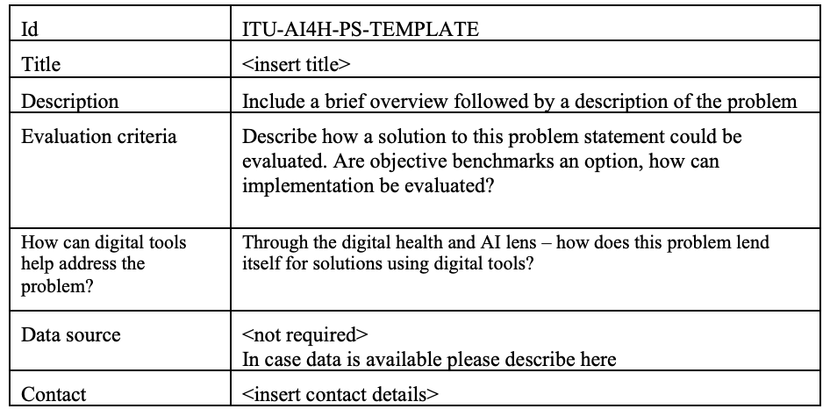
Template for problem statement submissions
3 million undiagnosed TB patients annually
Reported incident TB cases (WHO, TB program, hospital)
Identify underrepresented patient groups, use of mobile diagnosis tools (apps, questionnaires, etc)
None
Your feedback needed - what needs to be in this submission form?

Slide 8
Next steps
Sameer will discuss with WHO
Set up website and submission portal via AI4Good
Publish the call for problem statements and share widely with partners and colleagues
Wait, curate submissions (high-level versus detailed problem statements, by AI use case [UNAID definition], by topic area, …)
I’ll share the submission template next week, please take a look and provide your thoughts & feedback

