Slide 1
FGAI4H-M-040-A01
E-meeting, 28-30 September 2021
Source: | Editors DEL7.4
Title: | Updated DEL7.4: Clinical evaluation of AI for health - Att.1: Presentation
Purpose: | Discussion
Contact: | Naomi Lee Shubs Upadhyay Eva Weicken | E-mail: naomi.lee@lancet.com E-mail: shubs.upadhyay@ada.com E-mail: eva.weicken@hhi.fraunhofer.de
Abstract: | This PPT contains a presentation of: Status update Working Group on Clinical Evaluation Updates on DEL 7.4

Slide 2
Working Group on Clinical Evaluation Deliverable 7.4
FG-AI4H meeting “M”, 28 – 30 September 2021

Slide 3
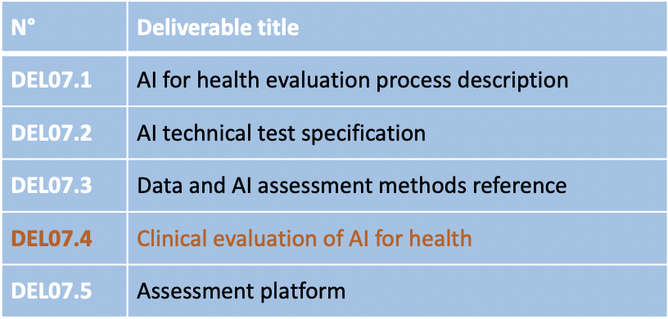
Introduction Working Group Clinical Evaluation
Deliverable 7.4 = Output document of WG-CE
Part of No. 7 deliverables “AI4H evaluation considerations”

Slide 4
Introduction Working Group Clinical Evaluation
build a community of collaboration around clinical evaluation of AI4H
guidance for current best practice evaluation, principles of evaluation (relevant across all countries)
Used by: researchers, clinicians, patients, developers, civil-society, policy-makers
special consideration of clinical evaluation in LMIC settings
applicable for FG-AI4H

Slide 5
Who is WG clinical evaluation?
65+ members from all around the globe & stemming from various fields
Co-chairs: Naomi Lee, Shubs Upadhyay, Eva Weicken
Writing group: Kassandra Karpathakis, Alastair Denniston, Xiao Liu, Jane Carolan, Tommy Wilkinson

Slide 6
Timeline - Where are we to date?

Slide 7
Where are we to date?
We are in the process of creating the outline
We want to give a transparent update and overview
We appreciate it very much if you read the doc. and provide feedback
Posted on the collaboration site: DEL 7.4

Slide 8
Revisions on the outline between meeting L & M
We redrafted the first section, now titled “model design and suitability“
We added ethics piece relevant to this work, by Rohit Malpani (WG-Ethics)
We added a figure and table
We improved consistency of message & language, reduced duplication

Slide 9
Work in progress
Review round 2 in progress
Particular discussions within the group on:
security of AI technologies
terminology
‘algorithmic validation’ to refer to evaluation of the AI model in silico
‘clinical validation’ to refer to evaluation of AI technology in context through clinical or interventional studies
Plus: this is part of contribution for common unified terms doc

Slide 10
Outline – Table of contents
Introduction and Background
Model design & suitability
Algorithmic validation
Clinical validation
Deployment and ongoing monitoring
Economic evaluation
Recommendations

Slide 11
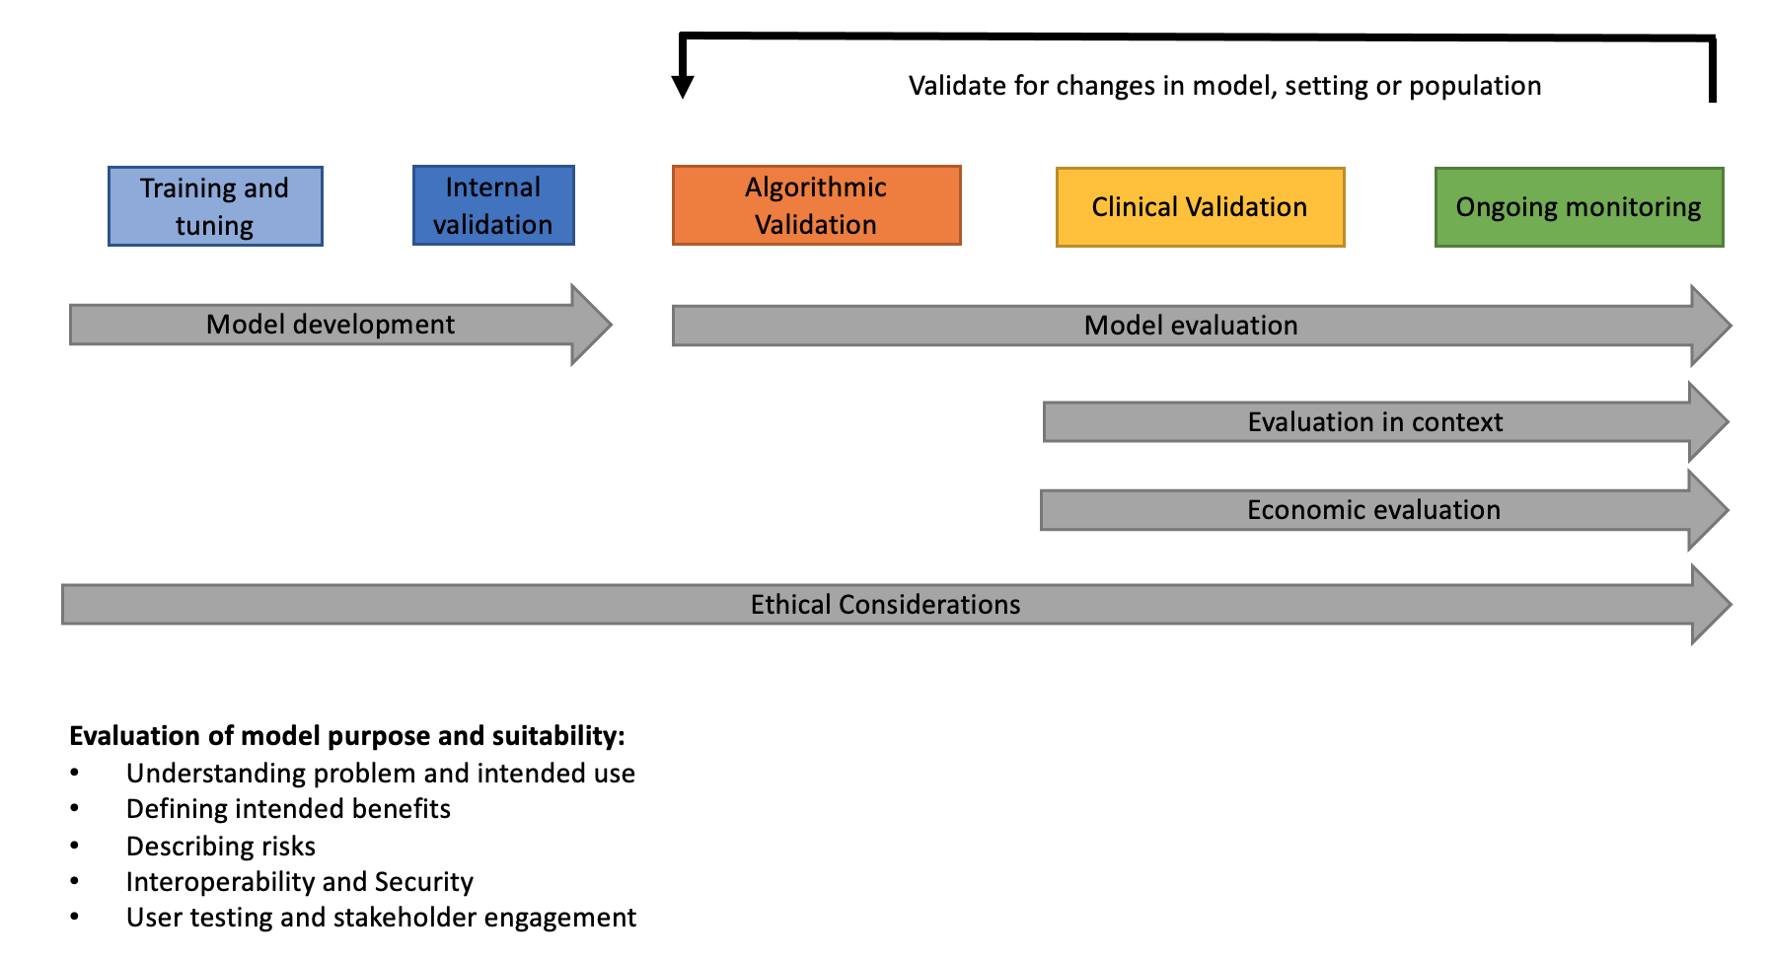
Introduction & Background
Framework for AI models in health

Slide 12
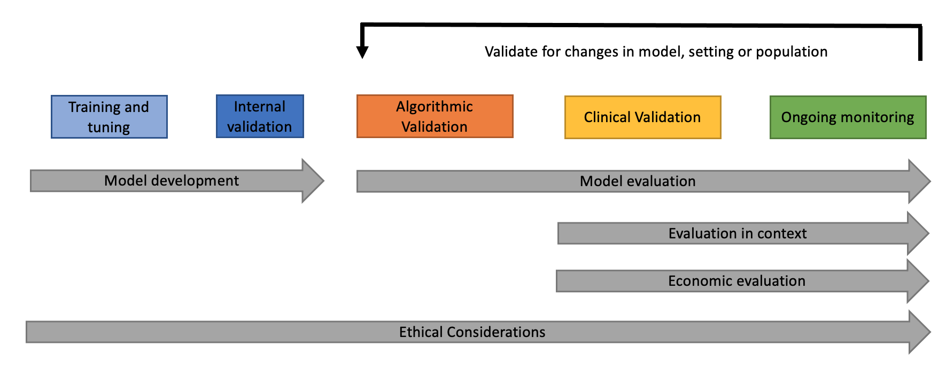
Model design and suitability
Understanding the problem and intended use
Defining intended benefits
Describing risks
Interoperability and security
User testing and stakeholder engagement

Slide 13
Algorithmic validation
‘Algorithmic validation’: to refer to evaluation of the AI model in silico
Requires:
understanding of the AI model through development & an assessment of the suitability of the data
Assessment of performance against one or more unseen external datasets & against the current standard of care, and potentially against other new AI technologies
Benchmarking of performance
Building high-quality datasets

Slide 14
Clinical validation
‘Clinical validation’: to refer to the evaluation of AI technology in context through clinical or interventional studies
Clinical studies seek to provide necessary evidence if AI is effective and safe to be deployed in clinical pathway
Evaluate the impact on the whole pathway, specific guidance on AI evaluation by Equator Network
List of specific elements for clinical studies

Slide 15
Deployment and ongoing evaluation
Deployment: ensure that evaluation is continued into the deployment phase & as long as the product continues to be used (generalisability)
Challenge: determine the level of additional evaluation required to appropriately assure version updates & continuously learning or adaptive algorithms
Ongoing evaluation: Monitoring of ongoing performance (safety & effectiveness)
Regulatory requirements
Users and developers of AI systems will be the two most active stakeholders engaging in post deployment monitoring
Algorithmic audits

Slide 16
Economic evaluation
Measurement of the expected costs relative to its expected impacts when implemented into a particular context
Types of economic evaluation for AI-enabled digital interventions
Reimbursement

Slide 17
Recommendations I
Ensuring that AI health technologies are effective, safe, ethical, inclusive and fair. Clinical evaluation & transparent communication regarding the use of AI systems, , their underpinning data, their performance and their safety systems is critical to deliver this
All stakeholders must be encouraged to carry out effective clinical evaluation & make the results open & accessible, made publicly available. Availability of the clinical evaluation plan is key to building trust and should be made publicly available.
Algorithmic validation, including benchmarking of AI models either by locally, nationally or more widely is important to ensure local performance is acceptable, and to compare performance of tools on particular datasets. The OCI is part of the FG-AI4H that is actively developing software that can be used by stakeholders to do this on their own datasets.

Slide 18
Recommendations II
Clinical studies, especially those with long term evaluation of AI tools is required- despite the expanding number of tools, there is a paucity of long term studies with clinical endpoints and rigorous safety analyses and this is holding back the potential of these tools. There is a lack of evidence on how transferable tools are that are developed in one setting and then used in another. Collaborative studies would accelerate progress and should be considered a priority.
Needs based development of AI models requires a dedicated effort to collect data in populations that are currently underrepresented and for clinical problems where AI may be effective, but datasets are poor. Not only does this facilitate development but also evaluation. Organisations like I-DAIR have identified this as a key task.

Slide 19
Recommendations III
6.
Procurers of AI tools should be clear about the economic evaluation that is required for AI tools. Not only is this important to ensure comprehensive evaluation, but it also builds trust in the evaluation system. While it is possible to find examples of where digital strategies explain what kind of evaluation should be done, it is still rare to find publicly available examples of where this has been done, and this can undermine public trust in procurement.
7.
Priority setting for digital tools in all country settings requires a much more active role for health technology assessment (HTA), in addition to the role of regulators. Where fulfilled by two different agencies, close dialogue should be maintained. Where HTA agencies already exist, these need to expand the workforce skills to include evaluation of AI technologies.
In countries where HTA capacity is low, this should be a key focus alongside expanding digital health tool.

Slide 20
Next steps
Receive feedback by 12 October 2021 & revise the outline doc.
Next iteration based on feedback
Follow-up meeting(s)
Share the draft with WHO for review

Slide 21
Thank you & Join us!
Please contact: eva.weicken@hhi.fraunhofer.de

