Slide 1
FGAI4H-M-039-A02
E-meeting, 28-30 September 2021
Source: | Geek Vision (Brazil)
Title: | TG-Ophthalmo: Strabismus and Artificial Intelligence App: Optimizing Diagnostic and Accuracy - Att.2: Presentation
Purpose: | Discussion
Contact: | João Victor Dias | E-mail: jvictordias@gmail.com
Abstract: | This PPT summarizes the study described in M-039, paper "Strabismus and Artificial Intelligence App: Optimizing Diagnostic and Accuracy", Transactional Vision Science and Technology, June 2021 (Vol. 10 No. 7; Article 22).

Slide 2
CHALLENGE – AI IN STRABISMUS
Scattered literature on A.I. applied in Strabismus
Non-standardized image repositories
Tiny and low-quality image samples
Plenty of rare classes
Subjective semiological evaluation of ocular versions
Eye versions evaluated on crude measures

Slide 3
OBJECTIVE
OCULAR VERSION AND GAZE CLASSIFICATION
Creating a tool to objectively assess versions of the gaze in its nine positions
Creating a benchmark
Best practices, continuous improvement and information sharing.
Developing an app
Easy-to-apply support app without internet need.
Enhancing the topic
Applying A.I. to empower strabismus studies.

Slide 4
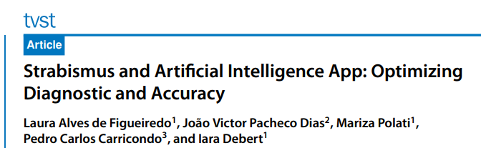
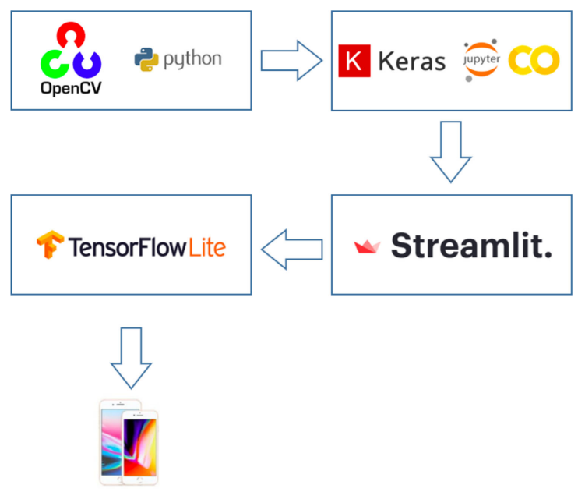
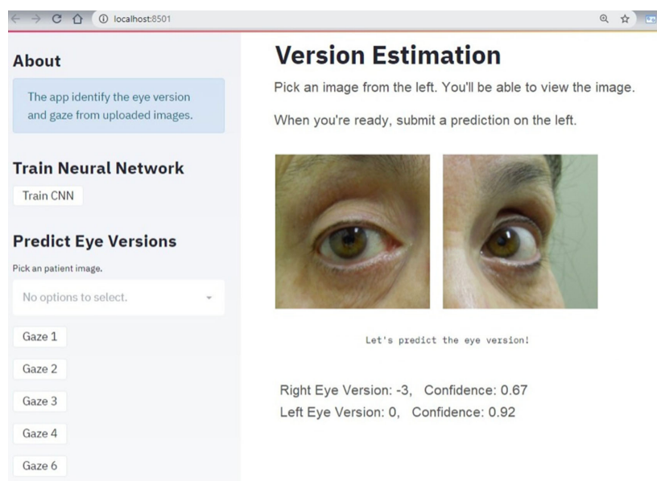
APPROACH - MACRO
The study was approved by the Research Ethics Committee of Hospital das Clínicas of the University of Sao Paulo.

Slide 5
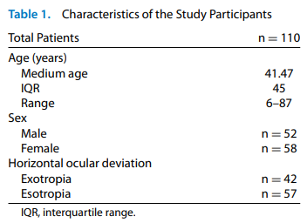
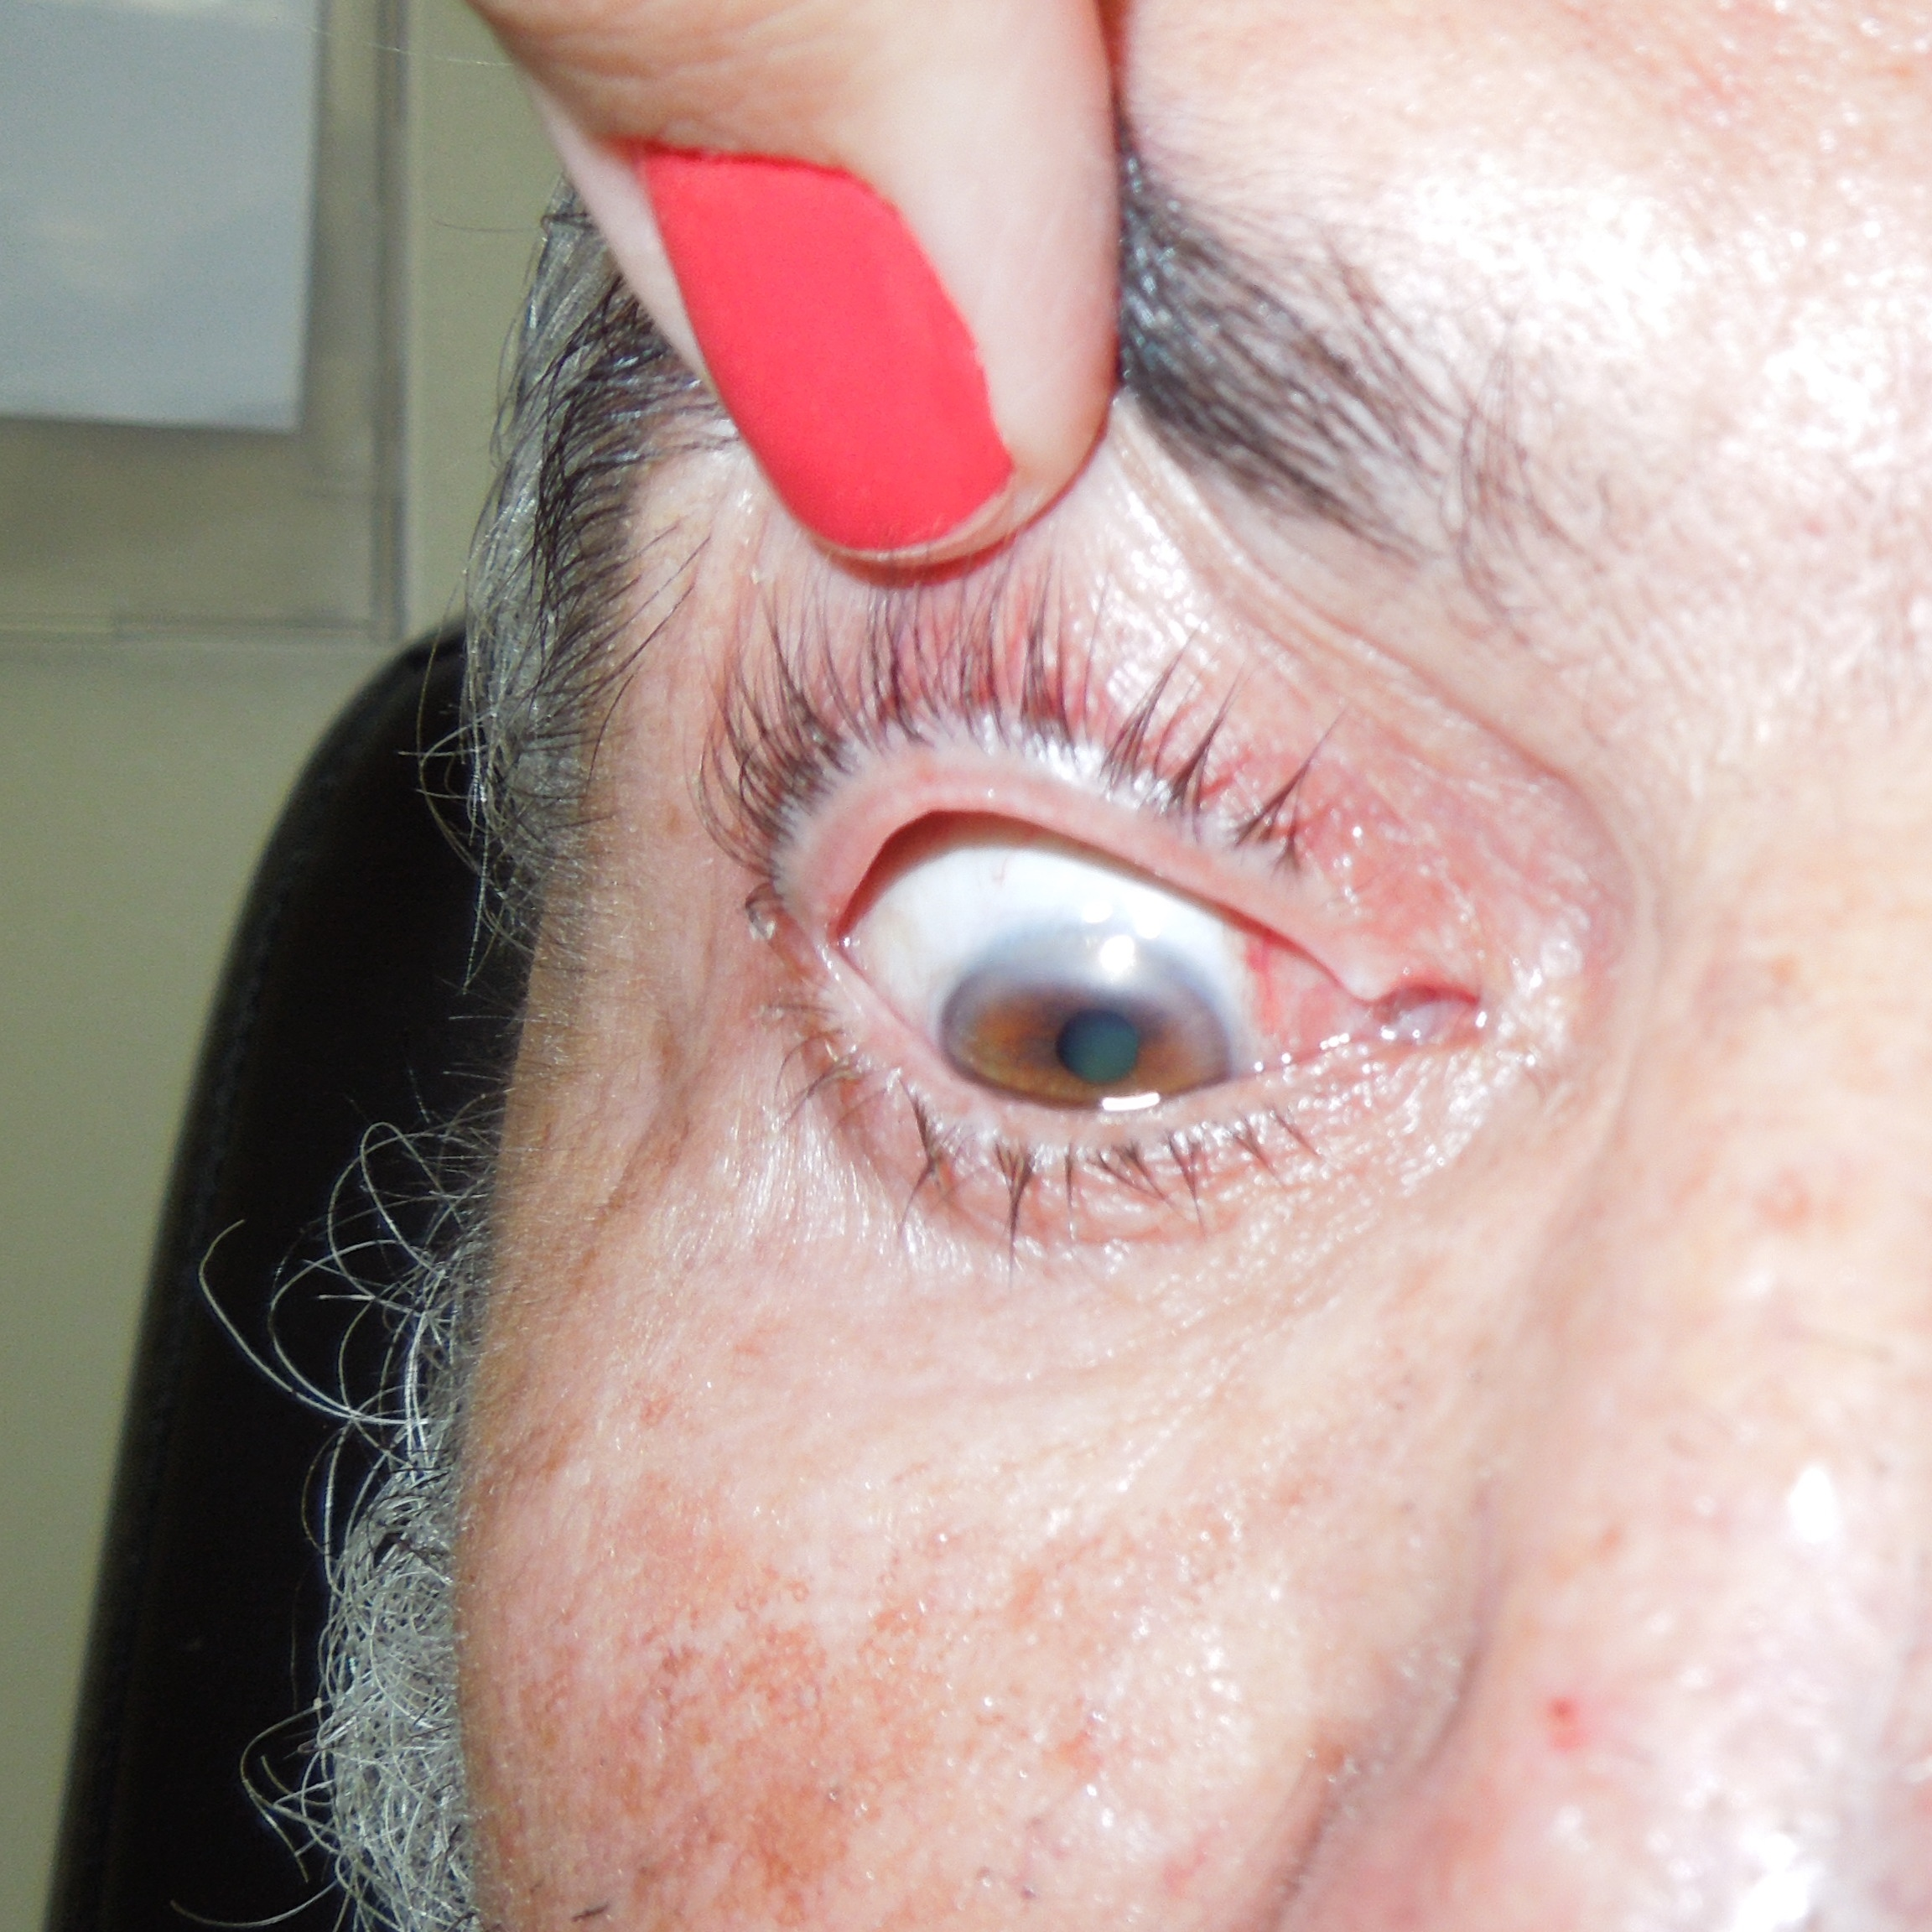
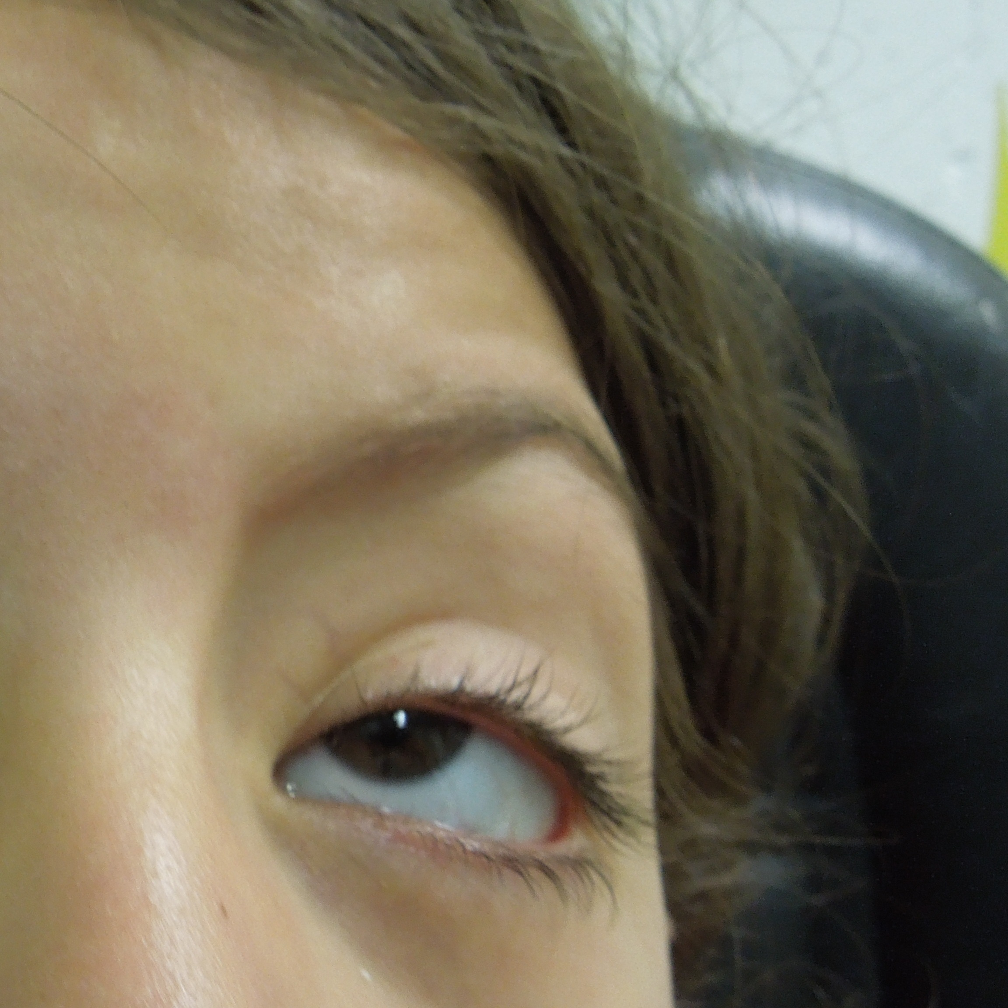
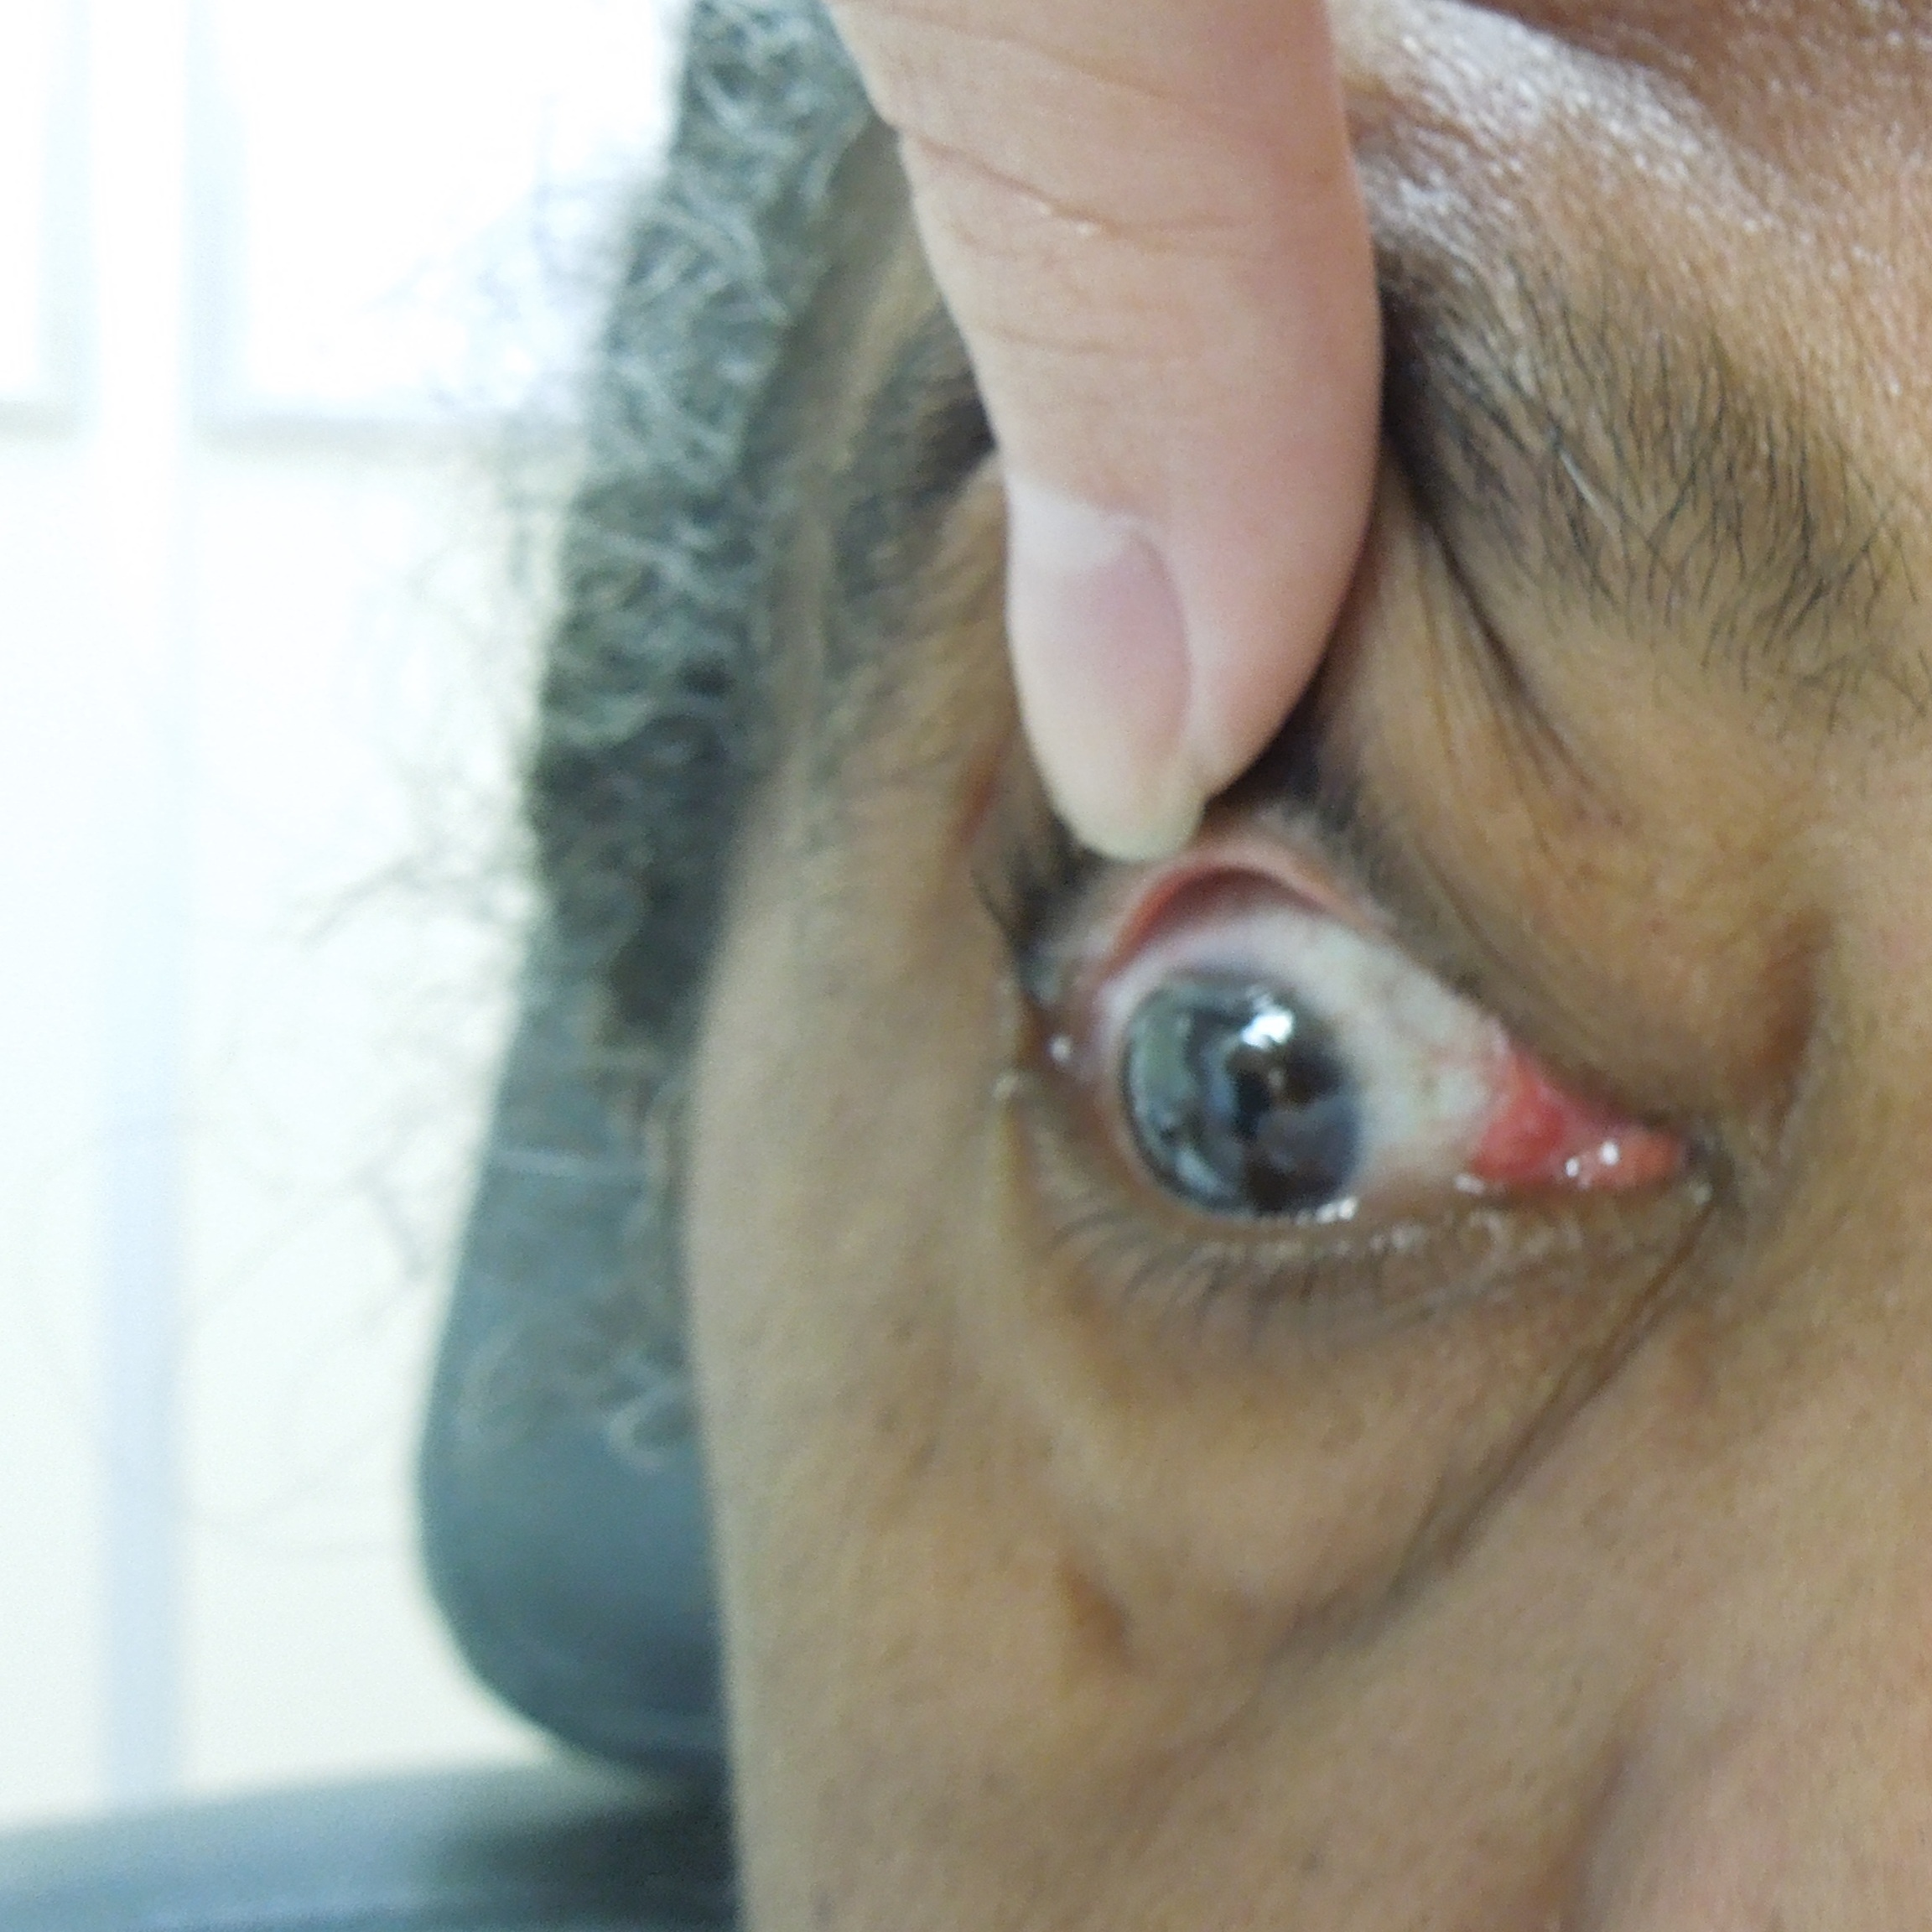
APPROACH - DETAILS
Patients
Gaze/Version Combination
Algorithm
323
69
Images standardization: OpenCV
Neural net architecture: ResNet50
Data augmentation: Albumentation
Deploying framework: Streamlit and Google Colab
App framework:
Tensorflow Lite
110 approved
Patients with characteristics as previous strabismus surgery or corneal diseases were excluded from the sample.
8 gazes with good potential
Many classes had only 1 image sample and in general, the small amount of samples made the process difficult.

Slide 6
COLLABORATION
Next steps
International benchmark
Algorithm improvement
App development
Database sharing
We believe we can create AI applications in Ophthalmology subtopics and advance the scientific literature.
Database
Algorithm
Apps

Slide 7



THANK YOU
jvictordias@gmail.com
https://www.linkedin.com/in/joaovictordias/
http://www.joaovictordias.org/cv.html

