Slide 1
FGAI4H-M-037-A01
E-meeting, 28-30 September 2021
Source: | WG-DAISAM
Title: | Updated DEL03: AI4H requirement specifications – Att.1: Presentation
Purpose: | Discussion
Contact: | Pradeep Balachandran | E-mail: pbn.tvm@gmail.com
Abstract: | This presentation contains the overview and the latest updates on the deliverable FG-AI4H DEL03-AI4H requirement specification.

Slide 2
System Requirements Specification(SRS): Conceptual Understanding
User Statement to Product Requirements Specification: How?
The process begins with a USER REQUIREMENT which, at the first level, can be translated as a simple USER STATEMENT , for example:
Neuro-physician AI startup company
User
AI Solution developer
We require a device that can predict the occurrence of seizures in the case of epileptic patients based on EEG monitoring
Planning Phase-Requirements Elicitation: How?
For the solution developer: A PRODUCT vision and a PROCESS to achieve it
- Requirements analysis methodology follows
a collaborative team-oriented approach (e.g. Working Groups and Topic Groups within FG-AI4H )
AI Product Development Lifecycle as the basis (e.g. Data Collection to Data Training to Model Development to Model Testing to Model Deployment to Model Maintenance, etc.)

Slide 3
System Requirements Specification(SRS): Conceptual Understanding
As part of the REQUIREMENTS ELICITATION process, stakeholders discuss on the following criteria / aspects:
What is the intended use / intervention type of the device ?(e.g. Prevention, Screening, Diagnosis, Treatment, Data Modeling, etc)
What is the primary & secondary(if any) task / function of the device ?(e.g. Classification, Prediction, Labeling, Segmentation, Detection, etc.)
Is the algorithm ‘locked’ (static model), or ‘adaptive’ (its behavior can change over time based on new data)
Which is the target product category?(e.g. SaMD, SaMS, S iMD, MMA, etc.)
Who is the primary and secondary user groups?( Clinicians, nurses, etc.)
In which CLASS (I, II, III, etc.) does the device belong to ? ( based on IMDRF - risk-based autonomy mapping table)
Based on the device category what are the expected performance, safety, and clinical safety & effectiveness, ethical and regulatory considerations

Slide 4
System Requirements Specification(SRS):Scope
As a result of the ELICITATION process,
Specify the high level description of AI4H system requirements across the entire AI4H process life cycle (i.e. from Data collection to Model Maintenance)
Functional requirements,
Performance requirements,
Operational requirements,
Interface requirements,
Safety and security requirements
Migration requirements,
Regulatory requirements, etc.
A sample performance requirement specification statement
“ The epileptic seizure event classification algorithm (shall/should/may) have a mean sensitivity of 80.2% ( 95% Confidence Interval, 75.2% - 86.5% ) and mean specificity of 89.3% ( 95% Confidence Interval, 81.3% - 95.7% ) “

Slide 5
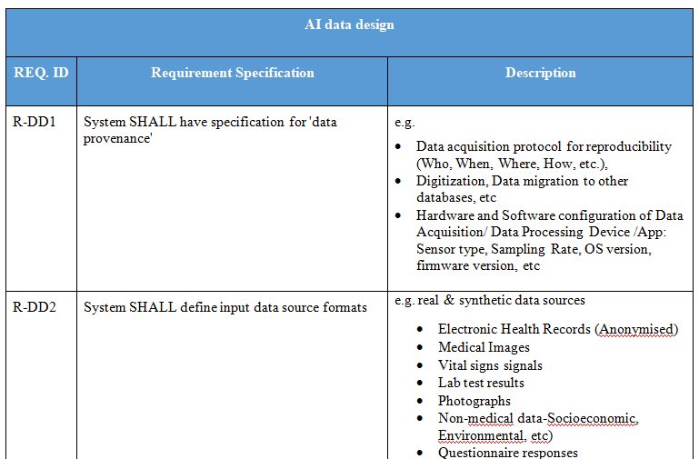
System Requirements Specification(SRS):Specimen format

Slide 6
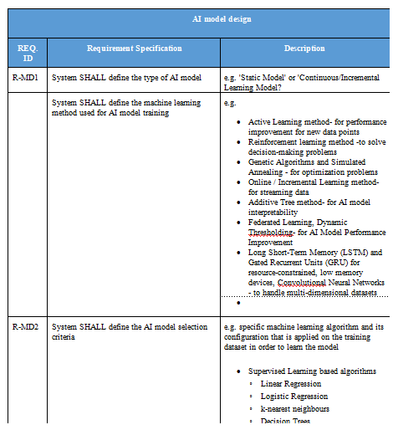
System Requirements Specification(SRS):Specimen format

Slide 7
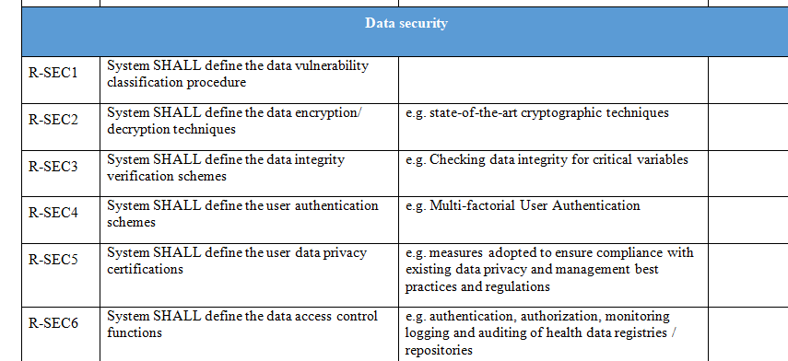
System Requirements Specification(SRS):Specimen format

Slide 8
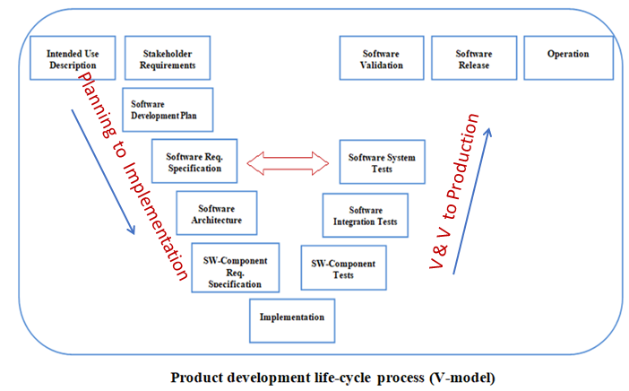
Main Goal: What is the utility of SRS (DEL 03) for the Topic Groups in particular?
For the Topic Groups, how this SRS can aid as a tool for system requirements traceability during ML4H Acceptance Testing
All TEST CASES should be TRACEABLE to REQUIREMENTS

Slide 9
SRS (DEL 03) revision (as on FG –K Jan-21-meeting)
Reconfigured DEL 03 AI4H system requirements into a separate ‘Requirements Traceability Matrix‘ which represents a mapping of TDD technical topics to ML4H Audit Requirements
Utility: Requirements Traceability Matrix was proposed as an auxiliary tool for TDD audit process’
Are TDD inputs ‘ verifiable' as requirements for the ML4H audit evaluation?

Slide 10
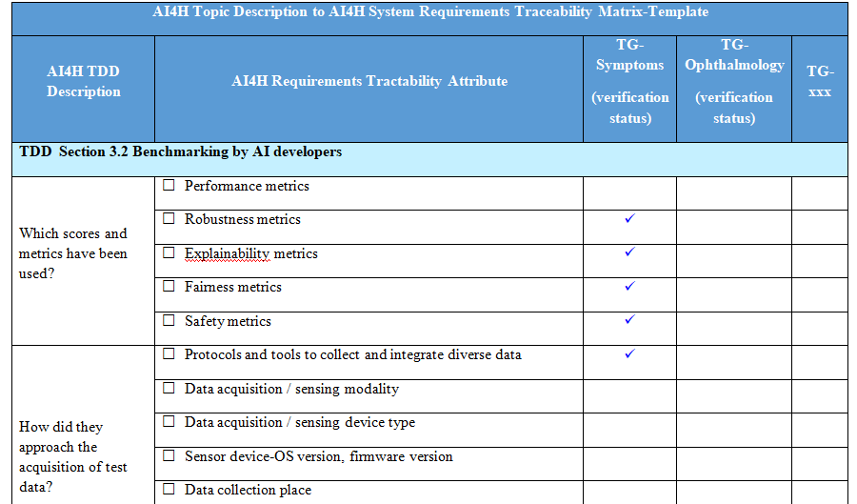
Requirements Traceability Matrix-Tool Template

Slide 11
SRS(DEL 03)revision (as on FG -L- May-21-meeting)
Extended Utility # 1: Requirements traceability matrix to enable ‘custom mode’ reporting service under the AI4H assessment platform (Open Code Project)
The reporting parameters can be configured on the basis of model evaluation metrics defined in the requirements traceability matrix, which include the following:
AI Evaluation process flow metrics
AI Model performance evaluation metrics
AI Model risks and severity metrics
AI Model bias & fairness metrics
AI Model explainability metrics
AI Model generalizability metrics
AI Model interpretability metrics
AI Model robustness metrics
AI Model uncertainty metrics
AI Assessment platform -infrastructure resourcing metrics
Device security & privacy metrics
Patient safety metrics

Slide 12
DEL 03 revision (as on FG -M- Sep-21-meeting)
Extended Utility # 2: Requirements traceability matrix to provide reference inputs for ‘Test Plan Creation’ to aid ‘ ML4H Requirements Audits (e.g. Trial Audits 2.0 project) ’ under the AI4H assessment platform
From an ML4H audit perspective
Aim:
How can we use this requirements traceability matrix to estimate the quality metric- ‘cost of SRS non-conformance’ during MI4H Requirements Audit and help towards minimizing that cost? ( during ‘system verification & validation’ or ‘acceptance testing’ )
2. How can we use this requirements traceability matrix to create ‘Test Plans/ Test Cases’ to support the following types of tests during MI4H Requirements Audit ?(e.g. Performance testing, UI testing, etc.)
How can we relate every instance of SRS-non-conformance (defects or errors) to the overall non-conformance cost- as part of MI4H Acceptance Testing?
How can requirements traceability matrix attributes be used as potential METADATA candidates under the Data Storage and Catalog Package of the AI4H assessment Platform ?(with reference to Ferath’s work on building Metadata repository)

Slide 13
Thank you

