Slide 1
FGAI4H-M-030-A01
E-meeting, 28-30 September 2021
Source: | Editors
Title: | Att.1: Presentation (M-030, M-031)
Purpose: | Discussion
Contact: | Eva Weicken | E-mail: eva.weicken@hhi.fraunhofer.de
Abstract: | This PPT contains a presentation of: an introduction to the topic groups an update on DEL 10_0 “Del. 10_0: AI4H use cases: Topic Description Documents” (M-031) an update of the “FG-AI4H onboarding document” (M-030)

Slide 2
Agenda
Introduction
topic groups
topic description documents
More topic group activities
Discussion points
Updates Onboarding document

Slide 3
Standardization of health AI: multidisciplinary & complex undertaking
Public health
Medicine
Research in academia/ industry
Government
Regulation
Ethics
AI/ML

Slide 4
Collaboration

Slide 5
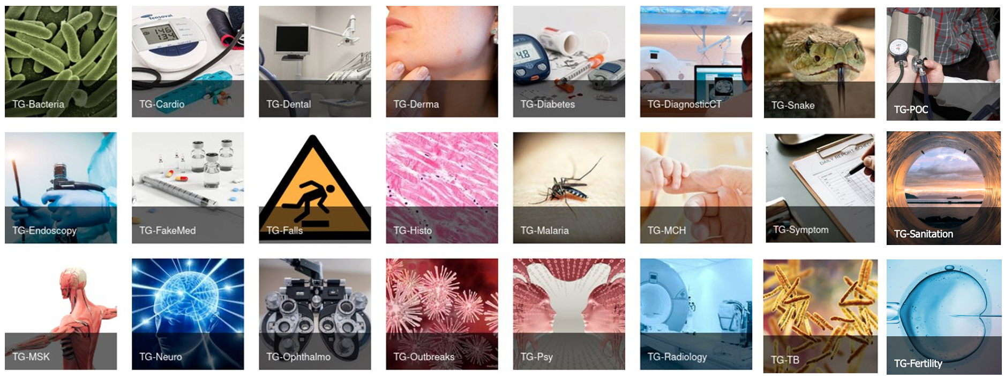
What is a topic group?
specific health/AI use case, e.g., Malaria detection from blood smear images, tuberculosis screening from x-rays
bringing together experts and data
producing evidence and case studies, propose procedures to benchmark AI models
Provide feedback to and follow guidance from working groups

Slide 6
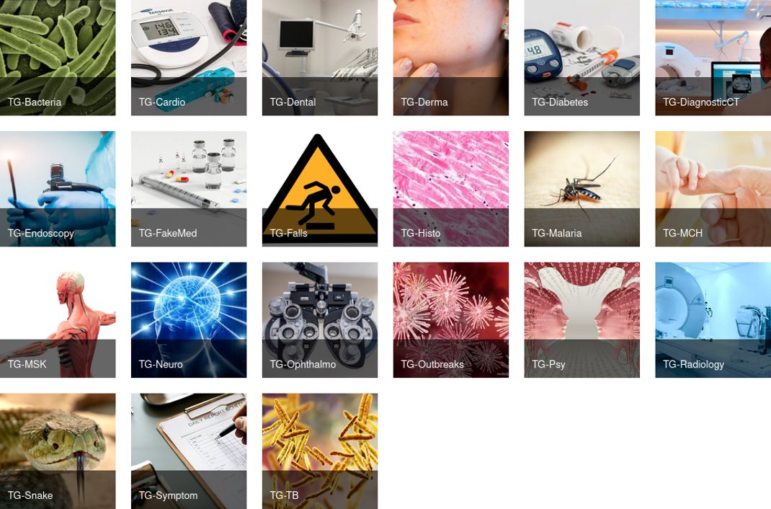
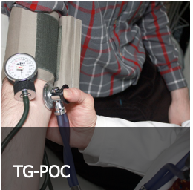
24 topic groups by September 2021

Slide 7
24 topic groups by September 2021
Cardiovascular disease management / TG-Cardio
Dermatology / TG-Derma
Dental diagnostics and digital dentistry/ TG-Dental
Primary/secondary diabetes prediction/ TG-Diabetes
Endoscopy/ TG-Endoscopy
Falsified medicine/ TG-FakeMed
Falls among the elderly/ TG-Falls
Histopathology/ TG-Histo
Malaria detection/ TG-Malaria
Neurological disorders/ TG-Neuro
Ophthalmology/ TG-Ophthalmo
Sanitation for public health/ TG-Sanitation
Outbreak detection/ TG-Outbreaks
Psychiatry/ TG-Psy
Radiology/ TG-Radiology
Snakebite and snake identification/ TG-Snake
Symptom assessment/ TG-Symptom
Tuberculosis/ TG-TB
Volumetric chest computed tomography/ TG-DiagnosticCT
Bacterial infection and anti-microbial resistance/ TG-Bacteria
Maternal and child health/ TG-MCH
Musculoskeletal medicine/ TG-MSK
Human reproduction and fertility/ TG-Fertility
Point-of-care diagnostics/ TG-POC
(topic group descriptions are available here)

Slide 8
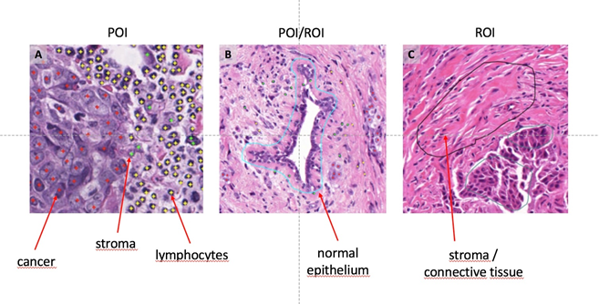
topic group example: histopathology
Example annotations of histopathology images
Prof. Klauschen (LMU/Charité)
Facilitate use of AI to identify tumor cells and lymphocytes in image data
Develop comprehensive histological image data set

Slide 9
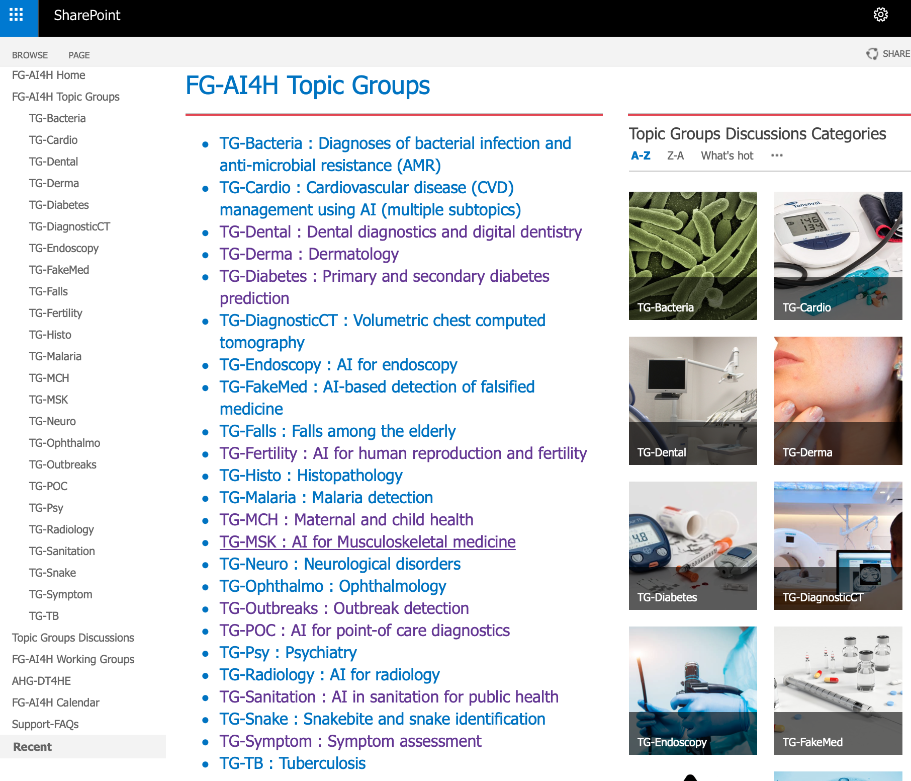
How do topic groups work?
Topic driver(s) organize work
Call for topic group participation
Collaboration via regular meetings
Developing a topic description document

Slide 10
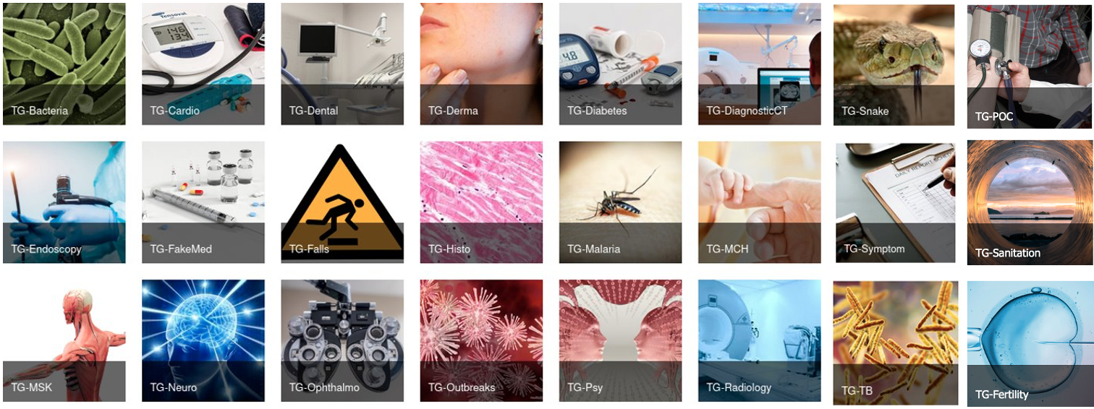
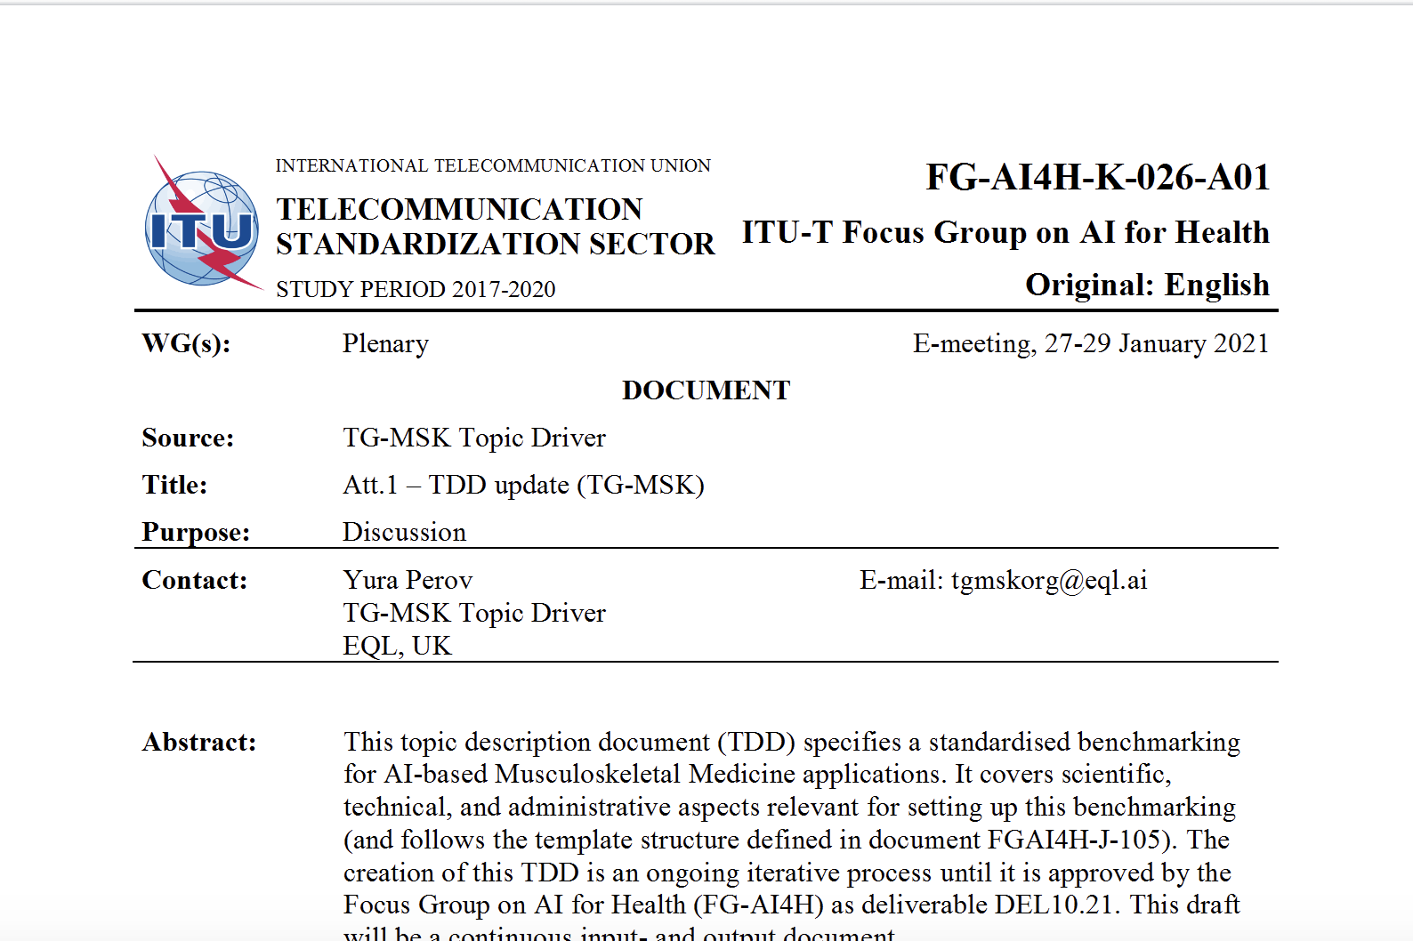
Topic Description Document (TDD)
TDDs/deliverables No. 10.1–10.24

Slide 11
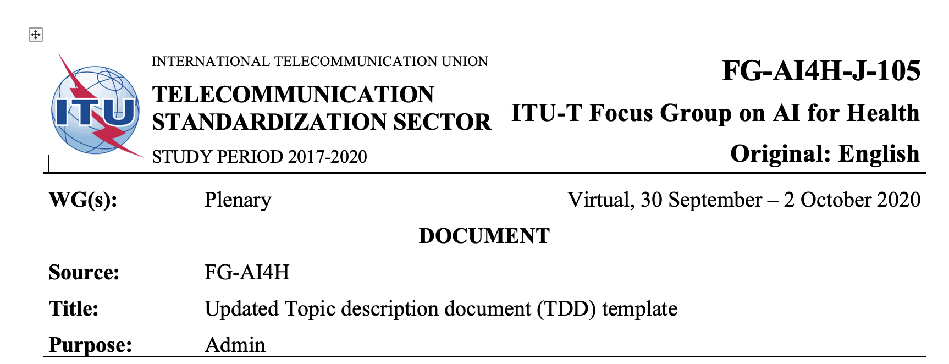
Topic Description Document (TDD)
Same TDD-template for all topic groups (latest “J-105“)
Iterative process, updates presented at each meeting
TDD includes:
TG- Background
TG- Features
Operations
Benchmarking details

Slide 12
More topic group activities

Slide 13
Topic groups & WG-Ethics
WG-Ethics provided feedback on TDD-ethics section
Ethics-expert meeting: idea to develop a Q&A on practices of ethics in AI4H
questions (and answers) can be submitted by each topic group

Slide 14
Discussion points
Experiences of OCI & auditing
Q&A ethics (TDD-section?)
TDD-template update? When?
Peer-review process of deliverables/TDD?

Slide 15
Updates Onboarding document
OCI and audit trials
New Topic groups
Updated figures and tables
Find the Onboarding document here

Slide 16
Thank you!
Please contact: eva.weicken@hhi.fraunhofer.de

