Slide 1
FGAI4H-M-028-A01
E-meeting, 28-30 September 2021
Source: | TG-Sanitation Topic Driver
Title: | Att.3 – Presentation (TG-Sanitation)
Purpose: | Discussion
Contact: | Alex Radunsky Co-driver AI4H TG-Sanitation Director Global Health and Policy, ITGH | E-mail: alex.radunsky@mail.harvard.edu
Abstract: | This PPT contains a presentation of the new TG-Sanitation.

Slide 2
TG - Sanitation
Alex Radunsky, ScD MPH
Co-driver AI4H TG-Sanitation
Director Global Health and Policy, ITGH

Slide 3
Executive Summary
Problem statement - Community based data can help us predict diarrheal disease outbreaks before they occur.
High frequency data collection will provide insight into transmission.
Detection currently relies on manual sample collection.
By developing sanitation data collection, we expect to detect outbreaks early and enable action.
Evaluation of smart sanitation technology through a human rights frameworks can better serve the vulnerable.
Develop and apply ethical frameworks for community evaluation of diarrhoeal disease risk in vulnerable community in eThekwini South Africa.
Project timeline

Slide 4
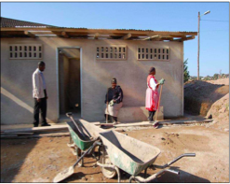
Community based data can help us predict diarrheal disease outbreaks before they occur.
Diarrheal disease is among the leading cases of death globally
These infectious diseases disproportionately impact children in low-income countries (WHO Global Health Estimates, 2021)
Waste management system
Watershed management system
Health System Access and utilization
Community Ablution Block

Slide 5
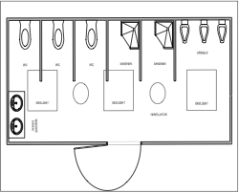
High frequency data collection across the watershed, waste management, CAB toilet, and community center will provide insight into transmission.
Automated testing vs. manual lab testing
Predicting outbreaks
Faster intervention in health care
Prevent transmission, prevent an outbreak

Slide 6
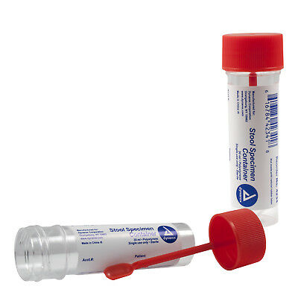
Detection currently relies on manual sample collection.
Outbreak detection
Direct markers (e.g. health system data)
Indirect markers (e.g. sales of antidiarrhoeal drugs)
(WHO, 2019a) (CDC, 2021)
Population level surveillance
Representative household survey (recent symptoms, diagnosis, treatment)
Manual sampling and laboratory testing of local water supply, river systems, stool samples
Detection of virus, bacteria, parasite by enzyme linked immunosorbent assay or rapid immunochromatographic test

Slide 7
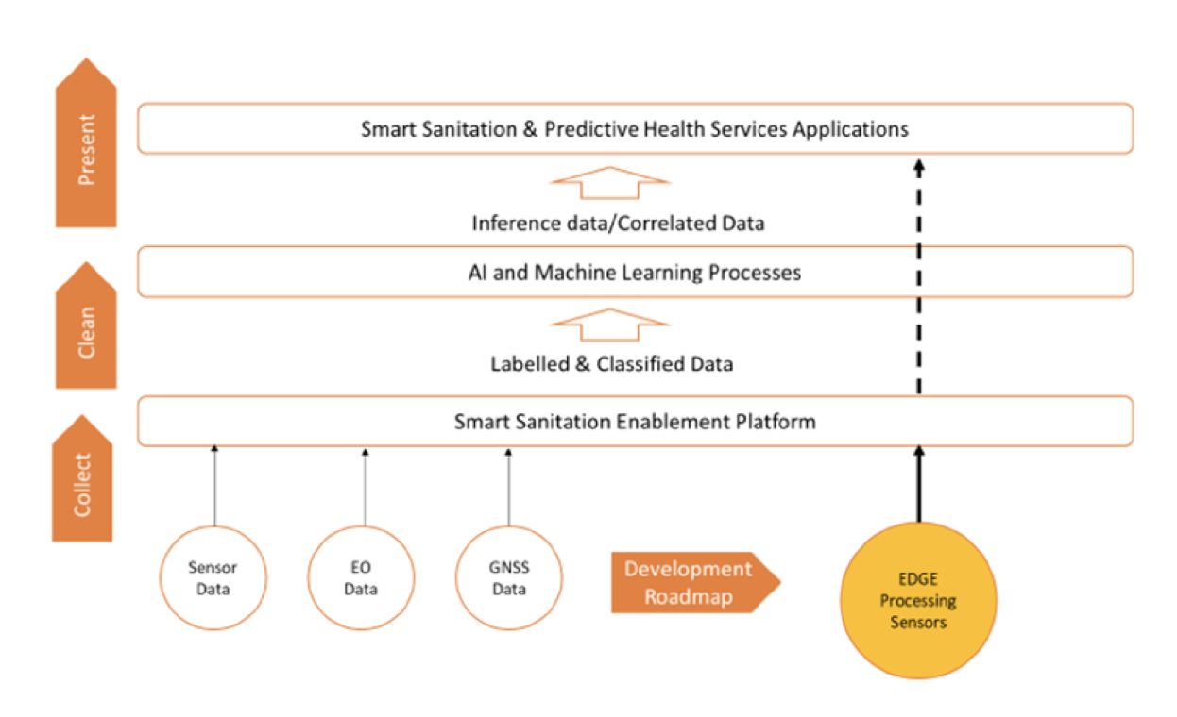
By developing high-frequency sanitation data collection, we expect to detect outbreaks early and enable action.
The key novel technology is an array of data streams that will provide a consolidated view of factors contributing to spread of diarrhoeal disease:
Granular measurement of CAB usage and disease detection therein
Area-level measurements of weather patterns and water level and quality
Supply chain KPIs of the sludge disposal and pyrolysis process
Satellite observations of land use, water levels and atmospheric composition
An AI to predict outbreaks will be developed during the course of our TG, incl. benchmarking and early validations of the model
The data streams are designed and will be rolling out during the early stages of the project
AI model under definition will be developed during the course of the FG
Target: Prediction of disease outbreaks in informal settlements around Durban, ZA
Notes:
Weather observations
Water level, turbidity and pathogen sampling
Atmospheric composition
Land use and water level
Community Ablution Block usage and edge-computed disease detection
Health surveys through hotspot-based apps
Process KPI’s from sludge treatment plant

Slide 8
Evaluation of smart sanitation technology through a human rights frameworks can better serve the vulnerable.
Review the work of technology legal scholars who have applied Human Rights frameworks to other technologies with the potential for systemic surveillance
Determine how major data privacy regulations, applies to smart sanitation technology
General Data Protection Regulation (GDPR)
Health Insurance Portability and Accountability Act (HIPAA)
Chinese Personal Information Protection Law (PIPL)
Identify and make policy recommendations

Slide 9
Ethical Guidelines & Technical Recommendations
A) Develop and B) apply ethical framework for AI predictive ML models for social good in sanitation.
Development
Risk-assessment of benchmarking AI in sanitation using social ecological model
Mapping core AI ethics principles (e.g., justice as fairness, autonomy as informational privacy; transparency as explainability) to mitigate ethical risk of predictive ML in sanitation
Assessment of these ethics principles as applied to sanitation in light of risk-assessment
Develop sub-criteria (guidelines) for ethical framework developed for AI in sanitation.
B. Application
Review literature on AI and ML on technical methods to apply principles developed above
Analysis and recommendations for AI applications in smart sanitation

Slide 10
Project timeline
Data streams will be available gradually as sensors are rolled out
Manually collection and laboratory testing during early stage rollout will be supplanted by high frequency data streams
System
Deployment & Validation
Requirements Capture
Design of Data Collection Infrastructure
Data Collection Rollout
2020
2021
2022
2023
AI system specification and development
Meeting M

Slide 11
APPENDIX Contributors
Co-drivers
Khahlil Louisy klouisy@hks.harvard.edu
Alex Radunsky alex.radunsky@mail.harvard.edu
Contributors
Augusto Gesualdi augusto.gesualdi@pathcheck.org
Rebecca Perez rebecca.perez@wadham.ox.ac.uk
Maria Carnovale carnovalemaria@outlook.com
Simona Tiribelli simona.tiribelli@pathcheck.org
Gokul Parameswaran gokul.parameswaran@keble.ox.ac.uk

