Slide 1
FGAI4H-M-027-A03
E-meeting, 28-30 September 2021
Source: | TG-Fertility Topic Drivers
Title: | Att.3 – Presentation (TG-Fertility)
Purpose: | Discussion
Contact: | Susanna Brandi Eleonora Lippolis | E-mail: susanna.brandi@merckgroup.com E-mail: eleonora.lippolis@merckgroup.com
Abstract: | This PPT summarizes progress, current status and next steps of the TG-Fertility for presentation and discussion during the M meeting.​

Slide 2
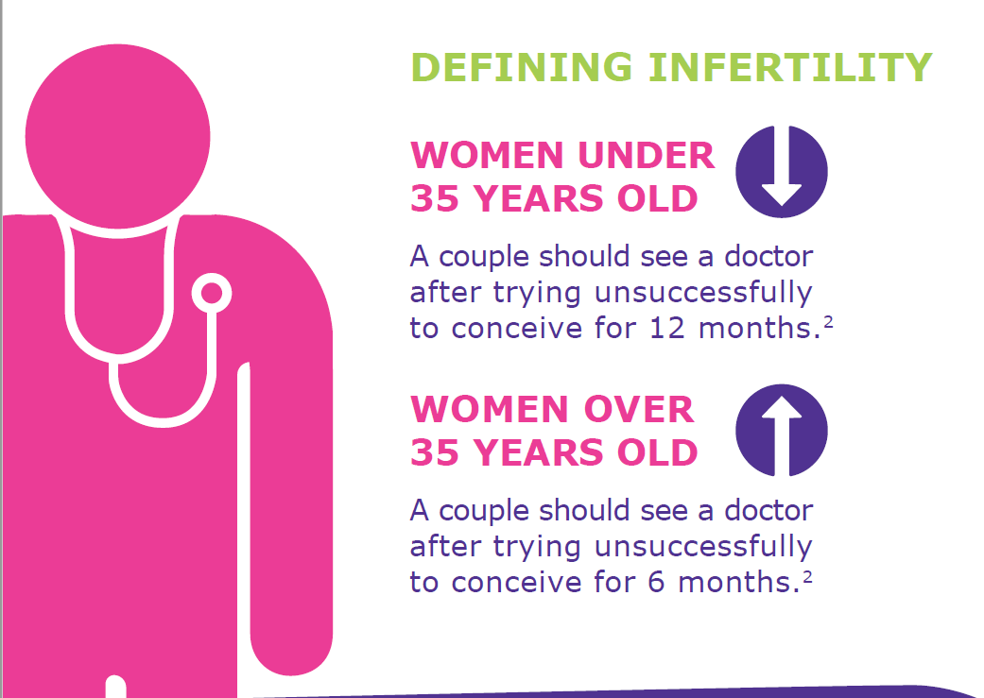
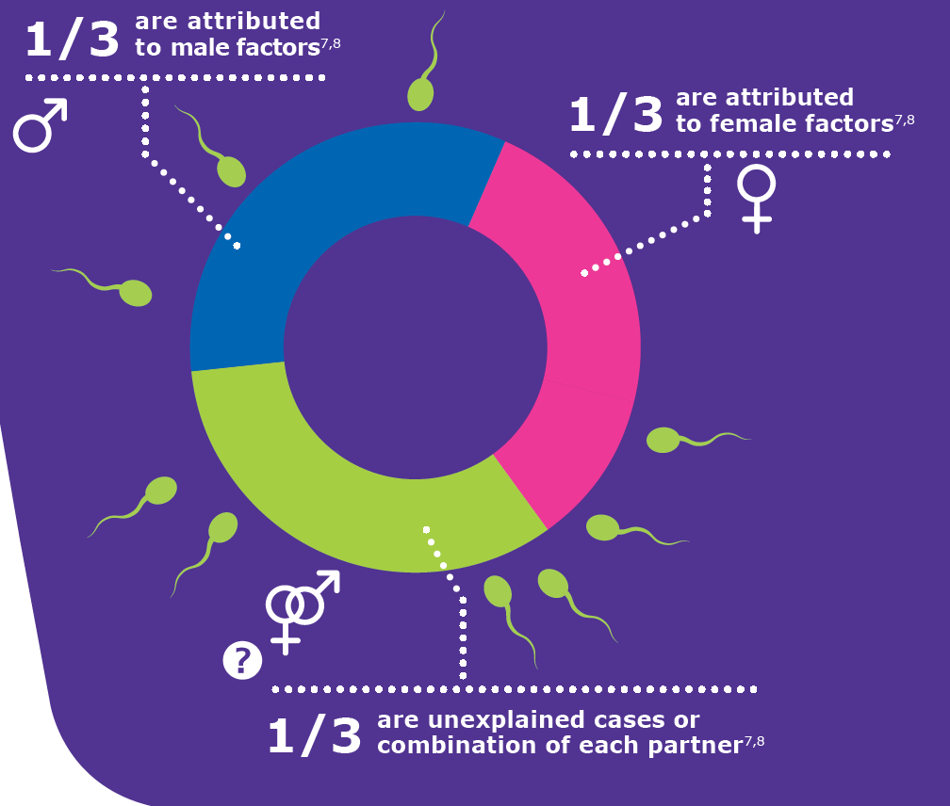
The truth about infertility
INFERTILITY IS NOT JUST A WOMAN’S PROBLEM

Slide 3
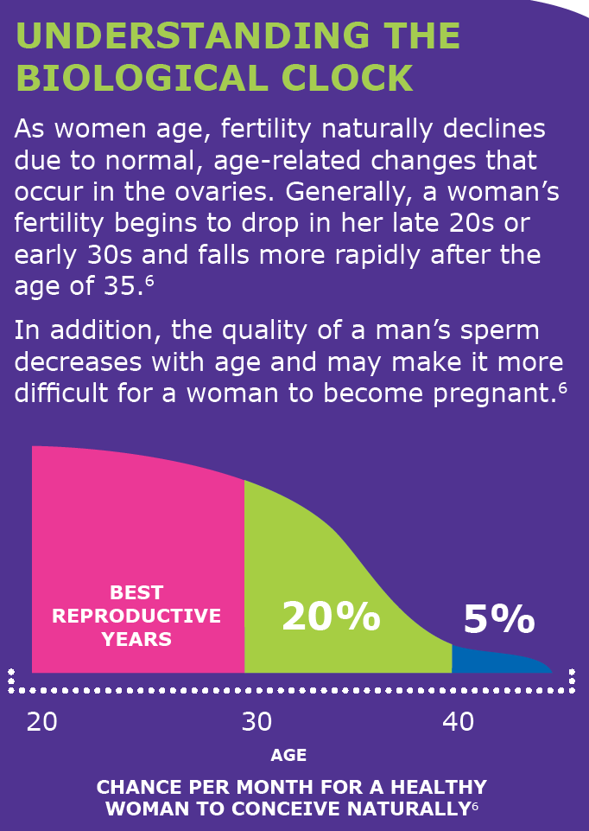
The truth about infertility
The immense impact on emotions and quality of life
Infertility can affect a couple’s quality of life, individually, their relationship with each other, and their relationships with those closest to them.^{9,10}

Slide 4
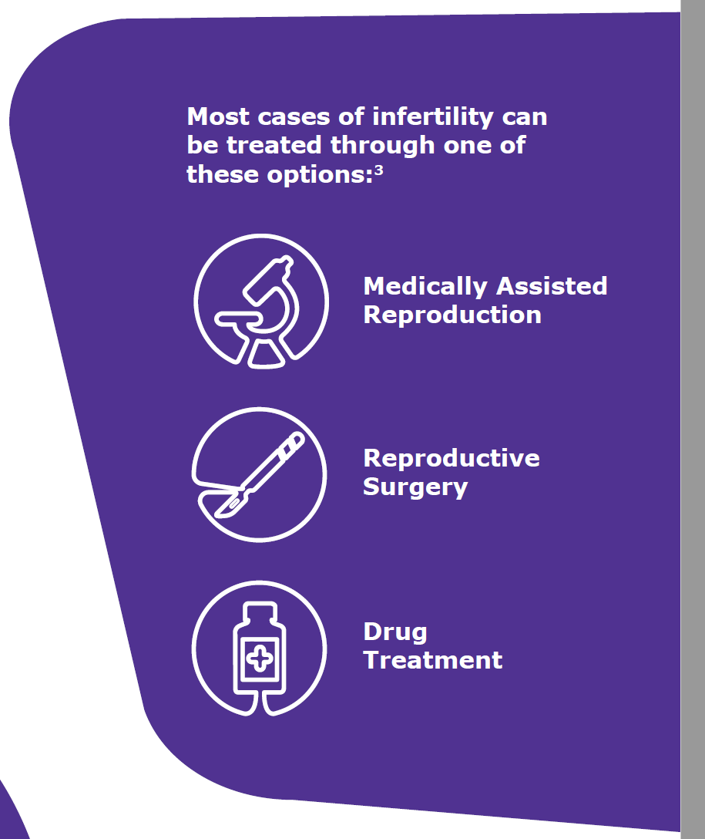
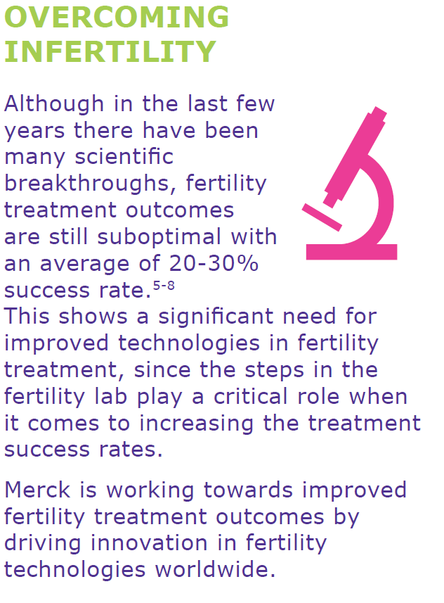
The truth about infertility

Slide 5
TG-Fertility consists of a multidisciplinary team of 8 experts
ITU/WHO TG-Fertility | Progress and current status
Alison Campbell CARE Fertility
Dan Nayot The Fertility Partners
Eleonora Lippolis Merck KGaA
Gerard Letterie Seattle Fertility
Stefan Wagner European School of Management & Technology
Susanna Brandi Merck KGaA
Tex VerMiylea Ovation Fertility
Wenjing Zheng Merck KGaA
Business and innovation
Data scientists
Physicians
Embryologists

Slide 6
TG-Fertility activities have been kicked-off with a workshop
ITU/WHO TG-Fertility | Progress and current status
1
3
KOLs recruitment
Call for Topic Group Participation
2
Continue working on the TDD
Kick-off meeting with the full team
Operation Management
Definition and agreement of work packages

Slide 7
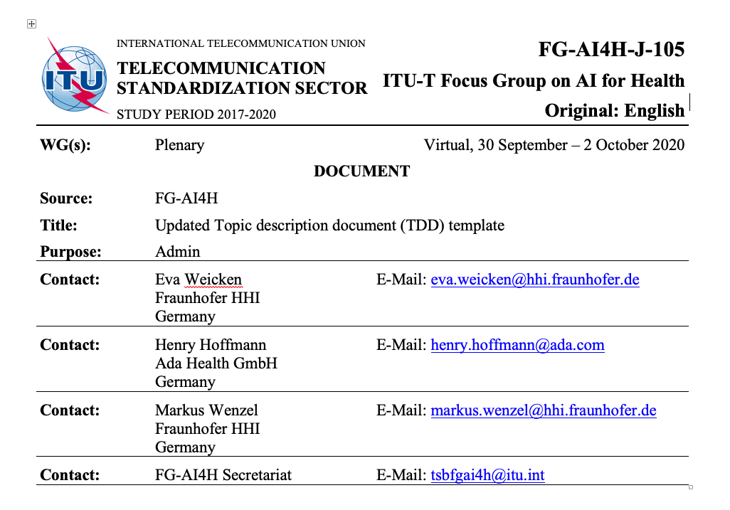
We have identified several work packages for the development of our TDD
ITU/WHO TG-Fertility Next Steps
Introduction
About the FG-AI4H topic group on AI for Fertility
Documentation
Status of this topic group
Status update for meeting
Topic group participation
Initiated and for review
TDD
Topic description
Subtopic [A]
Definition of the AI task
Current gold standard
Relevance and impact of an AI solution
Existing AI solutions
Subtopic [B]
Ethical considerations
Literature review
Use Cases
Fertility data harmonization (Ontology)
Existing work on benchmarking
Subtopic [A]
Publications on benchmarking systems
Benchmarking by AI developers
Relevant existing benchmarking frameworks
Subtopic [B]
Benchmarking by the topic group
Subtopic [A]
Overall discussion of the benchmarking
Regulatory considerations
Existing applicable regulatory frameworks
Regulatory features to be reported by benchmarking participants
Regulatory requirements for the benchmarking systems
Regulatory approach for the topic group

Slide 8
We propose that the topic group description document will be made in a step-wise approach
Phase 1
Phase 2
TDD
Document Intro
Subtopic A
Definition of the AI task
Current gold standards
Relevance and impact of an AI solution
Existing AI solutions
Ethical considerations
Fertility ontology document
TDD
Existing work on benchmarking
Benchmarking by the topic group
Overall discussion on benchmarking
Regulatory considerations
Literature review
1st TDD release
Phase 3 (use cases)

Slide 9
Questions?

Slide 10
References
Boivin, J. et al. New Debate: International estimates of infertility prevalence and treatment-seeking: potential need and demand for infertility medical care. Human Reproduction. 2007. 22 (6):1506-1512
Thoma, M.E. et al. Prevalence of infertility in the United States as estimated by the current duration approach and a traditional constructed approach. Fertility and Sterility 2013 9 (5):1324-1331
WHO. (2013). Meeting to develop a global consensus on preconception care to reduce maternal and childhood mortality and morbidity: World Health Organization Headquarters, Geneva, 6–7 February 2012: meeting report. pp. 46-49
American Medical Association. AMA backs global health experts in calling infertility a disease. 13 June 2017. Available at: https://wire.ama-assn.org/ama-news/ama-backs-global-health-experts-calling-infertility-disease Last access: June 2017
Zegers-Hochschild, F. et al., The International Committee for Monitoring Assisted Reproductive Technology (ICMART) and the World Health Organization (WHO) Revised Glossary on ART Terminology, 2009. Hum Reprod 2009 24 (11):2683-2687
American Society for Reproductive Medicine. 2012. Age and Fertility – A guide for patients. [Online] Available at: http://www.reproductivefacts.org/globalassets/rf/news-and-publications/bookletsfact-sheets/english-fact-sheets-and-info-booklets/Age_and_Fertility.pdf Last access: June 2017
Agarwal et al. A unique view on male infertility around the globe. Reproductive Biology and Endocrinology. 2015 (13):37
American Pregnancy Association. 2015. [Online] Available at: http://americanpregnancy.org/infertility/whatisinfertility.html Last access: June 2017
Kerr, J. et al. The experiences of couples who have had infertility treatment in the United Kingdom: results of a survey performed in 1997. Human Reproduction. 1999 14 (4): 934-938
Chachamovich, J. R. et al. Investigating quality of life and health-related quality of life in infertility: a systematic review. Obstet Gynaecol 2010 31 (2): 101-10

Slide 11
Backup

Slide 12
Infertility is a disease that impacts one in six couples and its treatment is unique, complex and divided in different phases
2. Egg pick up
4. Egg fertilization
6. Embryo transfer
catheter
1. Ovarian stimulation hormone therapy
3. Sperm preparation
5. Embryo development

Slide 13
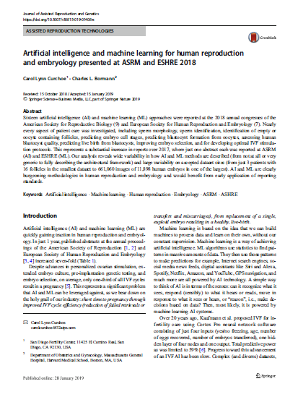
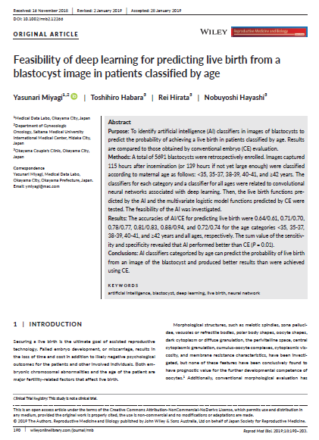
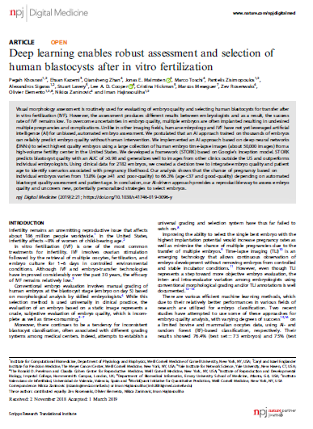
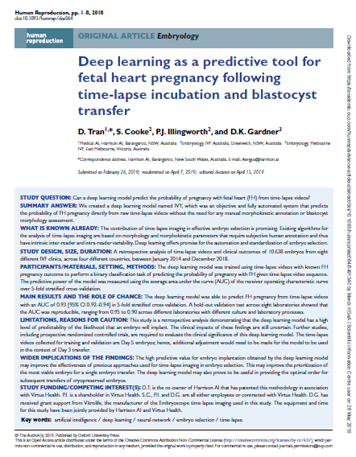
AI publications in medicine are growing very fast since a few years – Fertility is catching up as well
Total:1466
Notes:
ESHRE/ASRM 2018
18 Articles
Machine learning
Neural Networks
Oocytes, Sperms and Embryos
Predict LBR
Multiple algorithms
Google NetIncept
3pts, 16 fols, 661,060 images
11,898 embryos x 1440 = 17M Images

Slide 14
Advanced analytics and AI enables the creation of new products and services that improve treatment outcomes and efficiency
Patient Identification
Consultation
Stimulation & Triggering
ART Lab
Transfer & Pregnancy
Broader patient identification due to identification of new infertility indicators and correlations of behavioral patterns through big data analytics
Improved patient expectations management through predictive analysis and individual prediction of IVF success
Higher treatment success rates through personalized treatment protocol individualized interventions if necessary
Support clinical decision making throughout all lab process steps based on advanced AI algorithms and computer vision to identify most viable embryos
Increasing successful transfers and improving receptivity through intelligent algorithms and biomarkers that help to determine the status of the endometrium
Data-driven business opportunities delivered through AI, data analytics, and connectivity solutions add value throughout the entire IVF journey

Slide 15
Advanced analytics and AI enables the creation of new products and services that improve treatment outcomes and efficiency
Patient Identification
Consultation
Stimulation & Triggering
ART Lab
Transfer & Pregnancy
iDAScore®
Most AI solutions are currently performed without any standardized process, regulatory or harmonized quality standards

Slide 16
Given the maturity and the recent developments of AI in Fertility, there are several challenges that need to be addressed to ensure safety, reliability and transparency
Challenges
Proposal
Data
Data
Heterogeneity of data sources
Data quality and data size
Bias in the data, noise or partial evidence
Definition of quality standard and guidelines to harmonize data
Facilitate integration and collection of data from different sources
Validation
Validation
Proper validation on hold-out data and lack of benchmark
Lack of clinical prospective validation
Definition of guidelines for proper development and validation
Creation of benchmarks
Timeline
Enroll key opinion leaders
Assess and define areas of focus
Scope existing and emerging applications
Create guidelines, facilitate harmonization of data and creation of benchmarks

