Slide 1
FGAI4H-M-026-A03
E-meeting, 28-30 September 2021
Source: | TG-MSK Topic Drivers
Title: | Att.3 - Presentation (TG-MSK)
Purpose: | Discussion
Contact: | Peter Grinbergs (EQL, UK) & Yura Perov (Individual Contributor, UK) | E-mail: tgmskorg@googlegroups.com (the email is read by Peter, Yura and their associates)
Abstract: | This PPT summarizes the status of work within TG-MSK, for presentation and discussion during the meeting.

Slide 2
Background & Relevance
“Musculoskeletal conditions comprise more than 150 diagnoses that affect the locomotor system; that is, muscles, bones, joints and associated tissues…” [1]
Painful MSK conditions affect 20-33% of the world's population [1].
According to the WHO, “[Musculoskeletal] conditions are the leading contributor to disability worldwide, with low back pain being the single leading cause of disability globally. ... MSK conditions significantly limit mobility and dexterity, leading to early retirement from work, reduced accumulated wealth and reduced ability to participate in social roles. The greatest proportion of non-cancer persistent pain conditions is accounted for by MSK conditions. ... MSK conditions are commonly linked with depression and increase the risk of developing other chronic health conditions” [1].
Up to 30% of consultations carried out by primary care doctors in the UK (as an example) are for MSK conditions [2].

Slide 3
Background & Relevance
Together with the worldwide shortage of health professionals (including doctors and physiotherapists) [3], it is clear there is a pressing need to introduce, support and grow the potential use of reliable, safe, accurate solutions powered by AI and ML. This need exists across the world and the solutions must be accessible and affordable in order to provide universal coverage.
That is especially important in the light of existing inequalities: AI applications have the power to reduce them but it also should be ensured that they do not worsen any.

Slide 4
Topic Group’s Goal
The topic group is dedicated to AI/ML applications for MSK medicine. It is dedicated to establishing standardised benchmarking guidelines.
That includes specifying input data and outputs of AI systems for different AI tasks for MSK medicine.
The topic group focuses on prevention strategies, triage (in particular identifying urgency), diagnosis, prognosis and treatment of musculoskeletal (MSK) conditions with the applications of artificial intelligence (AI) and machine learning (ML) approaches including computer vision (CV), augmented and virtual reality (AR/VR), natural language processing (NLP), natural language understanding and other approaches.

Slide 5
Topic Group Status
There are now 8 members in the topic group.
5* further topic group meetings happened since the last focus group meeting.
The third version of the Topic Description Document was created (using the new template). It is a work-in-progress.
* - one more meeting did not happen because there was only one participant.

Slide 6
The current focus
Prediction and prevention of MSK conditions, including:
risk identification (e.g. probability estimation),
risk reduction (including new conditions, worsening of MSK condition states, etc.).

Slide 7
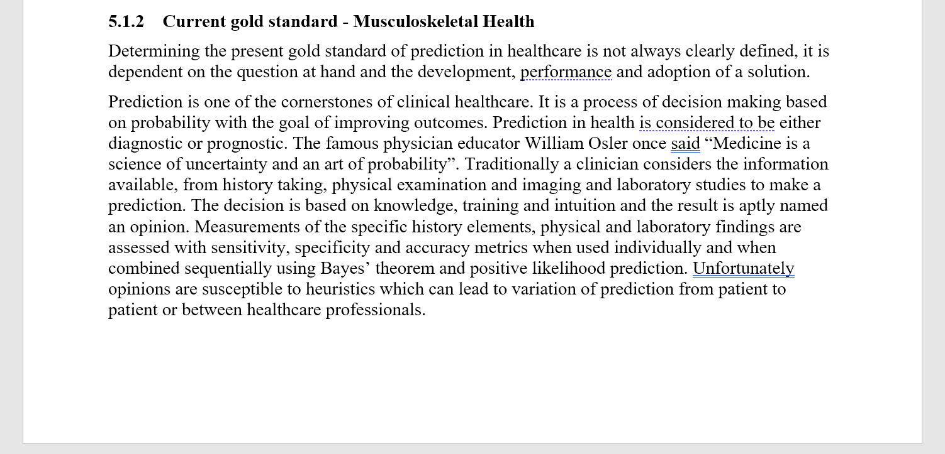
Updates to the TDD
This is a part of the new section.

Slide 8
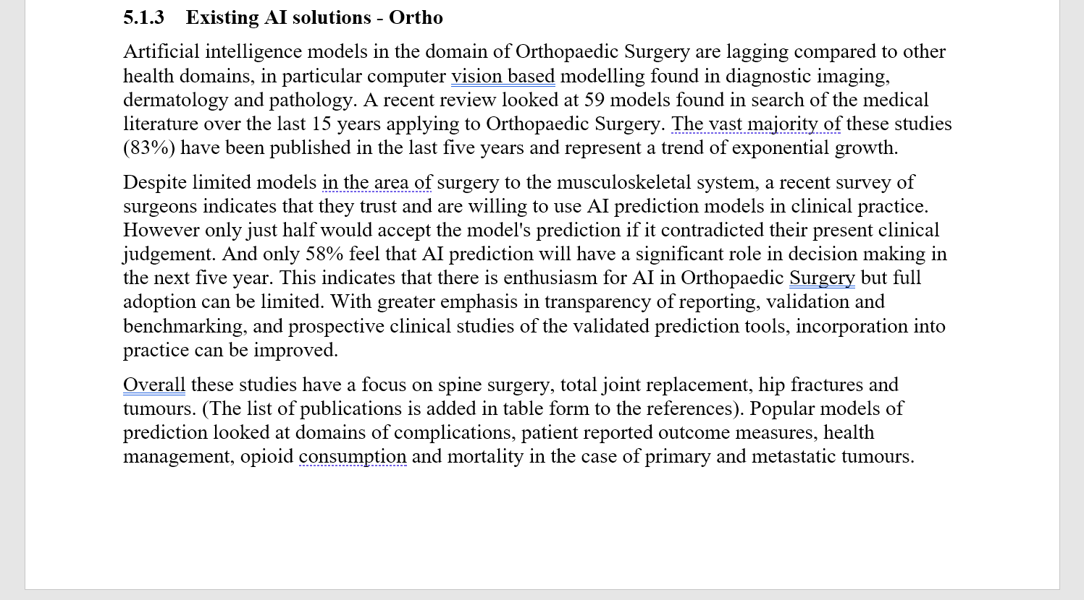
Updates to the TDD
This is a part of the new section.

Slide 9
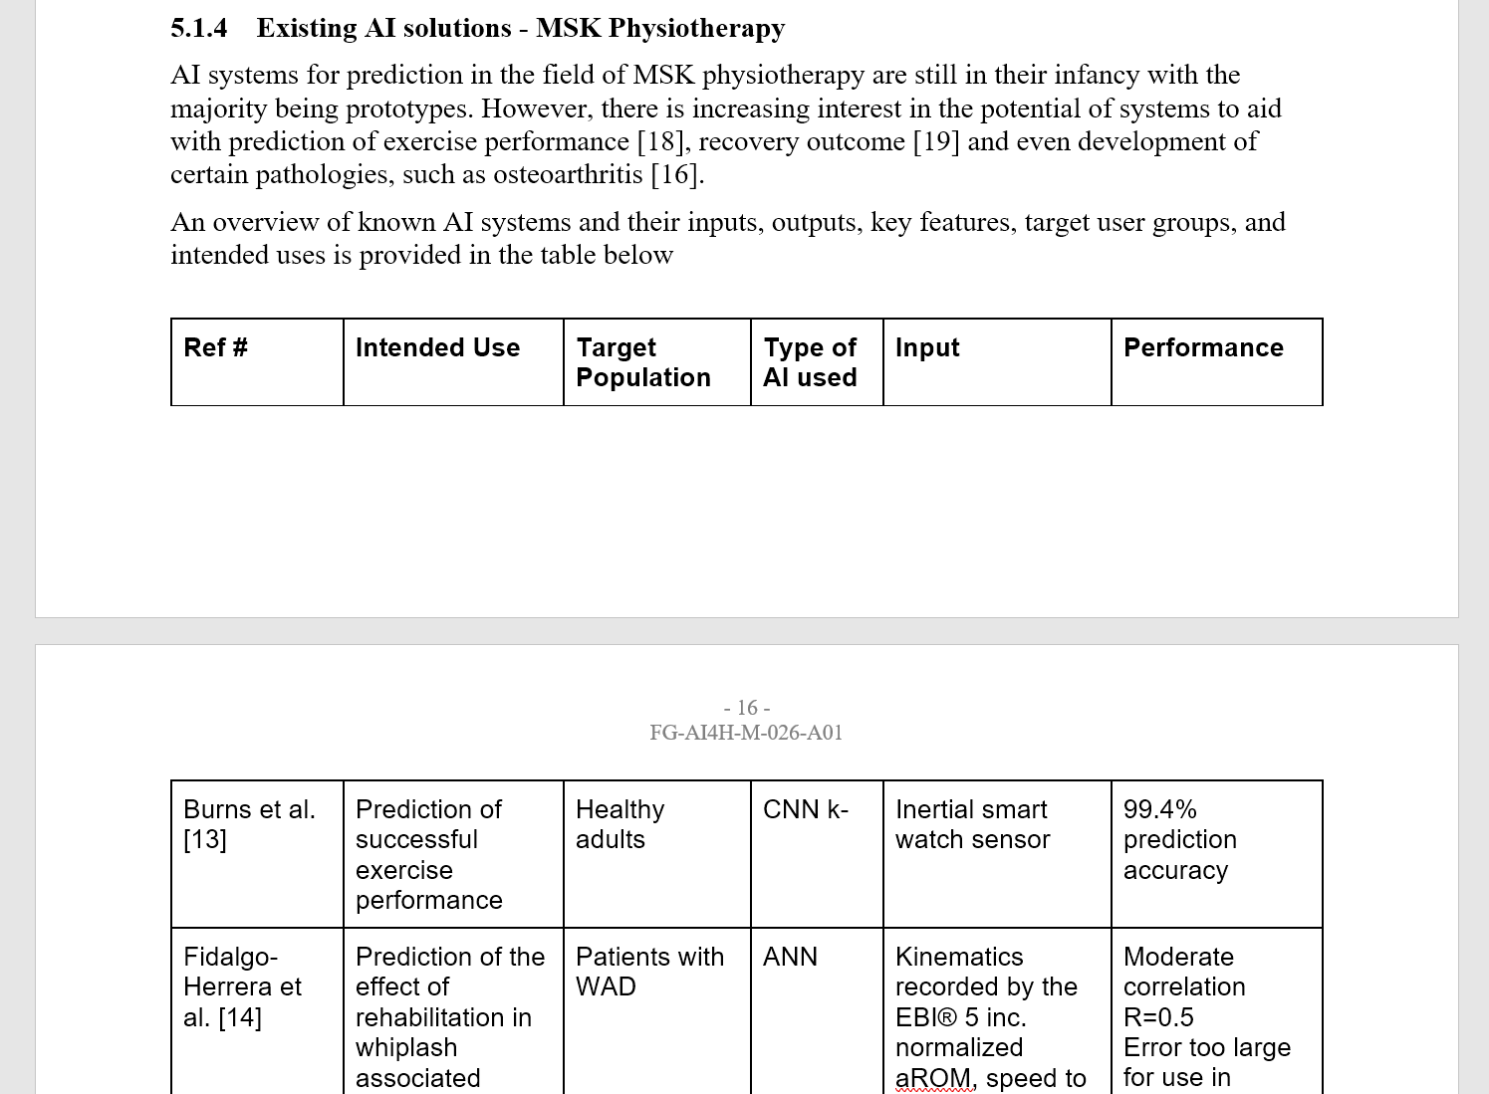
Updates to the TDD
This is a part of the new section.

Slide 10
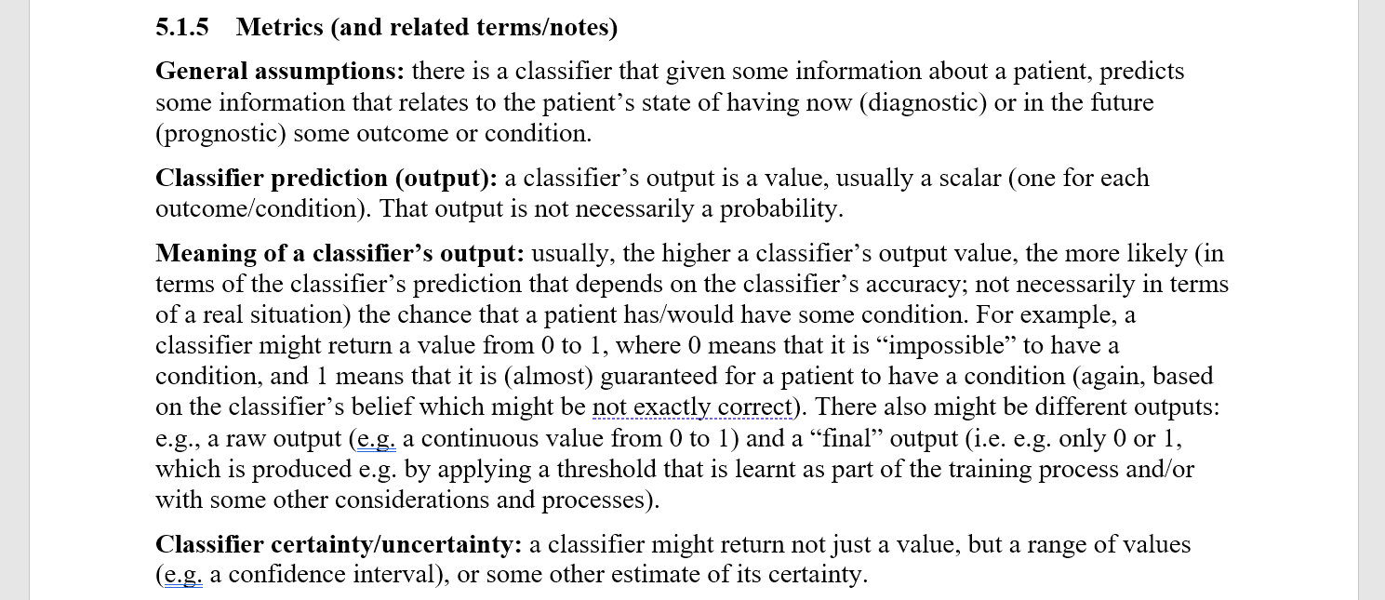
Updates to the TDD
This is a part of the new section.

Slide 11
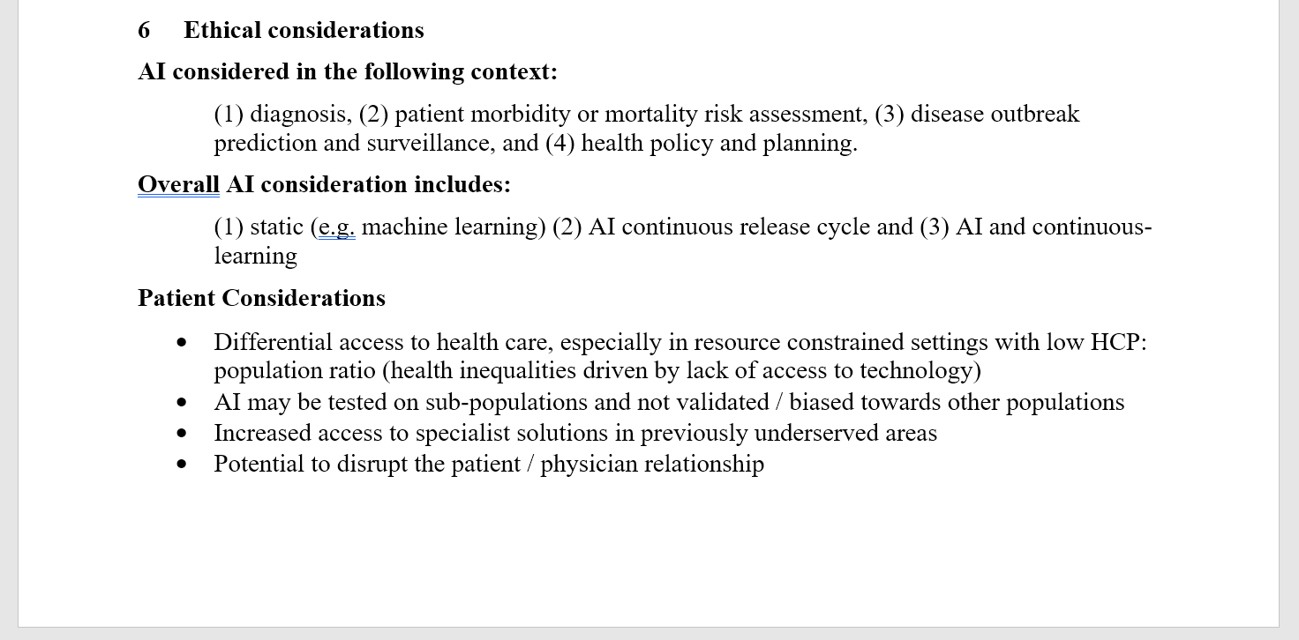
Updates to the TDD
This is a part of the new section.

Slide 12
Further updates and next steps for the topic group
To do:
Continue the work on the tasks and benchmarks
Continue the work on the TDD
Grow the topic group.
Identify particular use cases for the objectives of the topic group.
Defining a pathway; identifying a framework that works for that pathway that also has a broader scope.

Slide 13
References
[1] "Musculoskeletal conditions" on WHO website. https://www.who.int/news-room/fact-sheets/detail/musculoskeletal-conditions
[2] "Musculoskeletal" page on NHS England website. https://www.england.nhs.uk/elective-care-transformation/best-practice-solutions/musculoskeletal/
[3] "Health workforce requirements for universal health coverage and the Sustainable Development Goals", Human Resources for Health Observer, Issue No. 17. https://www.who.int/hrh/resources/health-observer17/en/

